Slide 1
Article 14
To determine if the Town will vote to raise and appropriate, or transfer from available funds, or authorize the Town Treasurer with the approval of the Select Board to borrow money by the issuance of bonds or notes under the provisions of Massachusetts General Laws c. 44, the sum of $1,500,000, or any other sum, to be expended under the direction of the School Committee for a feasibility study to consider the
construction of a new middle school, which may be located at 835 Old Marlboro Road, Concord, Massachusetts (the present site of the Sanborn Middle School),
Continued on next slide

Slide 2
Article 14
…provided, however, that this approval shall be contingent upon passage of a Proposition 2ó debt exclusion referendum under Massachusetts General Laws c. 59, § 21C(k), and further that any premium received by the Town upon the sale of any bonds or notes approved by the vote, less any such premium applied to the payment of the costs of issuance of such bonds or notes, may be applied to the payment of costs approved by this vote in accordance with Massachusetts General Laws c. 44, § 20, thereby reducing the amount authorized to be borrowed to pay such costs by a like amount, or take any other action relative thereto.

Slide 3
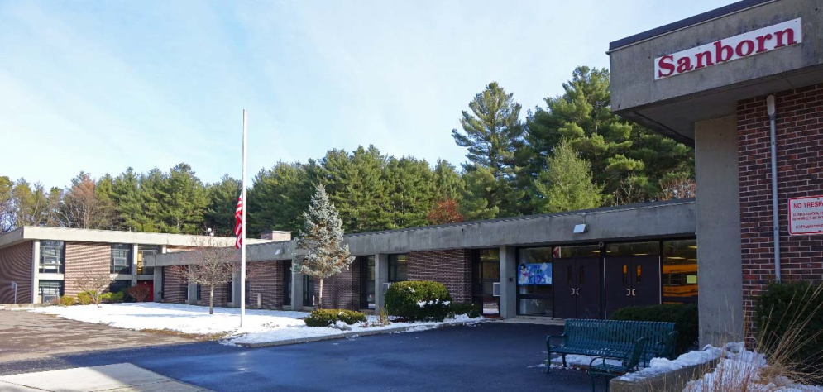
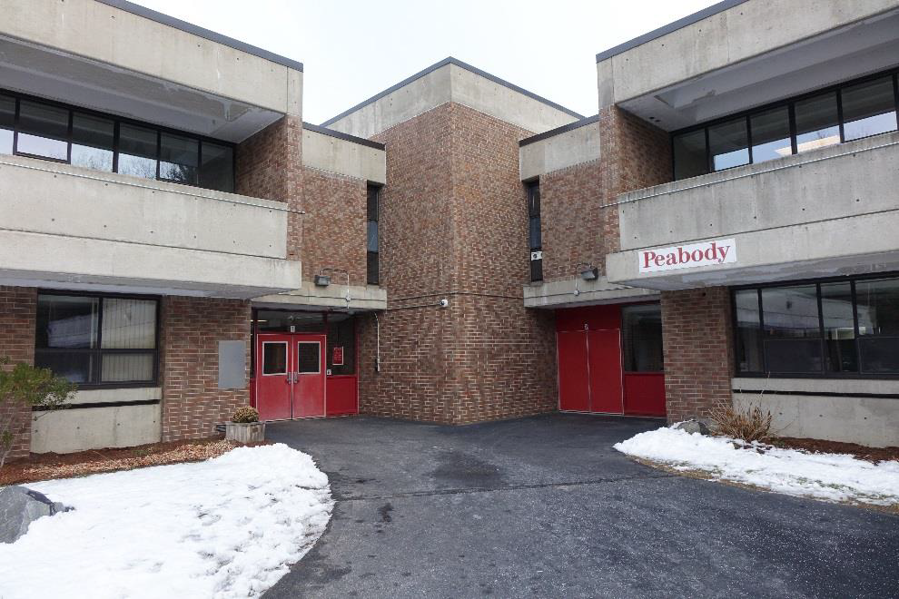
Article 14
Concord Middle School Facilities Planning:
Project Management, Feasibility, Schematic Design

Slide 4
Article 14
Overview
We face a time sensitive planning challenge related to both middle schools
The buildings, infrastructure, and equipment are all well beyond their useful – and reliable – life
We applied for MSBA support in 2017 and 2018 and were declined both times – lots of competition
We are faced with a difficult choice:
Reapply and risk being declined again
Move ahead on our own
Notes:
Reinforce that we are interested in feedback.

Slide 5
Article 14
The question comes down to cost and control
Self-funding will be more expensive –
though increased costs could be offset by avoiding escalations that are likely if we are not approved by MSBA in 2019
Waiting for MSBA approval is risky - systems failures and cost escalations are likely
Self-funding would allow us to build a school that better meets our educational needs and programs
We have attempted to describe all the issues in the slides that follow

Slide 6
Article 14
Caveats
We have not designed a building, but we have early input from architects Finegold Alexander
One building of ~125,000 SF to be located at Sanborn site
All cost estimates are based on best available data
Cost per SF of current MSBA projects
Cost escalation projections from MSBA
Cost of maintaining/replacing roof, plumbing, septic
At this point, there are more unknowns than knowns

Slide 7
Article 14
Agenda
Building Histories
Current Conditions
Process and Timeline
Project Costs
Cost of Waiting
Benefits of Self-Funding

Slide 8
Article 14
Sanborn – 55 Years Old
84,438 square feet on 31.29 acres
1964 – Sanborn opens
1989 – Elevator and ADA upgrades
1987 – Roof replaced
2003-05 – Windows replaced
2015 – Boilers and water heaters replaced
2004, 2010, 2016 – Modular buildings added with 2 classrooms each
Peabody – 49 Years Old
56,388 square feet on 7.99 acres
1968 – Peabody designed as Open-Concept Elementary School
1970 – Peabody opens as CMS overflow
1994 – Elevator and ADA upgrades
1999-2002 – Roof replaced
2003-05 – Windows replaced
2014 – Boilers and water heaters replaced
Notes:
Highlight ages of buildings, Peabody designed as elementary school, addition of modular classrooms at Sanborn to address overcrowding.

Slide 9
Article 14
2016 - Facilities Planning Committee Formed
Created Committee of 15 community members
Met monthly
Held public forums
Finegold Alexander Architects asked to answer the following:
What would it take to remain in the current buildings for 10 years?
What are options and estimated costs for a renovation project?
What are options and estimated costs for a new building?

Slide 10
Article 14
2017 - Finegold Alexander Architects Summary Findings
Current Conditions:
Peabody and Sanborn Conditions are Deteriorated and Obsolete
Although well-maintained, they are at the end of their lifespan
Two Campus Configuration is Inefficient and Expensive
“Overflow” status is not sustainable
Current Situation Creates Struggle for the School Community
Results in sub-optimal educational experience
10-Year Outlook:
Estimated cost to remain in current buildings for 10 years and attain appropriate educational environment: $34-47 Million
Notes:
$34-47 Million based on Finegold Alexander slides in addendum showing recommended work to stay in the buildings 10 years.
$34 million is the cost of all recommended actions (first two columns) in both buildings.
$47 million is the cost of all recommended plus optional actions (all three columns) in both buildings.

Slide 11
Article 14
Building Histories
Current Conditions
Process and Timeline
Project Costs
Cost of Waiting
Benefits of Self-Funding

Slide 12
Article 14
Current Conditions
Operational inefficiency
Outdated infrastructure
Aging equipment
Overcrowded buildings
Educational shortcomings

Slide 13
Article 14
Operational Inefficiency
Challenge to maintain educational and service equity between two buildings
Requires redundant positions
Expensive utility costs due to outdated systems
Excess operational expenses of $548,000 per year to maintain two buildings

Slide 14
Article 14
Outdated Infrastructure
Original Heating lines, Plumbing lines, and Electrical Systems
Sarnafil PVC roofs are at end of projected lifespan
Septic systems are over 50 years old
Ventilation and air circulation are nonexistent
Hazardous materials such as asbestos, mercury and PCBs are in both buildings
Neither building has a fire suppression system
Concrete is flaking off the Peabody building - final stages of
concrete failure

Slide 15
Article 14
Aging Infrastructure
Most mechanical and electrical equipment original to buildings.
Mechanical equipment unreliable and subject to failure.
No backup generator for power failure.
Parts often not available.

Slide 16
Article 14
Overcrowded Buildings
3 modular units at Sanborn
Students must continuously exit and enter building
Often creates delays in class start times
No bathrooms leads to extra time out of class
Sanborn custodial closet converted to learning space
Peabody “cafeteria” congested with lockers
Peabody stairwell congested between classes

Slide 17
Article 14
Educational Shortcomings
Lack of space for…
21st century, project-based learning
(STEAM…)
Interdisciplinary learning
Breakout spaces
Grade team implementation

Slide 18
Article 14
Building Histories
Current Conditions
Process and Timeline
Project Costs
Cost of Waiting
Benefits of Self-Funding

Slide 19
Article 14
Finegold Alexander hired
Cost to remain in existing buildings for 10 years?
Options & cost for renovation?
Options & cost for rebuild?
Peabody boilers & water heaters replaced
Finegold Alexander findings
“… operating two campuses is not fiscally prudent, and not in the interest of Concord taxpayers”
New CCHS opens
TM Warrant Articles Filed
2014
2015
2016
2017
2018
2019
Focus on completion of new CCHS
CMS Facilities Planning Committee formed
CMS Facilities Study Report
SOI #1 declined
SOI #2 declined
Sanborn boilers & water heaters replaced
Dr. Hunter (Superintendent) and Mr. Cameron (CMS Principal) begin tenures

Slide 20
Article 14
Statement of Interest (SOI)
Concord Submitted an SOI in 2017 and 2018
Invitations limited by available funding
Competitive process based on need and urgency as determined by MSBA
Out of 70 SOIs submitted to MSBA in 2018, 12 projects were invited to the eligibility period (17%)
Concord was not invited in 2017 or 2018
Next Submission Deadline April 2019 for 2021 Construction
Notes:
Point out that we believe our likelihood of acceptance into MSBA is low and decreases each year.

Slide 21
Article 14
District |  | School |  | Age of Existing Building |  | Current Grade Configuation |  | Enrollment |  | Square Footage |  | Building Condition |  | General Environment
 |  |  |  |  |  |  |  |  |  |  |  |  | Capacity
Brookline |  | John R. Pierce School |  | 1859/1974 |  | K-8 |  | 859 |  | 197,675 |  | 1 | Average | 1
Haverhill |  | Dr. Albert B. Consentino School |  | 1969 |  | 3-8 |  | 976 |  | 108,300 |  | 2 | Average | 1
Hull |  | Hull Memorial Middle School |  | 1948 |  | 6-8 |  | 188 |  | 67,546 |  | 2 | Under | 1
Norwood |  | Dr. Philip O. Coakley Middle School |  | 1974 |  | 6-8 |  | 737 |  | 128,100 |  | 3 | Average | 1
Peabody |  | William A Welch Elementary School |  | 1973 |  | PK-5 |  | 360 |  | 58,080 |  | 2 | Average | 1
Revere |  | Revere High School |  | 1974 |  | 9-12 |  | 1,991 |  | 324,375 |  | 2 | Average | 1
Spencer-East Brookfield RSD |  | David Prouty High School |  | 1966 |  | 9-12 |  | 293 |  | 100,000 |  | 4 | Under | 1
Stoneham |  | Stoneham High School |  | 1968 |  | 9-12 |  | 676 |  | 211,000 |  | 2 | Average | 1
Tyngsborough |  | Tyngsborough Middle School |  | 1968 |  | 6-8 |  | 409 |  | 80,000 |  | 1 | Under | 1
Walpole |  | Bird Middle School |  | 1961 |  | 6-8 |  | 491 |  | 88,500 |  | 2 | Under | 1
Webster |  | Bartlett Junion/Senior High School |  | 1979 |  | 9-12 |  | 439 |  | 186,000 |  | 1 | Under | 1
Westfield |  | Franklin Aveneue Elementary School |  | 1955 |  | K-4 |  | 248 |  | 33,804 |  | 2 | Average | 1

Slide 22
Article 14
2018 MSBA Invitations/2016 Building Survey
Of the 12 School Invited to the MSBA Program
85% of school were in category 1 or 2 building condition rating.
1 school rated 3.
1 school rated 4.
All schools rated 1 for general environment and were average or under rated in capacity

Slide 23
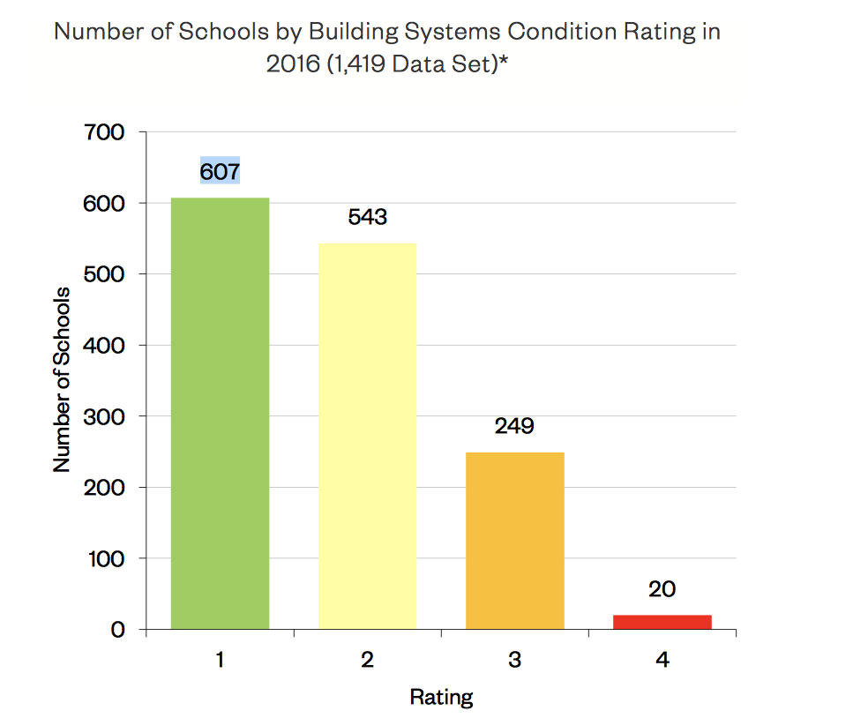
Article 14
Sanborn was rated a 2 in Building Condition

Slide 24
Article 14
Building Histories
Current Conditions
Process and Timeline
Project Costs
Cost of Waiting
Benefits of Self-Funding

Slide 25
Article 14
Project Construction
Average cost for 2019-2020 MSBA middle school projects is $648 per square foot
2017 Finegold Alexander study suggests ~125,000 square foot building to deliver our educational program
Total estimated cost in 2019 is approximately $81 million
Cost to build a new middle school will increase substantially each year
Construction cost growth from 2010 to 2016 for MSBA funded projects averaged 6.93% per year
Similar projects in process are projected at over $90 million
Given our best timeline, likely cost in $90 million + range
Notes:
Point out that the SC and District will be cost conscious in our planning.
This District Administration has already demonstrated its propensity to do so.

Slide 26
Article 14
Estimated tax impact of $90,000,000 Middle School
4.25% interest, level principal payment, 25 year term
Average Median Household Tax Impact : $764
Estimated peak year tax impact: $1,015
2019 Median Household Value : $881,550
2019 Median Tax Bill : $12,482
Notes:
Point out that the SC and District will be cost conscious in our planning.
This District Administration has already demonstrated its propensity to do so.

Slide 27
Article 14
Building Histories
Current Conditions
Process and Timeline
Project Costs
Cost of Waiting
Benefits of Self-Funding

Slide 28
Article 14
Major Infrastructure Failure Risks
Heating lines show signs of corrosion:
Recent leak at Sanborn
Total cost to replace heating estimated at $1,168,000
Sarnafil PVC roofs at end of projected lifespan:
Small leaks patched as they occur
Total cost to replace roofs estimated at $4,556,000
Septic System over 50 years old:
Recent back up at Sanborn – took learning spaces offline-Cost $20,000 to repair
Total cost to repair or replace septic: estimated at $300,000+
Potential Repair/ Replacement Costs Exceed $6,000,000

Slide 29
Article 14
Estimates of Waiting 1 year to reapply for MSBA funding
Assumptions
Acceptance into 2019 MSBA Eligibility (not guaranteed)
2-Year delay to Project Completion
Escalation Costs of 3-7% (based on MSBA current projects)
2019 New Middle School Building Cost: 90M
Costs
Escalation Cost (based on MSBA current projects)$5-15,000,000+
Operational Costs: $1,096,000
Capital/ Maintenance Costs: $200,000
TOTAL $6.3-16.3 Million
Potential Additional Costs: $0-6 Million
(due to Infrastructure Failures)
TOTAL COST OF WAITING 1 YEAR: $6.3-22.3 MILLION

Slide 30
Article 14
Reimbursement is based on a town’s “wealth factor”
CCHS project baseline reimbursement rate was 34.5%
CCHS project effective reimbursement rate (after exclusions) was 29%
Scope exclusions have continued to grow over time
Middle Schools likely to have more exclusions – auditoriums, regulation gymnasiums, etc
CMS project effective reimbursement rate is estimated to be 20-25%
On a $90m Building, estimated reimbursement is $18-22.5m
Reimbursement benefit is significantly consumed by waiting
Notes:
Point out that the SC and District will be cost conscious in our planning.
This District Administration has already demonstrated its propensity to do so.
Exclusions: auditoriums, regulation gymnasiums, sq footage to a certain size

Slide 31
Article 14
Building Histories
Current Conditions
Process and Timeline
Project Costs
Cost of Waiting
Benefits of Self-Funding

Slide 32
Article 14
Benefits of Self-Funding
Accelerated construction timeline by 1 to 2 years
Potential savings of $6.3-22.3 million through elimination of cost escalations, operating inefficiencies, and maintenance costs

Slide 33
Article 14
Benefits of Self-Funding
School Design that meets the needs of students and teachers
MSBA policy limits auditorium, gym, and other recreational space in middle schools
Would limit our educational program
Retro-fitting MSBA designs can increase building costs and future operational costs
School Design that enables incremental community value
i.e. Solar panels, LEED certification, Grid Services, Town Shelter, Gym/ Recreation Space

Slide 34
Article 14
To determine if the Town will vote to raise and appropriate, or transfer from available funds, or authorize the Town Treasurer with the approval of the Select Board to borrow money by the issuance of bonds or notes under the provisions of Massachusetts General Laws c. 44, the sum of $1,500,000, or any other sum, to be expended under the direction of the School Committee for a feasibility study to consider the
construction of a new middle school, which may be located at 835 Old Marlboro Road, Concord, Massachusetts (the present site of the Sanborn Middle School),
Continued on next slide

Slide 35
Article 14
…provided, however, that this approval shall be contingent upon passage of a Proposition 2ó debt exclusion referendum under Massachusetts General Laws c. 59, § 21C(k), and further that any premium received by the Town upon the sale of any bonds or notes approved by the vote, less any such premium applied to the payment of the costs of issuance of such bonds or notes, may be applied to the payment of costs approved by this vote in accordance with Massachusetts General Laws c. 44, § 20, thereby reducing the amount authorized to be borrowed to pay such costs by a like amount, or take any other action relative thereto.

