Slide 1
Article 16
To determine whether the Town will vote to approve $2,000,000, or any other sum, of debt authorized by the Concord-Carlisle Regional School Committee for the reconstruction of the access road and the design and construction of the parking lot; provided, however, that this approval shall be contingent upon passage of a Proposition 21/2 debt exclusion referendum under Massachusetts General Laws c. 59, § 21C(k) to exempt the Town’s allocable share of the amounts required for the payment of interest and
principal on said borrowing, or take any other action relative thereto.

Slide 2
Article 16
Article 16 requests approval for funds for the following on the CCHS Campus
Reconstruct the access road
Install lighting along the access road
Repair sidewalks and curbing
Restore parking to previous amounts

Slide 3
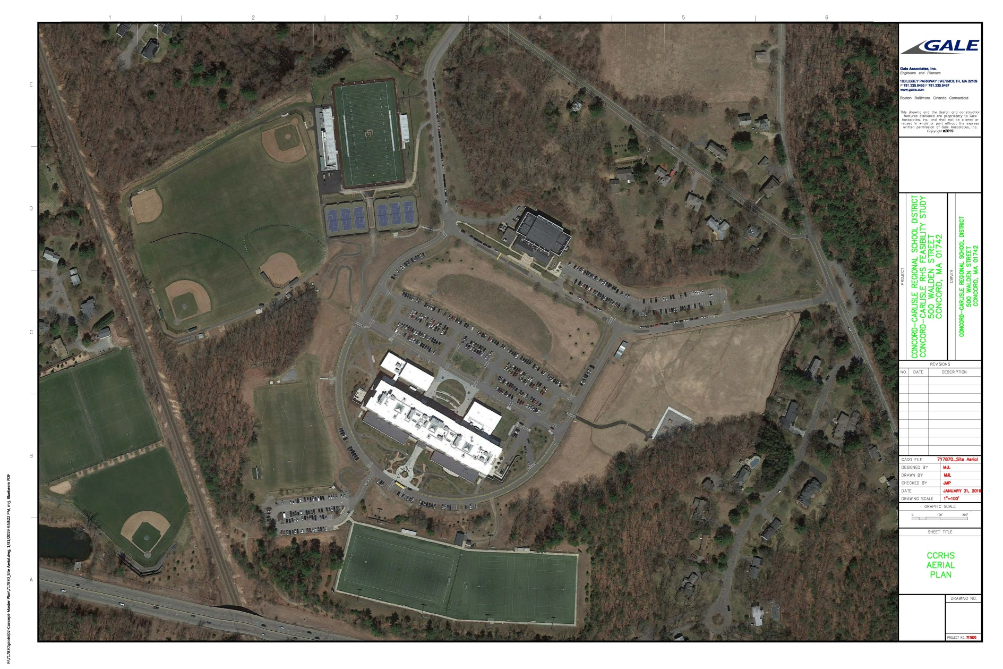
Article 16
Access Road
Parking

Slide 4
Article 16
Gale evaluated the campus access road as part of the campus feasibility study
  Thoreau Street entrance is in poor condition with cracks and patches through the extent of the apron
  Significant ponding with damaged, cracked, and uneven pavement at the Walden Street entrance
  The entire length of the access road has alligator cracks, patches, and potholes
  Tensile strength of the access road is failing and there may be a substandard base material
  Sidewalks and curbing are cracked and in need of replacement

Slide 5
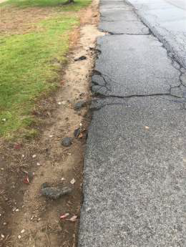
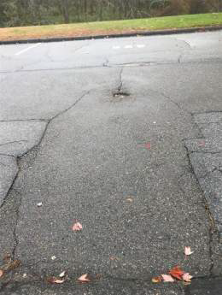
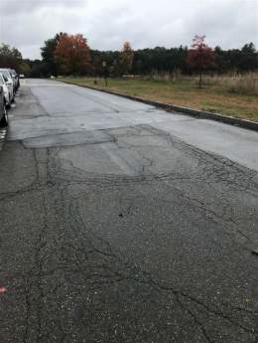
Article 16
Broken and spalled pavement on sidewalks
Sunk utility covers
Multiple patches and significant cracking
Concerns have continued regarding the safety of the road and the sidewalks and limited ADA Accessibility

Slide 6
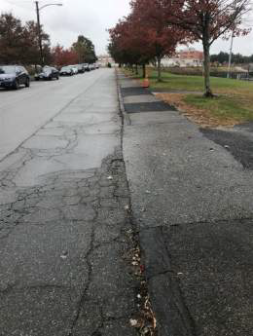
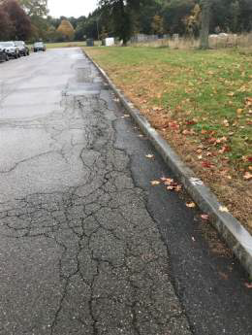
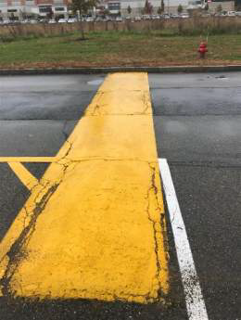
Article 16
Multiple patches and significant cracking

Slide 7
Article 16
Gale Associates’ study provided the specifications to bring road into compliance
Reconstruction includes new gravel subbase, compaction, and paving of road
Reconstruction includes new granite curbing, ADA curb cuts, lighting, and drainage improvements
Estimated cost is $1,224,812

Slide 8
Article 16
Moved into new CCHS building
Demolition of old building begins
Old parking lot still in use
2015
April
New parking lot comes online
Remediation of old parking lot begins
Campus has 135 fewer parking spaces
Has resulted in considerable stress for families and administration
2015
November

Slide 9
Article 16
Front Circle 7
We propose to restore 104 spaces
Beede Center 8
Behind AD Office 14
135 Fewer Spaces
Front Drive (L&A) 28
Lower Gym 34
Near WIQH 34
4 Loading Dock
28 Side Roads
DLW Turf Fields 100
39 Loop Road
100 DLW Turf Fields
Student Lot 323
242 Main Lot
Total = 548
Total = 413

Slide 10
Article 16
Since 2015, multiple actions have been taken to overcome the parking deficit
SC urged a “wait and see” approach
Faculty parking moved to upper turf lot
School rented spaces from Beede Center
Spaces were numbered to improve enforcement
Carpool challenge was promoted
Parking Management

Slide 11
Article 16
Since 2015, much consideration has been given to considering options for the campus
Campus Advisory Committee formed in 2017
Campus Oversight Committee formed in 2018
Gale Associates engaged to conduct feasibility study in 2018
Campus Sustainability Committee formed 2019
Campus Planning

Slide 12
Article 16
Despite best efforts, parking capacity remains inadequate
Many drivers (juniors) no longer can have spaces
Students arrive extra early to grab spots; defeats the purpose of the later start time
Lack of visitor spaces results in taking of student spaces
Insufficient capacity for large community events
Continued stress for families
Huge distraction and time consumer for administration

Slide 13
Article 16
Why must students drive to school?
Why can’t they take the late bus?
Off campus sports teams – i.e. hockey, golf
After school jobs
Caring for siblings (especially single parent households)
Club sports – soccer, cross-country skiing, rowing, etc
Music lessons and performances – often in Boston
Parking cannot continue to be treated only as a privilege

Slide 14
Article 16
Gale Associates’ study proposed a location and size of a future parking lot
104 additional spaces
Estimated cost of $790,903
Would not impede future development of a track and field on the remediated landfill site
Would not impede future development of an amenities building

Slide 15
Article 16
School Committee is requesting $2,000,000 to complete both projects
Actual costs could be less. CCRSD will only borrow an amount necessary to fund actual project costs with debt service commencing in FY21.
While the estimates Gale provided for both were stand alone, combining Parking and Access Road Reconstruction provides economies of scale.
Based on FY20 assessment ratios and a 10 year repayment schedule, estimated FY21 assessment impact are:
    $210,700 for Concord $69,300 for Carlisle

Slide 16
Article 16
Access Road Reconstruction $ 1,224,812
Restore 104 Parking Spaces $ 790,903
Total $ 2,015,715

Slide 17
Article 16
To determine whether the Town will vote to approve $2,000,000, or any other sum, of debt authorized by the Concord-Carlisle Regional School Committee for the reconstruction of the access road and the design and construction of the parking lot; provided, however, that this approval shall be contingent upon passage of a Proposition 21/2 debt exclusion referendum under Massachusetts General Laws c. 59, § 21C(k) to exempt the Town’s allocable share of the amounts required for the payment of interest and
principal on said borrowing, or take any other action relative thereto.

