Slide 1
ARTICLE 22: CPC
Town of Concord
Community Preservation Committee
2019 Annual Town Meeting
Warrant Article 22
Finance Committee Public Hearing
February 25, 2019

Slide 2
ARTICLE 22: CPC
The Community Preservation Act in Concord
1.5% out of a possible 3% surcharge on real estate property tax bills
First $100,000 of taxable value is exempt
Persons with income less than 80% of area median income are exempt
Seniors with income less than 100% of area median income are exempt
Locally raised funds are matched on a percentage basis by funds in the State Community Preservation Fund

Slide 3
ARTICLE 22: CPC
Recommendations for CPA Funding in Warrant Article 22
Open Space $341,619

Slide 4
ARTICLE 22: CPC
Regional Housing Services Program
Summary of Project: Inter-municipal program providing professional housing services to develop and monitor Concord’s affordable housing programs.
Recommended Funding: $19,000
Category: Community Housing
Town of Concord

Slide 5
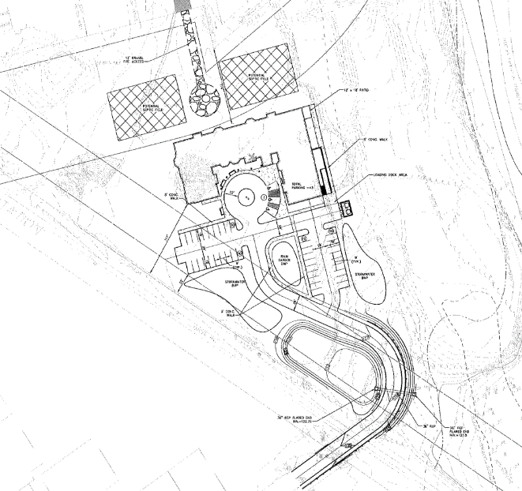
ARTICLE 22: CPC
Junction Village Affordable Assisted Living Development
Summary of Project: Concord’s first entirely affordable assisted living development will include 83 affordable units with 43 at deeply affordable levels.
Recommended Funding: $300,000
Category: Community Housing
Town of Concord

Slide 6
ARTICLE 22: CPC
Junction Village Affordable Assisted Living Development
Total Project Cost: $18,071,533
Town of Concord

Slide 7
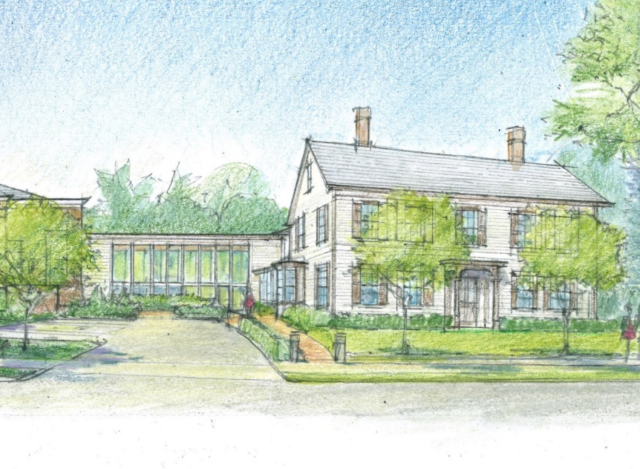
ARTICLE 22: CPC
Expansion and Renovation of the Main Library and the Heywood-Benjamin House
Summary of Project: Preservation of the exterior of the Heywood-Benjamin House and renovations to the interior spaces to comply with ADA accessibility regulations.
Recommended Funding: $500,000
Category: Historic Preservation
Concord Free Public Library Corp.

Slide 8
ARTICLE 22: CPC
Expansion and Renovation of the Main Library and the Heywood-Benjamin House
Total Project Cost: $10,000,000
Concord Free Public Library Corp.

Slide 9
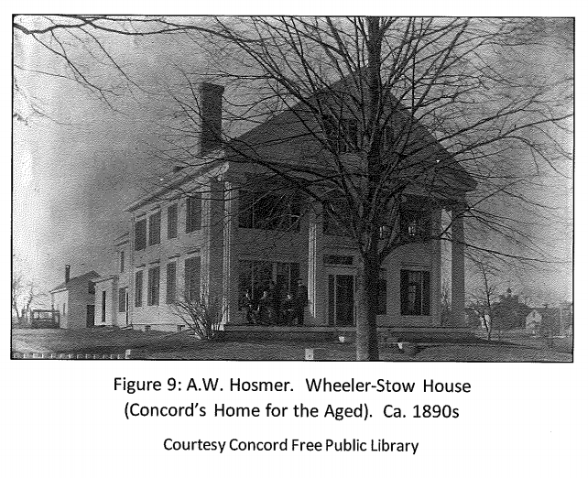
ARTICLE 22: CPC
110 Walden Street Preservation Project
Summary of Project: Preparation of the architectural designs, specifications and supporting documents needed for permitting for the preservation work identified in the Historic Structures Report.
Recommended Funding: $20,800
Category: Historic Preservation
Concord Home for the Aged

Slide 10
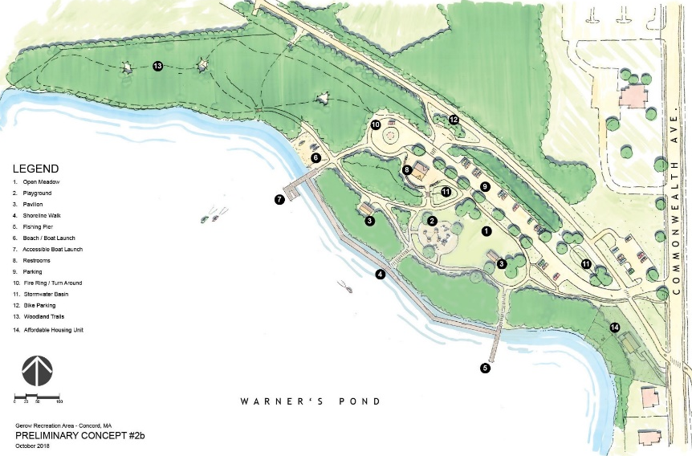
ARTICLE 22: CPC
Gerow Recreation Area Improvements
Summary of Project: Capital improvements including the construction of the new park entrance, parking, paved connections to the BFRT and bike entrance, walking paths, blazed woodland trails, and a waters-edge erosion control system and shoreline dock.
Funding Recommendation: $200,000
Category: Open Space and Recreation
Town of Concord

Slide 11
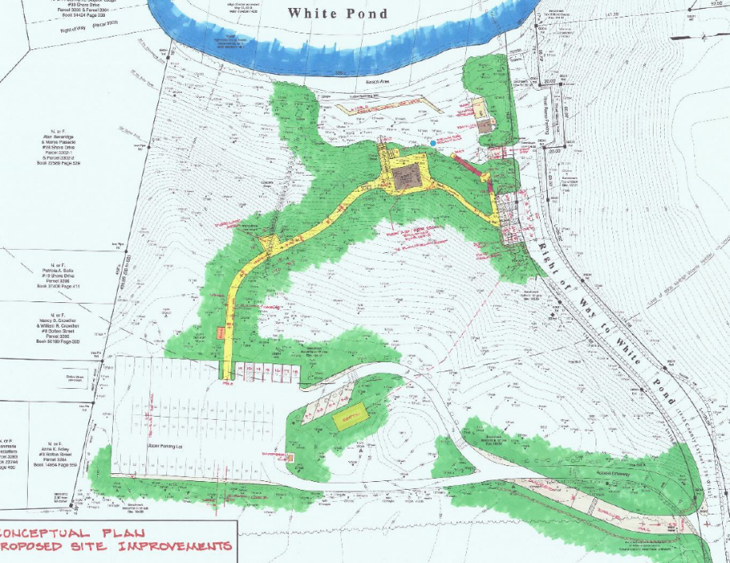
ARTICLE 22: CPC
White Pond Beach Access Improvements
Summary of Project: Accessibility improvements to White Pond beach; including the creation of a sloped and accessible walking pathway connecting the parking area to the waterfront, and renovation of the current restroom facilities to make them fully accessible.
Funding Recommendation: $250,000
Category: Open Space and Recreation
Town of Concord

Slide 12
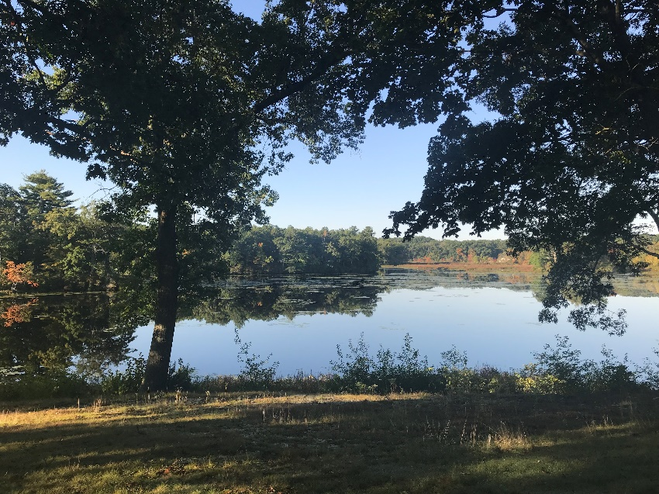
ARTICLE 22: CPC
Warner’s Pond Dredging Project
Summary of Project: Permitting and associated work necessary for the dredging of Warner’s Pond.
Funding Recommendation: $75,000
Category: Open Space and Recreation
Town of Concord

Slide 13
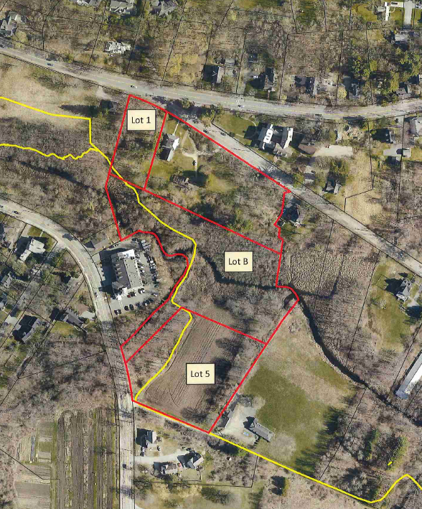
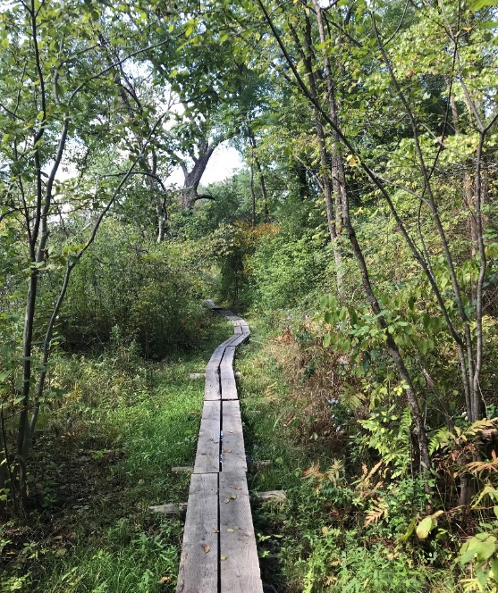
ARTICLE 22: CPC
Emerson Land Acquisition
Summary of Project: Purchase of a 3.4 acre parcel of land located between the Ralph Waldo Emerson House and the access from Walden Street. The Emerson-Thoreau Amble is located over this parcel, which includes the Mill Brook.
Funding Recommendation: $90,000
Category: Open Space
Town of Concord

Slide 14
ARTICLE 22: CPC
Emerson Land Acquisition
Total Project Cost: $200,000
Town of Concord

Slide 15
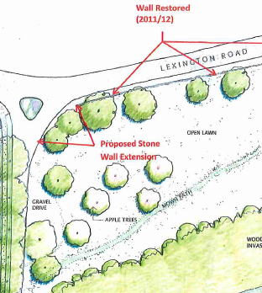
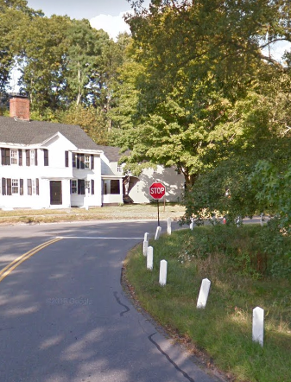
ARTICLE 22: CPC
Heywood Meadow Stone Wall Extension
Summary of Project: Replace the bollards at the intersection of Heywood Street and Lexington Road with approximately 70 feet of fieldstone wall.
Funding Recommendation: $21,619
Category: Open Space
Town of Concord

Slide 16
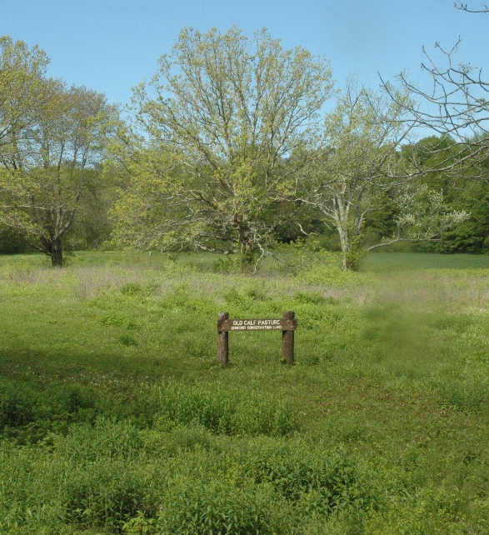
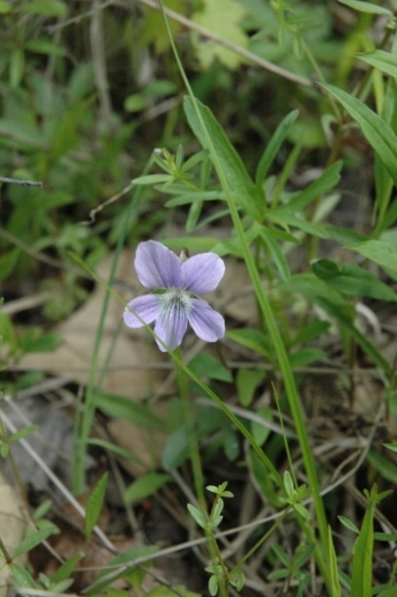
ARTICLE 22: CPC
Old Calf Pasture Habitat Restoration
Summary of Project: Continued removal of the invasive species glossy buckthorn, in an effort to protect the largest population of the state listed Britton’s violet at the Old Calf Pasture.
Funding Recommendation: $5,000
Category: Open Space
Town of Concord

Slide 17
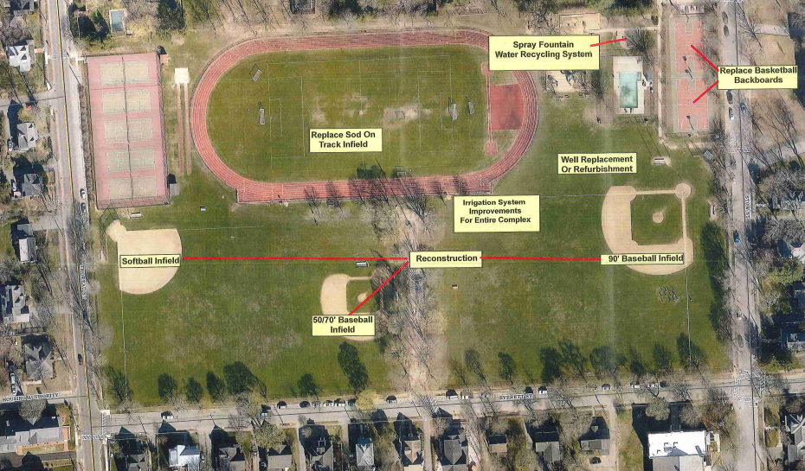
ARTICLE 22: CPC
Emerson Field Improvements
Summary of Project: Improvements include irrigation system upgrades, well redevelopment, baseball field and softball field renovations, and improvements to the spray fountain. Pathway installation and ADA upgrades, replacement of fencing, backstops, and player bench areas.
Funding Recommendation: $300,000
Category: Recreation
Town of Concord Public Works

Slide 18
ARTICLE 22: CPC
Emerson Field Improvements
Total Project Cost: $1,020,000
Town of Concord Public Works

Slide 19
ARTICLE 22: CPC
Staff and Technical Support
Summary of Project: Funding for staff support, signage, legal and consulting services, public notices, copying, and other administrative expenses.
Funding Recommendation: $30,000
Category: Administration
Town of Concord

Slide 20
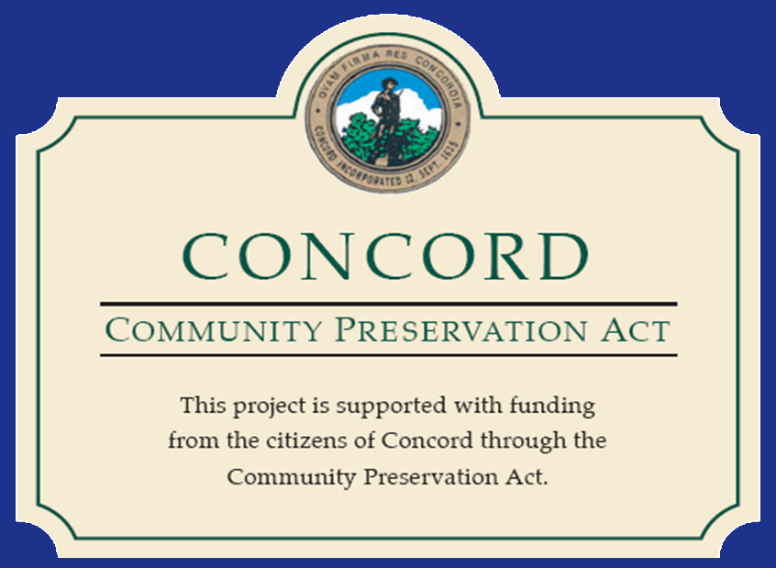
ARTICLE 22: CPC

