Slide 1
Article 10 Minuteman Regional Technical High School FY20 BUDGET AND ASSESSMENTS
Presented by:
Carrie Flood
Concord representative to School Committee
February 25, 2019
Finance Committee Public Hearing

Slide 2
Article 10 Our Guiding Goals To Create Success
Promote excellent teaching

Slide 3
Article 10 Our Guiding Goals To Create Success
Promote excellent teaching
Integrate high quality technical education with academic instruction

Slide 4
Article 10 Our Guiding Goals To Create Success
Promote excellent teaching
Integrate high quality technical education with academic instruction
Demonstrate practical connections between multiple disciplines

Slide 5
Article 10 Our Guiding Goals To Create Success
Promote excellent teaching
Integrate high quality technical education with academic instruction
Demonstrate practical connections between multiple disciplines
Foster a safe, healthy learning environment

Slide 6
Article 10 Our Guiding Goals To Create Success
Promote excellent teaching
Integrate high quality technical education with academic instruction
Demonstrate practical connections between multiple disciplines
Foster a safe, healthy learning environment
Achieve purposeful career and college results

Slide 7
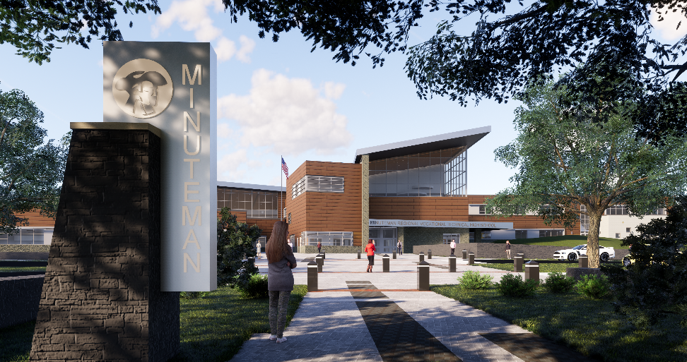
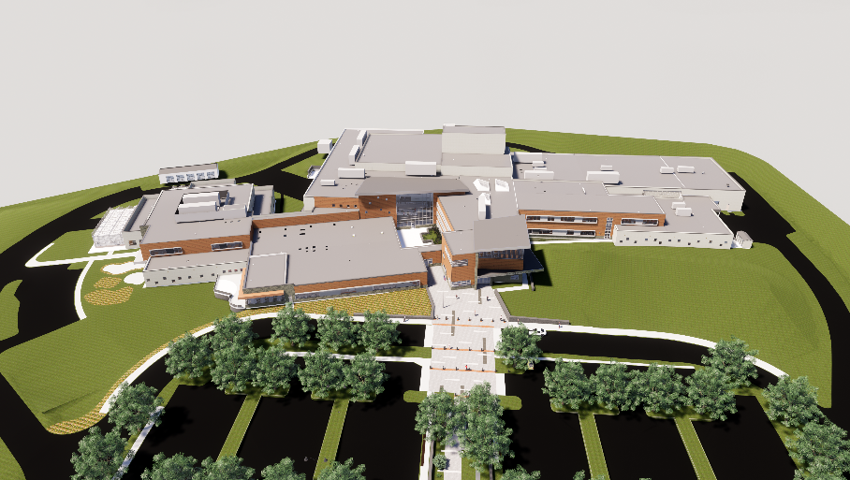
Article 10 Budget Focus – The New Minuteman HS
The FY20 Budget will fund the first year of operations in the new Minuteman High School building
The budget will include transition costs to move into the building and sustain the current building until demolition

Slide 8
Article 10 MORE GOOD NEWS!
Renewed Level 1 School by DESE
Blue Ribbon Status from US Dept of Ed
Approved for new Vet Tech program
Special legislation allows long-term leases ($$ will support members’ building debt)
New Minuteman Institute OK’d for 4 programs

Slide 9
Article 10 OVERALL ENROLLMENT HISTORY

Slide 10
Article 10 ENROLLMENT INITIATIVES
Utilize events, upgraded website, and social media/marketing

Slide 11
Article 10 ENROLLMENT INITIATIVES
Utilize events, upgraded website, and social media/marketing
Designate parent reps from member towns

Slide 12
Article 10 ENROLLMENT INITIATIVES
Utilize events, upgraded website, and social media/marketing
Designate parent reps from member towns
Discuss with DESE restrictions on access from non-member towns

Slide 13
Article 10 ENROLLMENT INITIATIVES
Utilize events, upgraded website, and social media/marketing
Designate parent reps from member towns
Discuss with DESE restrictions on access from non-member towns
Engage further discussion with non-member cities/towns on the benefits of joining the Minuteman district

Slide 14
Article 10 CONCORD ENROLLMENT AT MM

Slide 15
Article 10 OUR OPERATING BUDGET SHARE

Slide 16
Article 10 FY20 Budget
FY20 Budget – Without Building Project Debt Service $19,660,330
Up 3.4%
Building Project – Debt Service
$ 3,108,500
Up 45%
Concord is one of 6 member towns that voted to exempt its share of this debt service from the limits of Proposition 2 1/2

Slide 17
Article 10 Overall – FY20 Budget/Assessments
Total FY20 Budget
$22,768,830
Increase of $1,608,690 (7.6%)
Total Assessments to Towns
$15,856,904
Increase of $2,037,282 (14.7%)

Slide 18
Article 10 Major FY20 Budget Shifts
 | FY19 | FY20 | % change
Budget w/o New Bldg. | $ 19,016,734 | $ 19,660,330 | 3.4%
New Building Debt | $ 2,143,406 | $ 3,108,500 | 45.0%
Total Budget | $ 21,160,140 | $ 22,768,830 | 7.6%
State Aid | $ 2,962,095 | $ 2,924,795 | -1.3%
Prior Year Tuition | $ 3,438,424 | $ 3,047,131 | -11.4%
Current Year Tuition | $ 400,000 | $ 400,000 | 0.0%
E&D | $ 540,000 | $ 540,000 | 0.0%
Capital Fee (not yet!) | $ - | $ - | n/a
Total Other Revenue | $ 7,340,519 | $ 6,911,926 | -5.8%
Member Assessments | $ 13,819,621 | $ 15,856,904 | 14.7%
Concord's Share | $ 742,679 | $ 1,073,368 | 44.5%

Slide 19
Article 10 Concord Assessment
 | FY19 | FY20 | % change
Operating and other capital | $595,802 | $824,090 | 38%
New Building Debt (excluded from 2 ½) | $146,877 | $249,278 | 70%
Total Assessment | $742,679 | $1,073,368 | 45%

Slide 20
QUESTIONS?
Presented by:
Carrie Flood
Concord representative to School Committee
February 25, 2019
Article 10 Minuteman Regional Technical High School

Slide 21
FOLLOWING SLIDES ONLY IF NEEDED FOR QUESTIONS

Slide 22
Budget History – Last 4 Years

Slide 23
10 Year Freshman Enrollment

Slide 24
In District Total Applications
Recruitment Year | # of In District Applications
2017-2018 | 147 Received 10/2/17 to 9/27/18
2018-2019 (more applications in 8 months less!) | 157 Received 10/2/18 to 1/3/19

Slide 25
Out of District Application Activity
Eligible Applications -No CTE affiliation means they can enroll easily. | Ineligible Applications -CTE affiliation means they most likely cannot enroll.
24 | 24

Slide 26
FY20 Budget Expenditures By Function Code
ACCOUNT CODE | ACCOUNT DESCRIPTION | FY2018 ACTUAL | FY2019 BUDGET | FY2020 PROPOSED | DIFFERENCE
1000 | Administration | $1,478,119 | $1,439,784 | $1,446,330 | $6,546
2000 | Student Instructional Services | $9,469,220 | $9,821,058 | $10,352,764 | $531,705
3000 | Student Services | $1,925,226 | $1,942,355 | $2,020,897 | $78,544
4000 | Operation & Maintenance | $1,712,987 | $1,795,723 | $1,793,498 | -$2,224
5000 | Insurance, Retirement, Leases | $2,992,146 | $2,994,697 | $3,215,506 | $220,810
6000 | Community Services | $100,000 | $100,000 | $100,000 | $0
7000 | Asset Acquisition & Improvement | $222,406 | $410,360 | $205,000 | -$205,360
8000 | Debt Service | $1,149,931 | $2,636,163 | $3,614,834 | $978,669
9000 | Tuition Payments | $900 | $20,000 | $20,000 | $0
 | GENERAL FUND | $19,050,936 | $21,160,140 | $22,768,830 | $1,608,690

Slide 27
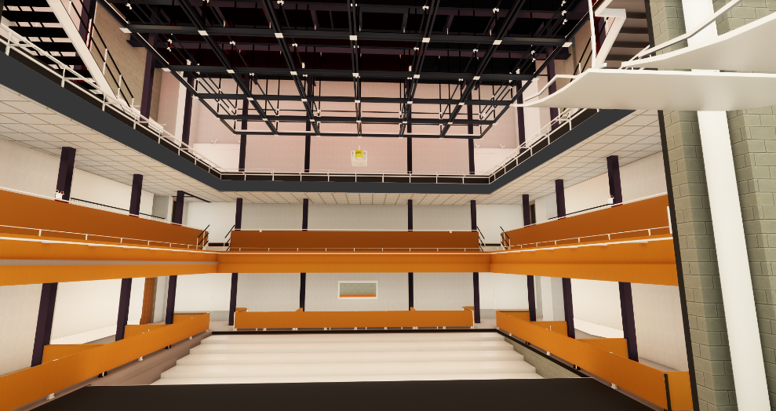
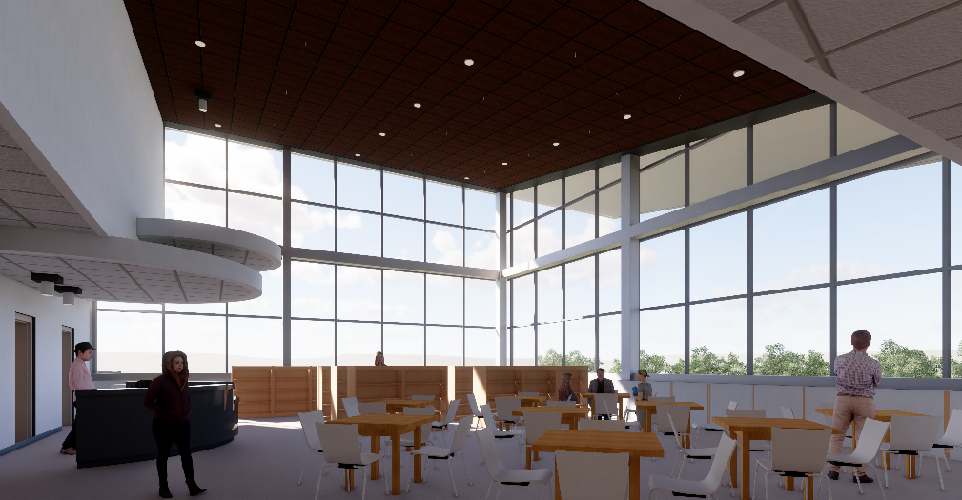
New Building – Budget Impacts
Programs:
.5 FTE Multi-Media Engineering Instructor
.5 FTE Logistics Engineer
Facility Maintenance:
.5 FTE Director of Facilities
Contracted Custodial Services

Slide 28
New Building Transition Costs
Staffing:
Add 0.5 FTE Logistics Engineering position | $ 40,158
Add 0.5 FTE Multi-Media Engineering position | 33,098
Reduce 3.0 FTE Building Maintenance Dept. | (156,721)
Add 0.5 FTE Director of Facilities | 50,000
Additional Days - Teaching Staff | 60,178
Contracted Services:
Custodial Services | 275,000
Notes:
.

Slide 29
FY20 Budget – Major Changes
Compensation Obligations $ 590,551
Staffing Changes (net) (202,261)
Stabilization Account (215,000)
Fund $85,000
Current Balance: $766,000
Instructional Equipment (15,000)
Fund $35,000
For unexpected equipment needs

Slide 30
FY20 Budget – Major Changes
Health Insurance – up $140,000
Estimated 5% rate increase
MM Retirement – Increase of $20,000
OPEB – Level funded at $50,000
Utilities – Net decrease $73,300
80% District/20% Facilities Revolving Acct
Does not include PV project savings
Custodial Services (est.) $275,000

Slide 31
New Building Transition Costs
Supplies:
Culinary Arts - Dining Room place settings | 8,740
Art Department - Equipment for Dark room | 8,440
School Lunch – place settings | 10,000
Utility Costs:
Electricity (assumes no PV installation) | (63,000)
Natural Gas service | (12,100)
Property & Casualty Insurance | 10,000
Stabilization Account | (215,000)

Slide 32
Staffing - Year to Year Changes
New Positions:
.5 FTE Dir. of Facilities
Asst. Director of Career and Tech. Ed.
.5 FTE Multi-Media Instructor
.5 FTE Logistics Engineer
Asst. Director, Admissions (filled in FY19)
Social Worker/Adj. Counselor (filled in FY19)
Positions Eliminated:
Director of Educational Technology
2 FTE Teaching Staff
1 retirement
3 FTE Building Maint.
2 FTE Admin. Support
Both retirements

Slide 33
Capital/Debt Service
Category | FY19 Budget | FY20 Proposed
Building Repairs | $5,000 | $5,000
Stabilization Fund | $300,000 | $85,000
Equipment | $85,000 | $65,000
Vehicles | $20,360 | $50,000
Debt Service – School Project | $2,143,406 | $3,108,500
ESCO Lease | $492,757 | $506,333
TOTAL | $ 3,046,523 | $ 3,819,833

