Slide 1

Junction Park Conceptual Redesign Project
Public Forum #1, February 16, 2022
Sponsored by the Bruce Freeman Rail Trail Advisory Committee
BFRTAC@concordma.gov

Slide 2
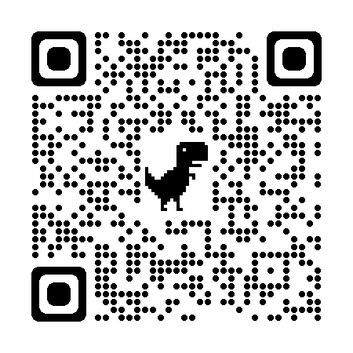
Welcome and Logistics
Presentation materials are/will be available at The Bruce Freeman Rail Trail Advisory Committee website (use our smartphone to scan the QR Code)
This forum will end at 6:00PM and there will be other public forums to continue the conversation so if we do not get to you will still have a chance to be heard
Ideas, questions, comments can be sent to the BFRTAC email address: BFRTAC@concordma.gov

Slide 3
Agenda
Review Objectives
Setting the Stage: A Brief History of Junction Park and Overview of the Project
Community Input to Date
Framing and Discussion of ideas for short term approaches
Framing and Discussion of ideas for long term redesign
Summary and Next Steps
4:00 PM to 6:00 PM

Slide 4
Objectives for Today
Create a shared understanding of the background and key issues involving Junction Park safety
1
Review the task given to Bruce Freeman Rail Trail Advisory Committee
2
Discuss ideas for short-term concepts
3
Discuss ideas for long-term concepts
4
Solicit community input on concepts discussed
5

Slide 5

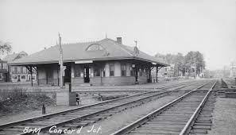
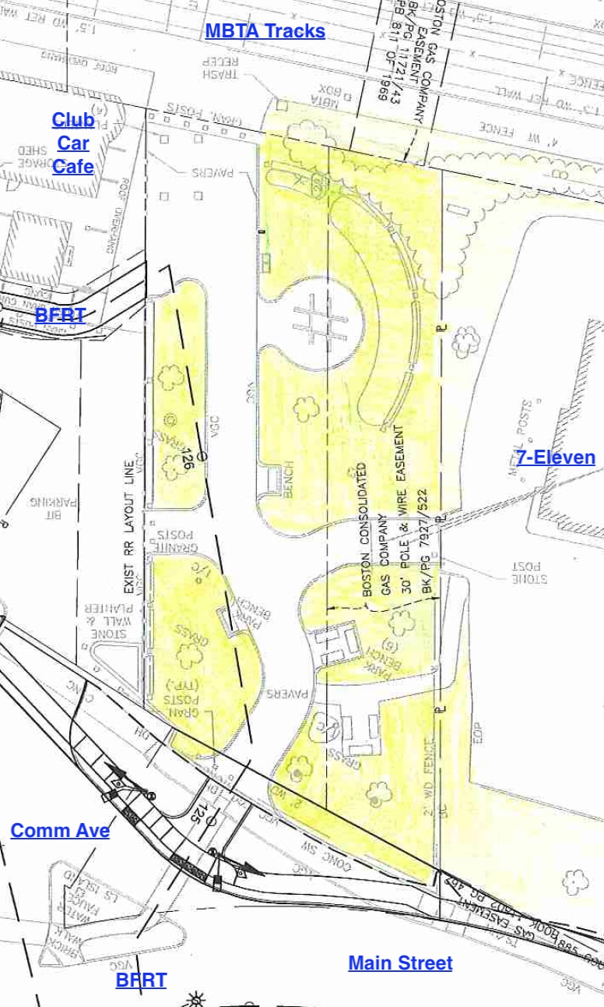
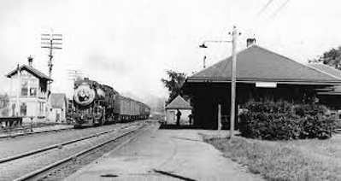
Junction Park: Context

Slide 6
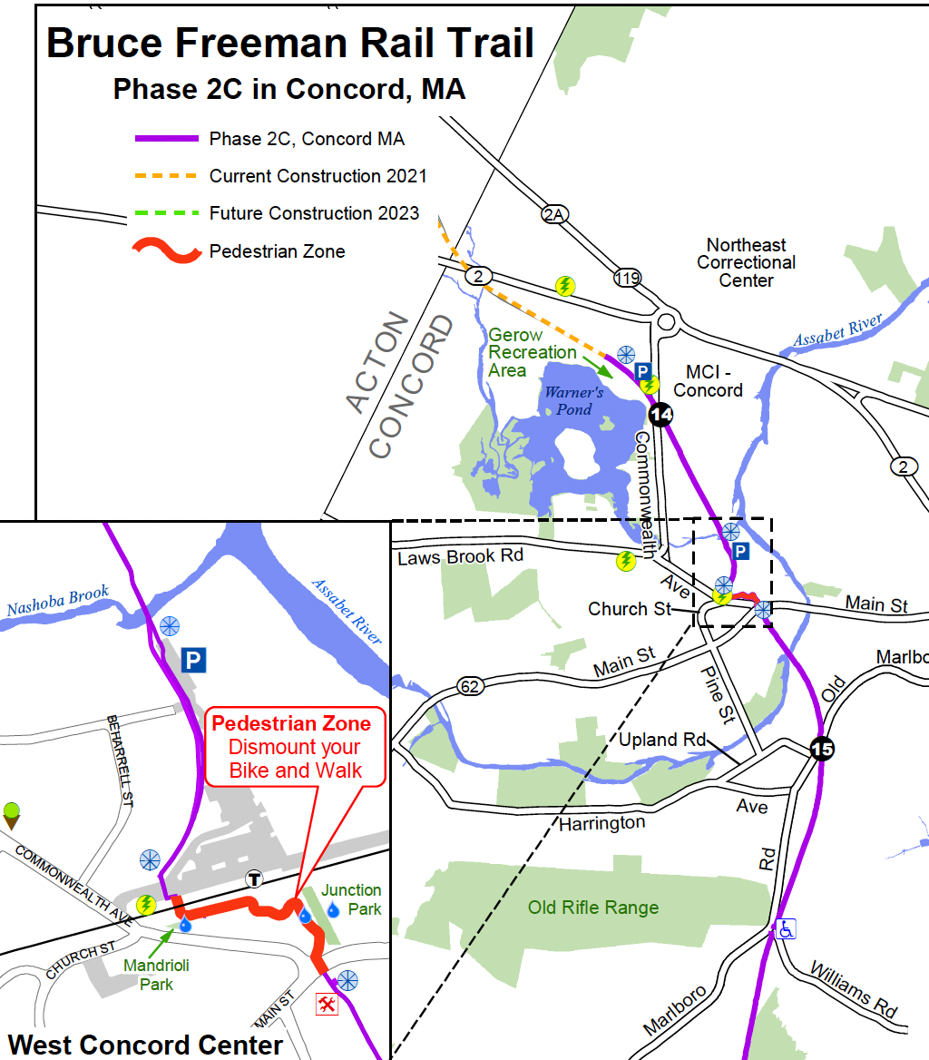
BFRT in Concord
1
Phase 2C partially completed in 2018 but not connected to the rest of the Trail which terminates in Lowell
The Route 2 Bridge opens July 2022 (see star)
The bridge will connect to the full trail will increased rail trail traffic in West Concord

Slide 7
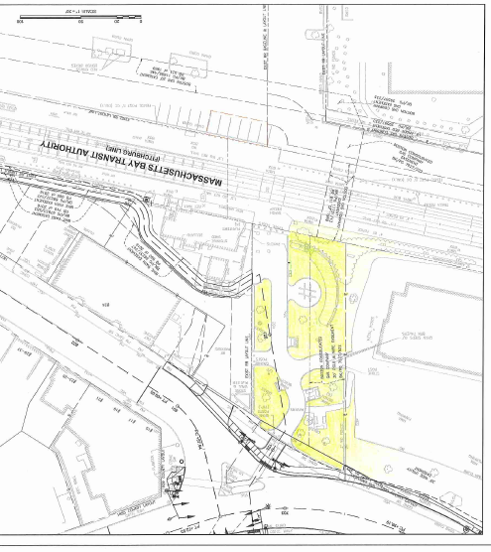
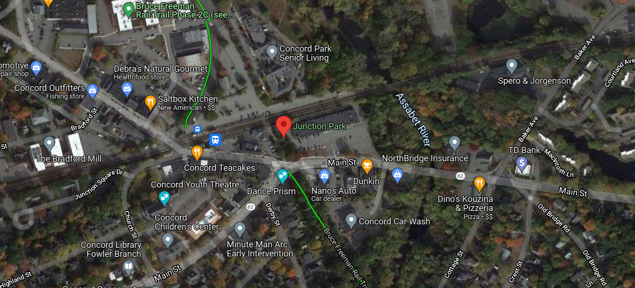
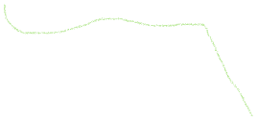

Where is Junction Park?
2

Slide 8
Orienting
2a
North
West
East
South

Slide 9
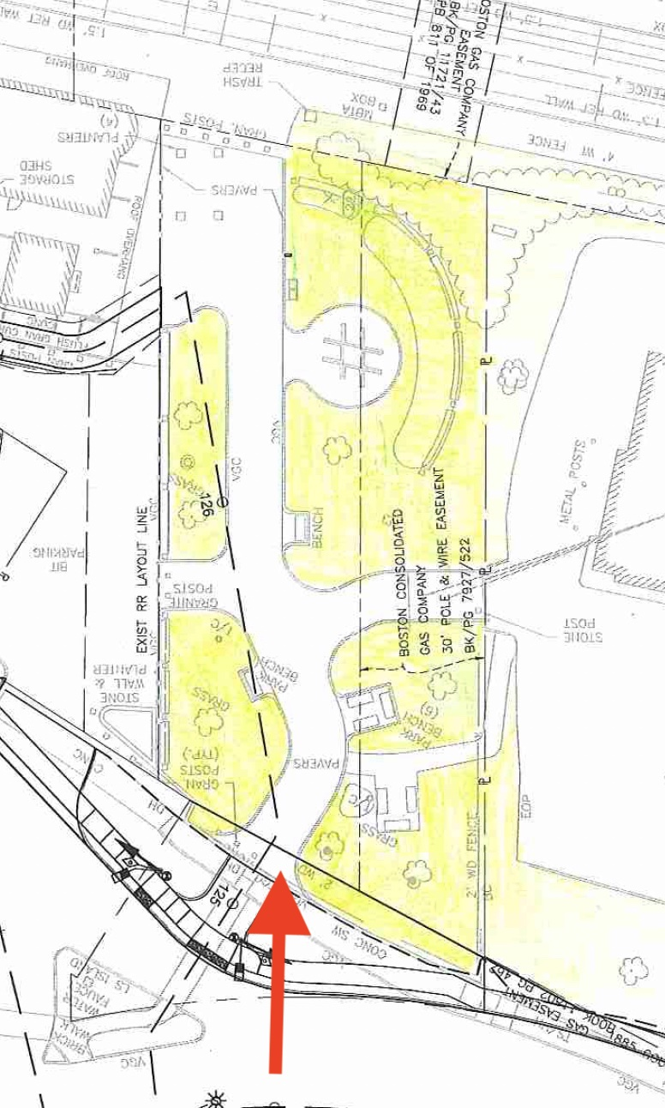
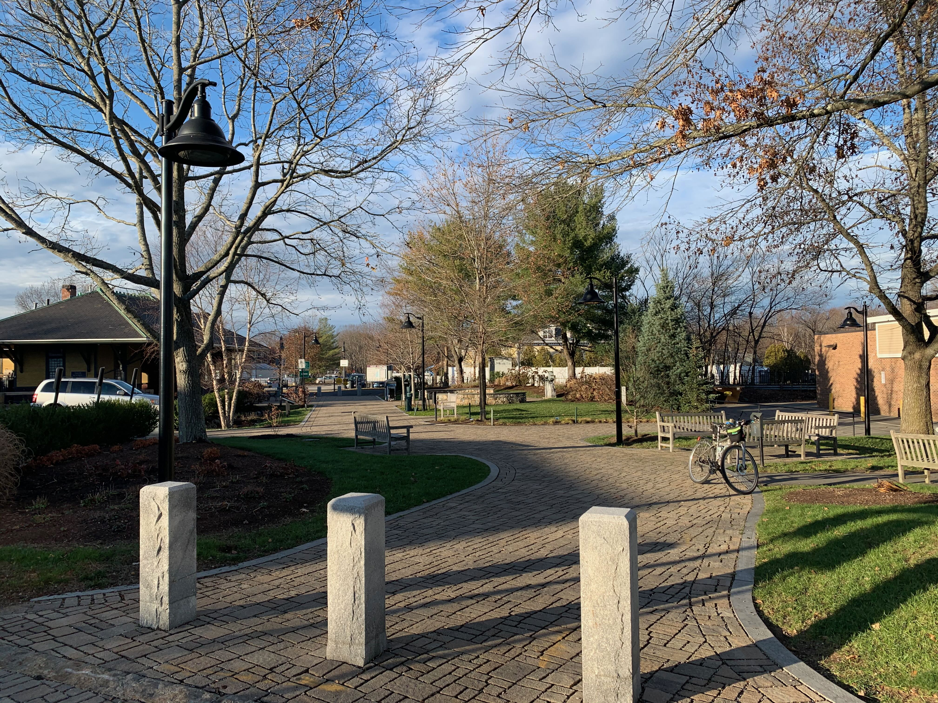
View from Commonwealth Avenue looking North
3
Main entrance of junction park

Slide 10
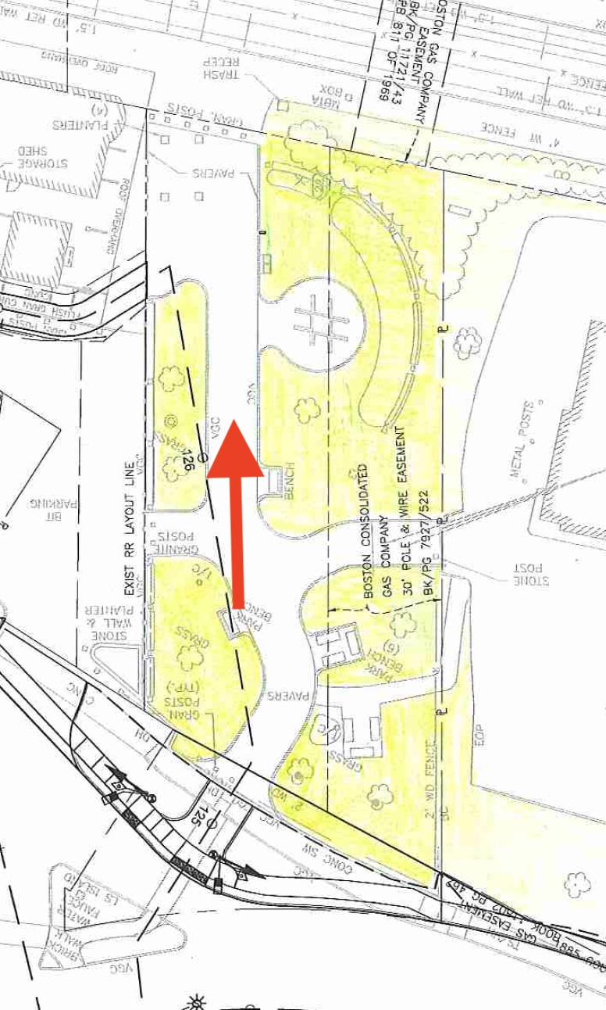
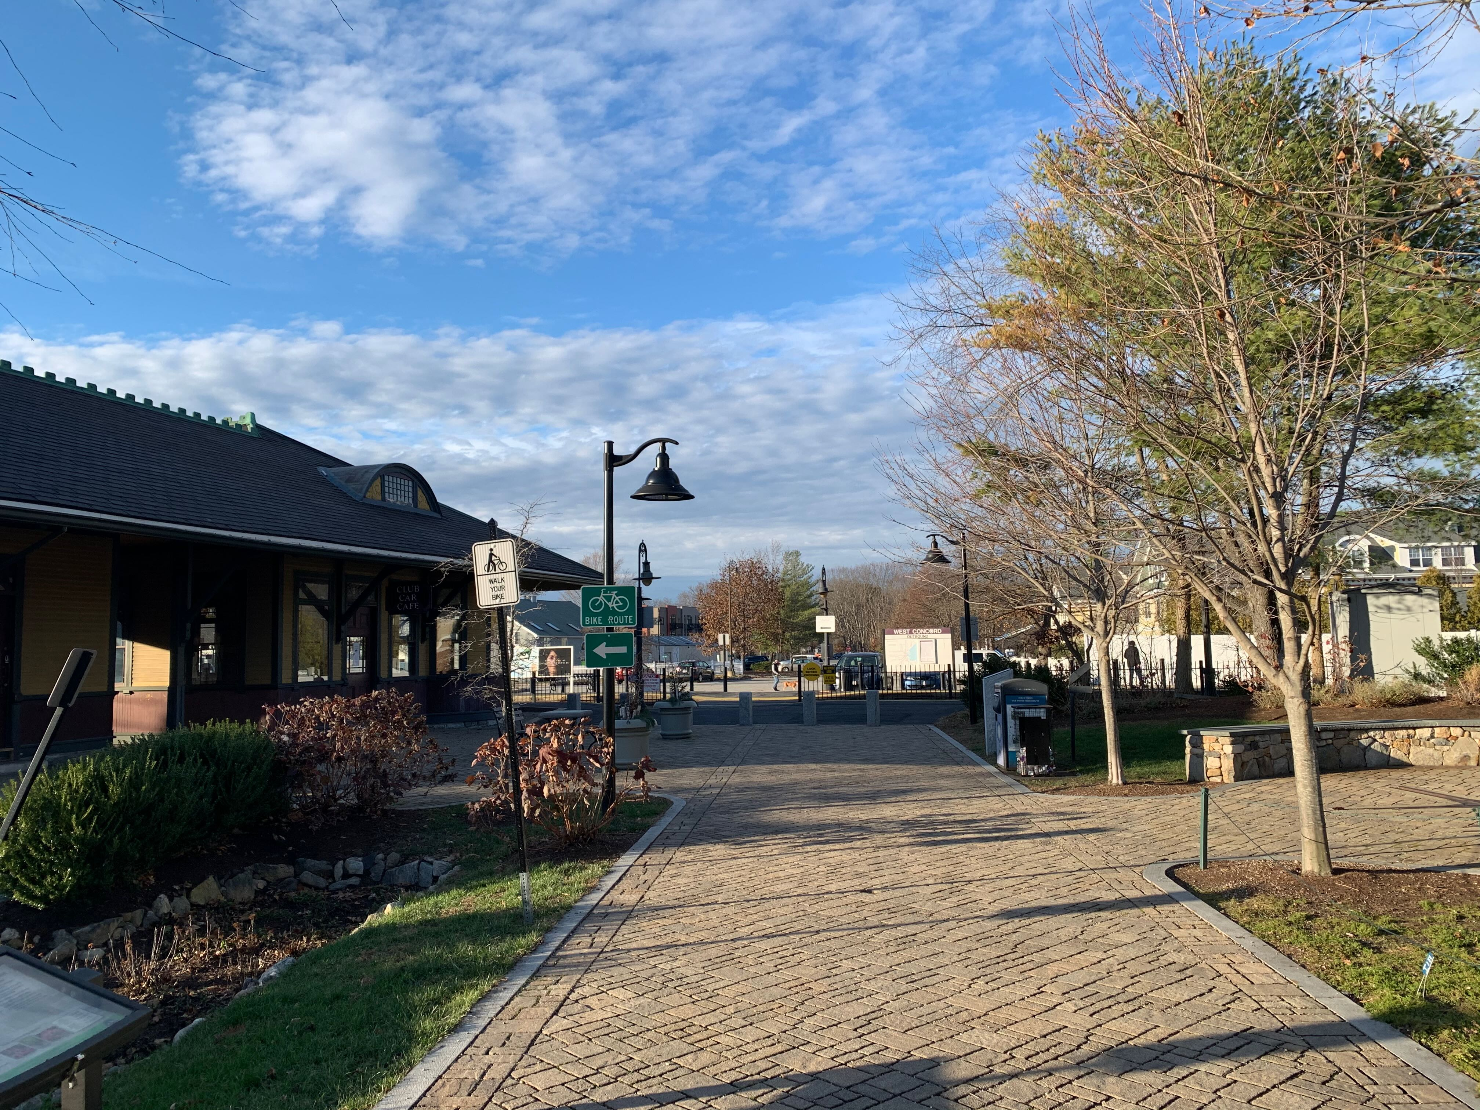


Looking North
Main path towards MBTA (club car café on left)
4

Slide 11
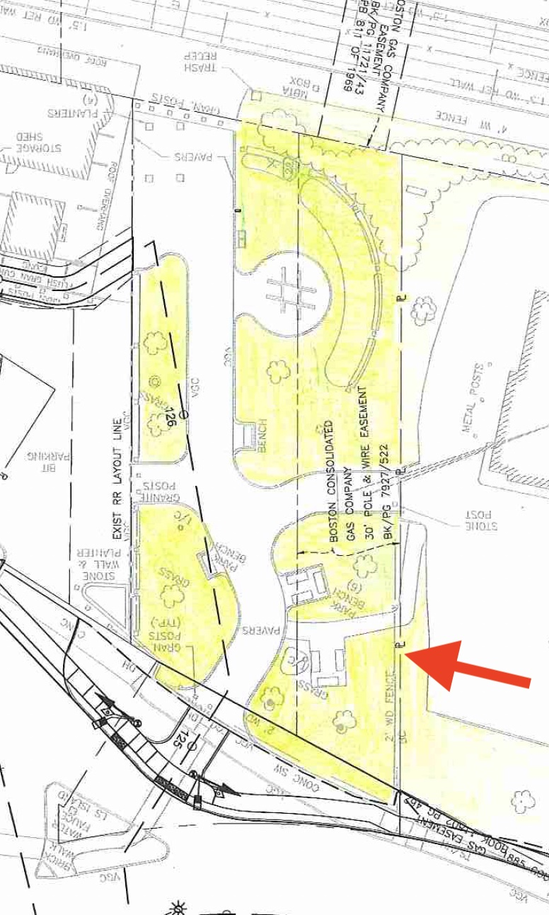
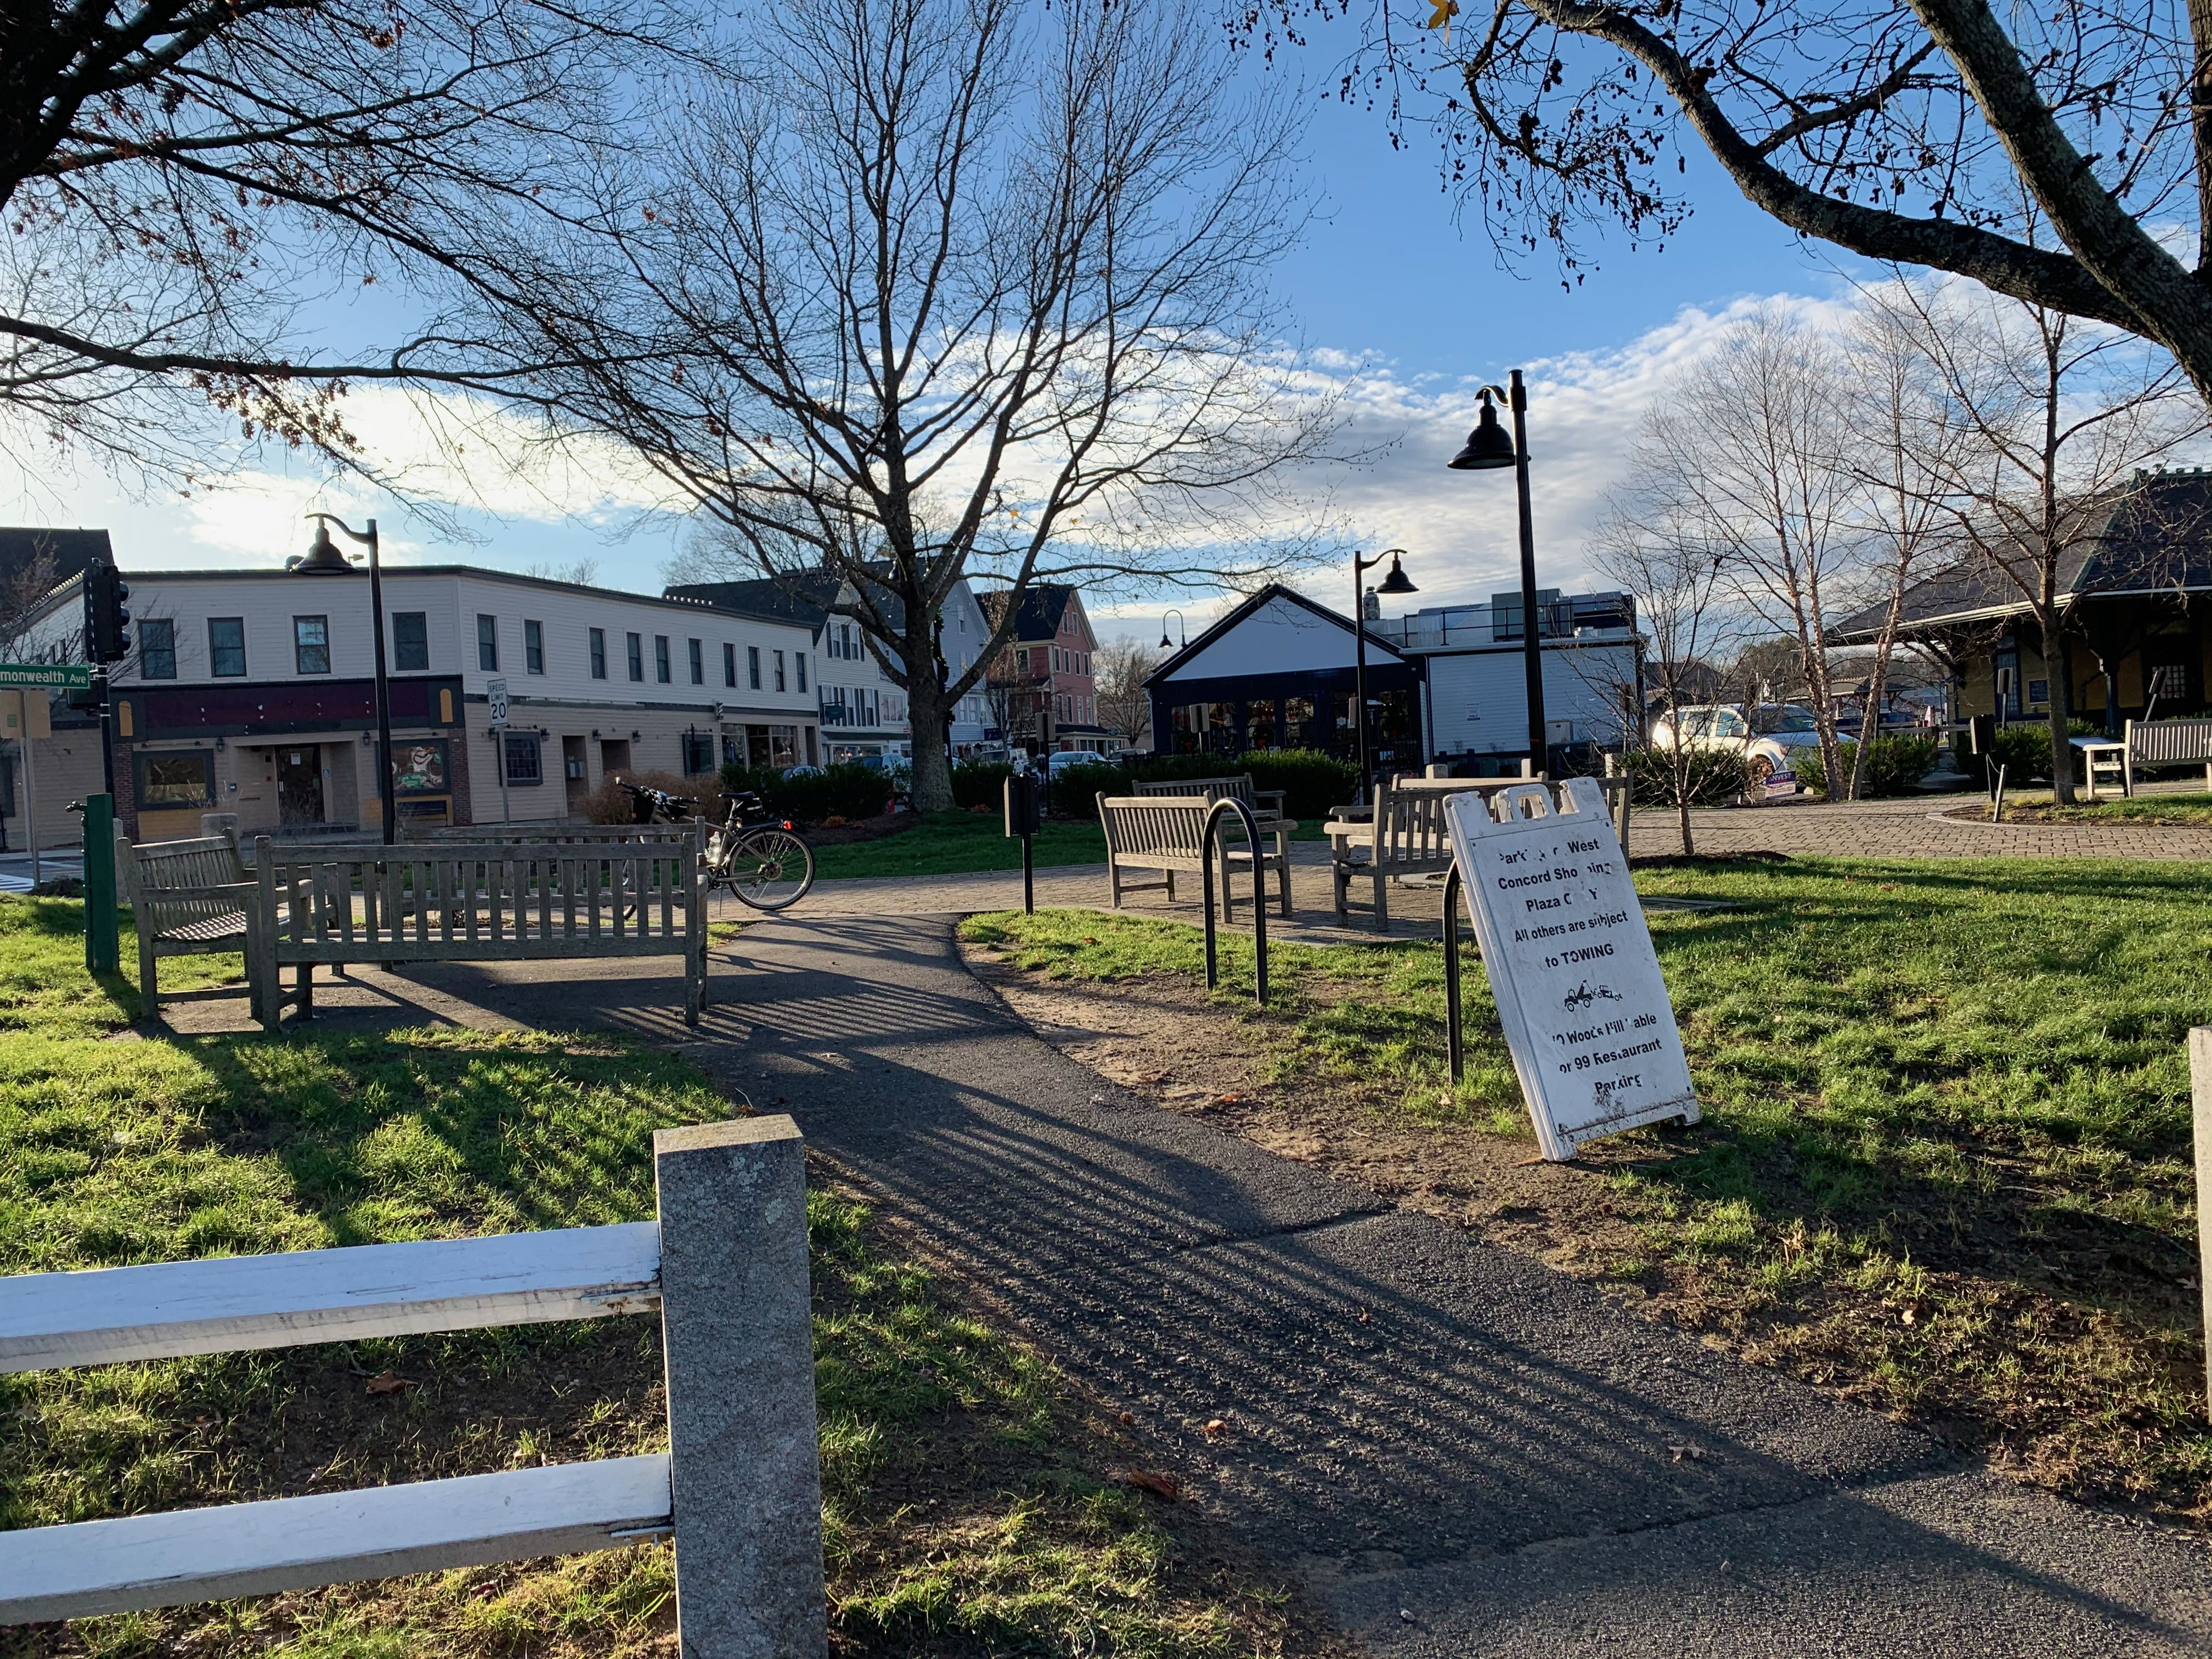
5
Looking Southwest
Path from 7-Eleven parking lot towards commonwealth avenue and junction park main entrance

Slide 12
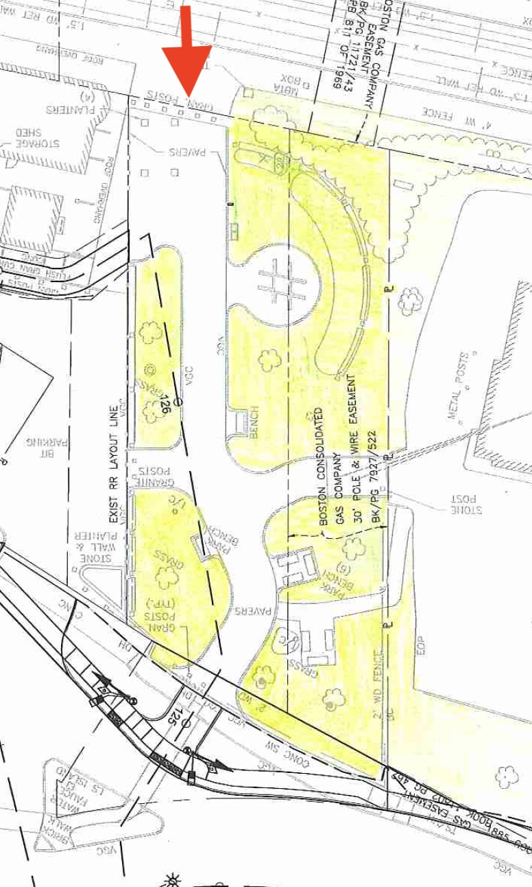
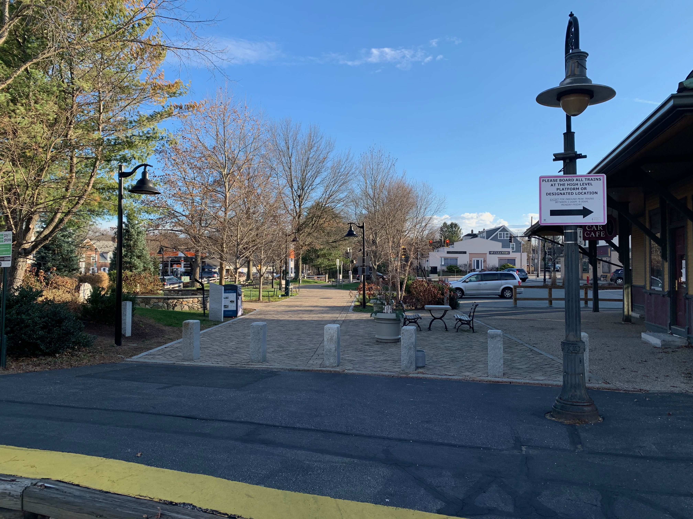
Looking South
6
View of junction park from mbta entrance (club car café on right)

Slide 13
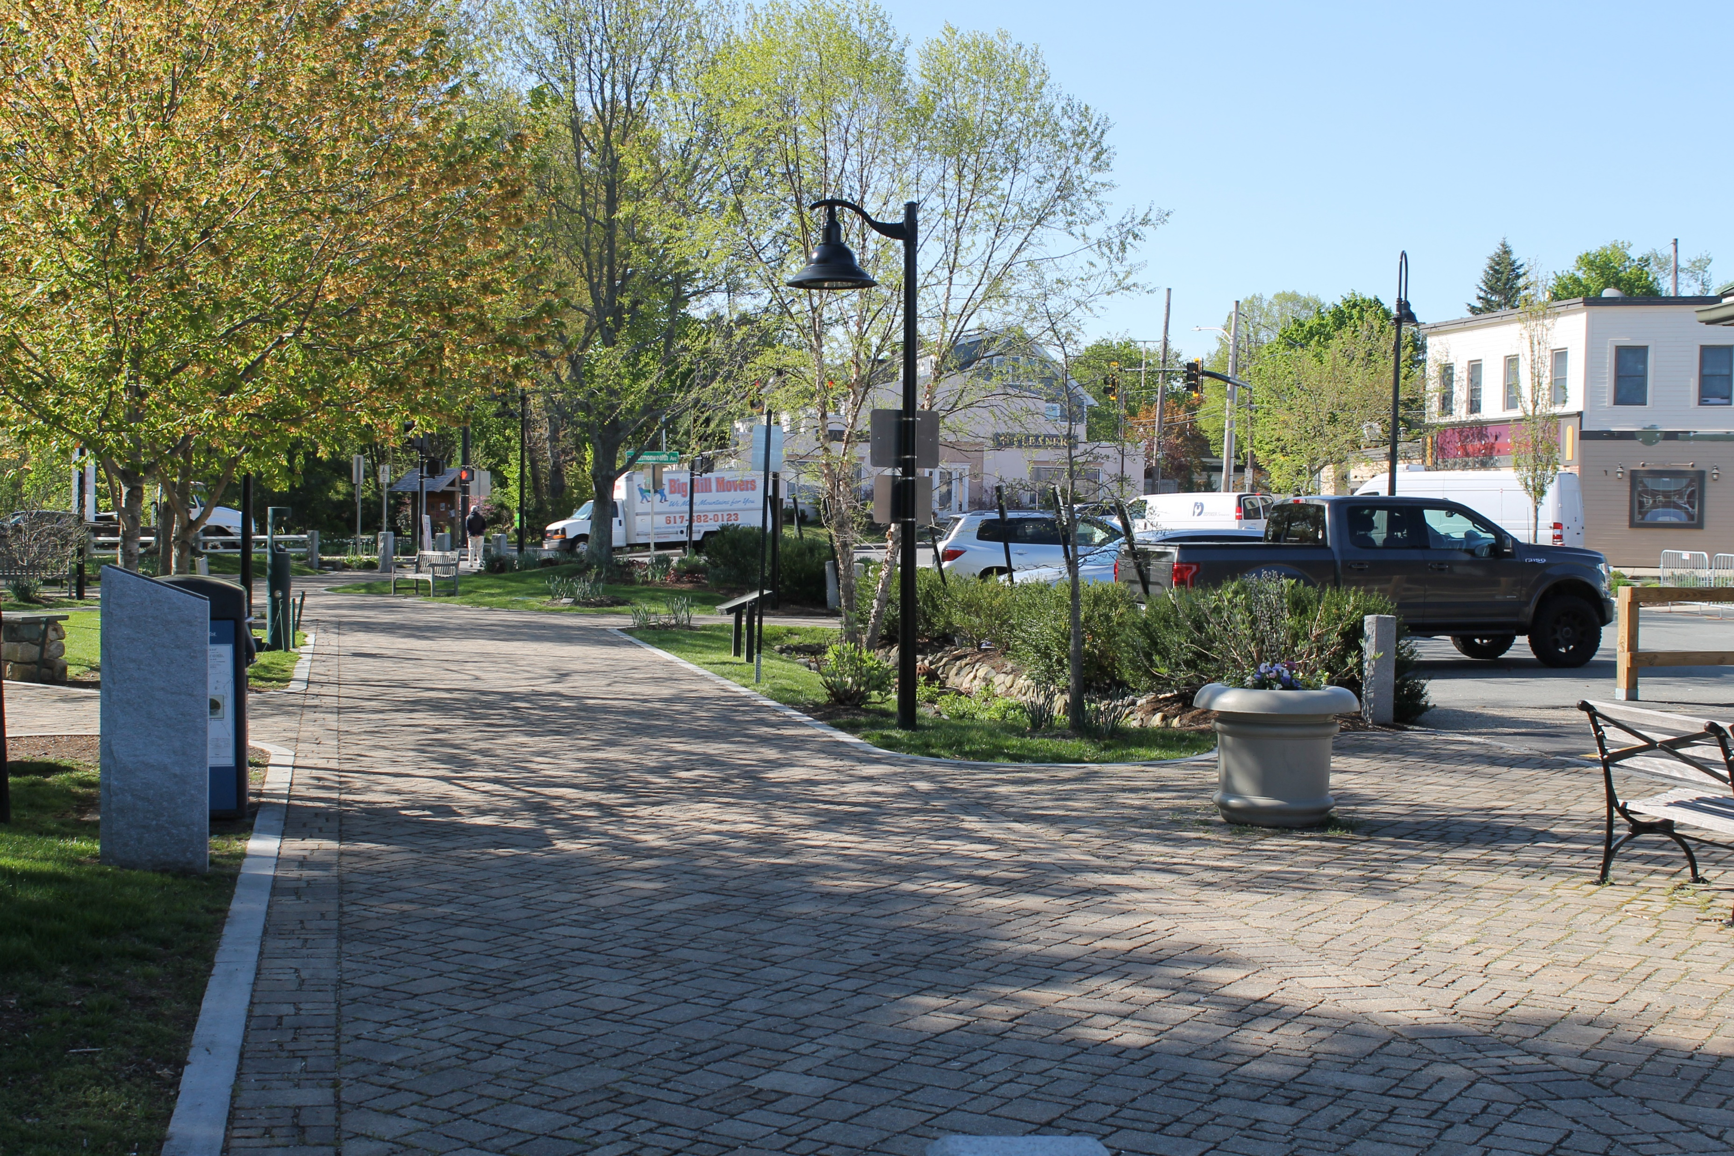
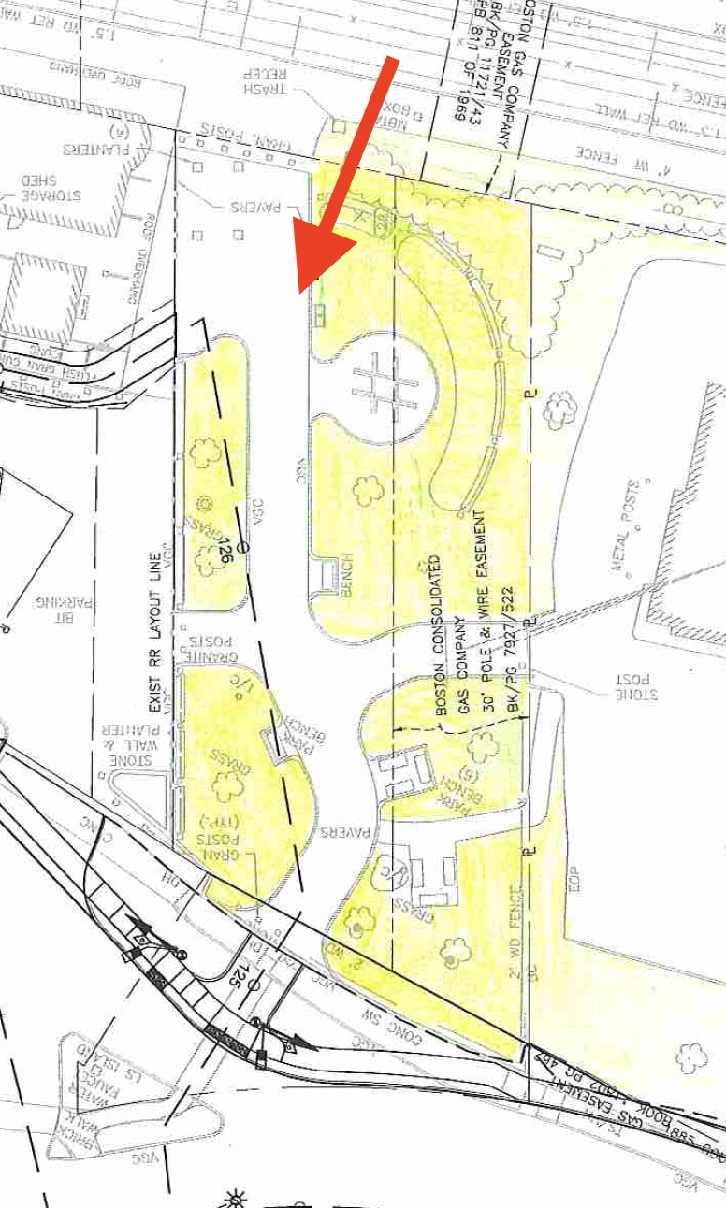
99-Restaurant
7
View from club car café seating area looking south

Slide 14
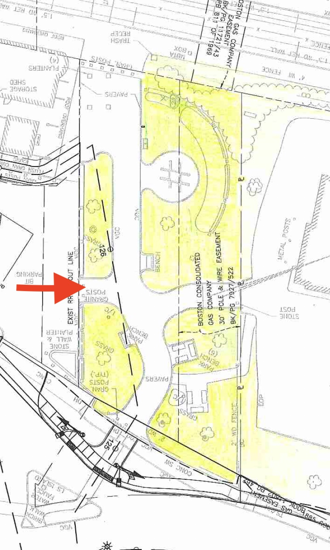
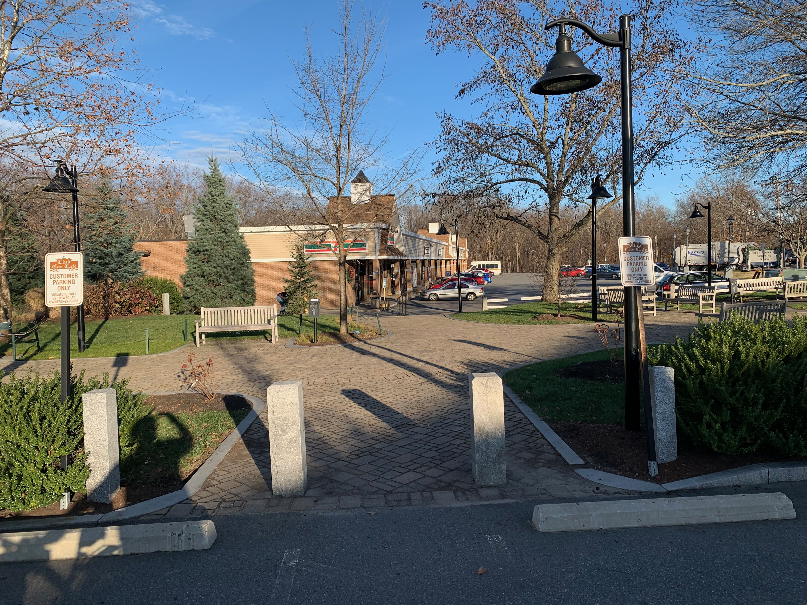
Looking east towards 7-Eleven
8
Junction park entrance from parking lot for club car cafe

Slide 15
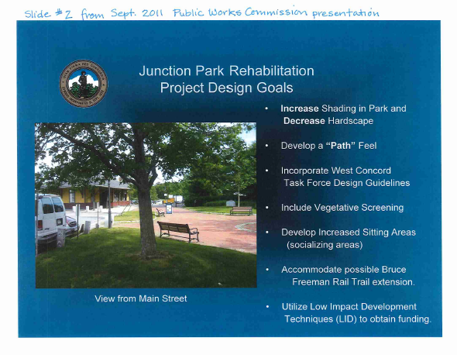
Past, Present and Future
1800’s-1900’s: Railroad right of way and/or active rail line
1980's: Rail line was abandoned and taken by MA
2000’s: The decision to build the park on the RR right of way was made
2011: Park was beautified (See right)
2018: Part of the BFRT completed in Concord
2020: Concerns raised about congestion in park and safety risks
2021: Select Board requested BFRTAC propose conceptual redesigns
July 2022: Route 2 Bridge to open
Late 2024: Last Half Mile in Concord and Sudbury portion to open.

Slide 16
Select Board Request to BFRTAC – OCT ‘21
A written recommendation to the Select Board to include:
A long term “conceptual redesign” of Junction Park To ensure the safety and separation pedestrians and those on wheels
Include a recommendation for a “short term” approach that augments signage and helps address increased ridership due to the completion of the Rt 2 Bridge in July 2022
Timing: The BFRTAC must deliver a recommendation to the Select Board no later than June 30, 2022
Short Term Solutions:
Can be implemented with limited funds, time and/or resources
Examples: better signage, adding "obstacles", adding markings, temporary barriers, more "educating" safe behaviors
Long Term Solutions:
Require more funding, time, resources and/or community involvement
Examples: rerouting pedestrian or rail trail traffic, changing landscaping, etc.

Slide 17
Actions to Date
October 2021: BFRTAC tasked with conceptual redesign
November 2021: Site Walk
December 2021: Key principles and approach developed
January 2022: Subcommittee appointed, held weekly meetings
February 2021: Survey Launched to gather community input
February 16, 2022: First Public forum

Slide 18
Junction Park: Survey Results

Slide 19
Junction Park Survey Results: Overview
Survey comprised 10 questions with 3 comment questions
566 responses including paper surveys as of 2/15/22
90% are Concord residents
11% of respondents are under 40, 37% are 40 – 60 years old, and almost 50% are over 60
We received almost 850 comments across three questions
All data and a copy of the analysis to date will be posted after online survey closes on February 18, 2022
Notes:
To be updated by Nat

Slide 20
Junction Park Survey Results: Usage
13% visit daily, 42% weekly, and 21% monthly
84% of respondents are passing through to get to businesses or the rail trail. Just 5% are heading to the park and 3% are commuters
Transportation "Mode" (multiple answers allowed) Top 5 are
Walking (58%)
Walking & Biking (19%)
Biking (13%)
Walking & Pushing Stroller (2%)
Pushing stroller (under 1%)
All others (8%)
Frequency of observed riding:
63% report seeing people riding 50% or less of the time
32% report seeing people riding between 50% and all the time
5% left blank
Notes:
To be updated by Nat

Slide 21
Junction Park Survey Results: Other
47% support major structural changes while 36% do not support and 17% left the question blank. Comments indicate they want more info on what comprises a "major structural change.
A quick and unscientific survey of comments surfaced the following themes:
While 20% of respondents to question 10 said there was a safety issue, another than 30% of respondents said the park was safe or there is no issue.
Across all 3 questions there is a lot of support and ideas for improved signage, trail markings (e.g. like the Freedom Trail), and barriers
The MBTA crossing is a significant issue for including safety and security of users as well as confusion about where the BFRT path actually goes (15% don’t know).

Slide 22
Illustrative (and incomplete) Survey Themes
Small, congested space with people moving at different speeds and in different directions
No barriers around train tracks
No notification that a train is coming
TWCGT have done an amazing job of landscaping and maintaining a special space in west concord
Lack of clarity on where rail trail goes
No clear path for the rail trail; Some not even aware the rail trail passes through the park
Bicyclists and walkers do not always agree on how safe it is
Concern about cars entering commuter parking lot where rail trail crosses
Concern about cars turning right at Commonwealth Ave rail trail intersection
Tables/planters in the way & there needs to be more tables and planters to slow people down
Dogs not on leashes
Kids running around, people hanging around
People not walking straight / walking side by side
Poor lighting
Congestive not conducive to calm park experience
People funneled to Junction Park only because there is no crossing on Main Street
Some pedestrians fear cyclists who don’t dismount and skateboarders and rollerbladers
Cyclists slow down to safely avoid pedestrians
It is inconvenient and sometimes difficult for cyclists to dismount
Some cyclists use street to avoid dismounting; some will not use trail if dismounting enforced?
Questions around need for and cost of major structural changes to the park
Not a problem – it's perfectly safe

Slide 23
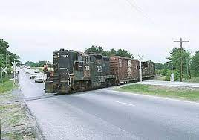
Junction Park: Public input

Slide 24
Key Problems to Address
Safety concerns due to:
Congestion due to size & layout of park
Lack of clarity on BFRT route
Convergence of people on and off wheels
Safety of MBTA crossing

Slide 25
Short Term Concepts
Help mediate the risk of some or all of the key problems
Keep the current layout of the park
Clarify where the rail trail is for riders and where pedestrian/park areas are for pedestrians
Increase safety with less expensive, more easily implemented measures
Examples of Possible Solutions:
Add signage to clarify where rail trail goes including pavement markings
Use "signifiers to visually show or direct people where to go (markings signs) or not to go (planters / fences / landscaping)
Regulate speed through the park
Notes:
Short Term Solutions:
Can be implemented with limited funds, time and/or resources
Examples: signage, moving planters, adding markings, educating people on safe behaviors
Long Term Solutions:
Require more funds, time, resources and/or discussion
Examples: rerouting pedestrian or rail trail traffic, changing landscaping, etc.

Slide 26
Long Term Conceptual Redesign Ideas
Mediate and resolve all key problems
Clarify where the rail trail is and where pedestrian/park areas are
Physically and safely separate the rail trail users from other Junction Park users
Examples of Possible Solutions fall into 3 categories::
Take land from MBTA property to West of park
Take west side of park and create separate bike path through current landscaped areas and add landscaping elsewhere
Use existing path to create separate bike lane and expand or add pedestrian pathways elsewhere in the park as needed and create/restore landscaping
A separate recommendation will concern the MBTA Crossing
Add visual and/or physical barrier before tracks (stacked fencers, gate, planters, etc.)
Add flashing lights with gate
Notes:
Short Term Solutions:
Can be implemented with limited funds, time and/or resources
Examples: signage, moving planters, adding markings, educating people on safe behaviors
Long Term Solutions:
Require more funds, time, resources and/or discussion
Examples: rerouting pedestrian or rail trail traffic, changing landscaping, etc.

Slide 27
Public Discussion Guidelines
Please state your name and address
Please state what your comments relate to (clarification, feedback or new idea)
Please keep your comments to 2 minutes or less
Comments that require follow up will be recorded and addressed.
Discuss short term concepts first – then long term
Email any ideas/questions to bfrtac@concordma.gov
Notes:
Short term discussion
Long term discussion

Slide 28
Short Term Concepts
Examples of Possible Solutions:
Add signage to clarify where rail trail goes including pavement markings
Use "signifiers to visually show or direct people where to go (markings signs) or not to go (planters / fences / landscaping)
Regulate speed through the park
Some possible questions to get the discussion started (or bring your own):
What ideas appeal to you and why?
What doesn't appeal and why?
What ideas are missing from this discussion of short term Concepts?
Who is a person that knows something that would be helpful to the Committee's work?
Notes:
Short Term Solutions:
Can be implemented with limited funds, time and/or resources
Examples: signage, moving planters, adding markings, educating people on safe behaviors
Long Term Solutions:
Require more funds, time, resources and/or discussion
Examples: rerouting pedestrian or rail trail traffic, changing landscaping, etc.

Slide 29
Long Term Conceptual Redesign Ideas
Examples of Possible Solutions fall into 3 categories::
Take land from MBTA property to West of park
Take west side of park and create separate bike path
Use existing path for separate bike lane and add pedestrian paths elsewhere
A separate recommendation will concern the MBTA Crossing
Add visual and/or physical barrier before tracks
Some possible questions to get the discussion started (or bring your own):
What ideas appeal to you and why?
Waht are your thoughts about "major structural change" and why?
What ideas are missing from this discussion ?
Who is a person that knows something that would be helpful to the Committee's work?
Notes:
Short Term Solutions:
Can be implemented with limited funds, time and/or resources
Examples: signage, moving planters, adding markings, educating people on safe behaviors
Long Term Solutions:
Require more funds, time, resources and/or discussion
Examples: rerouting pedestrian or rail trail traffic, changing landscaping, etc.

Slide 30
Next Steps
BFRTAC will review the feedback from this forum and schedule additional meetings
Please send any comments, questions, or other information to BFRTAC@concordma.gov
The next meeting of the full BFRTAC is March 3, 2022 at 7PM – Location TBA

Slide 31
Thank you
Notes:
179

