Slide 1

Junction Park Conceptual Redesign Project
Public Forum #1, February 16, 2022
Sponsored by the Bruce Freeman Rail Trail Advisory Committee
BFRTAC@concordma.gov

Slide 2
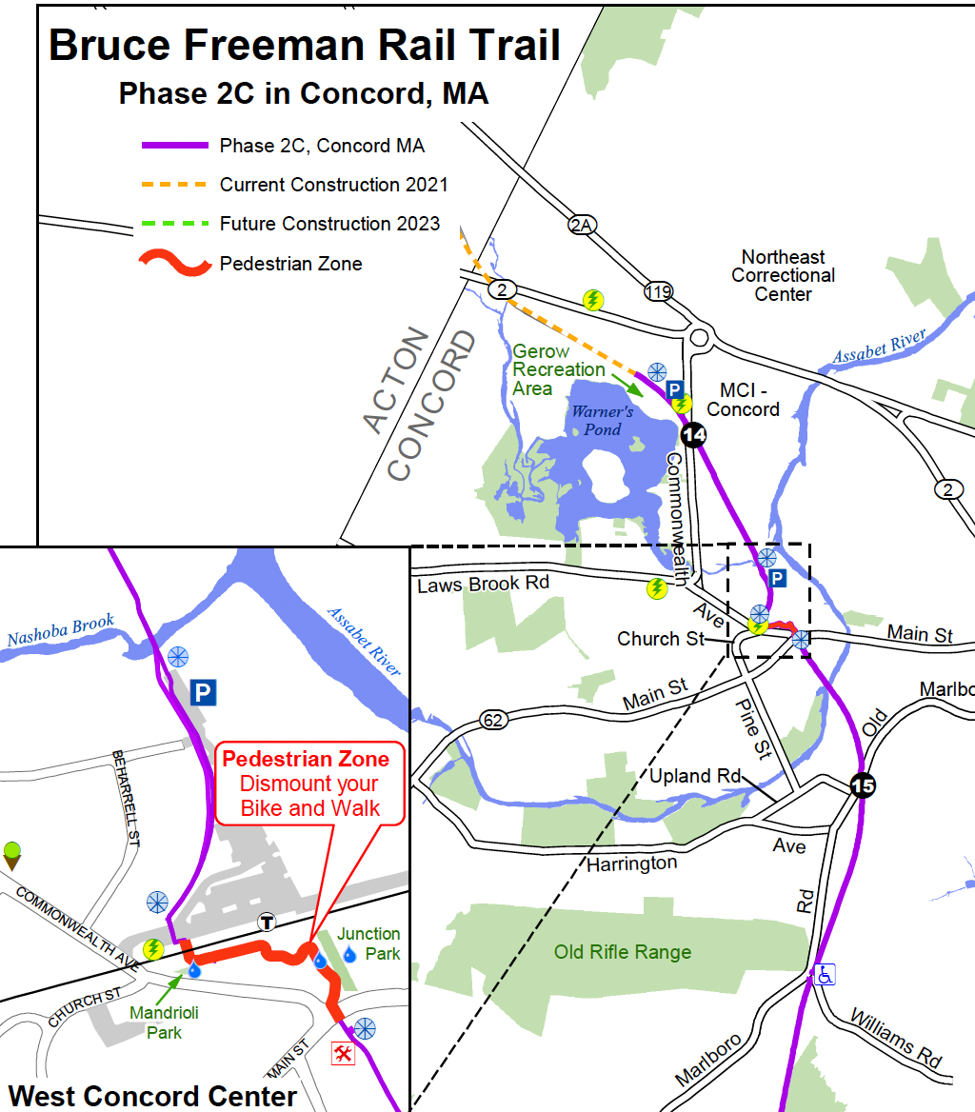
BFRT in Concord
1
Phase 2C partially completed in 2018 but not connected to the rest of the Trail which terminates in Lowell
The Route 2 Bridge opens July 2022 (see star)
The bridge will connect to the full trail will increased rail trail traffic in West Concord

Slide 3
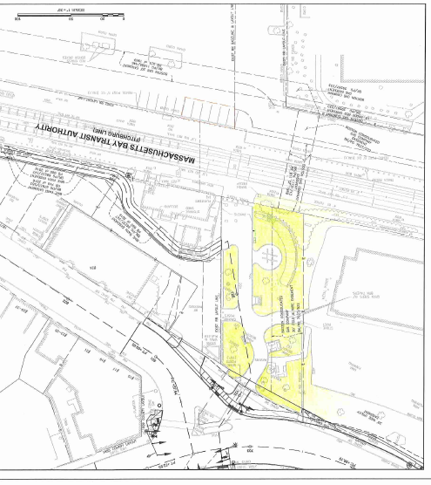
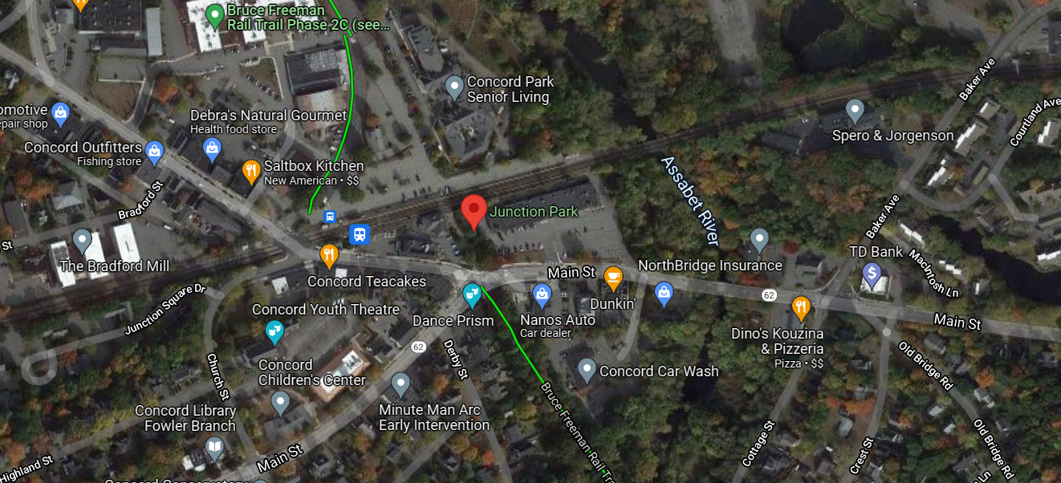
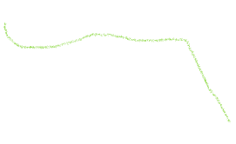

Where is Junction Park?
2

Slide 4
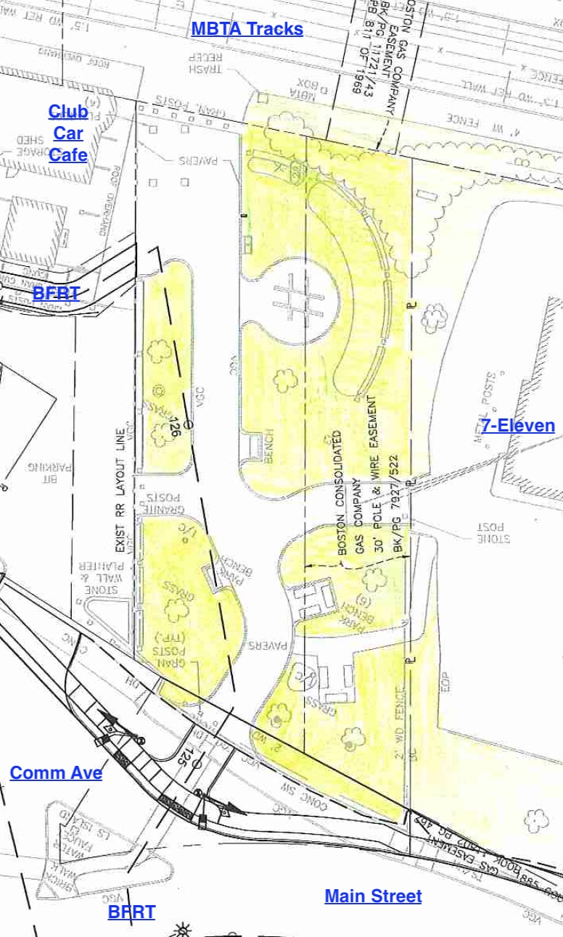
Orienting
2a
North
West
East
South

Slide 5
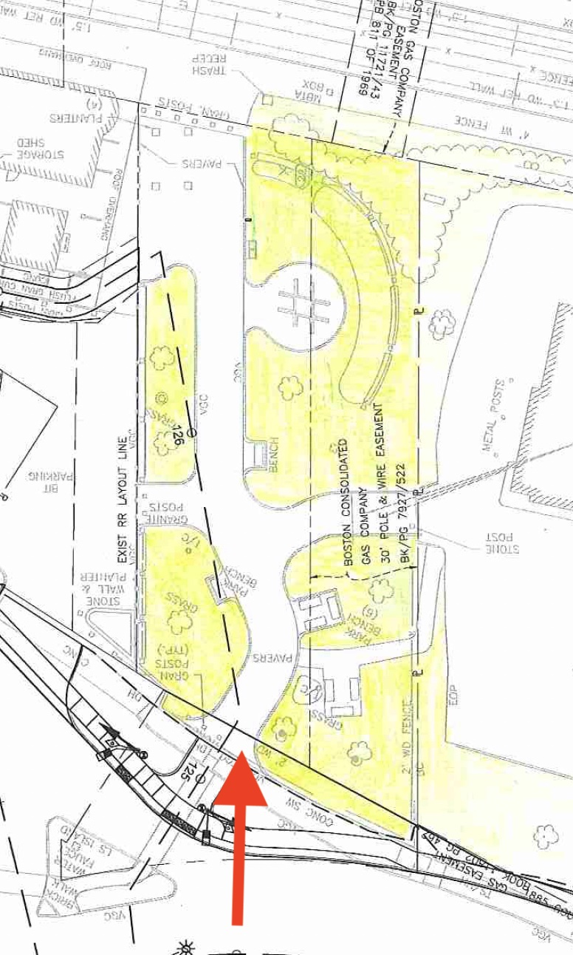
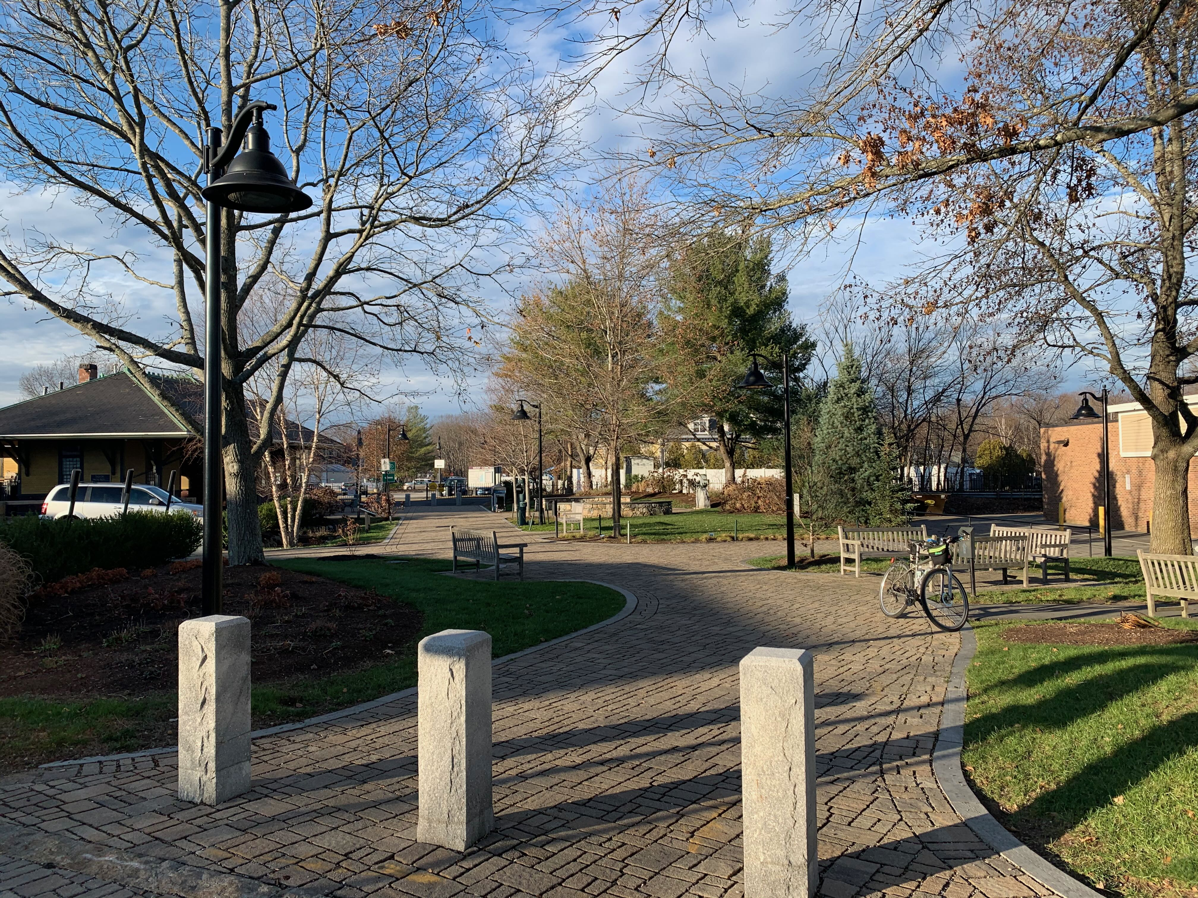
View from Commonwealth Avenue looking North
3
Main entrance of junction park

Slide 6
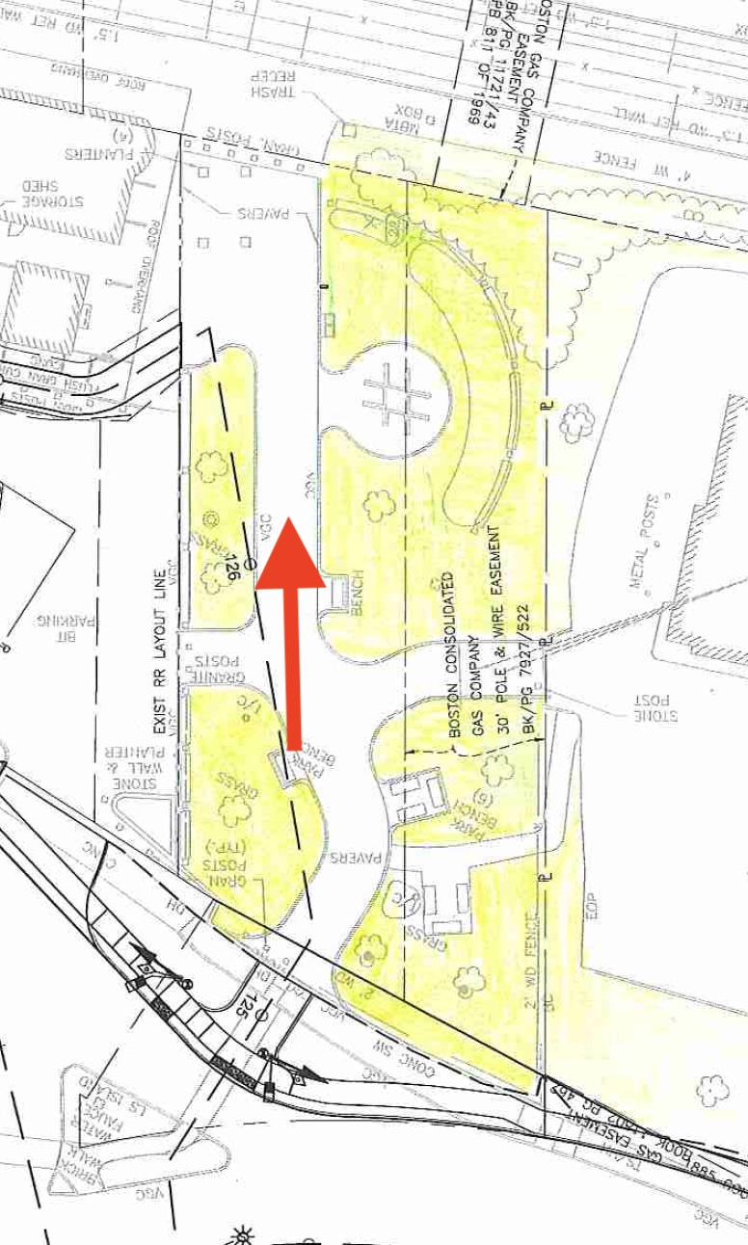
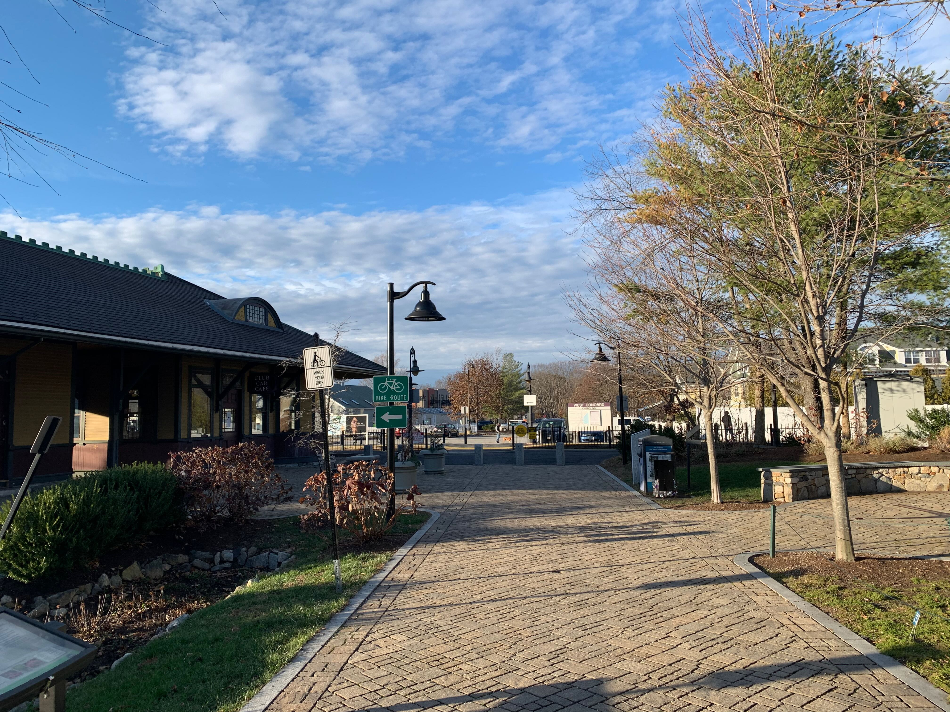


Looking North
Main path towards MBTA (club car café on left)
4

Slide 7
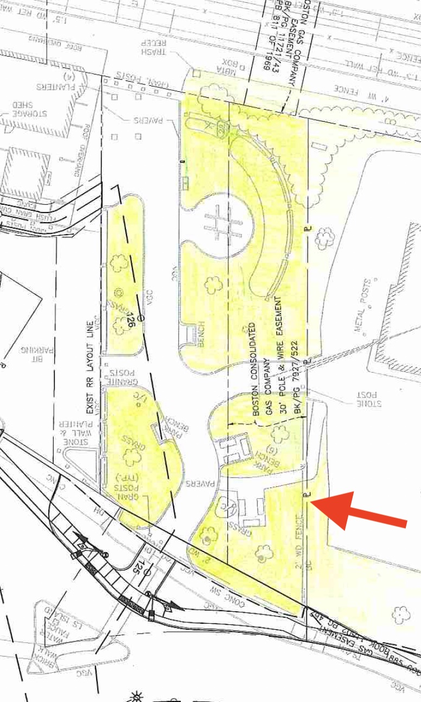
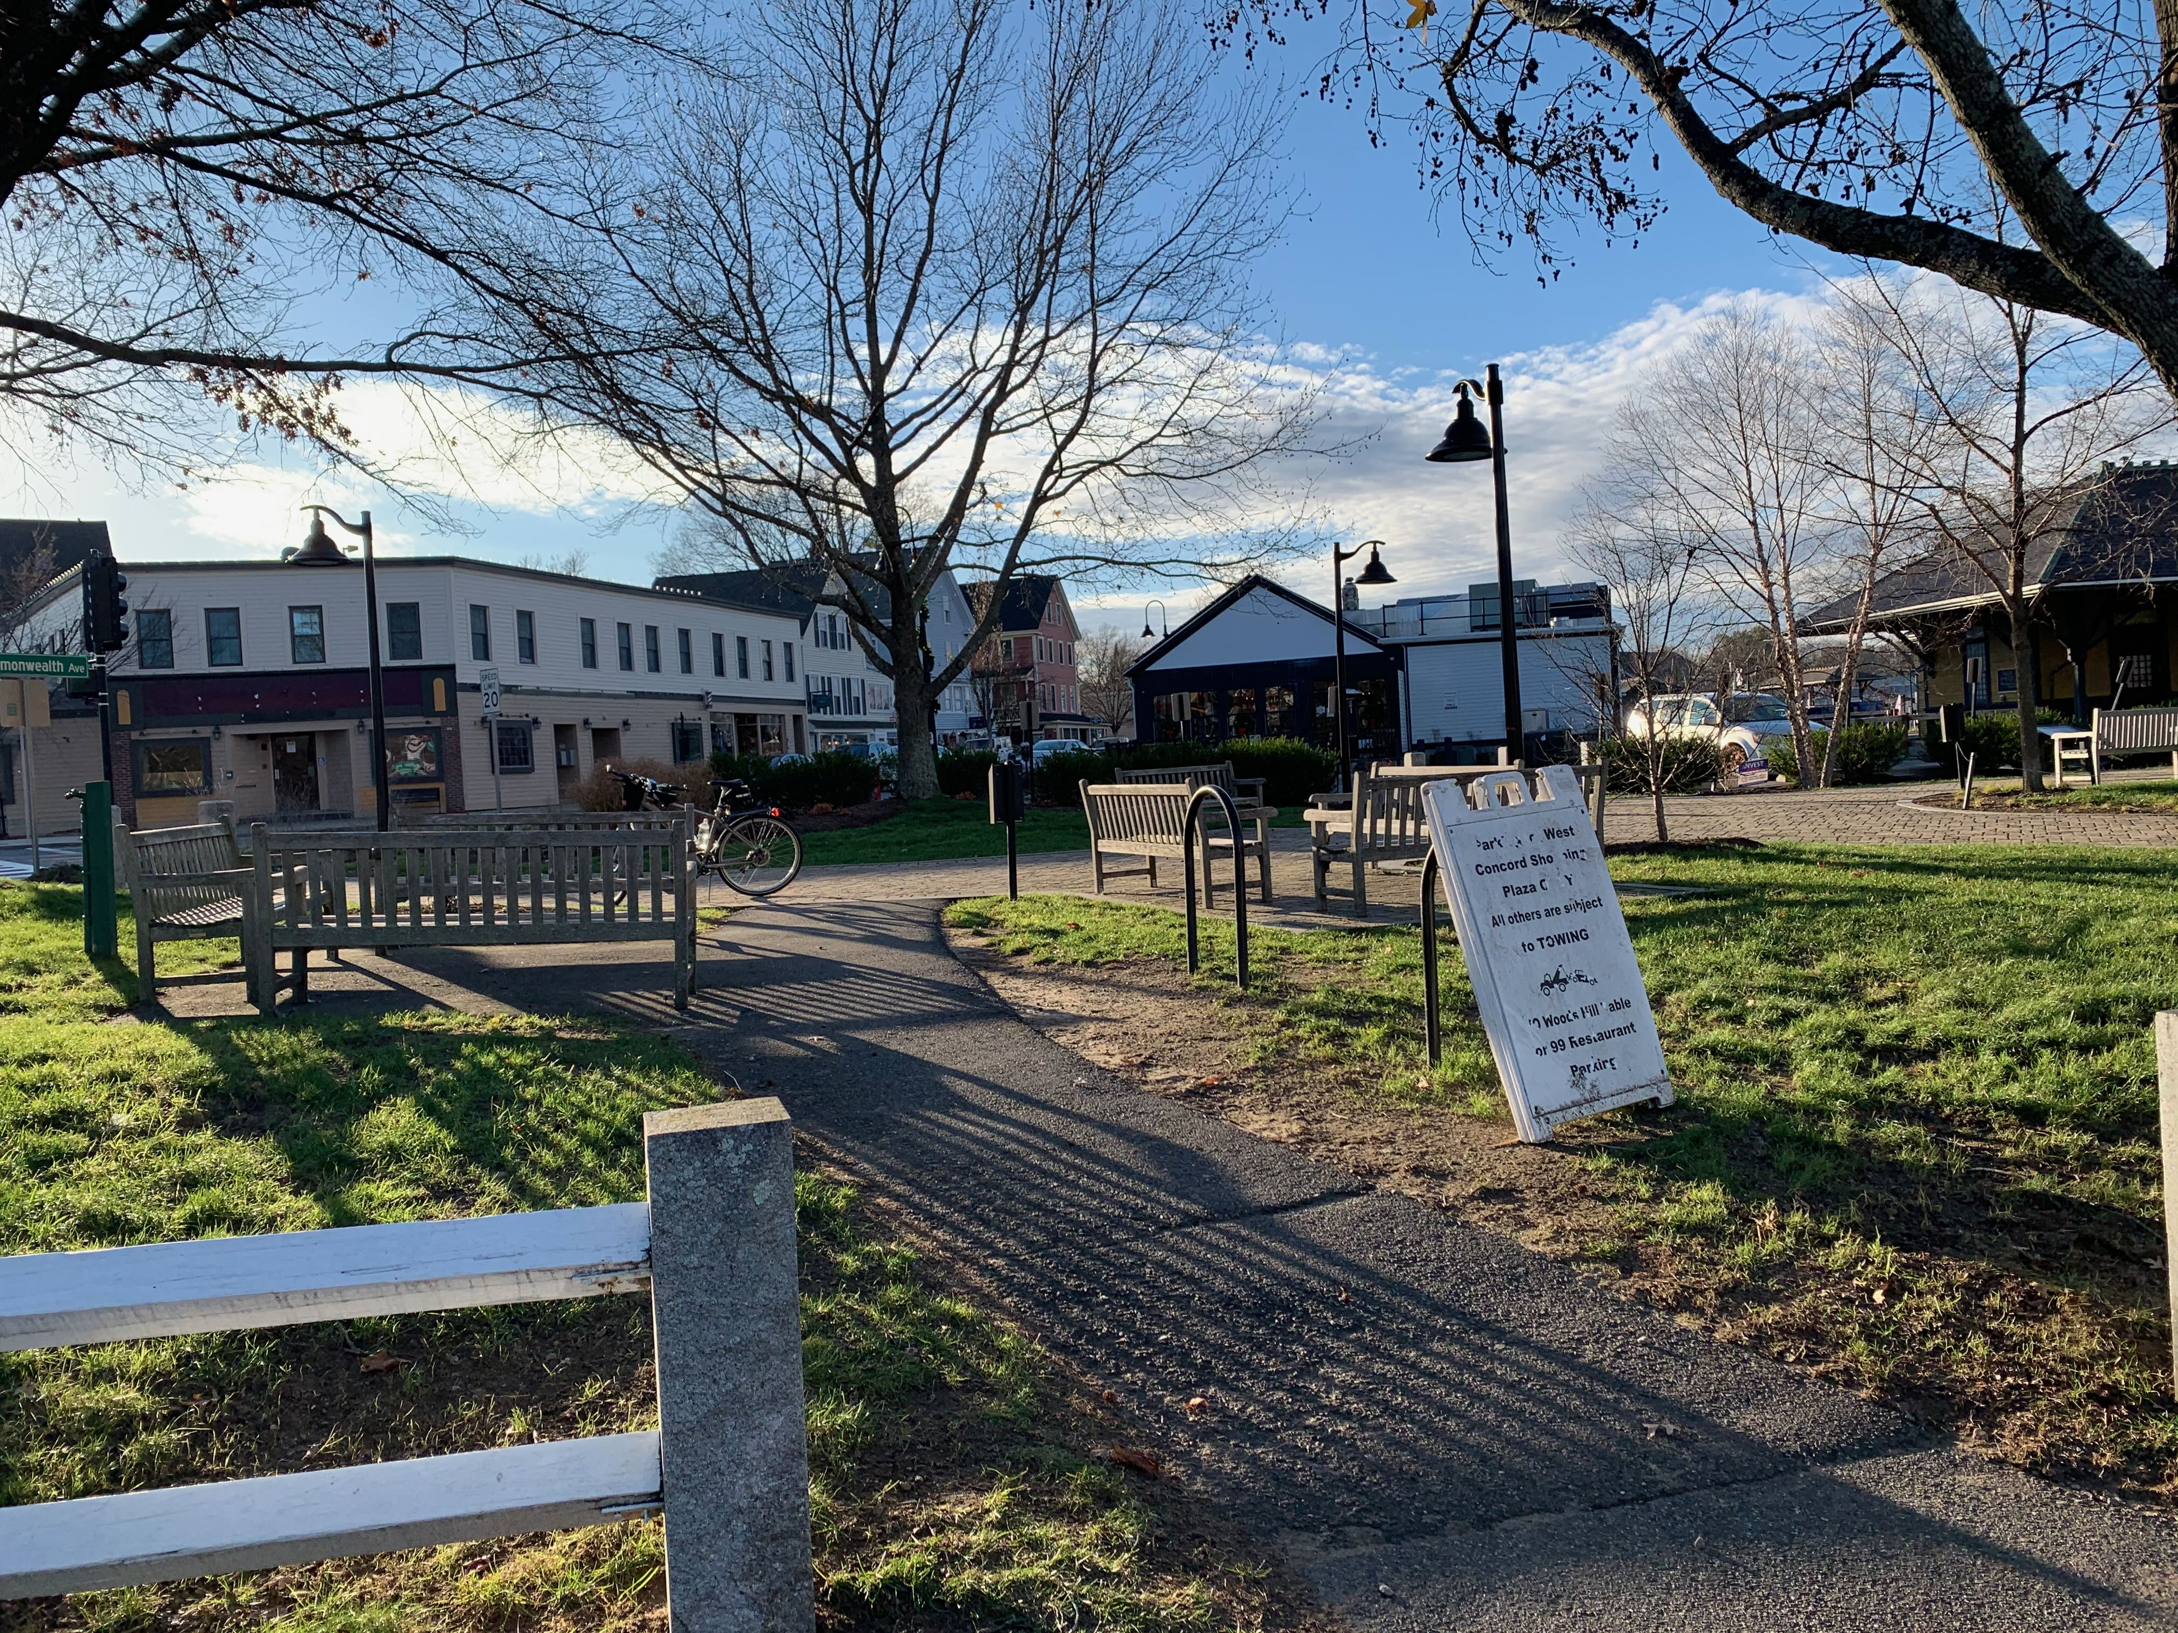
5
Looking Southwest
Path from parking lot with 7-Eleven looking towards commonwealth avenue and junction park main entrance

Slide 8
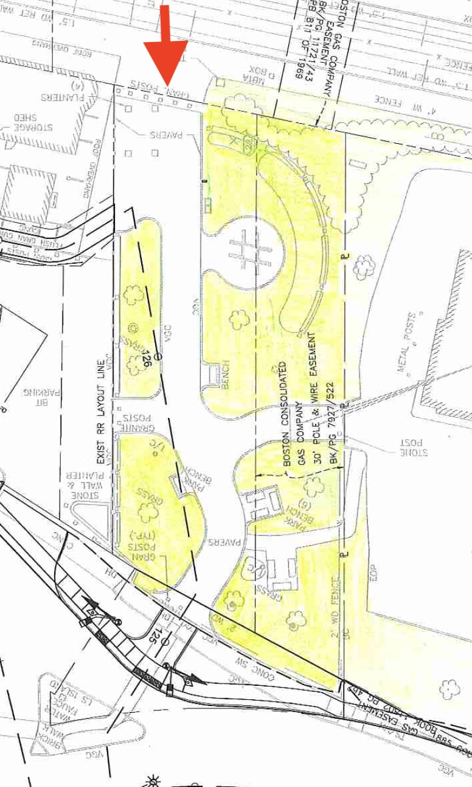
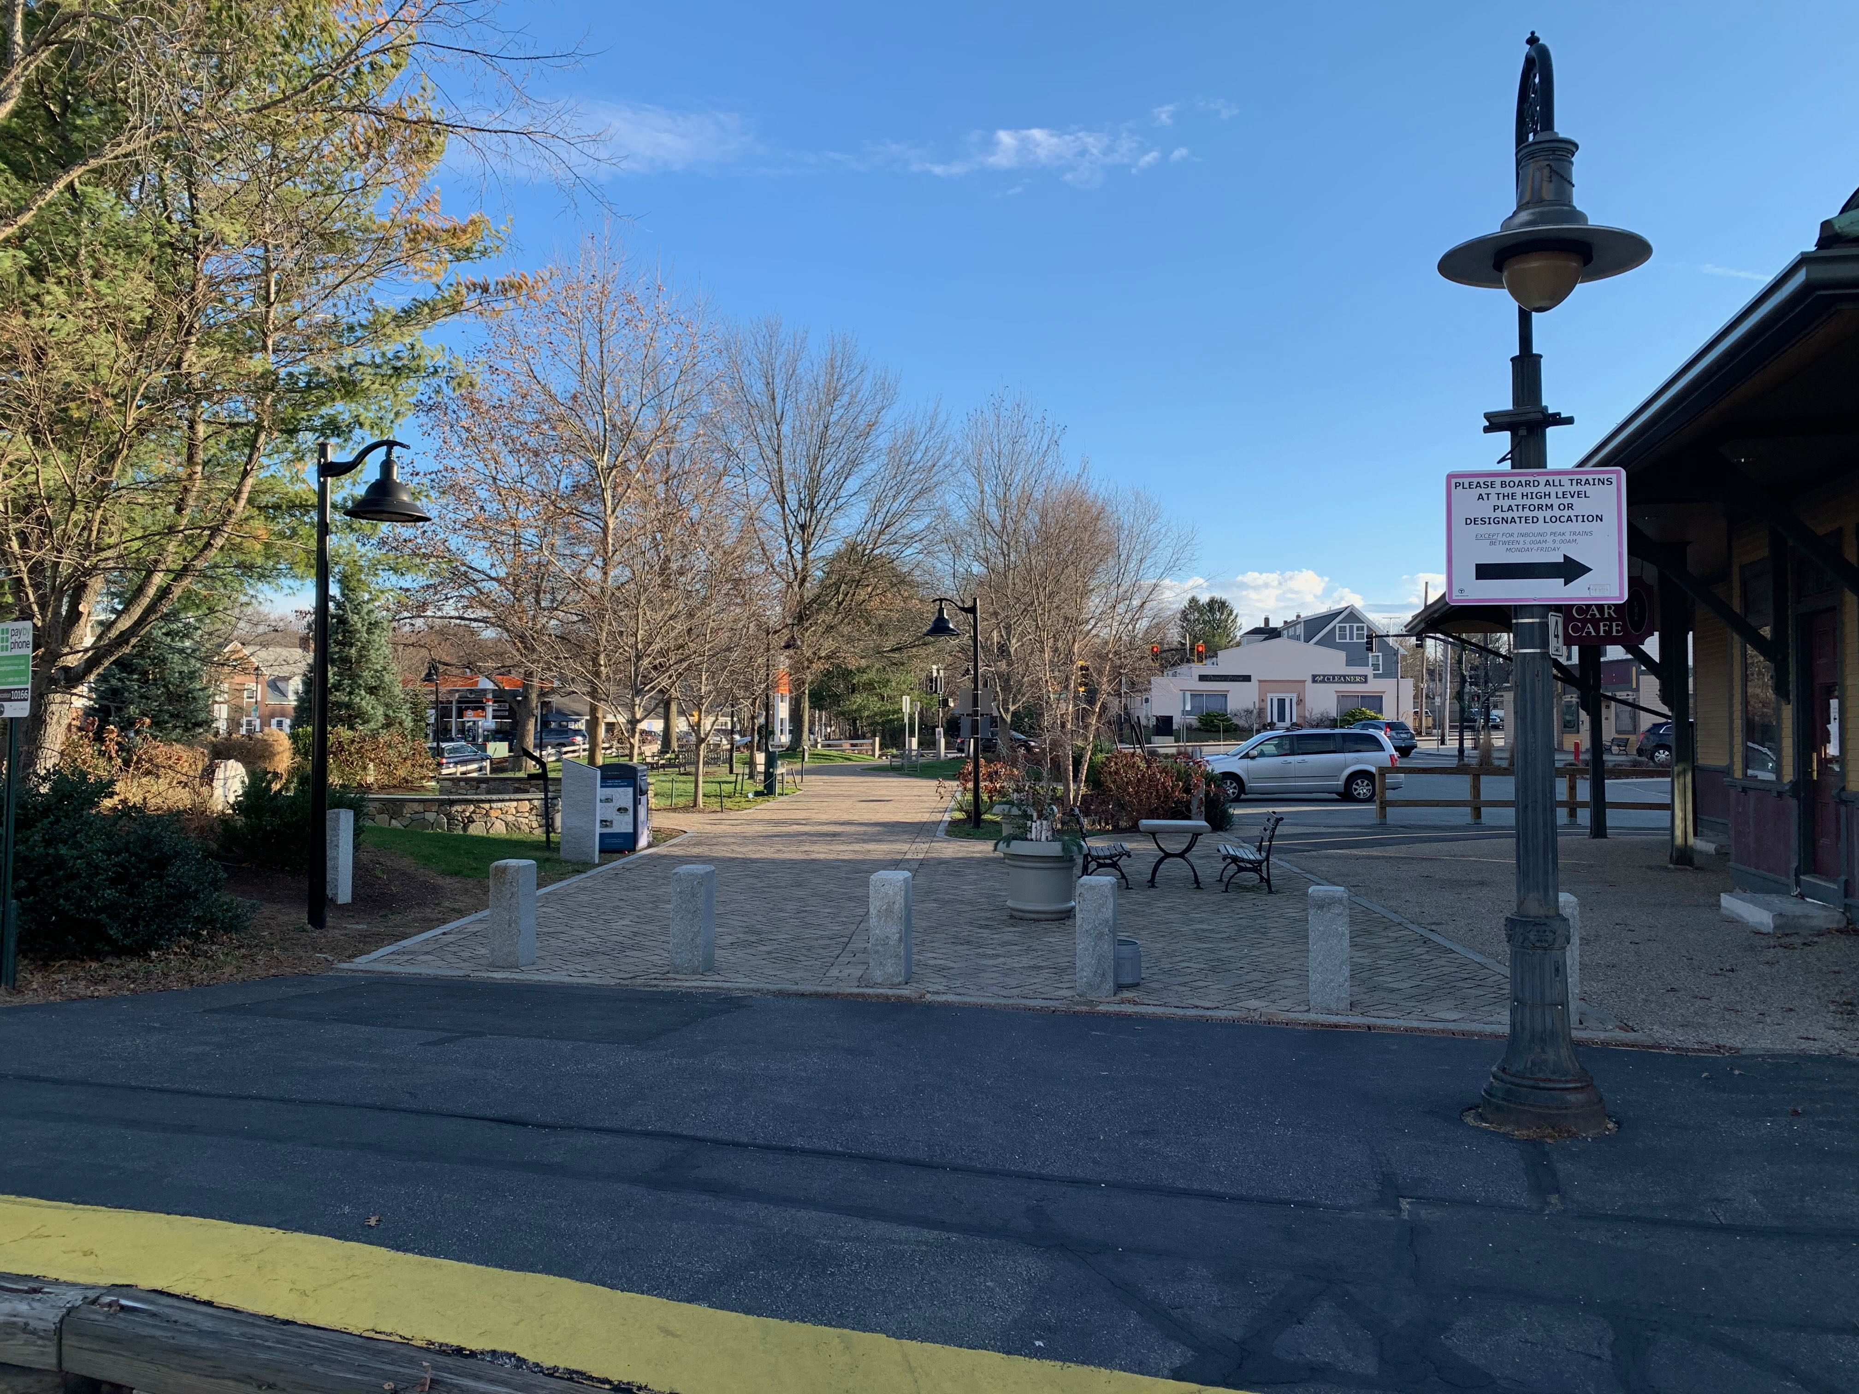
Looking South
6
View of junction park from mbta entrance (club car café on right)

Slide 9
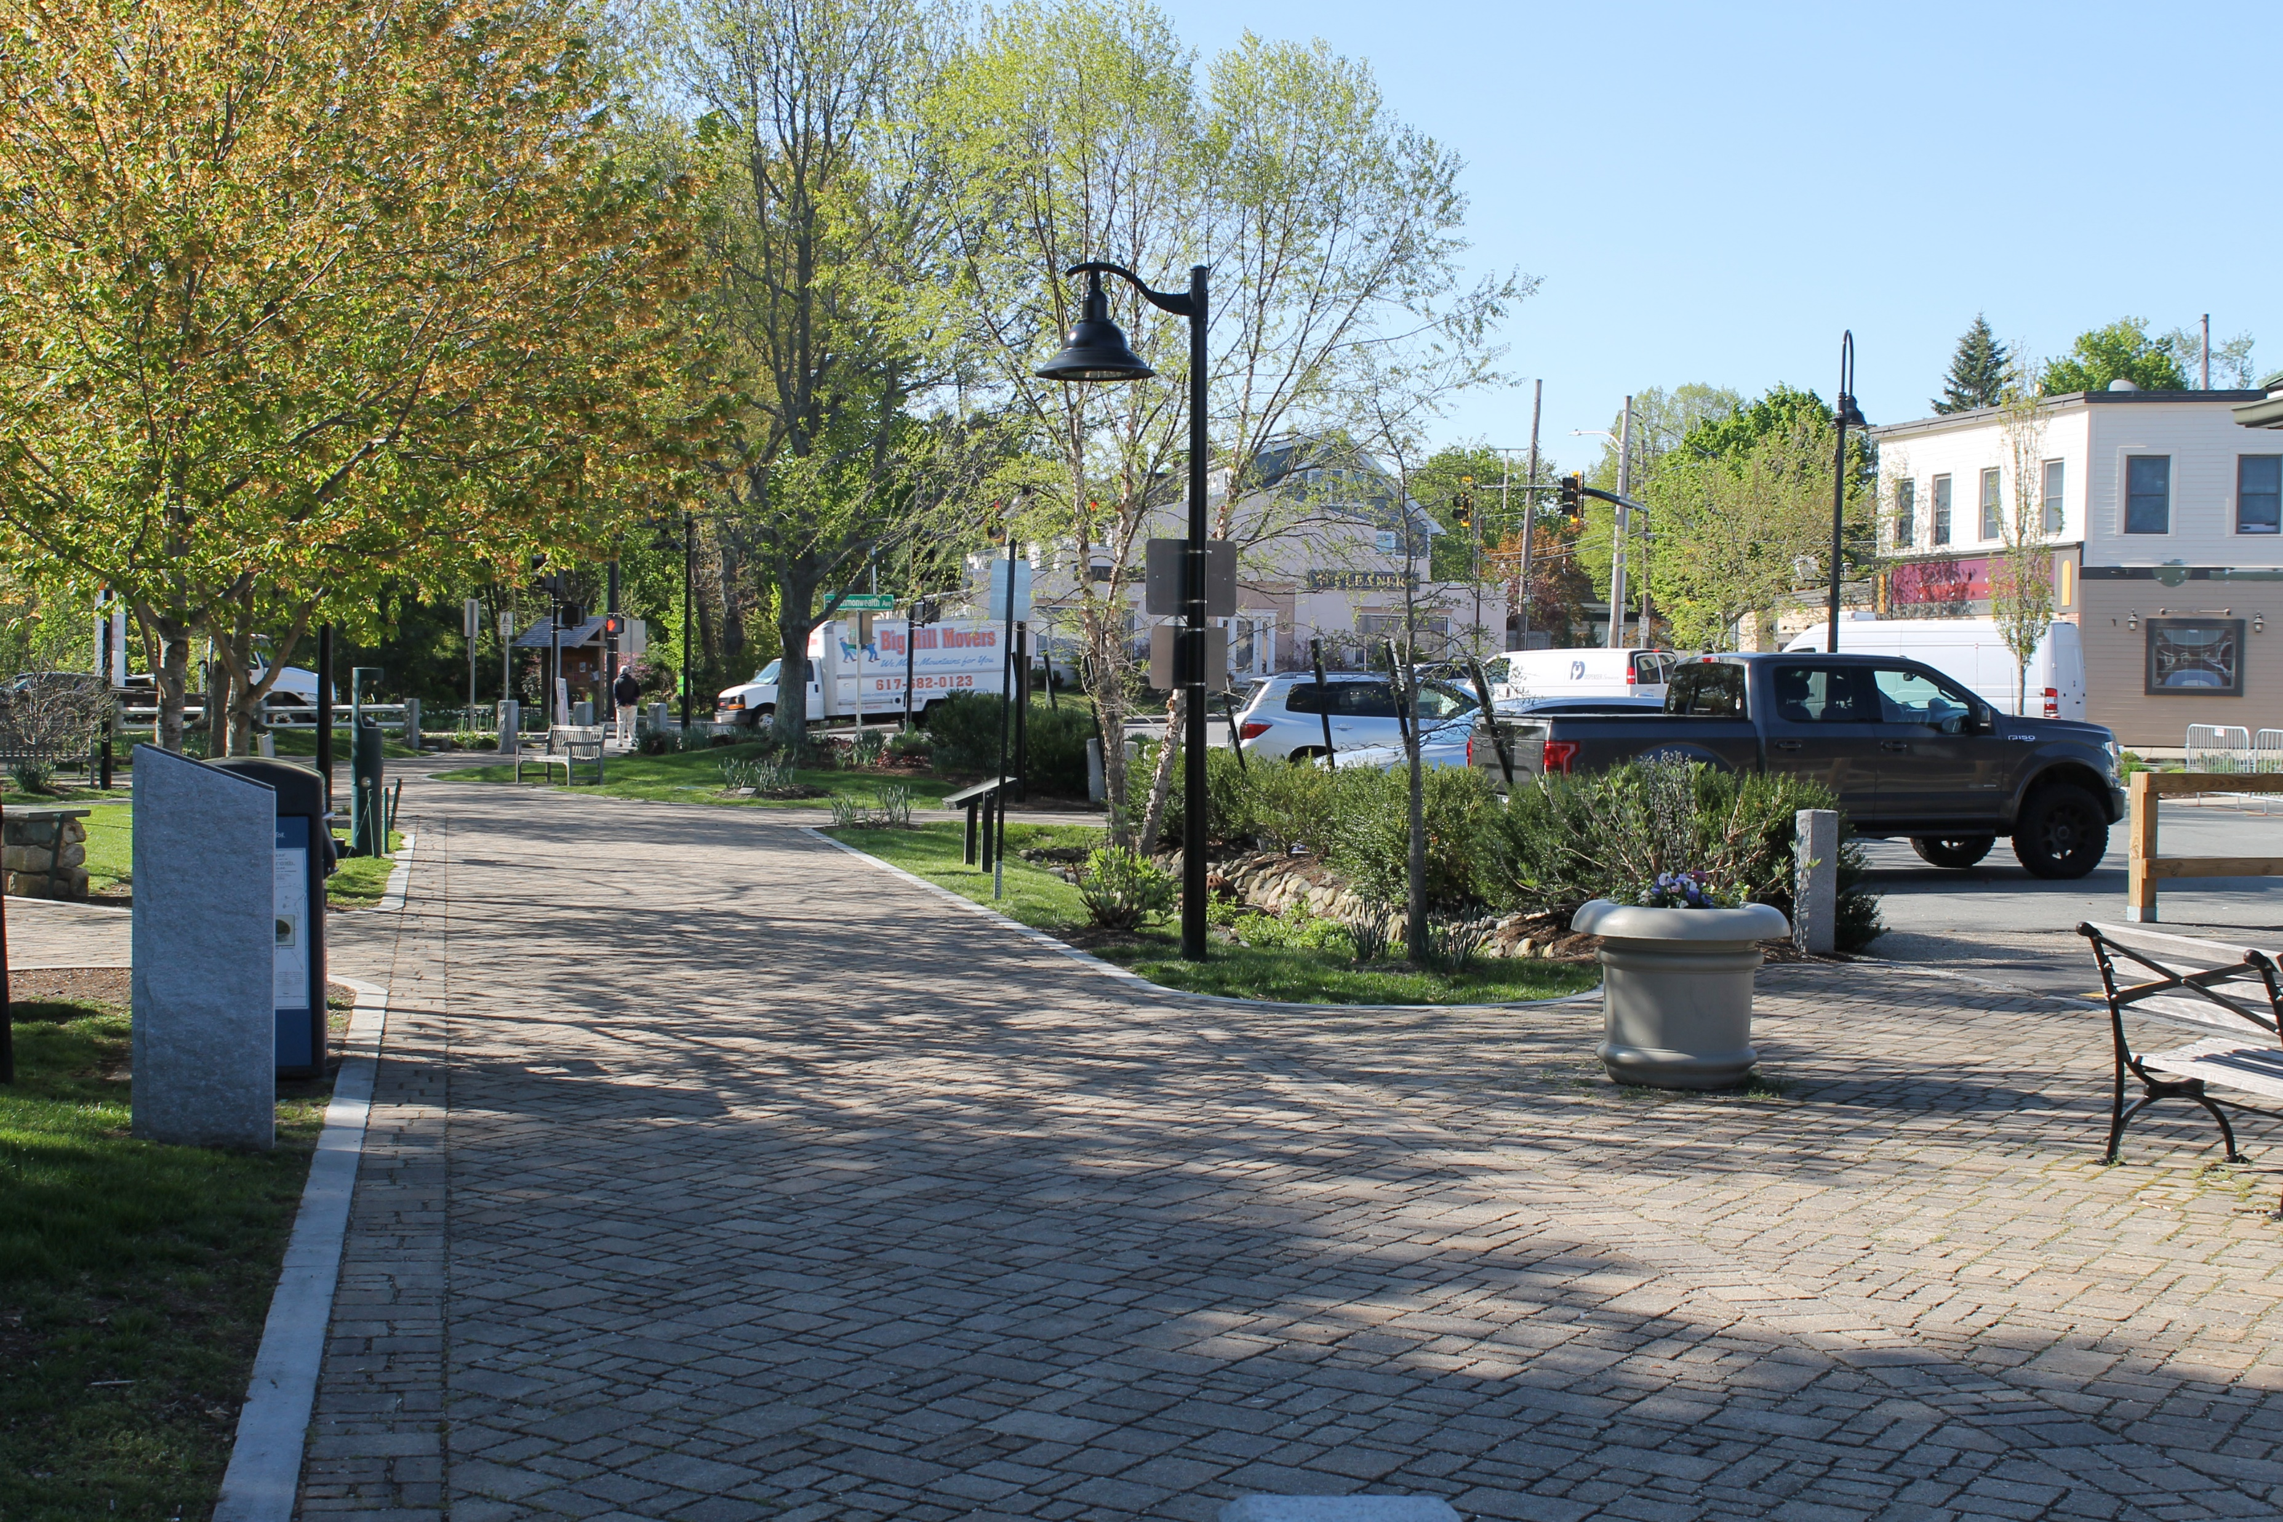
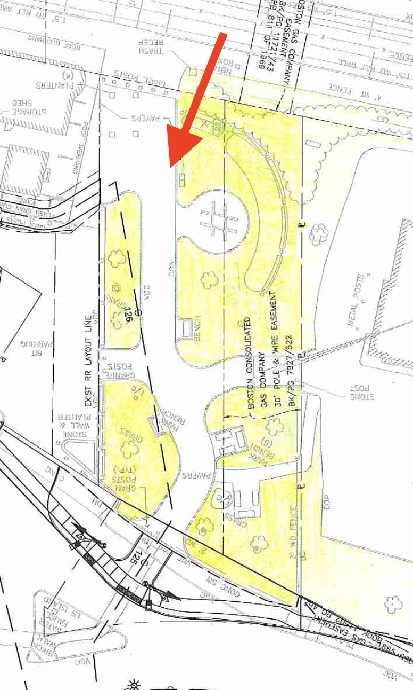
99-Restaurant
7
View from club car café seating area looking south

Slide 10
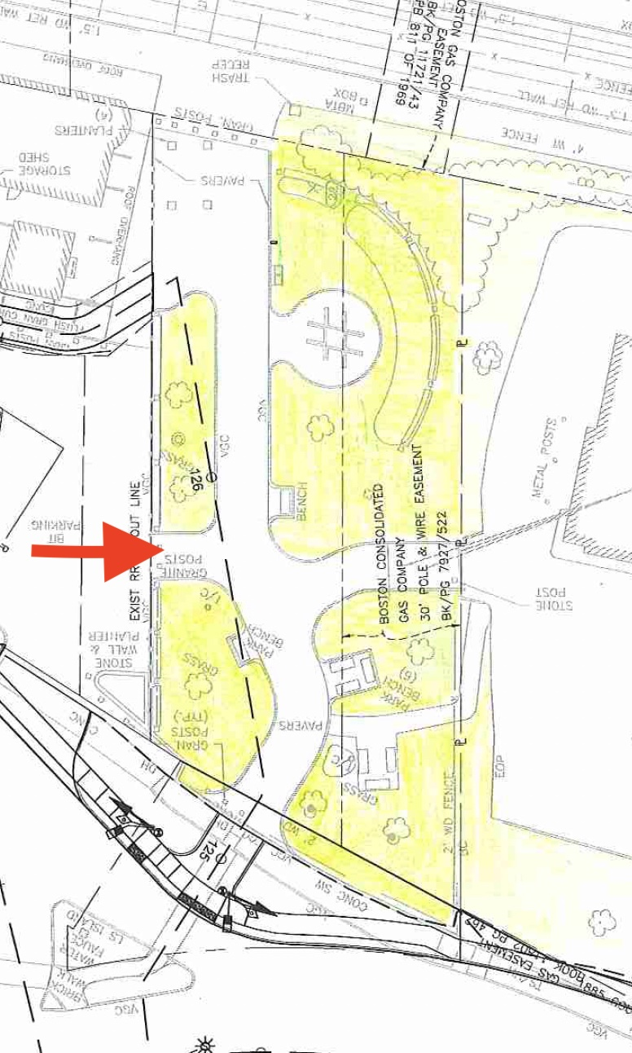
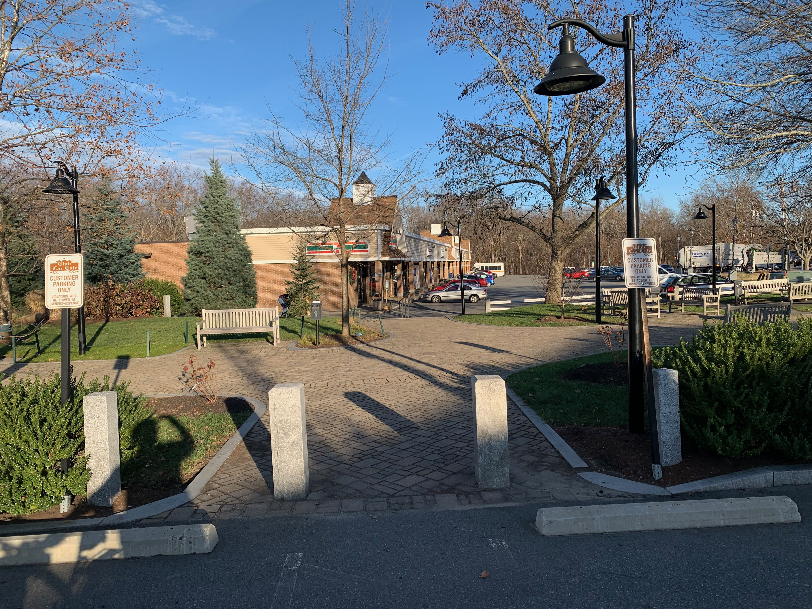
Looking east towards 7-Eleven
8
Junction park entrance from parking lot for club car cafe

