Slide 1
ARTICLE 34: Zoning Map Amendment
Residence A & Industrial Park B Zoning District
Planning Board Public Hearing
March 8, 2022

Slide 2
Proposed Changes
ARTICLE 34: Ind. Park B & Res. A Boundary
Amend the Zoning Map by expanding the Residence A Zoning District boundary and reducing the Industrial Park B Zoning District boundary
Only effects Assessor Parcels #4287-1 (477 Virginia Rd.) and #4287-1-2 (50A Virginia Rd.)

Slide 3
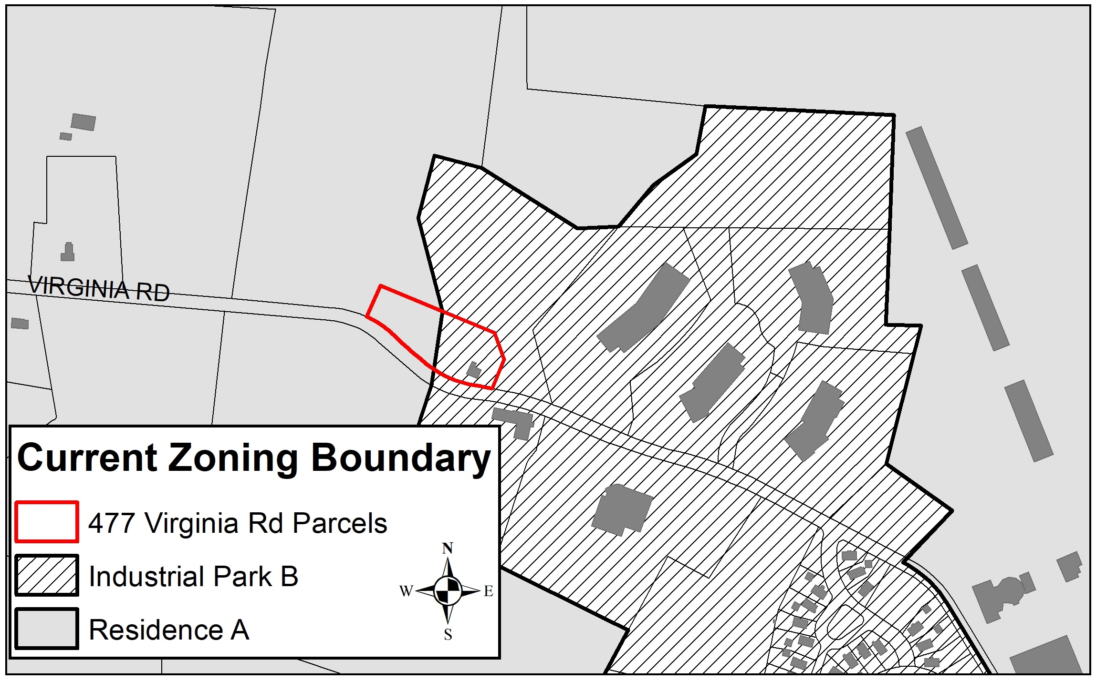
ARTICLE 34: Ind. Park B & Res. A Boundary
477 Virginia Rd.

Slide 4
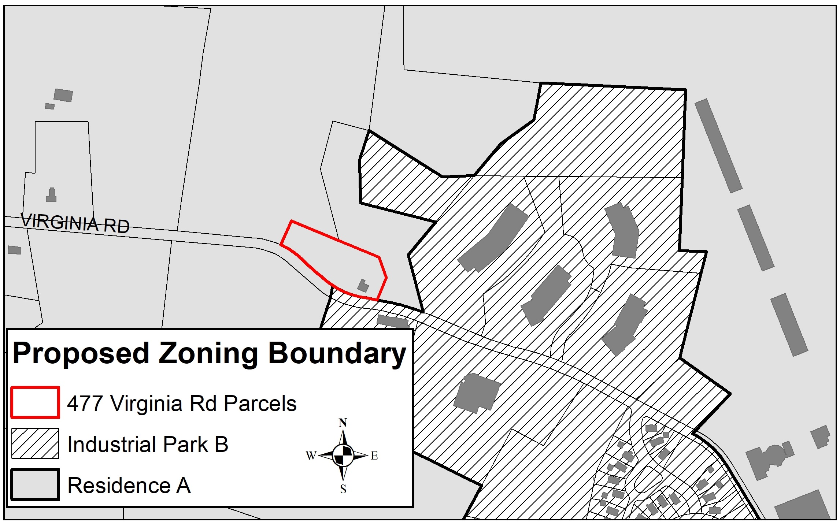
ARTICLE 34: Ind. Park B & Res. A Boundary

Slide 5
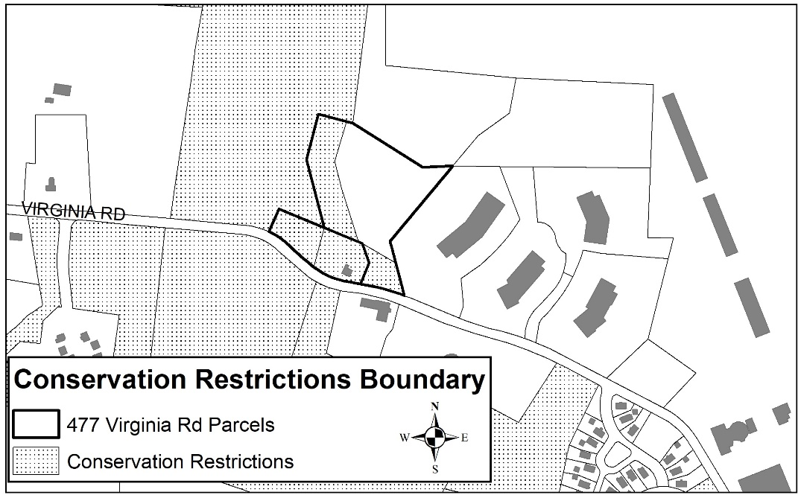
ARTICLE 34: Ind. Park B & Res. A Boundary

Slide 6
Reason for Map Amendment
ARTICLE 34: Ind. Park B & Res. A Boundary
Residence located in the Industrial Park B Zoning District
Residential is not allowed as a principal use in that District
Existing residence is legally non-conforming
Any alteration or additional residential structures and uses requires Special Permit AND Site Plan Review.
Notes:
Because the portion of the Lot upon which the residence is located is in the Industrial Park B Zoning District, it is non-conforming from a zoning use standpoint as a residence is not allowed as a principal use in that District. The proposed change to the Zoning Map would place all of 477 Virginia Road in the Residence A zone and return the residence to a use in conformity with zoning.

Slide 7
Reasons for Map Amendment
ARTICLE 34: Ind. Park B & Res. A Boundary
Proposed Map amendment places all of 477 Virginia Rd. in Residence A Zoning Dist.; becomes a conforming use
Currently, accessory residential structures and uses not permitted in existing Residence A due to existing CR.
Map amendment places a portion of 50A Virginia Road in Residence A, which allows other accessory residential structures and uses by-right

Slide 8
Questions
&
Comments

