Slide 1

Article 32: Zoning Bylaw Amendment Section 3.3 Formula Business
Planning Board Public Hearing
March 8, 2022
Notes:
Good afternoon. My name is Linda Miller and as a member of the Planning Board I will highlight, Article 32 which is a Zoning Bylaw Amendment that will add the Thoreau Depot Business District to our list of areas in the Formula Business Bylaw.

Slide 2
Purpose of the Bylaw & Warrant Article
Article 32: Sec. 3.3 Formula Business
To preserve the existing character, diversity, variety and scale of the district, which is vital to the continuation of Concord’s ability to attract both residents and visitors.
Add the Thoreau Depot Business District to Section 3.3 to limit the number of formula business to 14.
Notes:
The Formula Business Bylaw seeks to preserve the existing character and scale of our business districts. These districts are a great asset to Concord and enhance our ability to attract residents and visitors. This Warrant Article will limit the number of formula businesses in the Thoreau Depot Business District to 14.

Slide 3
What is a Formula Business?
Article 32: Sec. 3.3 Formula Business
A type of business activity that maintains two or more of the following standardized features:
1. array of services and/or merchandise, or menu
2. trademark, logo, service mark or symbol
3. décor, architecture, layout or color scheme
4. uniforms
sign
and these features are substantially the same at 15 or more such establishments, regardless of ownership or location.
Notes:
For those of you new to the concept of Formula Business, it is defined as a business activity with a variety of obvious standardized features (highlighted here) that are present at 15 or more establishments.

Slide 4
Background on Formula Business Bylaw
Article 32: Sec. 3.3 Formula Business
In 2011, Town Meeting approved:
A definition of formula business
A limit of 10 formula businesses in the West Concord Business and West Concord Village Districts (combined)
A special permit process for establishing, expanding or relocating formula businesses
Notes:
As background, Concord has more than a decade of experience in limiting formula businesses in the Business Districts.
At Town Meeting in 2011, Formula Businesses were defined;
were limited to 10 in the West Concord Business and West Concord Village Districts (combined) and
A special permit process for establishing, expanding or relocation of formula businesses was approved.

Slide 5
Background on Formula Business Bylaw
Article 32: Sec. 3.3 Formula Business
In 2019, Town Meeting added:
A limit of 12 formula businesses in the Concord Center Business District
The formula business definition and special permit process for establishing, expanding or relocating formula businesses remains the same
Notes:
In 2019 Town Meeting limited the number of formula businesses in the Concord Center Business District to 12.

Slide 6
Article 32: Sec. 3.3 Formula Business
What’s Special about the Thoreau Depot
Rail service from Concord to surrounding communities and into Boston began at the Depot in June 1844, and has continued since.
Fitchburg railroad initially supported by a small freight & lumber yard reflecting Concord’s early industrial period. Thoreau complained that the village's schedule was set by the times of arrivals and departures at the station.
Notes:
What is Special about the Thoreau Depot Business District?
Historically, rail service from Concord to Boston began in 1844. This rail reflects Concord’s early industrial period.

Slide 7
Article 32: Sec. 3.3 Formula Business
What’s Special about the Thoreau Depot
Nowadays, nearby schools and playing fields, library and arts buildings, and Town Forest and Walden Pond attract residents and many visitors to the Depot area where it serves as a gateway to the Concord “experience”.
Attractive residential areas border the retail and transit hubs.
Notes:
Today, nearby Schools, Playing fields, library and arts buildings, the Town Forest and Walden Pond attract many to the area. Attractive residential areas border the retail and transit hubs.
In general, The Thoreau Depot Business District is a gateway to the “Concord experience”.

Slide 8
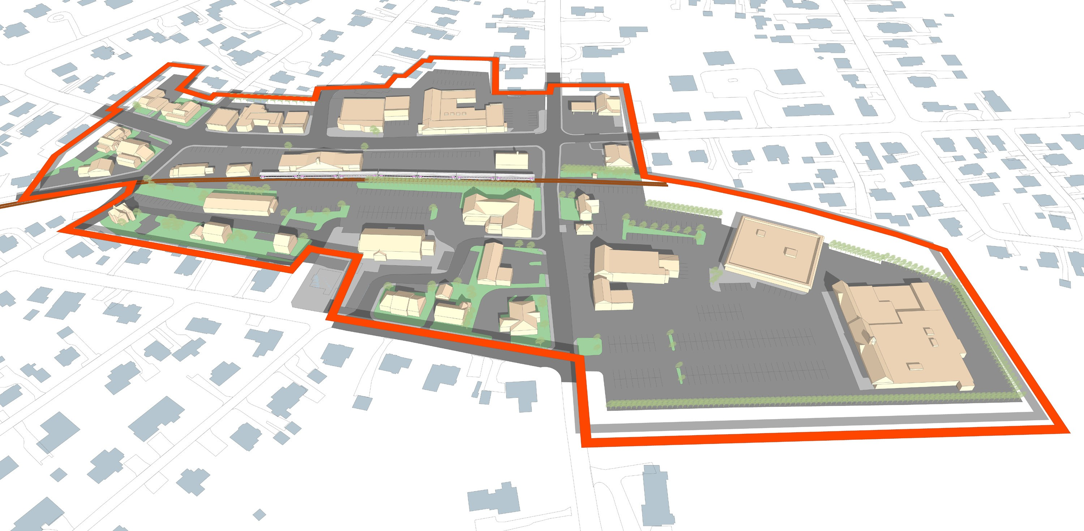
Boundary of Thoreau Depot Business District
Article 32: Sec. 3.3 Formula Business
Thoreau St.
Crosby’s Market
Sudbury Rd.
Notes:
This is a map of the Thoreau Depot Business District.

Slide 9
Existing TDB District Formula Businesses
Article 32: Sec. 3.3 Formula Business
Alphagraphics
Lapels Cleaners
Verizon Store
Cambridge Savings Bank
UPS Store
Rocky’s Ace Hardware
CVS
Dunkin Donuts
Starbucks
Mobil Gas Station
Cumberland Farms
Fitness Together
Total: 12 as of January 2022
Notes:
…and a list of current Formula Businesses.

Slide 10
Why set a limit of 14 formula business?
Article 32: Sec. 3.3 Formula Business
Preserves the current mix
Allows for the organic growth of existing businesses
Allows for a couple new formula businesses
Notes:
Why set the limit at 14? This preserves the current mix of valued Concord businesses at the Depot, allows for growth of those businesses and addition of new businesses.

Slide 11
Article 32: Sec. 3.3 Formula Business
Questions
&
Comments
Notes:
The Planning Board believes that Article 32 will enhance and support the Thoreau Depot Business District.
I’ll be glad to take your questions & comments.

