Slide 1
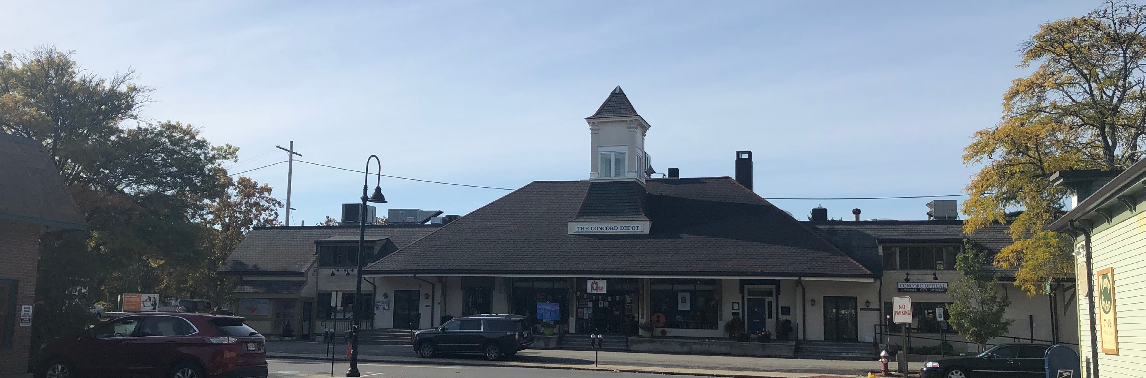

ARTICLE 33 Zoning Map and Thoreau Depot Business District
Public Hearing
March 8, 2022

Slide 2
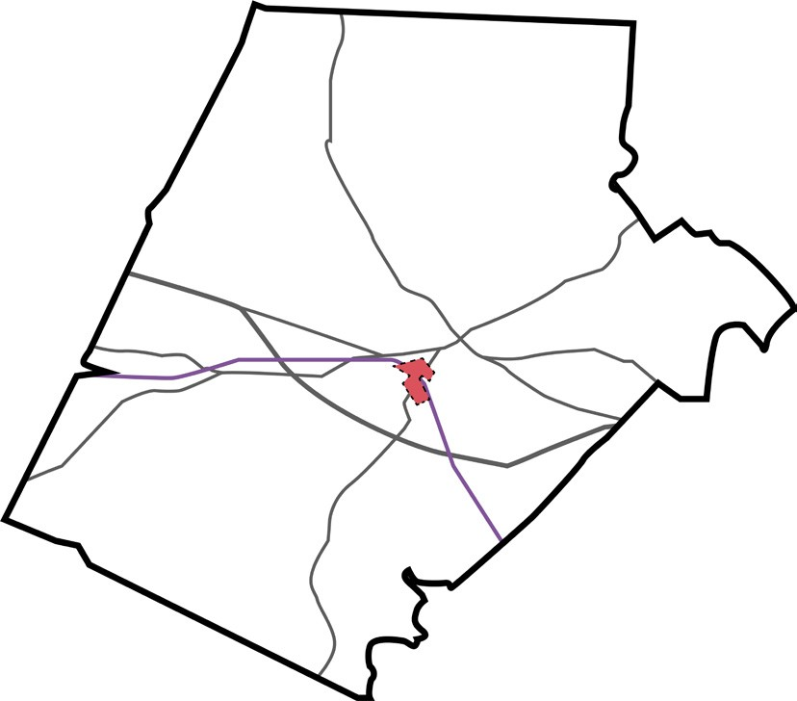
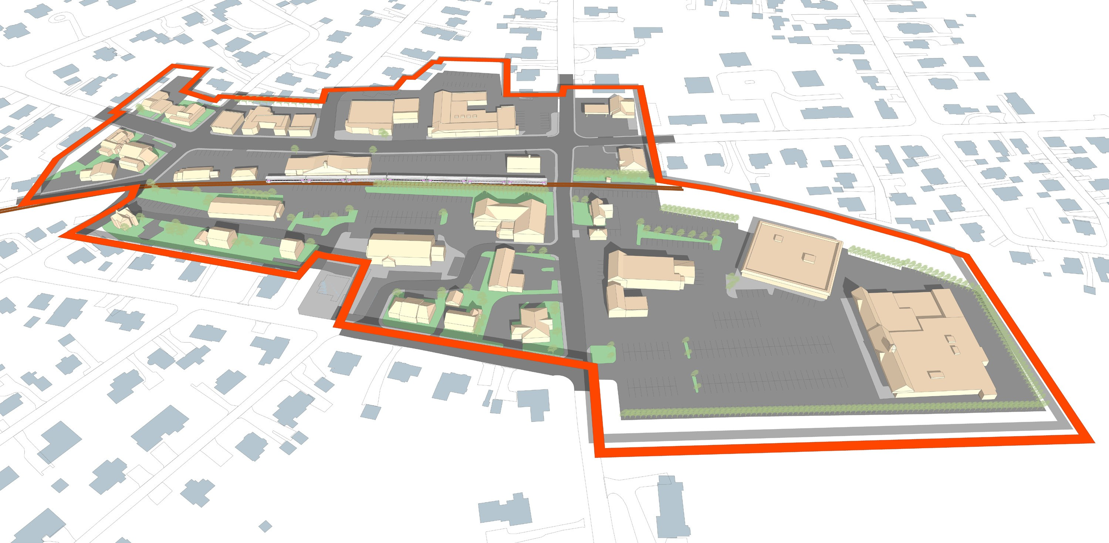

Thoreau Depot Business District
Lowell Rd
Study Area
Rt 2
Middle Street
Belknap Street
Thoreau Street
T
Sudbury Road
Grant Street
Crosby Market
Parcels: 28
Area (Parcels only): 15 acres Building Area: 200, 000 SF Median Building Coverage: 28% Median Impervious Surface: 71%
NORTH
0.1 MILE

Slide 3
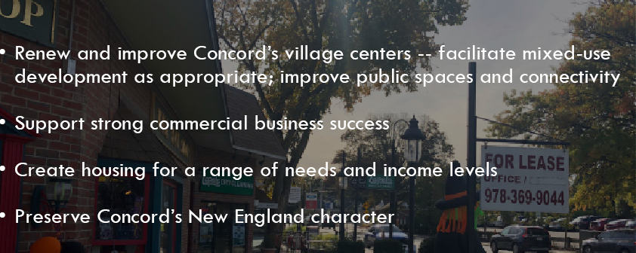
Envision Concord: 2030
Notes:
Note what a comp plan is (high level). This project brings it one step closer to the ground.

Slide 4
A Changing Population
Significant Shift in Household Composition Toward Senior Population
Concord had an estimated 6,876 households in 2015, a 13% increase since 2010, with an average household size of 2.52. The estimated number of households grew at a faster rate than population in part because the estimated average household size has declined (from 2.56 in 2010 to 2.52 in 2015). The smaller household trend supports the Metropolitan Area Planning Council (MAPC)’s population projection that by 2030, 34% of Concord’s population will be 65 years old or older (up from 20% in 2010), and the school- age population will decrease to 14% of the population (from 20% in 2010). This significant shift will require special planning to address housing, transportation, and service needs as well as economic equity in distribution of town financial resources (e.g. … housing options to downsize or age in place….).
Envision Concord: Bridge to 2030 Plan, page 34

Slide 5
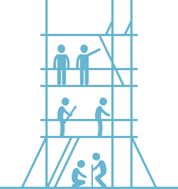

Process
Beginning in 2019, gathered public input to develop a vision for the Thoreau Depot area
Over the course of 2020 and 2021, created the framework (i.e., zoning) to help implement the vision through iterative public engagement
Identify additional recommendations (e.g., connectivity improve- ments) to help implement the vision

Slide 6
What is being proposed?
Prohibit some uses that are allowed today. No car dealerships, light industrial, additional gas stations, or professional offices on the first floor.
Lower the current height possible for pitched roofs, but allow for somewhat higher height via a special permit process within a confined area of the largest parcels (i.e., on Sudbury Road)
Prohibit parking in front yard setbacks and require public space along front yards on Sudbury Rd.
Reduce affordable housing requirements for smaller projects and specify affordability limits
Reduce open space requirement for mixed-use projects with a condition that it be functional and publicly accessible
Reduce residential parking requirements for mixed use projects to align with the needs of 1-2 bedroom units near public transit
Provide design standards so new development better reflects the architectural styles and scale of Concord.

Slide 7
Create Opportunity for Mixed-Use
Existing Provision | Potential Issue with Existing | Proposed Solution
All buildings on lot must be mixed-use (vertical mixed-use) | For deep or large lots, it may be difficult to require commercial uses throughout site | Along public street, require ground-floor commercial Allow single use buildings in other parts of site Clarify types of residential units allowed as part of a mixed-use development
For developments 4+ units, 20% units must be affordable | The current rate may hinder development for smaller projects. | 5-10 units: 10% affordable (80% AMI) >10 units: 20% affordable (half of units required at 80% AMI and balance between 100-120% AMI) Requirement for diverse bedroom mix
Open space = 2x GFA of residential portion. Reduced by SP | Based upon analysis the required open space could hinder many projects. Also opportunity to increase quality of open spaces. | Open space for residential = 15% of lot area Open spaces as publicly accessible to extent practicable. Allow reduction through improvements to off-site open spaces within neighborhood

Slide 8
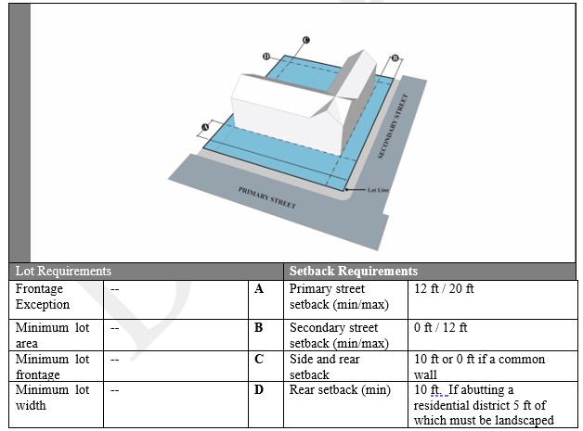
Dimensional Requirements

Slide 9
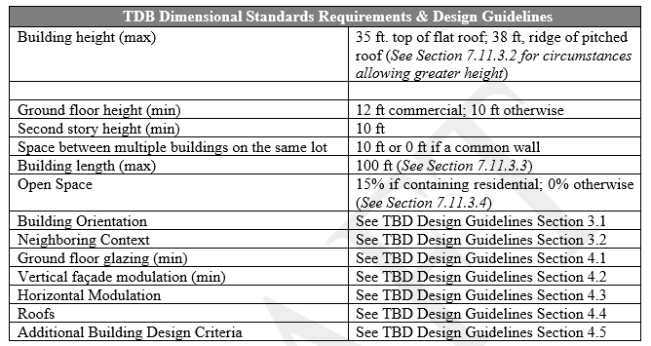
BUILDING DIMENSIONS AND OPEN SPACE

Slide 10
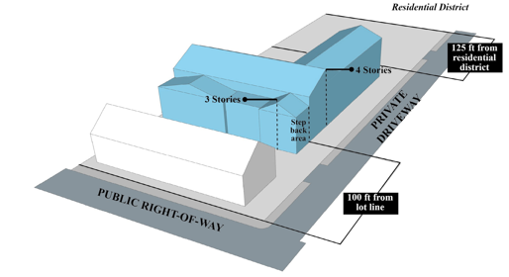
Increased Height by Special Permit

Slide 11
Parking
Location of Parking
Location of parking can help or hinder creation of a walkable neighborhood, so we are specifying that parking should be sited to the rear of buildings, and no parking within the front yard setback.
Parking Requirements
Based on number of units for residential and square footage for commercial
One parking space for each unit up to two bedrooms and two parking spaces for each unit with three or more bedrooms. Existing requirement is two spaces per unit, regardless of size.
Potential reductions by Special Permit (e.g., shared parking)
Commuter parking at Crosby’s
This is separate from zoning and is part of an agreement with the current owner. Changing zoning does not alter this agreement.
If the property is sold, regardless of zoning, the Town will work with the new owner on an agreement to provide sufficient commuter parking

Slide 12
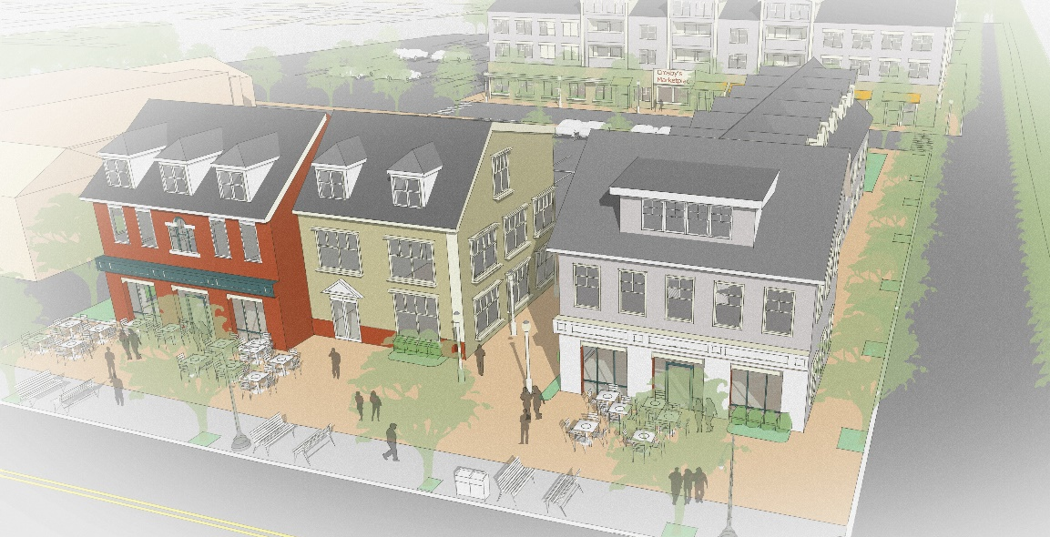
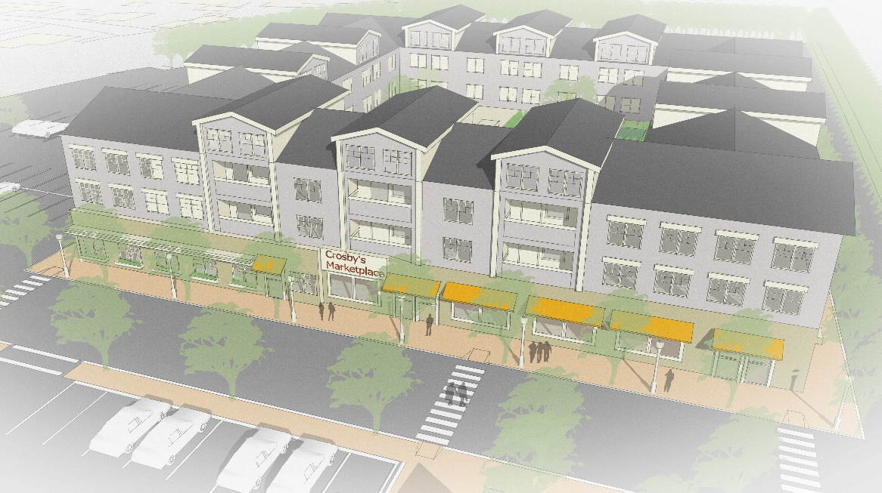
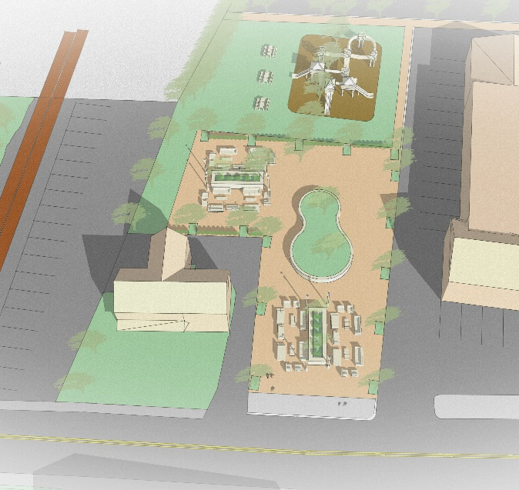
Hypothetical Buildout
Hypothetical Crosby’s Marketplace parcel redevelopment. Note: this is just one way that this property could be redeveloped. It attempts to provide a realistic scenario but any proposed development could differ from this example.
1
Building 1
Commercial area (ground floor): 4,440 SF
Residential units: 7
2
Building 2
Commercial area (ground floor): 5,800 SF
Residential units: 10
1
2
3
Building 3
Commercial area (ground floor): 31,600 Residential units: 46
4
Open Space
15% of total (including seating and
pathways on site)
3
4

Slide 13
Traffic
Q. How much traffic could the hypothetical build-out add?
Vehicular trips are typically estimated once a project is proposed, based on the type of uses and amount of development on any single project. MAPC consulted the ITE Manual for potential traffic impacts based upon general estimates of development.*
According to ITE, Crosby’s Marketplace is estimated to generate 1,500 trips per day.** Adding ~60 residential units would only add another 200 trips in total, spread throughout the day.
*ITE’s manual is far from perfect, and tends to overestimate trip generation, especially in walkable areas.
**According to ITE, suburban shopping centers such as Crosby’s generate 37 trips per 1,000 SF leasable area

Slide 14
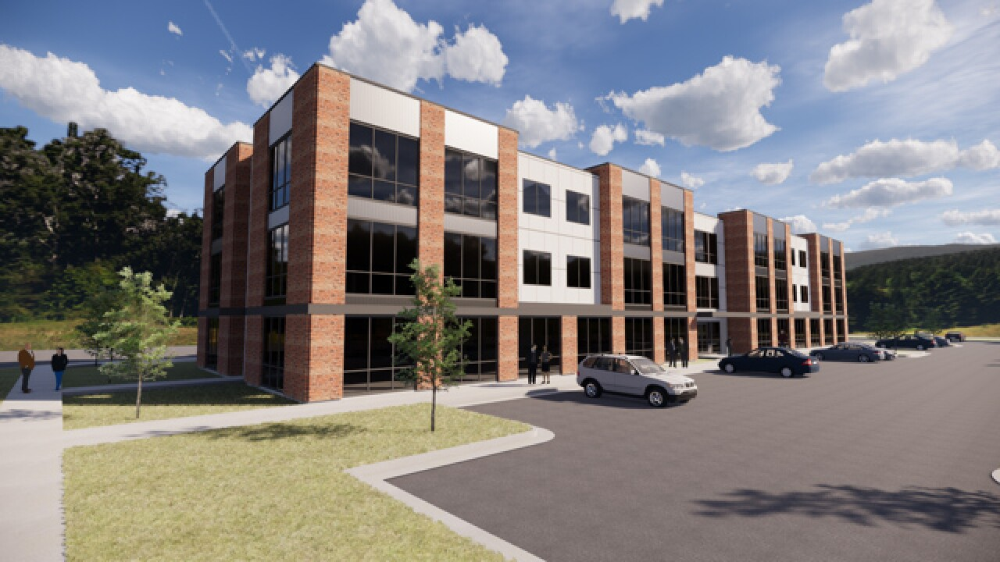
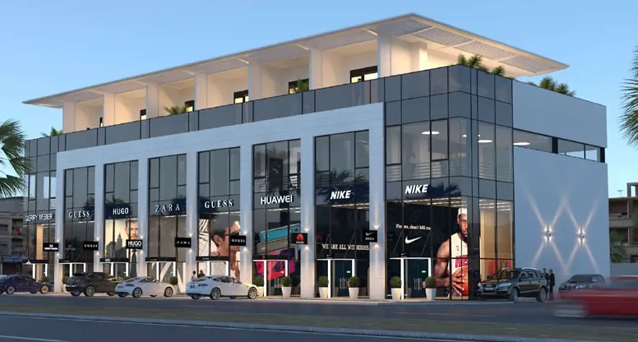
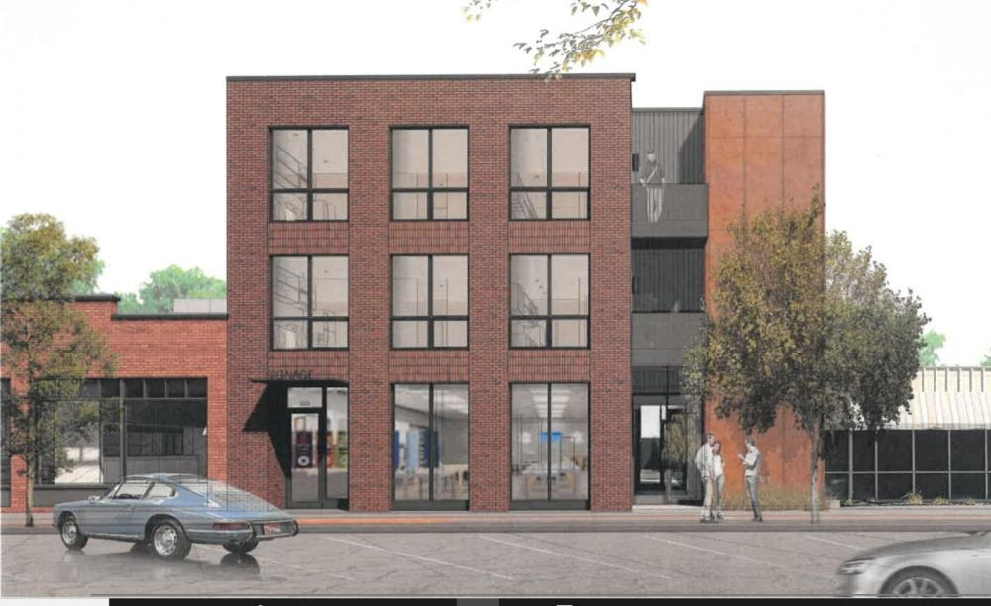
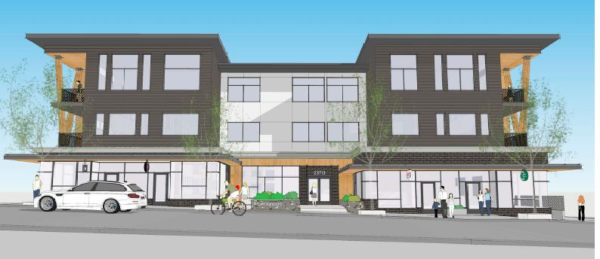
Design Guidelines
Issue: Under existing zoning (i.e., making no changes to zoning), buildings similar to this could be built

Slide 15
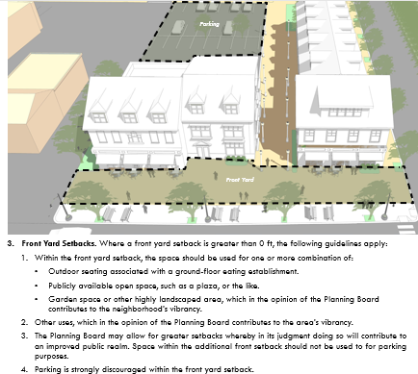
Design Guidelines

Slide 16
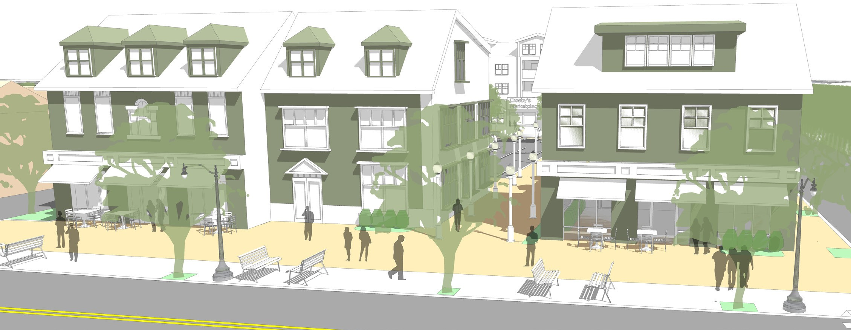
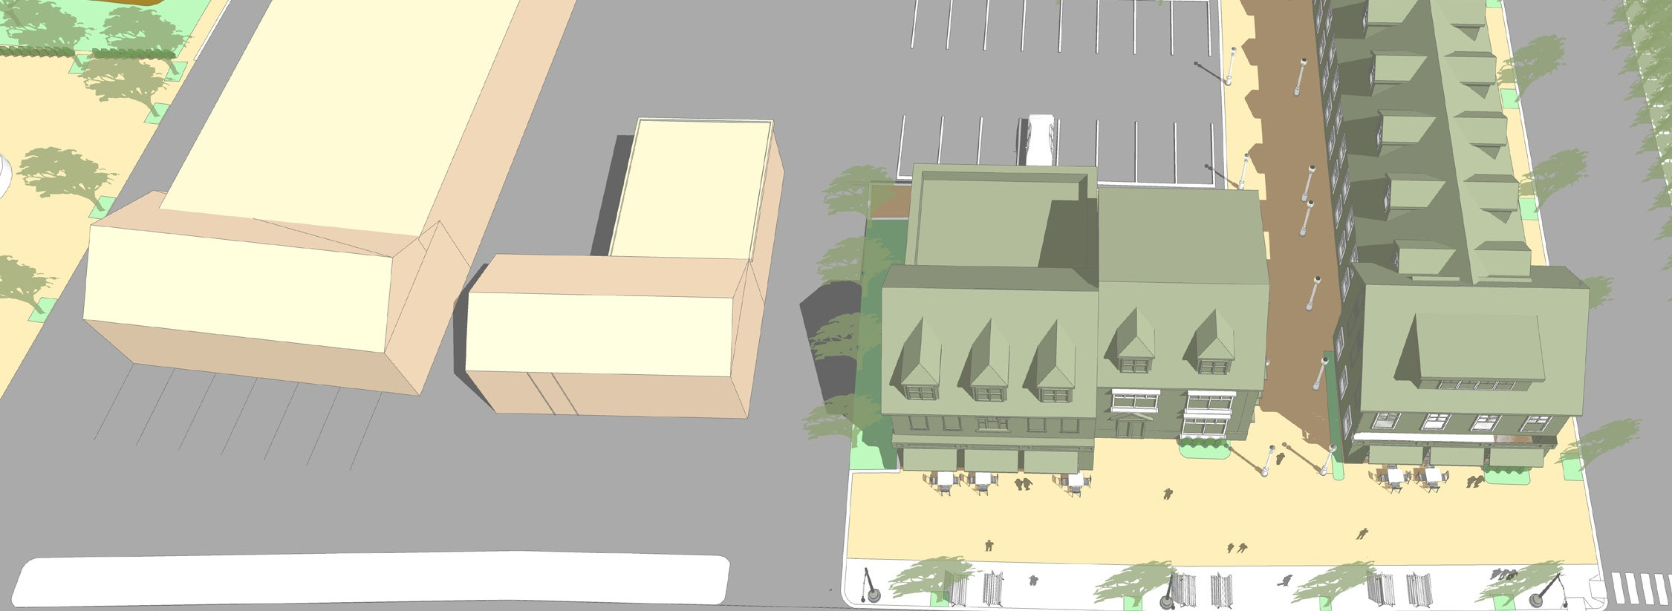


Design Guidelines

Slide 17
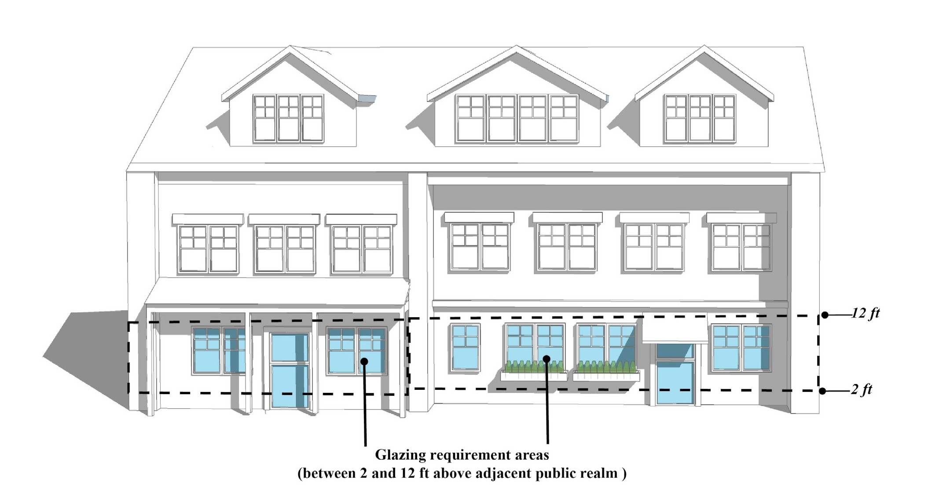
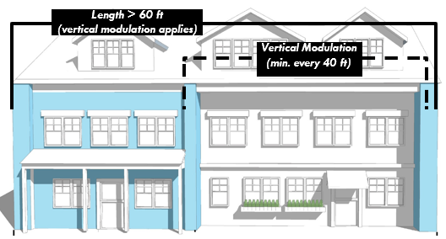
Design Guidelines

Slide 18
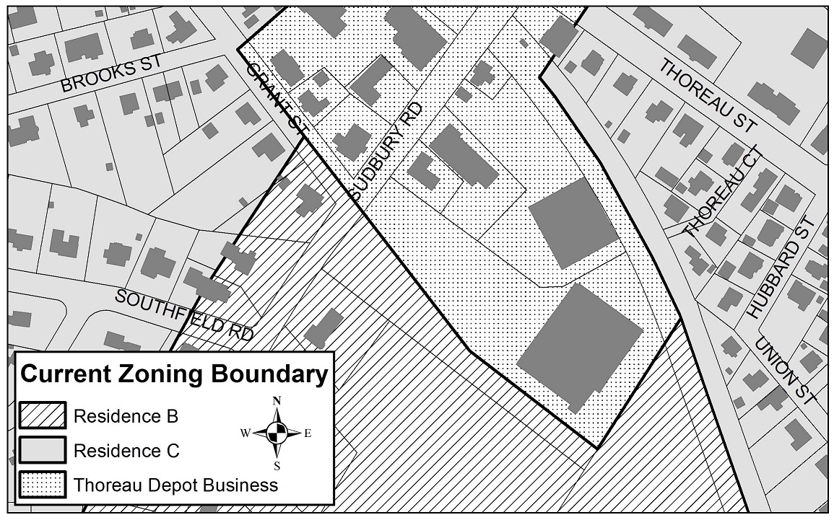
District Boundary Change

Slide 19
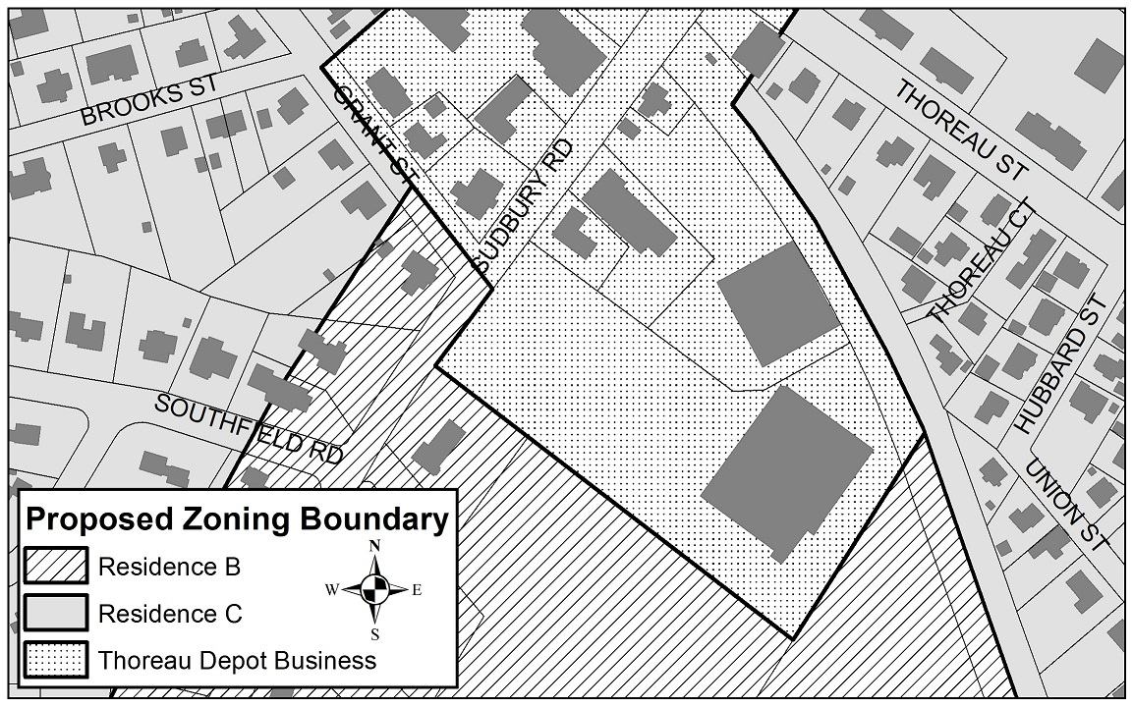
District Boundary Change

