Slide 1


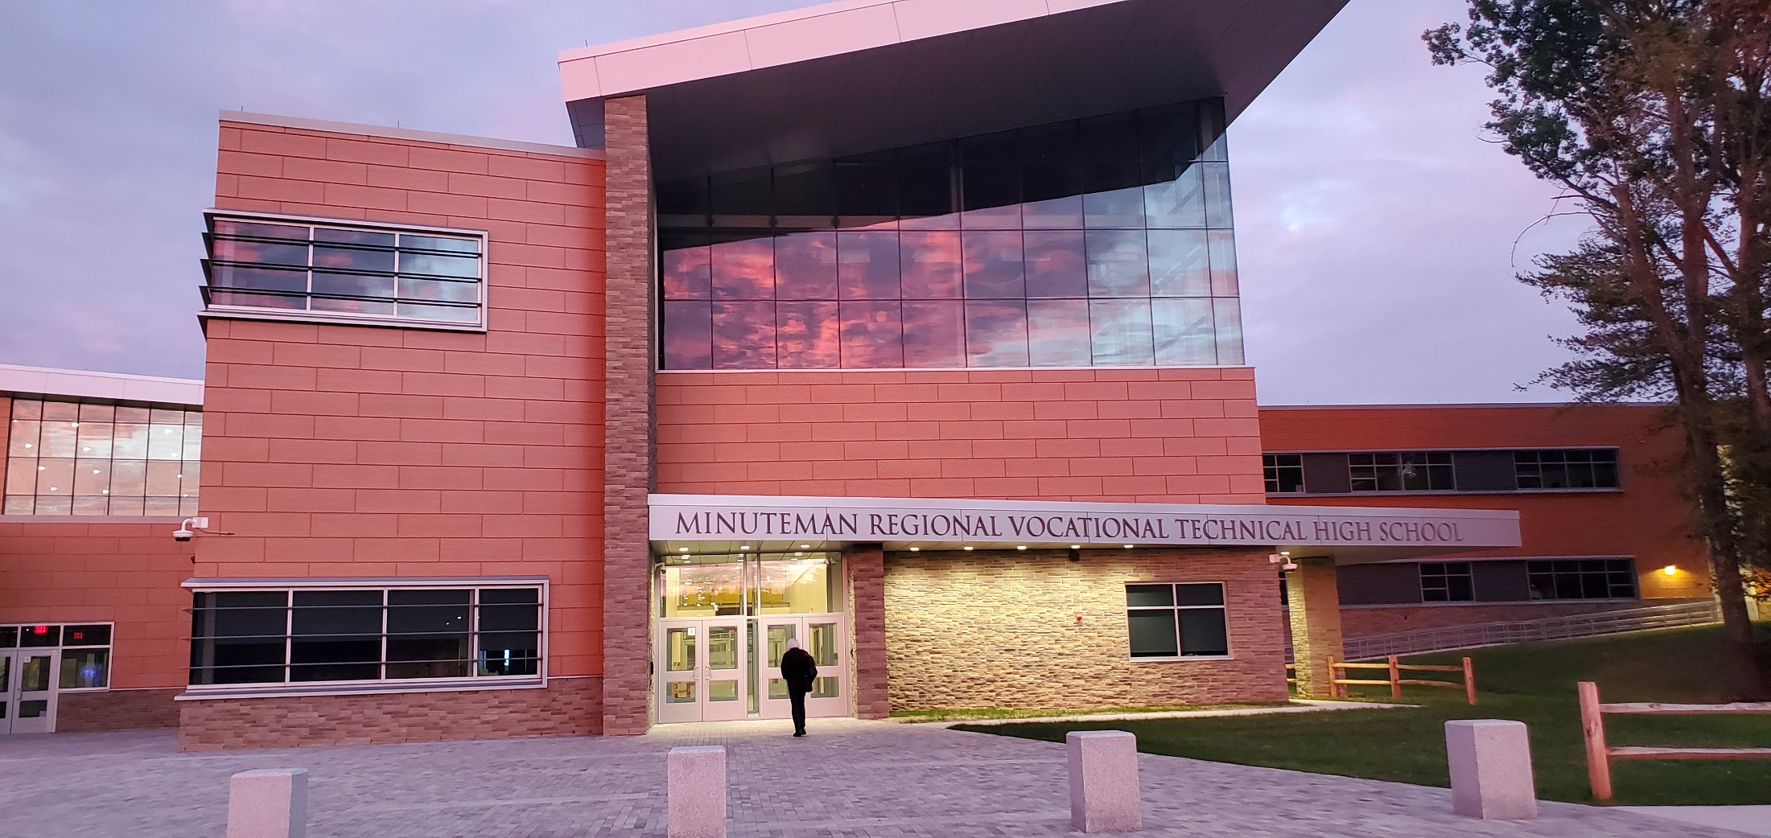

Edward A Bouquillon PhD Superintendent-Director
FY23 “Preliminary” Budget & Assessment
SUPERINTENDENT RECOMMENDED FY2023 BUDGET

Slide 2
Overall Budget Summary
FY23 Operating & Capital Request
$29,010,622
4.96% above FY22
FY23 Assessment to Members
$22,395,741
15.08% above FY22

Slide 3
FY23 DISTRICT BUDGET OBJECTIVES
Protect Student and Staff Health
  Critical to address Social Emotional Learning Needs
Deliver and Promote High Quality CVTE
Advance the MM Academy Model
Increase Enrollment Capacity of Facility
Athletic Fields Operations and Management
Campus Facilities Use & Rental Revenue
Close out MSBA Project

Slide 4
FY23 Operating Budget Drivers
Teachers Contract (2% plus Steps and Levels)
Health Insurance (10% Increase)
Transportation Increase (FY23 = 5% CPI)
Building Utilities (5% Projected Increase)
CTE Supply and Material Cost Increases
OPEB ($120,000 = $60,000 Increase)
Lease of 2 Field Trip/Worksite Buses ($50,000)
Stabilization ($500,000 = $150,000 Increase)

Slide 5
Budget Summary
FY23 Operating Request = $22,092,652
6.57% above FY22
FY23 Capital Request = $1,235,608
8.89% above FY22
FY23 MSBA Project Debt = $5,682,363
1.60% below FY22

Slide 6
Concord: Preliminary Assessment
Minimum Required Contribution $ 562,427
Transportation Assessment $ 33,653
Operating Assessment $ 415,407 Debt & Capital Assessment $ 84,036 Sub-Total $ 1,095,523 Building Project – Debt Service* $ 413,021 Total Assessment $ 1,508,544
*Debt service excluded from Prop 2 ½ limitation

Slide 7
Concord: Comparison of Assessment
Concord | FY22 | FY23 | Difference | % Change
Enrollment | 25 | 33 | 8 | 32.0%
Enroll 4 Yr. Avg | 23 | 27 | 4 | 17.4%
% Share Operating | 6.1% | 6.3% | 0.1% | 2.4%
% Share Capital | 7.7% | 7.9% | 0.1% | 1.4%
Min Req Contr | $434,410 | $562,427 | $128,017 | 29.5%
Transportation | $42,453 | $33,653 | ($8,800) | -20.7%
Operating | $362,406 | $415,407 | $53,001 | 14.6%
Debt & Capital Ops | $71,996 | $84,036 | $12,040 | 16.7%
MSBA Debt | $378,019 | $413,021 | $35,002 | 9.3%
Total Assessment | 1,289,284 | $1,508,544 | $219,260 | 17.0%
Notes:
Program closures in marketing and Telecomm still taking place.
Marketing – 2 more yrs.
Telecomm – 3 yrs. left

Slide 8
Concord Enrollment: Oct 1

Slide 9
Concord: Per Pupil Assessment
Concord | Operating Assessment | October 1 Enrollment Count | Per Pupil Assessment
Est. FY23* | $ 1,011,487 | 33 | $30,651
FY22 | $ 839,269 | 25 | $33,571
FY21 | $ 866,644 | 25 | $34,666
FY20 | $ 778,353 | 25 | $31,134
FY19 | $ 544,510 | 17 | $32,030
*Est. FY23 Per Pupil Assessment = FY23 Proposed Operating Assessment / Oct 1, 2021 Enrollment Count

Slide 10
Overall Enrollment: Oct 1

Slide 11
Enrollment HAS SHIFTED
Greater (almost all) In-District Enrollment
Out of District enrollment is decreasing
Out of District Tuition Revenue decreasing
Out of District Capital Fee Revenue decreasing
Resulting in:
Increased Assessments to members &
Reduced Per Pupil assessments

Slide 12
NON-Member Tuition & Capital Fee Reduction and Increasing Member Enrollment
Non-Member Tuition is set annually by the DESE Commissioner based on 125% of Statewide Foundation Vocational Rate.
Non-Member Tuition may include an incremental Special Education Fee per Student, if applicable.
Non-Member Capital Fee is based on average per pupil cost of Debt Service (New Building Only).
  The Fee varies depending on if Cities/Towns have less than (Type A) or more than (Type B) five Chapter 74 Programs.

Slide 13
Changes in Avg Enrollment
Changes in Assessment FY22-FY23

Slide 14
Member Towns: Per Pupil Assessment
Member Towns | Est. FY23* | FY22 | FY21 | FY20 | FY19
Acton | $27,944 | $27,584 | $34,418 | $34,594 | $31,269
Arlington | $29,776 | $28,341 | $32,611 | $34,109 | $33,680
Bolton | $27,098 | $30,587 | $40,133 | $33,605 | $32,279
Concord | $30,651 | $33,571 | $34,666 | $31,134 | $32,030
Dover | $30,903 | $27,196 | $24,555 | N/A** | $45,732
Lancaster | $31,748 | $28,913 | $30,700 | $32,246 | $26,834
Lexington | $32,452 | $31,016 | $35,299 | $35,535 | $30,758
Needham​ | $30,590 | $30,453 | $35,880 | $37,780 | $34,058
Stow​ | $28,350 | $26,893 | $28,005 | $32,244 | $33,831
* Est. FY23 Per Pupil Assessment = FY23 Proposed Operating Assessment / Oct 1, 2021 Enrollment Count
** The Enrollment for Dover was 0, therefore Per Pupil Assessment is unable to be calculated.

Slide 15
Application & Enrollment Trend
 | YOG ‘22 | YOG ‘23 | YOG ‘24 | YOG ‘25 | YOG ‘26
Total Applications | 168 | 272 | 390 | 323 | 358*
Nine Member Towns | 147 | 225 | 252 | 261 | 270*
Out of District (OOD) | 21 | 47 | 94 | 36 | 44*
OOD (Ineligible) | 49 | 38 | 44 | 26 | 44*
9th Gr Enrollment | 122 | 195 | 179 | 199 | 175
 |  |  |  |  | *As of 1/27/22
*Highlights:
Applications up 11% from one year ago currently*.
27% increase in overall Enrollment since FY19
65% increase from the current NINE MEMBER towns since FY19
Class of 2025 = 95% from NINE MEMBER towns.
Column1
Notes:
Previous best Showcase 404
+100 from last year’s Open House
Assistant director of admissions has moved on from Minuteman in early November
We set 60 as a manageable number for “shadowing” and closed registration three days before the event (we never closed it before)

Slide 16
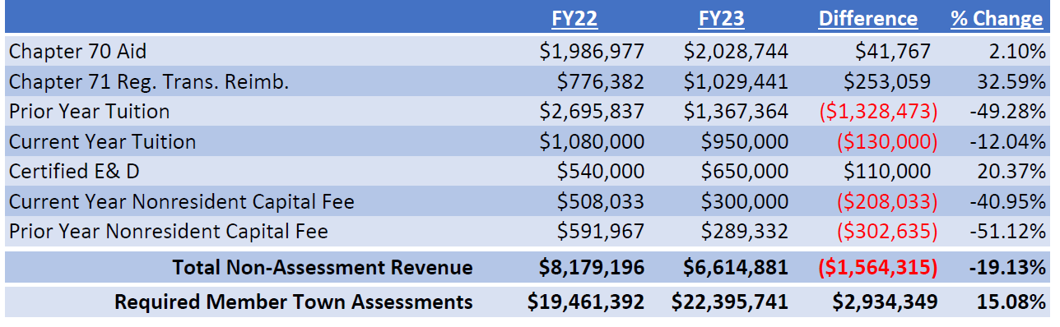
Out of District Revenue Decline

Slide 17
Budget Summary
FY23 Operating Request = $22,092,652
6.57% above FY22
FY23 Capital Request = $1,235,608
8.89% above FY22
FY23 MSBA Project Debt = $5,682,363
1.60% below FY22

Slide 18
Preliminary* Staffing Additions for FY23
2.0 FTE Student Support Professionals
1.0 FTE Program/Web Teacher
1.0 FTE Robotics/Automation Aide
1.0 FTE HR Support Specialist
0.5 FTE Library/Reading Aide
*Academic staff increases WILL be required to increase building capacity once academic space is determined.

Slide 19
Planned Staffing “Reductions” for FY23
1.0 FTE ISS Professional
1.0 FTE Program/Web Aide
1.0 FTE Logistics Engineering Teacher
1.0 FTE HR Director
NET INCREASE = 1.5 FTE

Slide 20
Career Technical Budget Priorities
Animal Science & Logistics Engineering Program Development
Shop Material and Equipment Increases
Make available workplace clothing and safety gear for all students
Student credentialing costs from Grants to District Budget:
  National Occupational Competency Testing Institute (NOCTI)
  American Welding Society (AWS)
  Occupational Safety and Health Administration (OSHA)
  Hazardous Waste Operations Emergency Response
  Certified Nursing Assistant (CNA)
  Emergency Medical Technician (EMT)
  Industry 4.0 (robotics/Automation/Mechatronics)
  State Board Licensing Examination Fees

Slide 21
Building Enrollment Beyond the
Design Enrollment of 628
Goal: Accommodate 800 students by Fall 2023
with no increase in debt.
Strategy #1: Annually Fund Capital Stabilization Account
Projected Account balance as of July 1, 2022: $1,434,600
Capacity Building Project in Progress:
North Metal Fab Shop: $700,000 Opening late Fall 2022
Increase Capacity by 32 students over four years
Strategy #2: Leverage Strategic Partnerships and Grants
Vet Clinical Renovation: Design now. Opening Fall 2023
Increase Capacity by 60+ students over four years

Slide 22
OPEB Estimated Liability as of
June 30, 2022
$26,124,691
11/30/2021 OPEB Trust Fund Balance = $471,240
NOTE: Estimated OPEB Net Liability as of
June 30, 2020, was $32,473,201
Notes:
done

Slide 23
Future Funding of OPEB
OPEB Study Group: Next 6 Years of Contributions to Budget Line 5250, Retiree Insurance:
    FY23: $725,000 - FY26: $1,155,000
    FY24: $762,000 - FY27: $1,215,000
    FY25*: $1,100,000 - FY28: $1,275,000
$725,000 in FY23 with 5% increases each year.
PLUS $300,000 in FY25*as ESCO Lease is retired.
Notes:
done

Slide 24
Overall Budget Summary
FY23 Operating & Capital Request
$29,010,622
4.96% above FY22
FY23 Assessment to Members
$22,395,741
15.08% above FY22

Slide 25
QUESTIONS e.Bouquillon@minuteman.org

Slide 26
BACKGROUND Slides

Slide 27
Communications FY23
Maintain marketing/recruitment of member enrollment.
Minuteman Technical Institute marketing and promotion
Roll out and management of New MM Website
Increase alumni success stories & student milestones
  Legislative Communications and Outreach
  Enlighten CTE perceptions within our member towns
  Increase early outreach to Grades 6 - 7
  Strengthen the Girls in STE(A)M Program Grades 5-12
  Parent Communications & Media Relations
  Managing Social Media Effectiveness
Notes:
Previous best Showcase 404
+100 from last year’s Open House
Assistant director of admissions has moved on from Minuteman in early November
We set 60 as a manageable number for “shadowing” and closed registration three days before the event (we never closed it before)

Slide 28
School Wide Goals 2022 - 2023
Extend Academy Professional Learning Communities to:
Provide a healthy, safe, supportive campus culture
Promote teacher leadership
Gather, share, analyze data to improve student outcomes
Deploy intelligent technology to enhance learning
Integrate academic and CVTE curriculum maps
Expand project-based learning
Develop rigorous integration of literacy and math

Slide 29
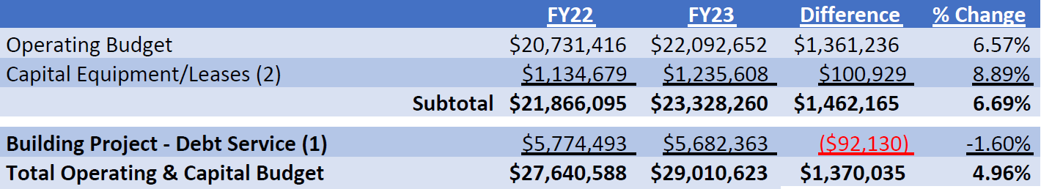
FY23 Operating and Capital
(1) A debt exclusion override was voted on this debt in the following towns: Acton, Arlington, Bolton, Concord, Dover, Lancaster, and Stow.
(2) Annual ESCO Lease assessments include the proportionate share due from the 6 towns that withdrew from the district effective July 1, 2017, and Belmont withdrawal effective July 1, 2020. This also includes the 1st payment on a 10 year note for the field lighting.

Slide 30
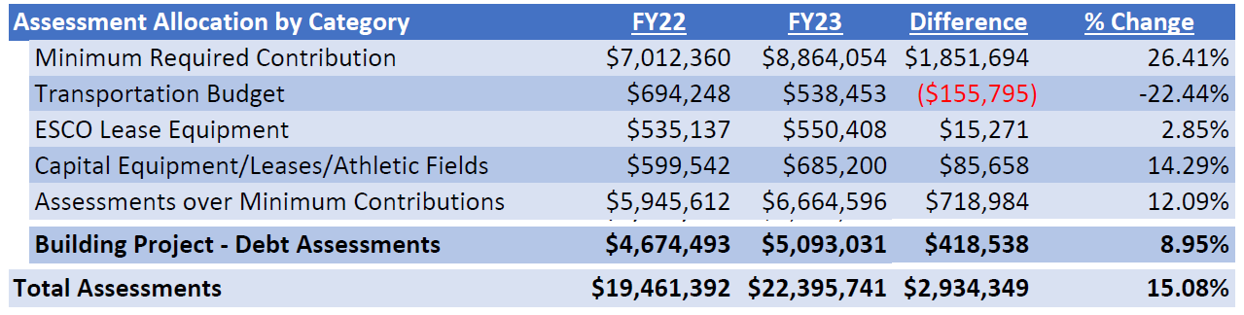
Assessment Components

