Slide 1
ARTICLE 37: Authorize Select Board to Petition to Impose a Checkout Bag Charge
Mr. Stein moves that the Town take affirmative action on Article 37 as printed in the handout.

Slide 2
ARTICLE 37: Authorize Select Board to Petition to Impose a Checkout Bag Charge
Joseph Stein, 21 Thoreau St.
With help from Surfrider Foundation (MA Chapter)

Slide 3
Summary
ARTICLE 37: Authorize Select Board to Petition to Impose a Checkout Bag Charge
Article 37 would authorize the Select Board to petition the state legislature for a special law requiring that retail establishments in Concord charge a minimum of $0.10 for each new checkout bag distributed.
Any money collected for bags would be retained by the retailer.

Slide 4
Purpose
ARTICLE 37: Authorize Select Board to Petition to Impose a Checkout Bag Charge
Incentivize consumers to reuse checkout bags, the most sustainable and economical option
Encourages consumers to decide if a bag is needed
Allow collected money to be retained by retailer to defray cost of checkout bags
Reduce waste and disposal/recycling costs borne by Town

Slide 5
ARTICLE 37: Authorize Select Board to Petition to Impose a Checkout Bag Charge
Article 37 is identical to articles passed at 2021
town meetings for Lincoln and Sudbury

Slide 6
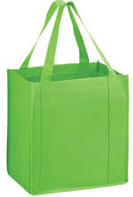
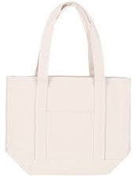
Good for the Environment
ARTICLE 37: Authorize Select Board to Petition to Impose a Checkout Bag Charge
Studies show that when consumers receive free checkout bags, they generally treat them as disposable
Bag reuse is best: environmental costs are spread over multiple uses
Studies also show that even a nominal charge can impact human behavior
Polypropylene
Cotton
Source: “Plastic Bag Bans: Analysis of Economic and Environmental Impacts.” Equinox Center, 2013.

Slide 7
Good for the Environment
ARTICLE 37: Authorize Select Board to Petition to Impose a Checkout Bag Charge
$0.10 bag charge experiment in Los Angeles, CA (2013):
45%
40%
5%
17%
Reusable Bag Use
No Bag Used
Source: “Plastic Bag Bans: Analysis of Economic and Environmental Impacts.” Equinox Center, 2013.

Slide 8
Good for Residents
ARTICLE 37: Authorize Select Board to Petition to Impose a Checkout Bag Charge
We are already paying for bags
Allows shoppers to save money by reusing bags
Reduced demand for new bags reduces Town disposal and recycling costs/taxes

Slide 9
Good for Businesses
ARTICLE 37: Authorize Select Board to Petition to Impose a Checkout Bag Charge
Check-out bags increase overhead – a charge helps defray costs
A charge levels the playing field, and helps stores switch to the most sustainable options
Massachusetts Food Association testified IN SUPPORT of a statewide bag charge (during 2019-2020 legislative session)
New sales opportunities
Branded reusable bags, etc.

Slide 10
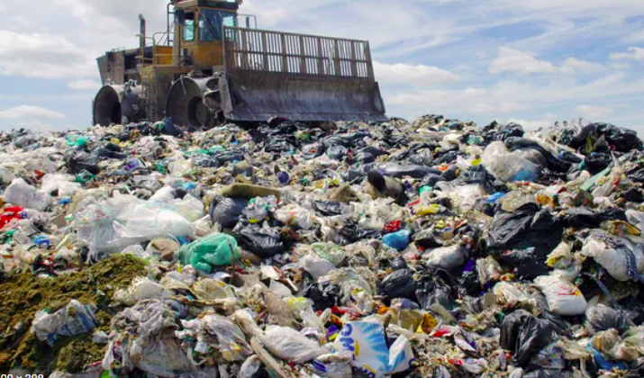
Why Now?
ARTICLE 37: Authorize Select Board to Petition to Impose a Checkout Bag Charge
Waste and climate crisis
Rising costs (bags, disposal/recycling)
Paper bag cost recently doubled ($0.10 → $0.20)
Crosby’s: “Starting to eat into margins”
Support by large retailers in town
Crosby’s, Concord Market, Debra’s
Still no statewide regulation
Neither for restrictions on single-use plastic bags, nor check-out bag charges

Slide 11
How Would It Work?
ARTICLE 37: Authorize Select Board to Petition to Impose a Checkout Bag Charge
At point-of-sale, retailers ask if you want a bag
Purchased bags treated like any other item
Listed on receipt
Subject to MA tax
Money collected remains with retailer
Charge would apply to any bag material type

Slide 12
Exemptions
ARTICLE 37: Authorize Select Board to Petition to Impose a Checkout Bag Charge
Bags in which loose products are placed by the consumer to bring to check out area
Produce bags, etc.
Small non-handled bags (or “sleeves”)
Medication bags, bookstore bags, bags for loose hardware, etc
Non-handled dry cleaning bags

Slide 13
It Works
ARTICLE 37: Authorize Select Board to Petition to Impose a Checkout Bag Charge
MA cities
$0.05: Boston, Haverhill
$0.10: Newton, Cambridge, Framingham
No impact to local economy
Elsewhere
Other US cities (ie, Denver, Boulder, Durango - all $0.10)
California (2014), Maine, Vermont
Denmark (1993), Ireland (2002), Germany, France, Belgium, Netherlands

Slide 14
A Triple Win
ARTICLE 37: Authorize Select Board to Petition to Impose a Checkout Bag Charge
Win for the environment
Win for Concord residents
Win for Concord businesses

Slide 15
ARTICLE 37: Authorize Select Board to Petition to Impose a Checkout Bag Charge
Mr. Stein moves that the Town take affirmative action on Article 37 as printed in the handout.

Slide 16
Q&A
ARTICLE 37: Authorize Select Board to Petition to Impose a Checkout Bag Charge

Slide 17

We Have a Problem
ARTICLE 37: Authorize Select Board to Petition to Impose a Checkout Bag Charge
Americans are wasteful
Per capita, we generate more waste than any other nation in the world (1700 lb./person/year)
America is 4% of world’s population, but generates 12% of global municipal solid waste
Source: “Global Waste Generation and Recycling Indices 2019 Report,” Verisk Maplecroft
Notes:
Almost 1 tons of waste/person/year on average

Slide 18
Charge vs. Refund?
ARTICLE 37: Authorize Select Board to Petition to Impose a Checkout Bag Charge
A charge is significantly more effective in changing human behavior than a refund/bonus
Example: $0.05 checkout bag charge/refund experiment in the DC area (2018)
“While the tax decreased disposable bag use by over forty percentage points, the bonus generated virtually no effect on behavior. These results are consistent with a model of loss aversion.”
Source: “Can Small Incentives Have Large Effects? The Impact of Taxes versus Bonuses on Disposable Bag Use.” Nov. 2018, Princeton University, Dept. of Economics

Slide 19
Unintended Consequences of Ban-Only Policies
ARTICLE 37: Authorize Select Board to Petition to Impose a Checkout Bag Charge
They shift people to using and disposing more paper bags
Paper better on degradability, but worse on net GHGs, water use, chemical emissions, deforestation.
They risk being environmentally counterproductive
Concord’s Plastic Bag Reduction Bylaw (2015) bans single-use plastic checkout bags, but retailers can be exempt by increasing bag thickness to make them “reusable” - violating bylaw intent
A checkout bag charge (coupled with a ban on single-use plastic checkout bags) is the most effective policy
Notes:
In the U.S., over 10 billion paper bags are consumed each year, requiring the felling of 14 million trees.
https://news.climate.columbia.edu/2020/04/30/plastic-paper-cotton-bags/#:~:text=Paper%20bags%20are%20made%20from,felling%20of%2014%20million%20trees.

Slide 20
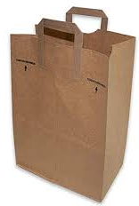
ARTICLE 37: Authorize Select Board to Petition to Impose a Checkout Bag Charge
Number of Uses Needed to Beat Single-Use
Plastic Bags on GHG Emissions
Paper: 3
Polypropylene: 11
Cotton: 131
Source: “Life cycle assessment of supermarket carrier bags.” UK Environment Agency. Report SC030148. 2011.

