Slide 1
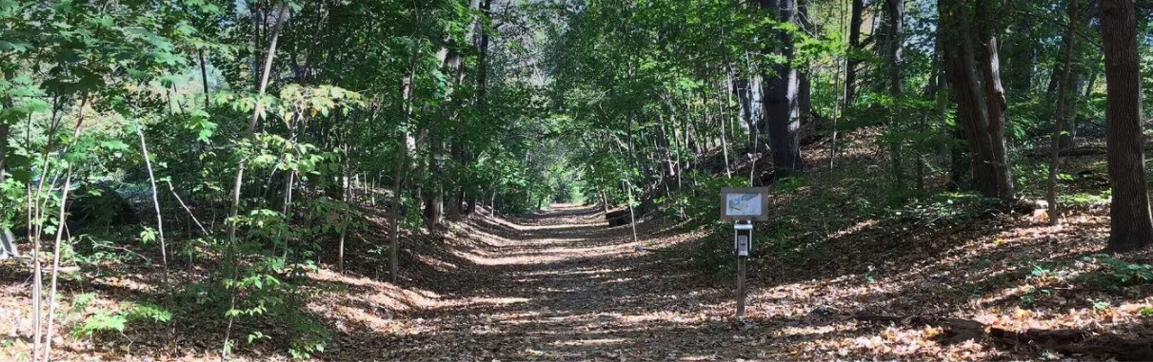
ARTICLE 47: Preserve Concord’s Reformatory Branch Trail
Preserve Concord’s Reformatory Branch Trail

Slide 2
Mr. Gailus moves that the Town recommend, to the owners of the various portions of the Reformatory Branch Trail in Concord and to the individuals and entities and all other parties responsible for the care thereof, that the Trail continue to be maintained in an unpaved natural condition for walking, hiking, jogging, dog walking, nature immersion, nature observation, photography, and cycling; …
ARTICLE 47: Preserve Concord’s Reformatory Branch Trail

Slide 3
… and that any future changes made to drainage, to features affecting individuals with reduced mobility, or to other aspects of the Trail, be done in a way that causes the least injury possible to existing trees, does not clear-cut trees to make the trail wider, and preserves to the greatest extent possible the existing natural characteristics of the Trail.
ARTICLE 47: Preserve Concord’s Reformatory Branch Trail

Slide 4
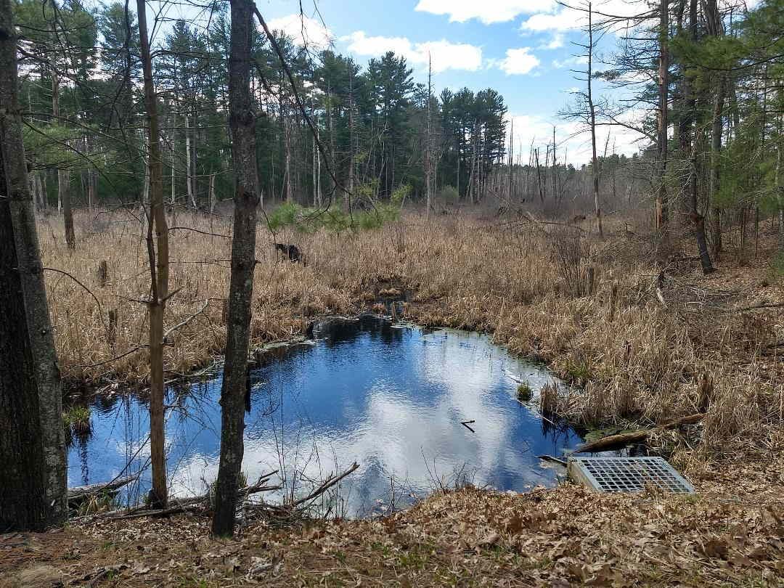
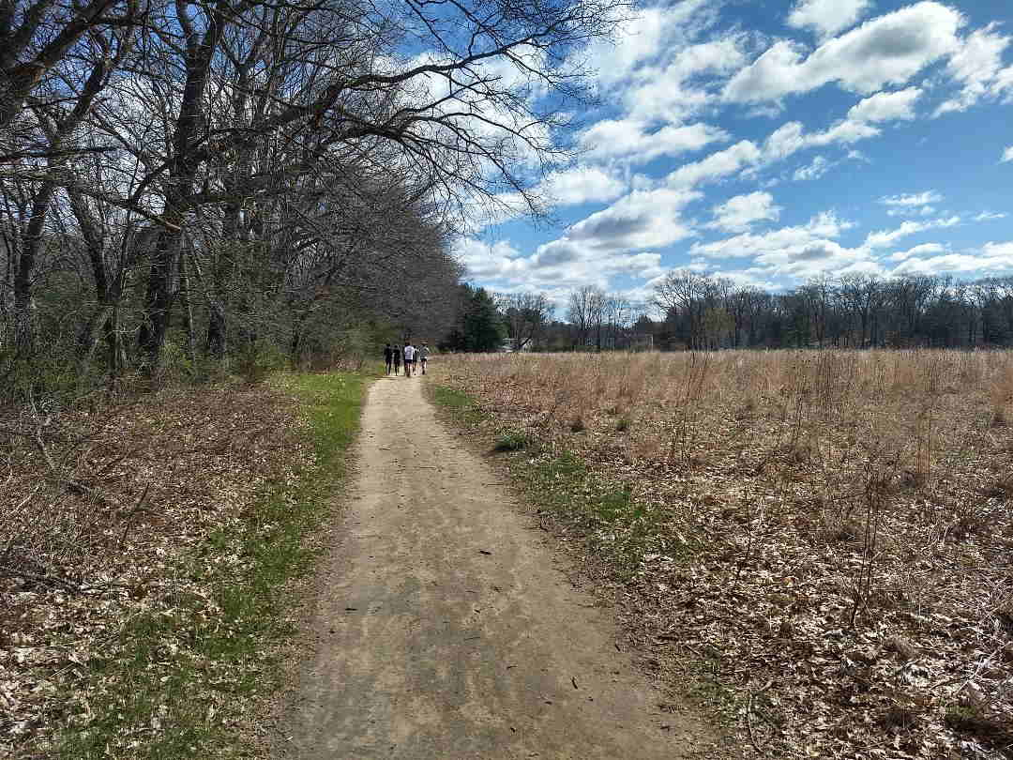
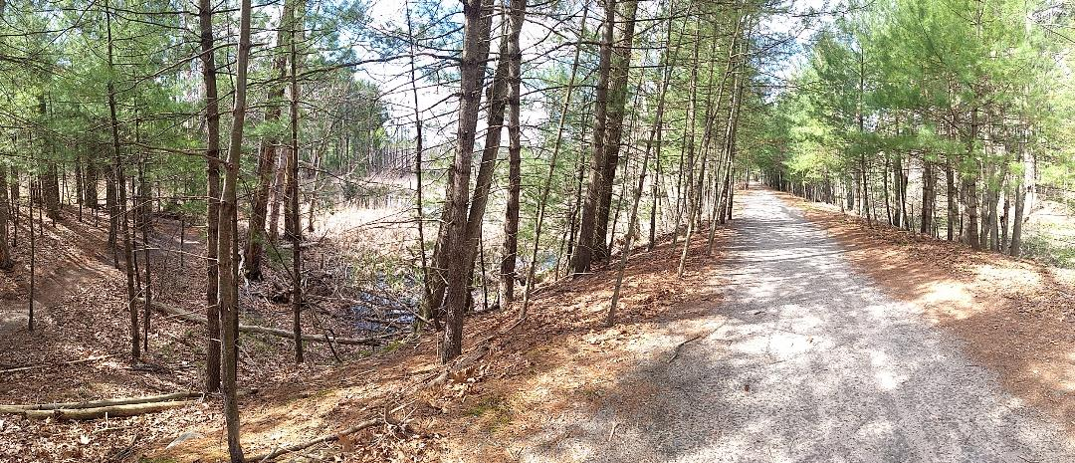
Concord's Reformatory Branch Trail is a gem of natural beauty and rare species habitat.
ARTICLE 47: Preserve Concord’s Reformatory Branch Trail

Slide 5
This Town asset is currently enjoyed by a wide range of users, including walkers, joggers, dog walkers, bird watchers, as well as cyclists of all levels and ages.
ARTICLE 47: Preserve Concord’s Reformatory Branch Trail

Slide 6
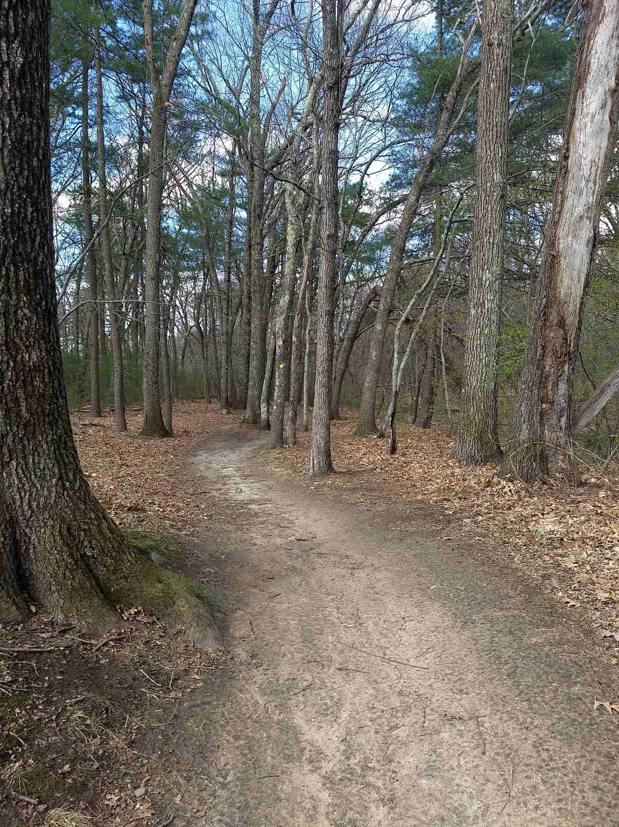
In light of recent threats to the survival of this exemplar of a mixed-use natural trail, this article reaffirms the Town's commitment to protect and preserve it.
ARTICLE 47:
Preserve Concord’s Reformatory Branch Trail

Slide 7
Special interests who favor extending the asphalt-paved Minuteman Bikeway through Concord using the Reformatory Branch Trail as the first step to implement a “vision” of MAPC Transportation planning.
ARTICLE 47: Preserve Concord’s Reformatory Branch Trail
Threats to this natural trail include:
MAPC = Metropolitan Area Planning Council

Slide 8
At the Oct. 21, 2021 HATS meeting, the MAPC Senior Transportation Planner shared his vision of building a bikeway through historic Concord, beginning with the Reformatory Branch Trail, a project to be followed by either land-taking and re-bridging of two rivers, or by constructing a bikeway along Barrett’s Mill Farm.
ARTICLE 47: Preserve Concord’s Reformatory Branch Trail
YouTube™ “Hanscom Area Towns Selectmen October 21, 2021”
https://www.youtube.com/watch?v=0WILM4H_5go
HATS = Hanscom Area Town Selectmen

Slide 9
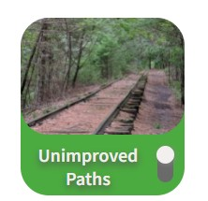
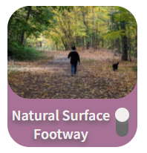
Contrary to actual fact, the MAPC’s “Trailmap” of regional trails, mislabels Concord’s Reformatory Branch Trail with the inaccurate “Unimproved Paths” image on the left instead of a more accurate “Natural Surface Footway” image on the right.
ARTICLE 47: Preserve Concord’s Reformatory Branch Trail

Slide 10
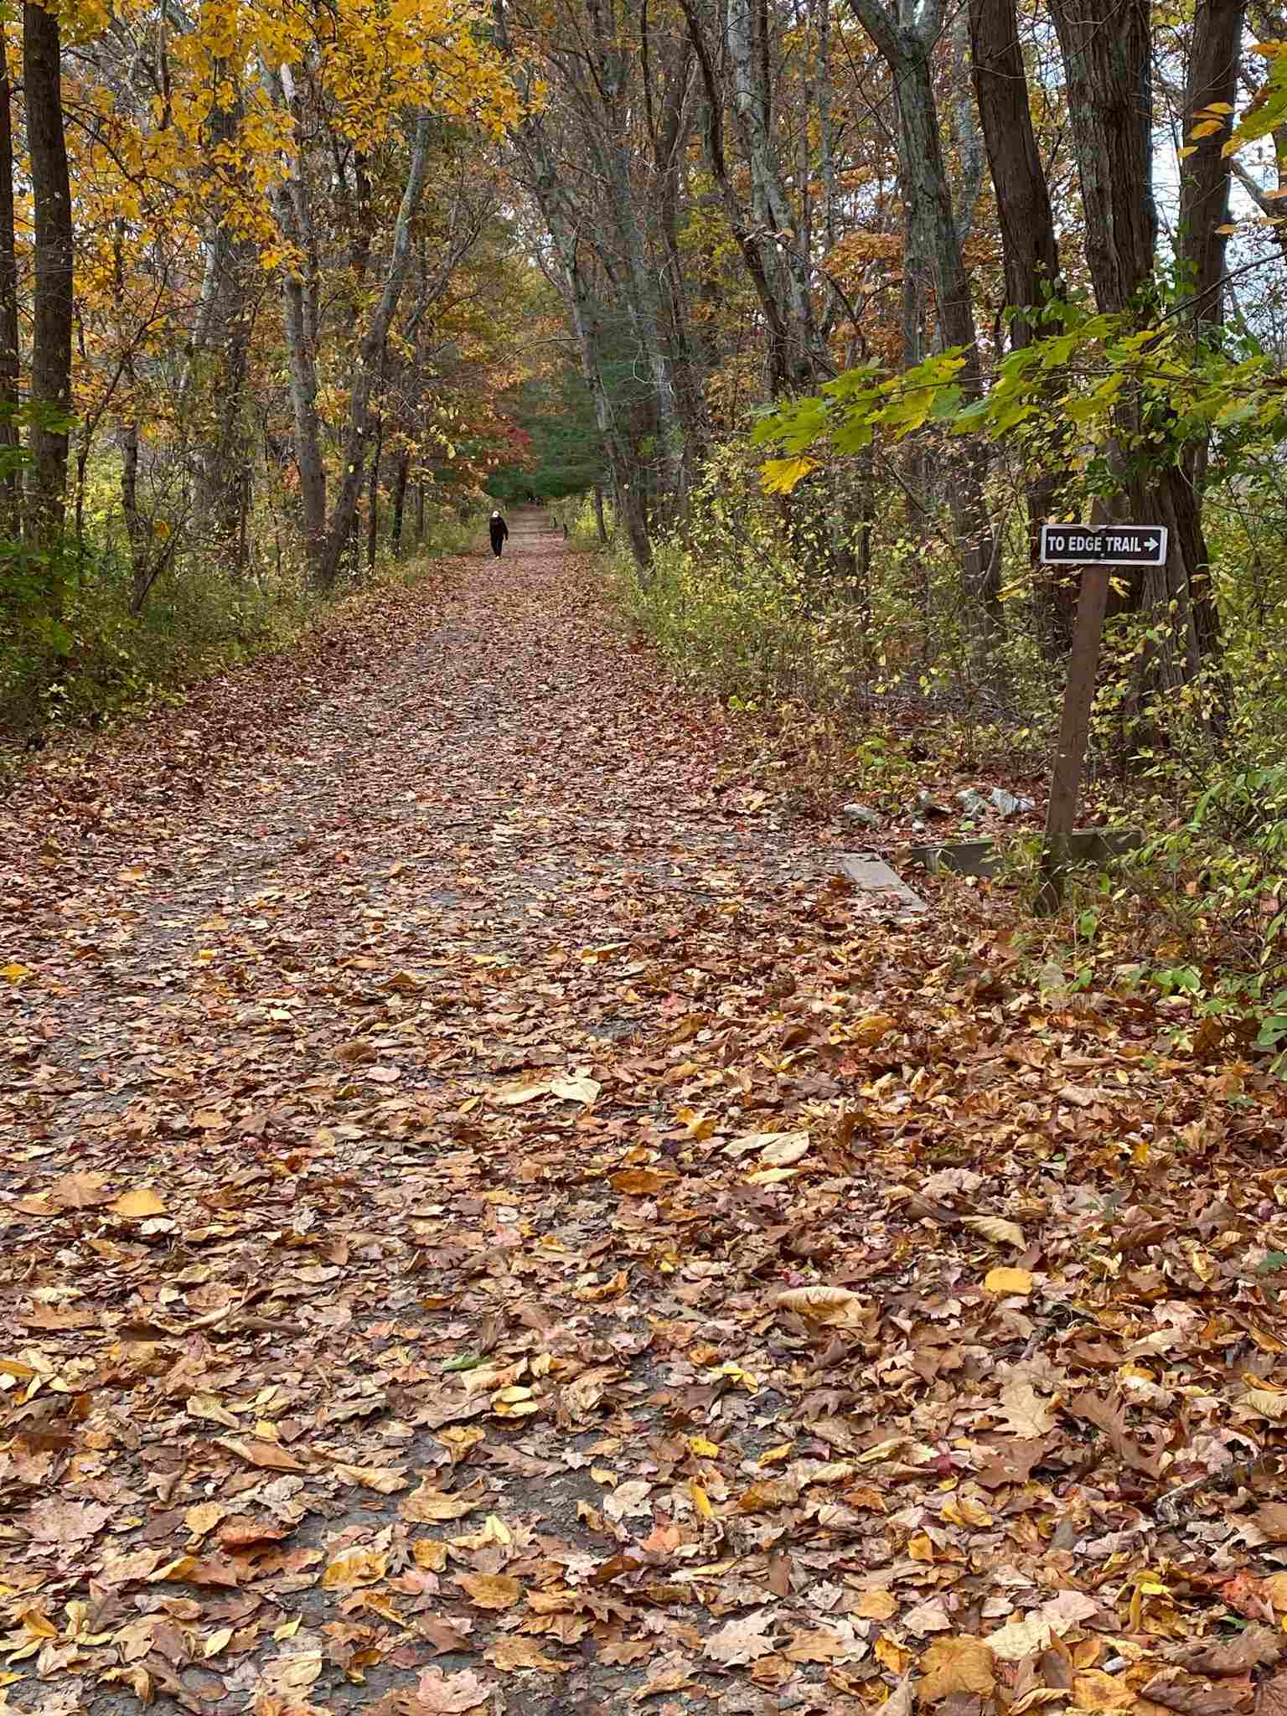
ARTICLE 47:
Preserve Concord’s Reformatory Branch Trail
The Reformatory Branch Trail
is maintained by the
Trails Committee & Trail Stewards, assisted by the
Division of Natural Resources
& Department of Public Works

Slide 11
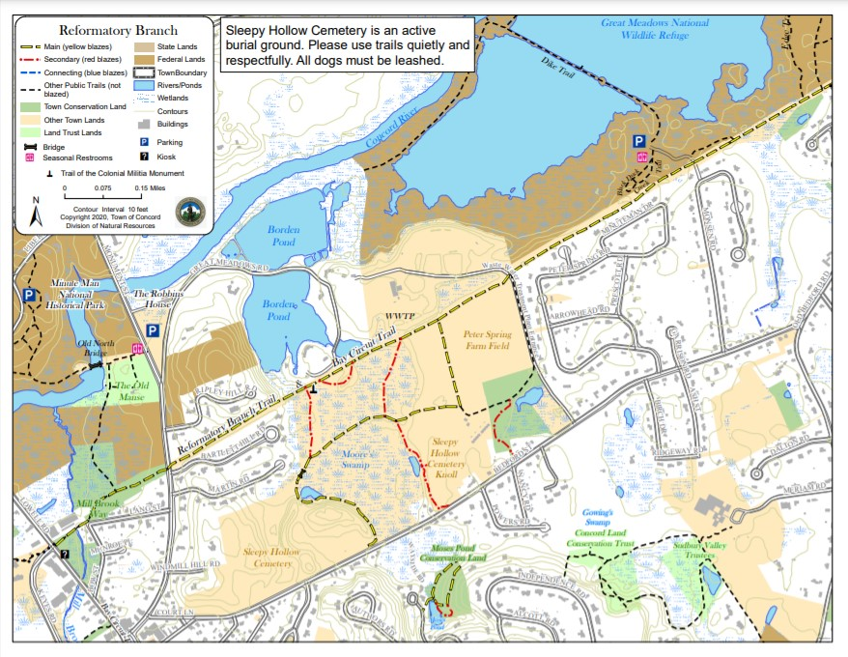
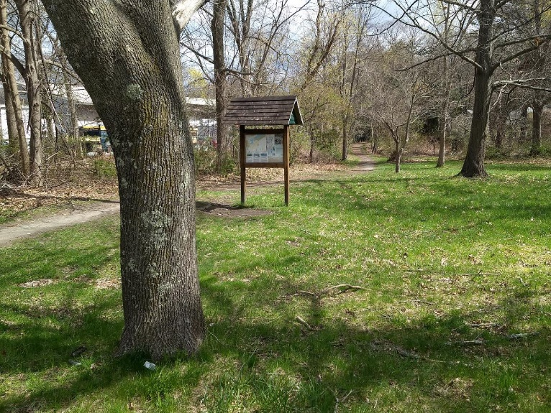
ARTICLE 47: Preserve Concord’s Reformatory Branch Trail
Division of
Natural Resources
Trail Map and Trail Guide:
https://www.concordma.gov/DocumentCenter/View/29011/Reformatory-Branch-Trail-Guide

Slide 12
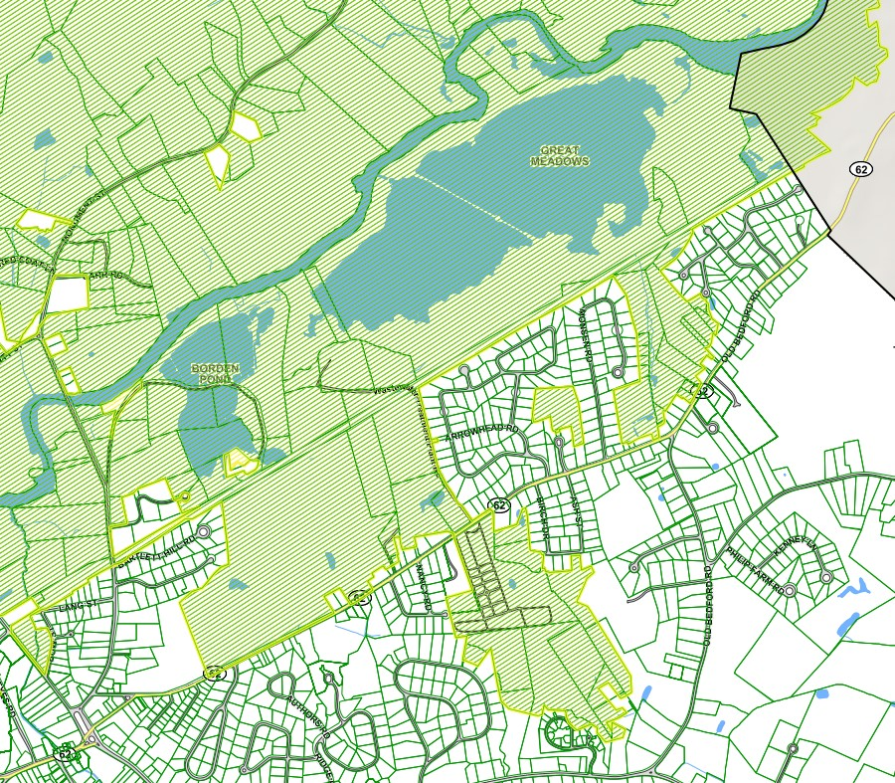
The broad red line shows the general location of Concord’s Reformatory Branch Trail which passes through wetland areas, wooded areas, and by farmland.
ARTICLE 47: Preserve Concord’s Reformatory Branch Trail

Slide 13
~1 mile of the Trail directly adjoins US Fish and Wildlife’s Great Meadows National Wildlife Refuge, whose large water impoundments appear in dark green at the top, below the meandering Concord River.
ARTICLE 47: Preserve Concord’s Reformatory Branch Trail

Slide 14
Importantly:
The Trail is imbedded in the middle of
Rare Species Habitat:
All of the area shown in light green.
ARTICLE 47: Preserve Concord’s Reformatory Branch Trail

Slide 15
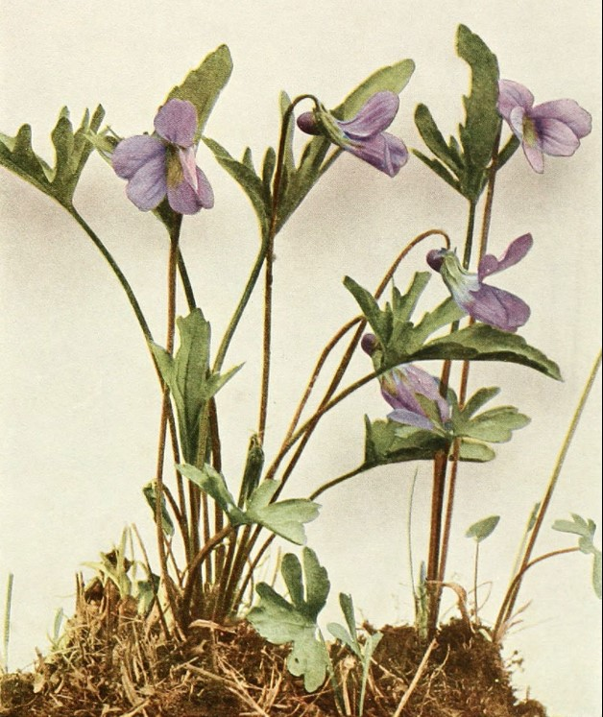
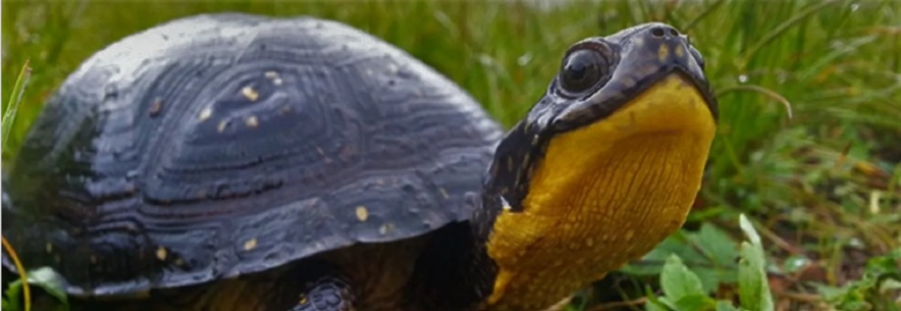
ARTICLE 47: Preserve Concord’s Reformatory Branch Trail
These local rare species are in our care.
They are our responsibility.
Blanding’s Turtle
Britton’s Violet
(Wikipedia)

Slide 16
Concord’s 1995 Bikeways Task Force Report stated
“… the goal should be the reservation of this trail for passive pedestrian use” for reasons that are still true:
ARTICLE 47: Preserve Concord’s Reformatory Branch Trail
Impact on endangered species habitat
U.S. Fish & Wildlife Service concerns for capacity

Slide 17

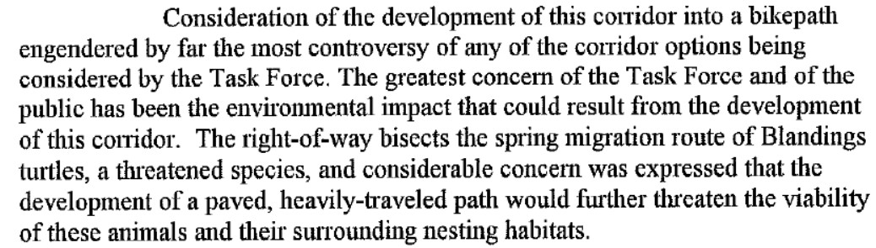
ARTICLE 47: Preserve Concord’s Reformatory Branch Trail

Slide 18
ARTICLE 47: Preserve Concord’s Reformatory Branch Trail
This concern still applies.

Slide 19
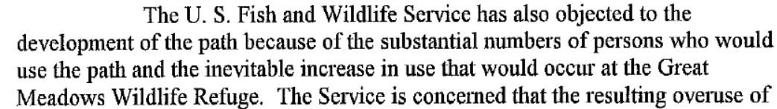
ARTICLE 47: Preserve Concord’s Reformatory Branch Trail

Slide 20
ARTICLE 47: Preserve Concord’s Reformatory Branch Trail
tan
tan
tan
This concern still applies.

Slide 21
This nature immersive natural trail in Concord provides mental and physical health benefits.
ARTICLE 47: Preserve Concord’s Reformatory Branch Trail
https://www.ncbi.nlm.nih.gov/pmc/articles/PMC7459647/
https://e360.yale.edu/features/ecopsychology-how-immersion-in-nature-benefits-your-health

Slide 22
ARTICLE 47: Preserve Concord’s Reformatory Branch Trail
Preserving existing mature trees is also important for local ecology, biodiversity, and environment:
“Growing existing forests to their biological carbon sequestration potential optimizes CDR while limiting climate change and protecting biodiversity, air, land, and water.”
https://www.frontiersin.org/articles/10.3389/ffgc.2019.00027/full
“It can take decades for young trees to start trapping carbon dioxide in considerable amounts.”
“Proforestation is when we let trees grow to their full potential.”
https://www.dogwoodalliance.org/2021/05/what-does-proforestation-look-like/

Slide 23
Concord’s Reformatory Branch Trail is an exemplar of a mixed-use natural trail, and this article reaffirms the Town's commitment to protect and preserve it.
ARTICLE 47: Preserve Concord’s Reformatory Branch Trail

Slide 24
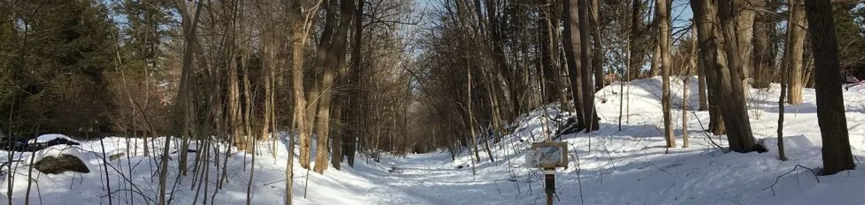
This trail in its present state teaches us about
Nature’s powers of recovery and renewal.
ARTICLE 47: Preserve Concord’s Reformatory Branch Trail

Slide 25
ARTICLE 47: Preserve Concord’s Reformatory Branch Trail
Preserve Concord’s Reformatory Branch Trail

