Slide 1
Article 29: Appropriation of Parking Meter Receipts
ARTICLE 29: Appropriation of Parking Meter Receipts
Ms. Ackerman moves to appropriate the sum of $300,000 from Parking Meter Receipts to fund expenses related to parking enforcement or public transportation initiatives for the fiscal year ending June 20, 2023.

Slide 2
Appropriation of Parking Meter Receipts
ARTICLE 29: Appropriation of Parking Meter Receipts
In accordance with Mass. Gen. Laws c.40, §22C, Parking Meter Receipts require annual appropriation
The amount available for appropriation is up to 100% of the estimated balance as of June 30 of the prior fiscal year

Slide 3
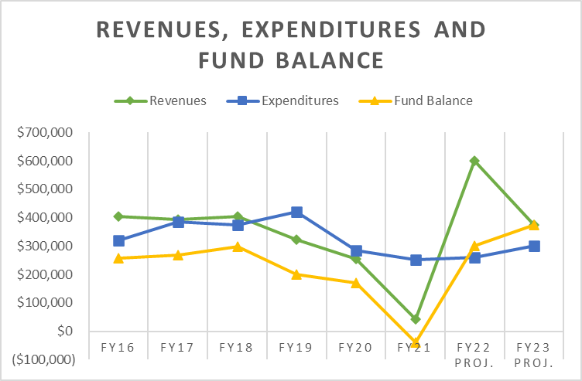

Slide 4
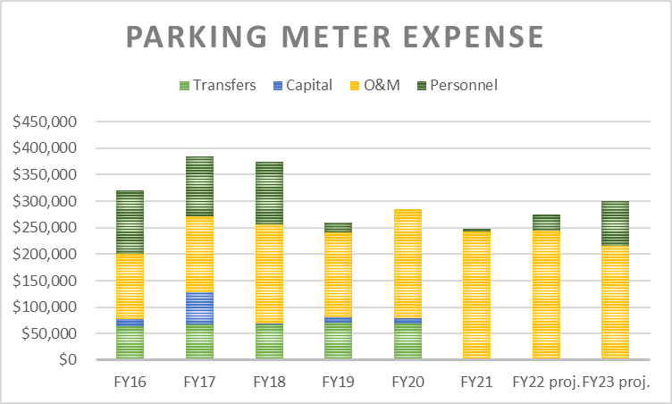
ARTICLE 29: Appropriation of Parking Meter Receipts

Slide 5
Article 28: Appropriation of Parking Meter Receipts
ARTICLE 29: Appropriation of Parking Meter Receipts
Ms. Ackerman moves to appropriate the sum of $300,000 from Parking Meter Receipts to fund expenses related to parking enforcement or public transportation initiatives for the fiscal year ending June 20, 2023.

