Slide 1

Article 32: Zoning Bylaw Amendment
Section 3.3 Formula Business
May 1. 2022
Annual Town Meeting
Notes:
Good afternoon. My name is Linda Miller and as a member of the Planning Board I will highlight, Article 32 which is a Zoning Bylaw Amendment that will add the Thoreau Depot Business District to our list of areas in the Formula Business Bylaw.

Slide 2
Article 32: Sec. 3.3 Formula Business
MOTION: Ms. Miller moves that the Town take affirmative action on Article 32 as printed in the Warrant with the following changes in the second paragraph under Section 3.3.2 :
The total number of formula businesses in the Concord Center Business District is limited to 12. The total number of formula businesses allowed in the Thoreau Depot Business District is limited to 14. The total number of formula businesses in the West Concord Business District and the West Concord Village District combined is limited to 10. When either the applicable limit is reached, no new formula businesses may be established in the applicable district until and unless an existing formula business closes, adapts so that it no longer qualifies as a formula business, or relocates outside of the affected business district. If a business in current operation becomes a formula business by means of additional locations being established, this business shall count toward the total number of formula businesses, but shall not be considered as a formula business being established.
Notes:
Ms. Miller moves that the Town take affirmative action on Article 32 as printed in the Warrant with the following changes in the second paragraph under Section 3.3.2 :
The total number of formula businesses in the Concord Center Business District is limited to 12. The total number of formula businesses allowed in the Thoreau Depot Business District is limited to 14. The total number of formula businesses in the West Concord Business District and the West Concord Village District combined is limited to 10. When either the applicable limit is reached, no new formula businesses may be established in the applicable district until and unless an existing formula business closes, adapts so that it no longer qualifies as a formula business, or relocates outside of the affected business district. If a business in current operation becomes a formula business by means of additional locations being established, this business shall count toward the total number of formula businesses, but shall not be considered as a formula business being established.

Slide 3
Purpose of the Bylaw & Warrant Article
Article 32: Sec. 3.3 Formula Business
To preserve the existing character, diversity, variety and scale of the district, which is vital to the continuation of Concord’s ability to attract both residents and visitors.
Add the Thoreau Depot Business District to Section 3.3 to limit the number of formula business to 14.
Notes:
The Formula Business Bylaw seeks to preserve the existing character and scale of our business districts. These districts are a great asset to Concord and enhance our ability to attract residents and visitors. This Warrant Article will limit the number of formula businesses in the Thoreau Depot Business District to 14.

Slide 4
What is a Formula Business?
Article 32: Sec. 3.3 Formula Business
A type of business activity that maintains two or more of the following standardized features:
1. array of services and/or merchandise, or menu
2. trademark, logo, service mark or symbol
3. décor, architecture, layout or color scheme
4. uniforms
sign
and these features are substantially the same at 15 or more such establishments, regardless of ownership or location.
Notes:
For those of you new to the concept of Formula Business, it is defined as a business activity with a variety of obvious standardized features (highlighted here) that are present at 15 or more establishments.
Concerns have been raised regarding the legality of the Formula Business Bylaw. It is important to note that the Formula Business Bylaw does not prohibit a formula business from being established, even if the maximum number has been reached. A formula business can adapt its business model to change these five features so that they are no longer standardized so that the business would no longer be considered a formula business.

Slide 5
Background on Formula Business Bylaw
Article 32: Sec. 3.3 Formula Business
In 2011, Town Meeting approved:
A definition of formula business
A limit of 10 formula businesses in the West Concord Business and West Concord Village Districts (combined)
A special permit process for establishing, expanding or relocating formula businesses
Notes:
As background, Concord has more than a decade of experience in limiting formula businesses in the Business Districts.
At Town Meeting in 2011, Formula Businesses were defined;
were limited to 10 in the West Concord Business and West Concord Village Districts (combined) and
A special permit process for establishing, expanding or relocation of formula businesses was approved.

Slide 6
Background on Formula Business Bylaw
Article 32: Sec. 3.3 Formula Business
In 2019, Town Meeting added:
A limit of 12 formula businesses in the Concord Center Business District
The formula business definition and special permit process for establishing, expanding or relocating formula businesses remains the same
Notes:
In 2019 Town Meeting limited the number of formula businesses in the Concord Center Business District to 12.

Slide 7
Article 32: Sec. 3.3 Formula Business
What’s Special about the Thoreau Depot
Rail service from Concord to surrounding communities and into Boston began at the Depot in June 1844, and has continued since.
Fitchburg railroad initially supported by a small freight & lumber yard reflecting Concord’s early industrial period. Thoreau complained that the village's schedule was set by the times of arrivals and departures at the station.
Notes:
What is Special about the Thoreau Depot Business District?
Historically, rail service from Concord to Boston began in 1844. This rail reflects Concord’s early industrial period.

Slide 8
Article 32: Sec. 3.3 Formula Business
What’s Special about the Thoreau Depot
Nowadays, nearby schools and playing fields, library and arts buildings, and Town Forest and Walden Pond attract residents and many visitors to the Depot area where it serves as a gateway to the Concord “experience”.
Attractive residential areas border the retail and transit hubs.
Notes:
Today, nearby Schools, Playing fields, library and arts buildings, the Town Forest and Walden Pond attract many to the area. Attractive residential areas border the retail and transit hubs.
In general, The Thoreau Depot Business District is a gateway to the “Concord experience”.

Slide 9
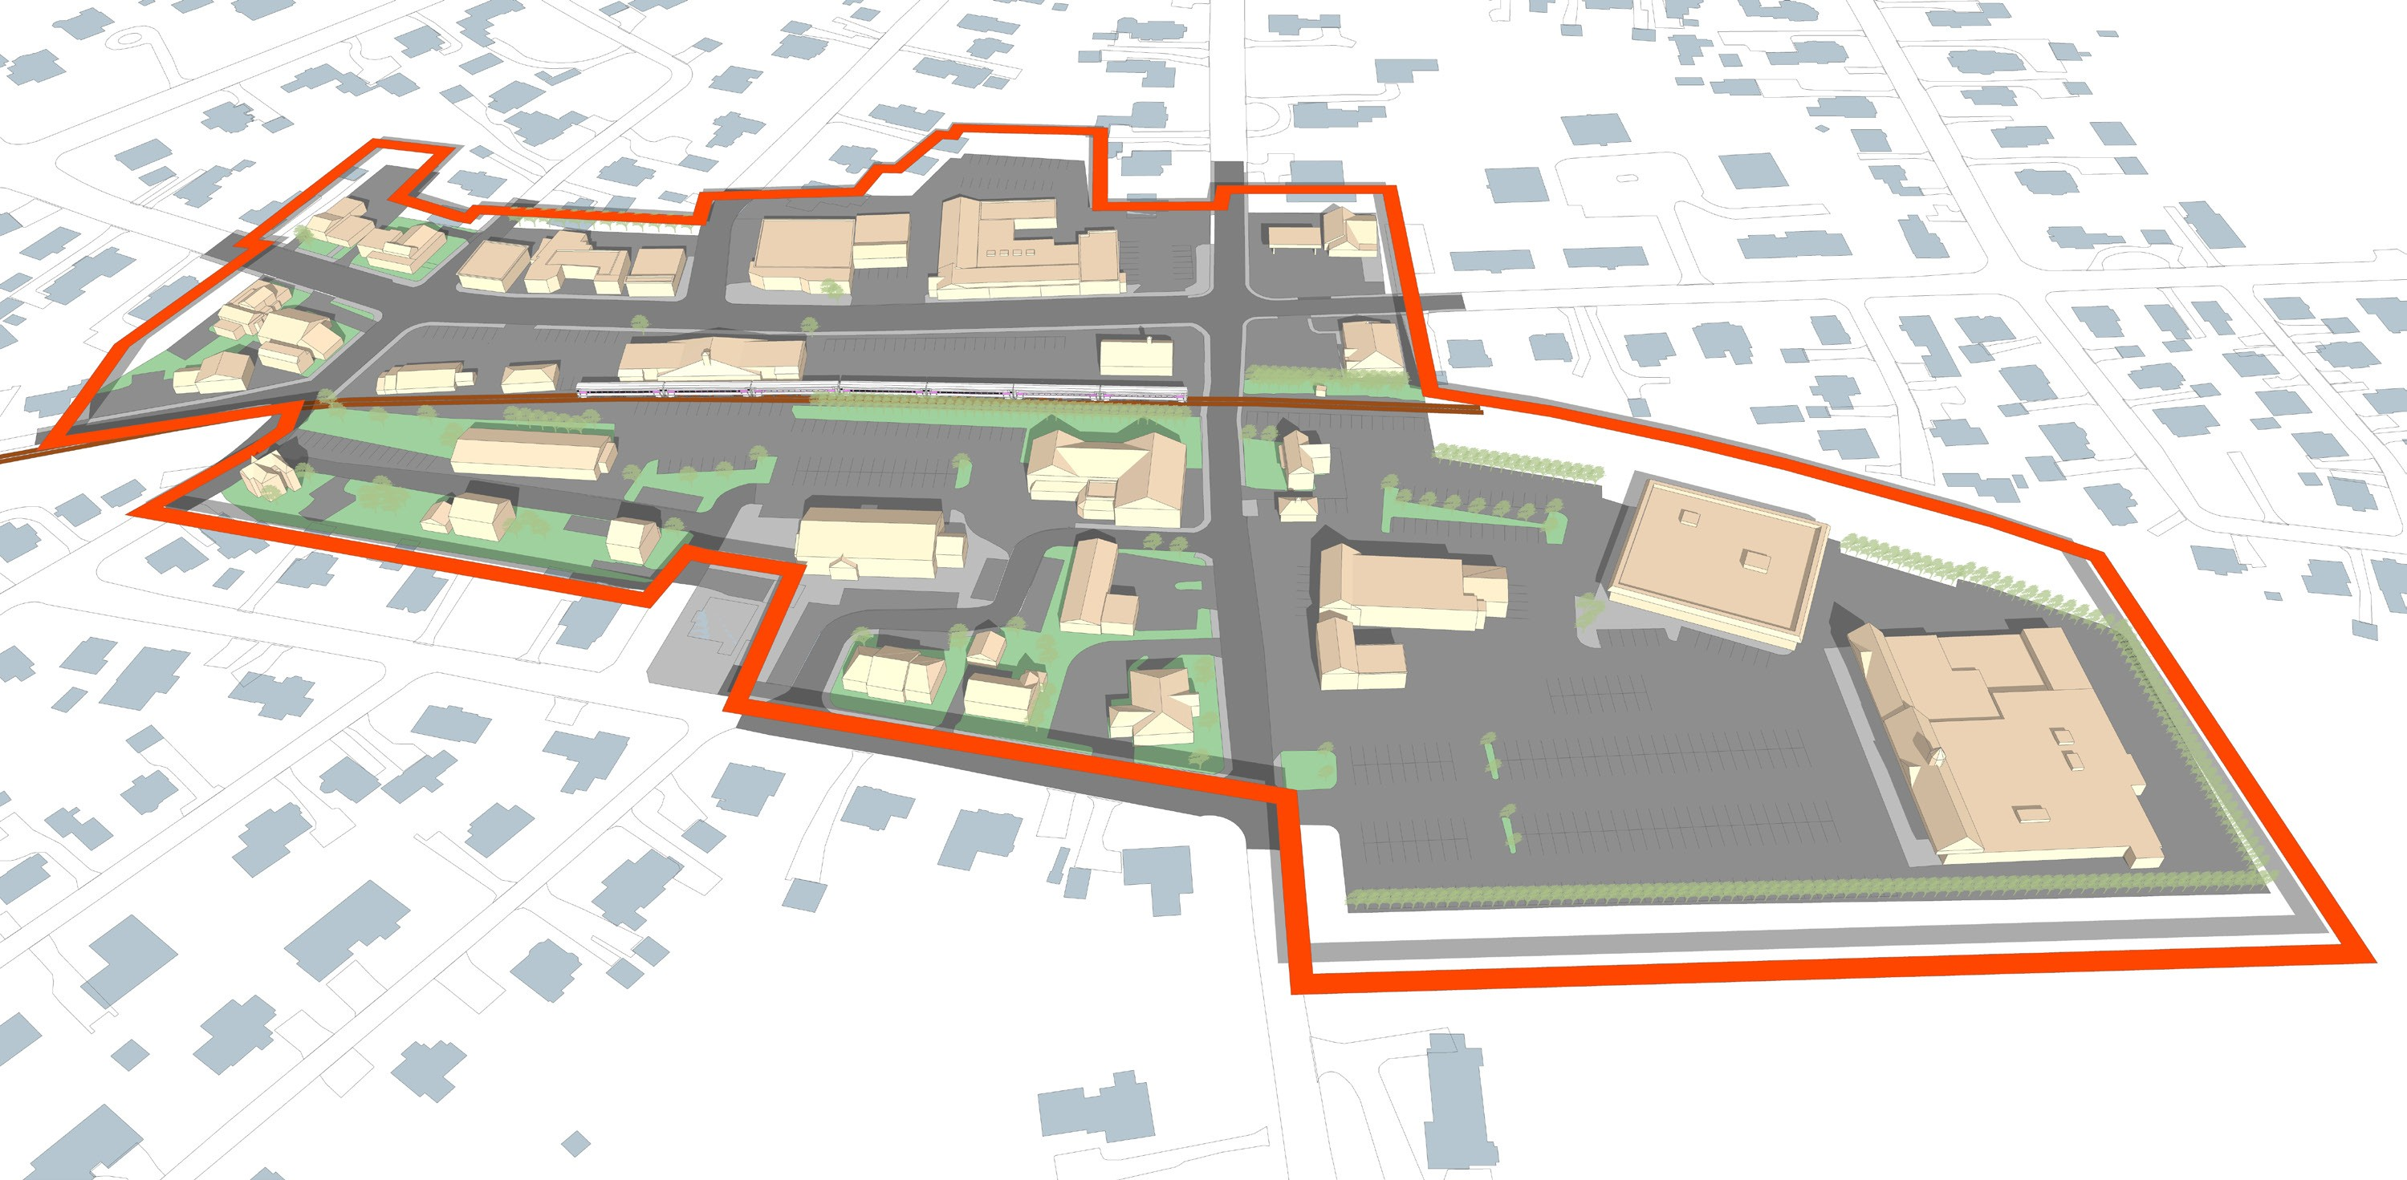
Boundary of Thoreau Depot Business District
Article 32: Sec. 3.3 Formula Business
Thoreau St.
Crosby’s Market
Sudbury Rd.
Notes:
This is a map of the Thoreau Depot Business District.

Slide 10
Existing TDB District Formula Businesses
Article 32: Sec. 3.3 Formula Business
Alphagraphics
Lapels Cleaners
Verizon Store
Cambridge Savings Bank
UPS Store
Rocky’s Ace Hardware
CVS
Dunkin Donuts
Starbucks
Mobil Gas Station
Cumberland Farms
Fitness Together
Total: 12 as of January 2022
Notes:
…and a list of current Formula Businesses.

Slide 11
Why set a limit of 14 formula business?
Article 32: Sec. 3.3 Formula Business
Preserves the current mix
Allows for the organic growth of existing businesses
Allows for a couple new formula businesses
Notes:
Why set the limit at 14? This preserves the current mix of valued Concord businesses at the Depot, allows for growth of those businesses and addition of new businesses.

Slide 12
Article 32: Sec. 3.3 Formula Business
MOTION: Ms. Miller moves that the Town take affirmative action on Article 32 as printed in the Warrant with the following changes in the second paragraph under Section 3.3.2 :
The total number of formula businesses in the Concord Center Business District is limited to 12. The total number of formula businesses allowed in the Thoreau Depot Business District is limited to 14. The total number of formula businesses in the West Concord Business District and the West Concord Village District combined is limited to 10. When either the applicable limit is reached, no new formula businesses may be established in the applicable district until and unless an existing formula business closes, adapts so that it no longer qualifies as a formula business, or relocates outside of the affected business district. If a business in current operation becomes a formula business by means of additional locations being established, this business shall count toward the total number of formula businesses, but shall not be considered as a formula business being established.
Notes:
Ms. Miller moves that the Town take affirmative action on Article 32 as printed in the Warrant with the following changes in the second paragraph under Section 3.3.2 :
The total number of formula businesses in the Concord Center Business District is limited to 12. The total number of formula businesses allowed in the Thoreau Depot Business District is limited to 14. The total number of formula businesses in the West Concord Business District and the West Concord Village District combined is limited to 10. When either the applicable limit is reached, no new formula businesses may be established in the applicable district until and unless an existing formula business closes, adapts so that it no longer qualifies as a formula business, or relocates outside of the affected business district. If a business in current operation becomes a formula business by means of additional locations being established, this business shall count toward the total number of formula businesses, but shall not be considered as a formula business being established.

