Slide 1
ARTICLE 36. Local Ballot Option
ARTICLE 36: Local Ballot Option
Ms. Ackerman moves:
That the Town adopt the provisions of Mass. Gen. Laws c. 53, § 18B , which would allow the Town to provide Concord voters with information related to ballot questions.

Slide 2
Why Vote for this?
ARTICLE 36: Local Ballot Option
Legal language on ballot question can be confusing.
Add explanations, including Pros /Cons.
Voters receive summary explanation in the mail.
May improve voter turnout.
Accept MGL c. 53, § 18B. No other action needed.

Slide 3
What is Included
ARTICLE 36: Local Ballot Option
Full text of each question
Fair and concise summary of each question
Pro and Con Arguments
One sentence explaining the impact of a Yes vote
One sentence explaining the impact of a No vote
* Mailed to every voting household
* On handout available at the polls

Slide 4
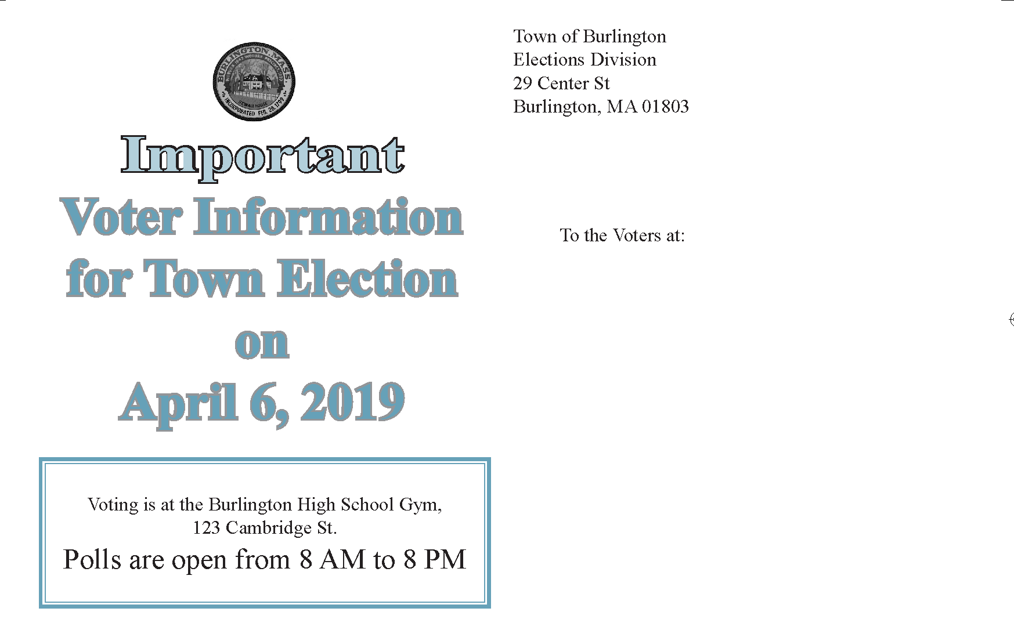
ARTICLE 36: Local Ballot Option

Slide 5
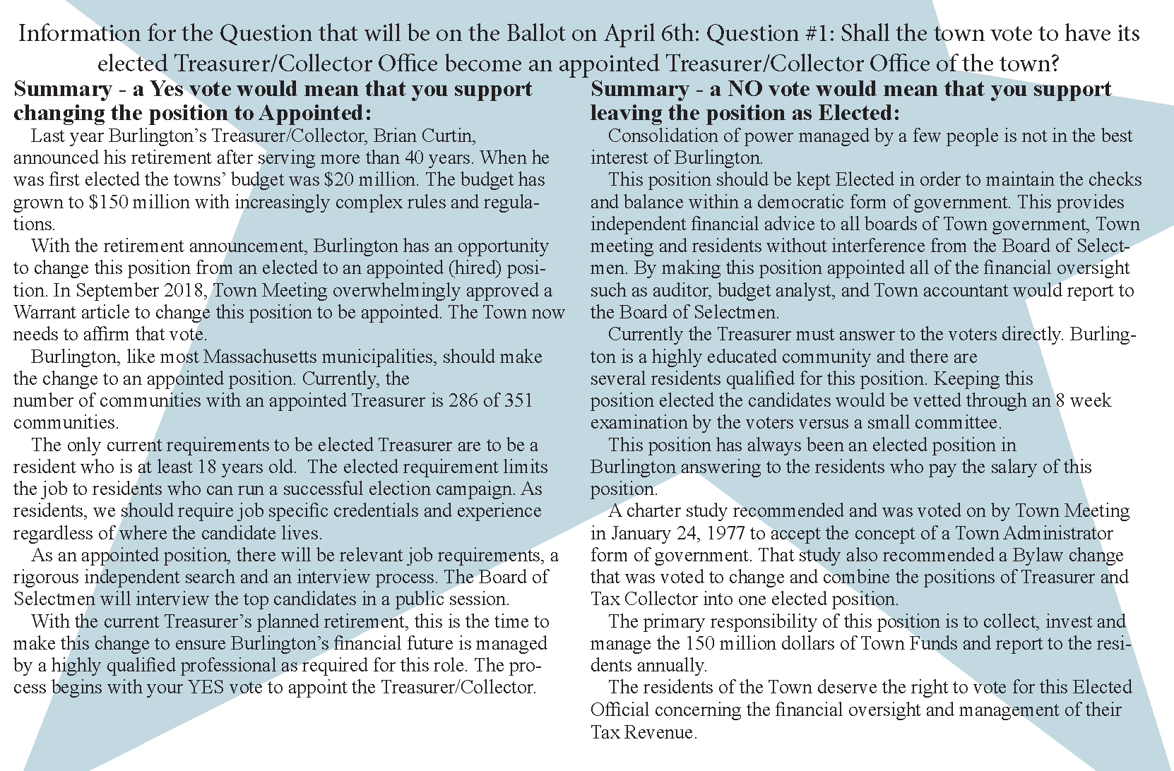
ARTICLE 36: Local Ballot Option

Slide 6
Timetable
ARTICLE 36: Local Ballot Option
Ballot Question Vote | Select Board votes that question shall appear on ballot.
35 days before election | Select Board notifies Town Clerk.
28-34 days before election | Proponents/opponents asked to submit written arguments.
At least 20 days before election | Summary arguments sent to Select Board for mailing to voters.
At least 7 days before election | Ballot question & summary arguments mailed to households.

Slide 7
ARTICLE 36. Local Ballot Option
ARTICLE 36: Local Ballot Option
Ms. Ackerman moves:
That the Town adopt the provisions of Mass. Gen. Laws c. 53, § 18B , which would allow the Town to provide Concord voters with information related to ballot questions.

