Slide 1
ARTICLE 10: Capital Improvement & Debt Plan
Ms. Ackerman moves that the Town take affirmative action on Article 10, as printed in the handout pertaining to the Article.

Slide 2
Capital Spending Categories
Tier One:
Cash Outlay
Minimum useful life of 2 or more years
Maximum cost per item is $250,000
Total FY23 request is $1,509,700
Tier Two:
Debt Issuance
Minimum useful life of 5 or more years
Maximum cost per item/ project is $2,500,000
Total FY23 request is $4,500,000

Slide 3
General Government
Information Systems | Technology Upgrades | $200,000
Facilities Administration | Building Improvements | $40,500
Facilities Administration | Feasibility Study – Carousel Pre-School | $25,000
Resource Sustainability | Resource Sustainability Fund | $100,000
Finance
Assessors | Recertification & Revaluation | $35,000
Planning & Land Management
Planning | Subdivision Rules & Regulations Update | $75,000
Natural Resources | Pond, Stream, & Field Management & Improve | $20,000
Public Safety
Police Department | Vehicles, Equipment, & Training Rm. Upgrades | $259,200
Fire Department | Vehicles and Equipment | $135,000
Public Works
Engineering | Asset Mgt., Safety, Stripping, Signage, & Signals | $235,000
Highway Maintenance | Small Equipment | $7,500
Park and Trees | Small Equipment and Shade Trees | $37,500
Heavy Equipment | Vehicles & Heavy Equipment | $340,000
CAPITAL OUTLAY TOTAL |  | $1,509,700
Capital Outlay:
$1,509,700
Notes:
Here are the Tier 1 or Capital Outlay Projects sorted by Department.

Slide 4
Capital Outlay: Improvements
Technology Improvements
Facility Improvements
Knox Trail Exterior Painting and Repairs
Hunt Gym Conference Room Window Replacement
Hunt Gym Plexiglas Storm Window Replacement
Firewall Acquisition
Remote Meeting Tech.
Staff Computers
Datacenter Battery Backups
Public Bld. Wireless Improvements

Slide 5
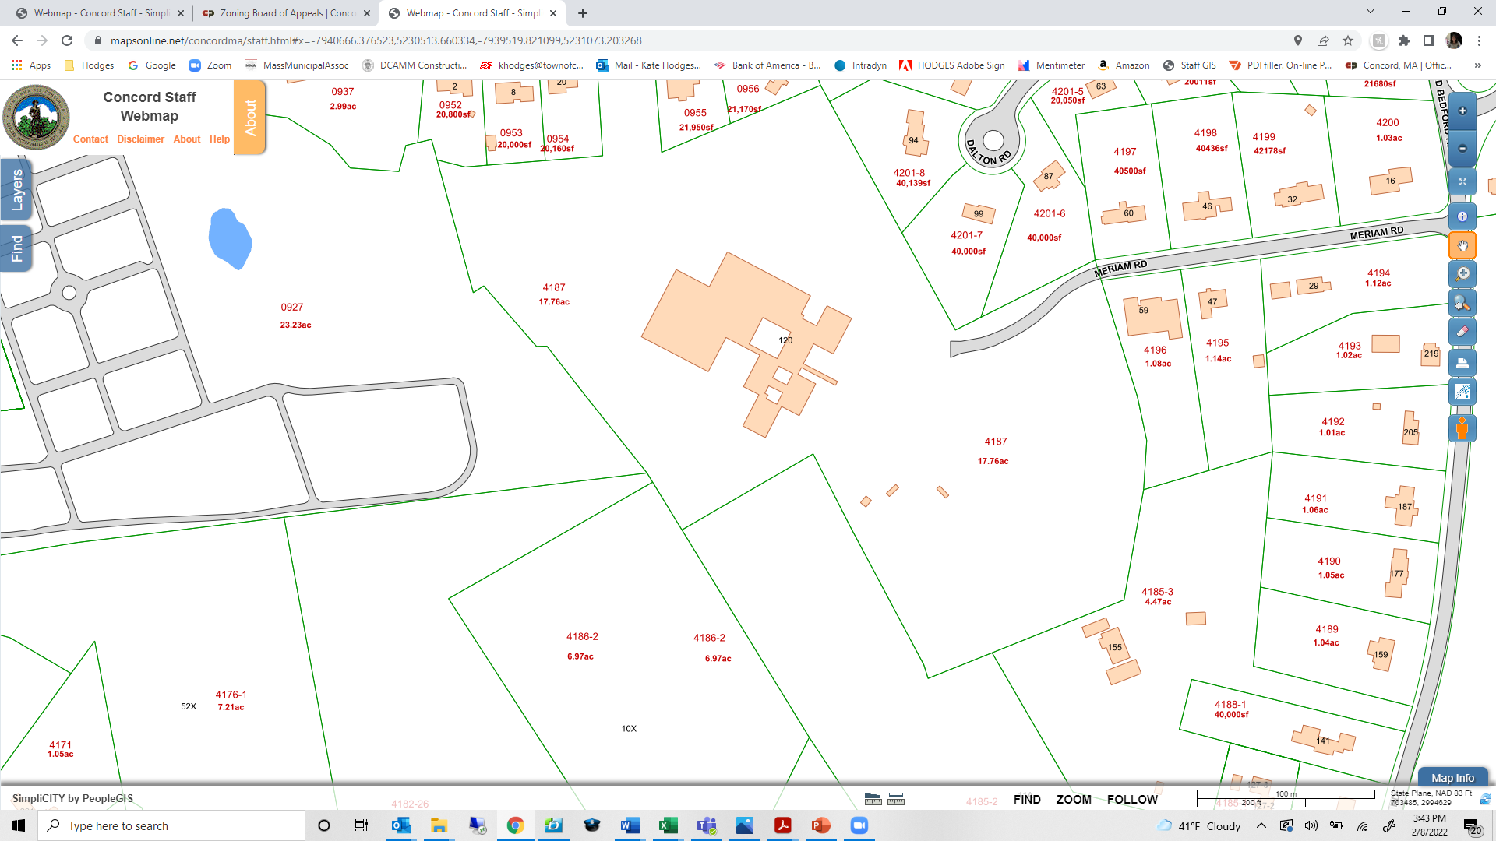
Concord Elder Services/COA &
Carousel Preschool
Feasibility Study
COA
Notes:
$25,000 is allocated for a feasibility study relative to the use of the three Ripley building pods which are currently leased to the Concord Children’s Center. The Children’s Center is constructing a new facility for their operation and expect to vacate the space in 2023. This will allow the space to be used, potentially, for Concord Recreation’s Carousel Preschool which is currently housed in the western wing of the Harvey Wheeler Community Center.
Harvey Wheeler is also the home of the Concord COA. We have discussed the need for expanded senior programming areas as the senior population have been growing a great deal over the past many years. The ability for the COA to expand and use the entirely of the Harvey Wheeler building will not only benefit the seniors in Concord, but help that operation sustain and grow as our community ages.
Carousel’s move will allow them to continue to provide important preschool and early childhood educational care close to Concord Center the hub of Concord Recreation which is the Hunt Gym

Slide 6
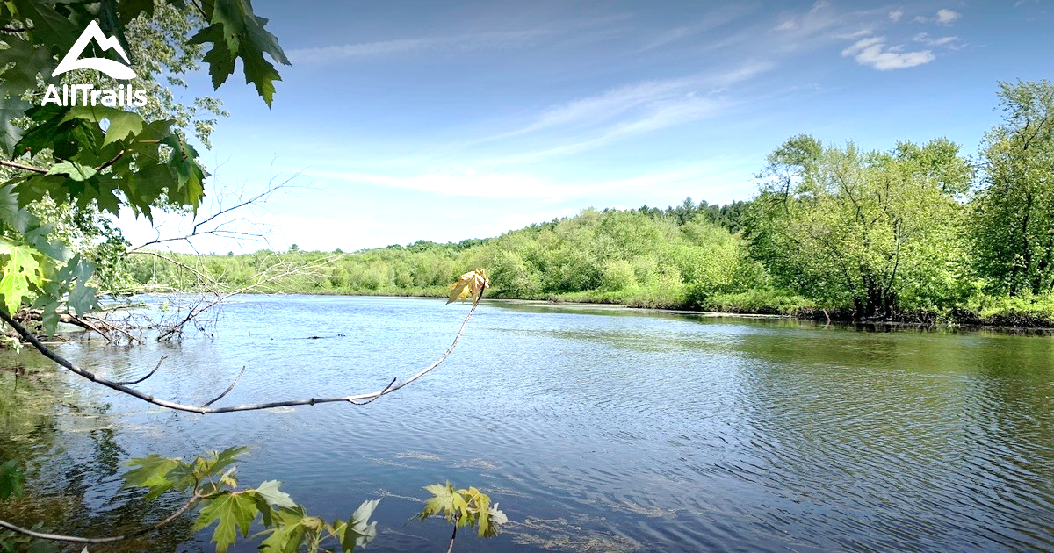

Planning & Land Management
Subdivision Rules & Regulations Update
Pond, Stream & Field Management or Improvements
Notes:
The Town’s subdivision rules and regulations were last updated in 2007. At this time, they are not up to date with current practices for stormwater management, landscaping and engineering design standards for roadway improvements. This request is for $75K to fund a consultant to assist in updating these and ensuring the regulations comply with State legislation and the Subdivision Control Law.
$10K is requested for pond and stream management and intended to provide limited funds for emergency response situations which arise in these areas. The hope is that when something happens in these are – such as flooding of small rivers or tributaries because of bever activities, we are able to react and respond before there is damage. This amount can also be used to plant or replant wetland areas which have been disturbed.
$10K is also requested for agricultural fields improvements and is intended to provide a source of funding to purchase materials and hire contractors that will work to improve soil characteristics and quality and to define or delineate agricultural land or preserve farm fields within the Town’s more than 200 acres of municipally-owned fields.

Slide 7

Capital Outlay: Improvements
Sustainability Improvements
Finance Improvements
Matching Funds for Green Communities
Environmental Efforts & Community Stewardship Events
Electric Vehicle Charges
EV Grant Matches
Cyclical Revaluation & Recertification (every 5 years)
Notes:
$100,000 will be allocated to Sustainability efforts Town Wide which has been Concord’s practice for nearly 10 years. Examples of how these funds may be used can be seen here and include matching funds for grant opportunities and expanded the Town’s electrical vehicle capacity and fleet.
Following a change in Massachusetts state law in 1979, all communities are required to perform a comprehensive valuation of all properties within the community, including a detailed market analysis relative to property sales.
Once this is complete a community can be "certified" by the state’s Department of Revenue. All communities are required to be "recertified" every five years, in order to be recertified, a community must demonstrate that it has maintained the integrity of its property data, analyzed the sales market, adjusted values to be at 100 of market value, and met various statistical requirements.
The $35,000 sought under this line item is for efforts relative to that endeavor.

Slide 8

Police Vehicles Equipment Training Room Upgrades
Maintain Community AED’s
Turnout Gear
Small Vehicle Replacement
POLICE
FIRE
Notes:
The Police Department will be receiving $259,200 for the replacement of 5 mobile laptop modems for their vehicles, to replace 4 vehicles in line with the Department’s vehicle fleet rotation. Due to the higher prices for Hybrid Utility Vehicles, each vehicle request needed to be increased by $5k.
As of now, the PD has _____ Hybrid vehicles and _____ fully electric vehicles.
Other needs for this funding include various public safety equipment, night vision goggles and replaced of the AV equipment on the 3rd floor station training room which is more than 15 years old.
Concord Fire is responsible for maintaining 31 community AED including at least one unit in each of the town buildings, each schools, and both public libraries. The funds are to replace the batteries in each of the units.
Firefighter turnout gear has also been requested at a funding level of $30K. The integrity to the equipment is vital to the safety of the Fire Personnel and there is a 10-year lifespan on all equipment. Each FF has 2 sets of gear which equal one set every 5 years in terms of replacement schedules.

Slide 9
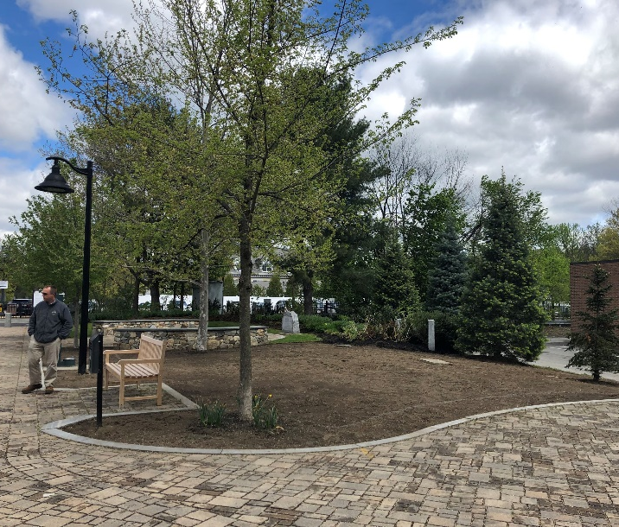
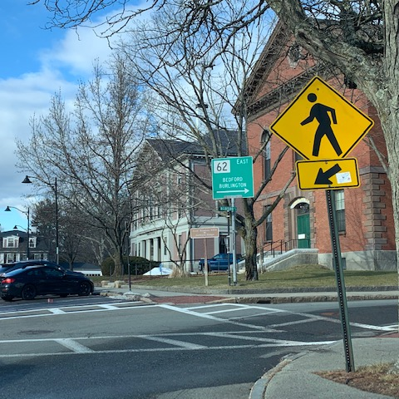
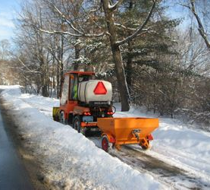
Public Works
Asset Management
Safety, Signals & Signals
Small Equipment
Shade Trees
Heavy Equipment
Notes:
This year, CPW is looking for $40K to purchase an asset management tool that will have them utilize technology to completely inventory infrastructure systems and their conditions in order to program systematic maintenance for these assets.
Additional monies will be used roadside needs such as guardrail replacements or repairs, line striping and signage and ensuring that center and fog lines as well as crosswalks are visible and vibrant.
Other needs include:
$37,500 for the replacement or addition of several public shade trees and
$340K for the replacement of a variety of small equipment which the various Public Works Division use to perform maintenance work.
For the Park and Tree Division, these include: leaf blowers, chainsaws, and weed trimmers.
For the Highway Division, this includes: asphalt cutting saws, material compactors and heavy equipment attachments.

Slide 10
Debt: $4,500,000
General Government
Facilities Administration | Municipal Buildings, General | $52,750
Facilities Administration | Municipal Buildings, 133/135 Keyes Rf. Replace. | $581,250
Parks & Playgrounds | Park Improvements, Emerson Basketball Court | $150,000
Parks & Playgrounds | Park Improvements, Gerow Park | $200,000
Public Works
7H1. Road Improvements | Traffic Improvements | $382,000
7H1. Road Improvements | Pavement Management | $2,000,000
7H2. Drainage Program | Culvert & Bridge Repairs | $772,000
7H4. Heavy Equipment | Vehicles & Heavy Equipment | S362,000
Concord Public Schools
FUNDS TOTAL |  | $4,500,000

Slide 11
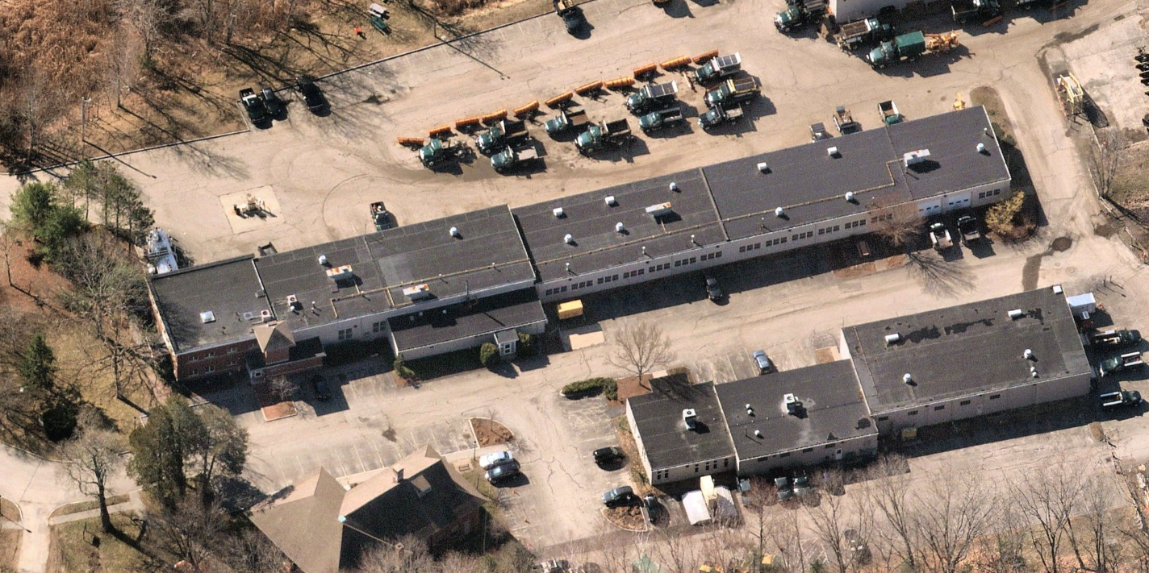
Public Works Roof Replacement
Notes:
$52,750 has been allocated to Municipal Facilities, similar to the amount under the Capital Outlay. This will be used to fun extraordinary repairs or failures within town buildings that do not fit into a routine category.
A little over $581K has been allocated to the Keyes Road campus for Public Works to aide in the replacement of both building’s roofs which have well exceeded their life expectancy and are failing.

Slide 12
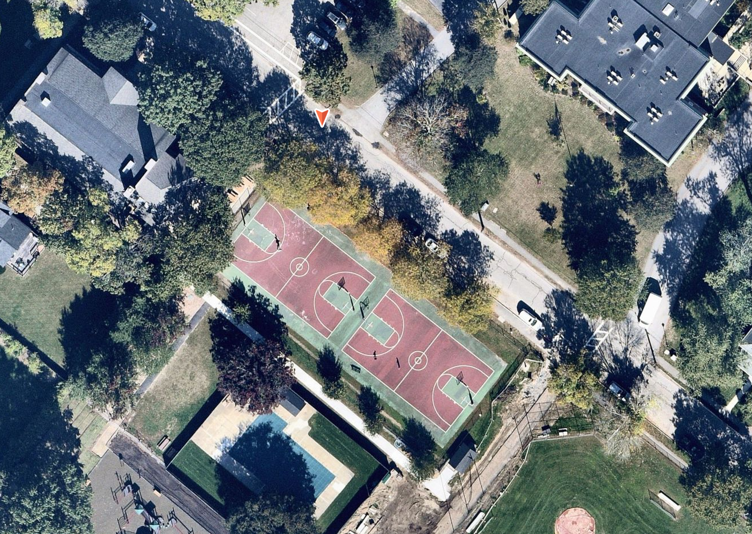
Emerson Park Hunt Gym Area
Basketball Court Resurfacing
Notes:
The Emerson Public Basketball Courts are used year-round by members of the public. When you walk by, you can often see several rogue balls and other equipment left out encouraging those in the area to stop and play.
It has been more than 15 years since the courts were smoothed and resurfaced. Major cracks and fault lines exist which have given way to frost heaves and made a number of spots within the court area unsafe.
$150,000 is proposed to totally refurbish the ground area making it safe and usable for all.

Slide 13
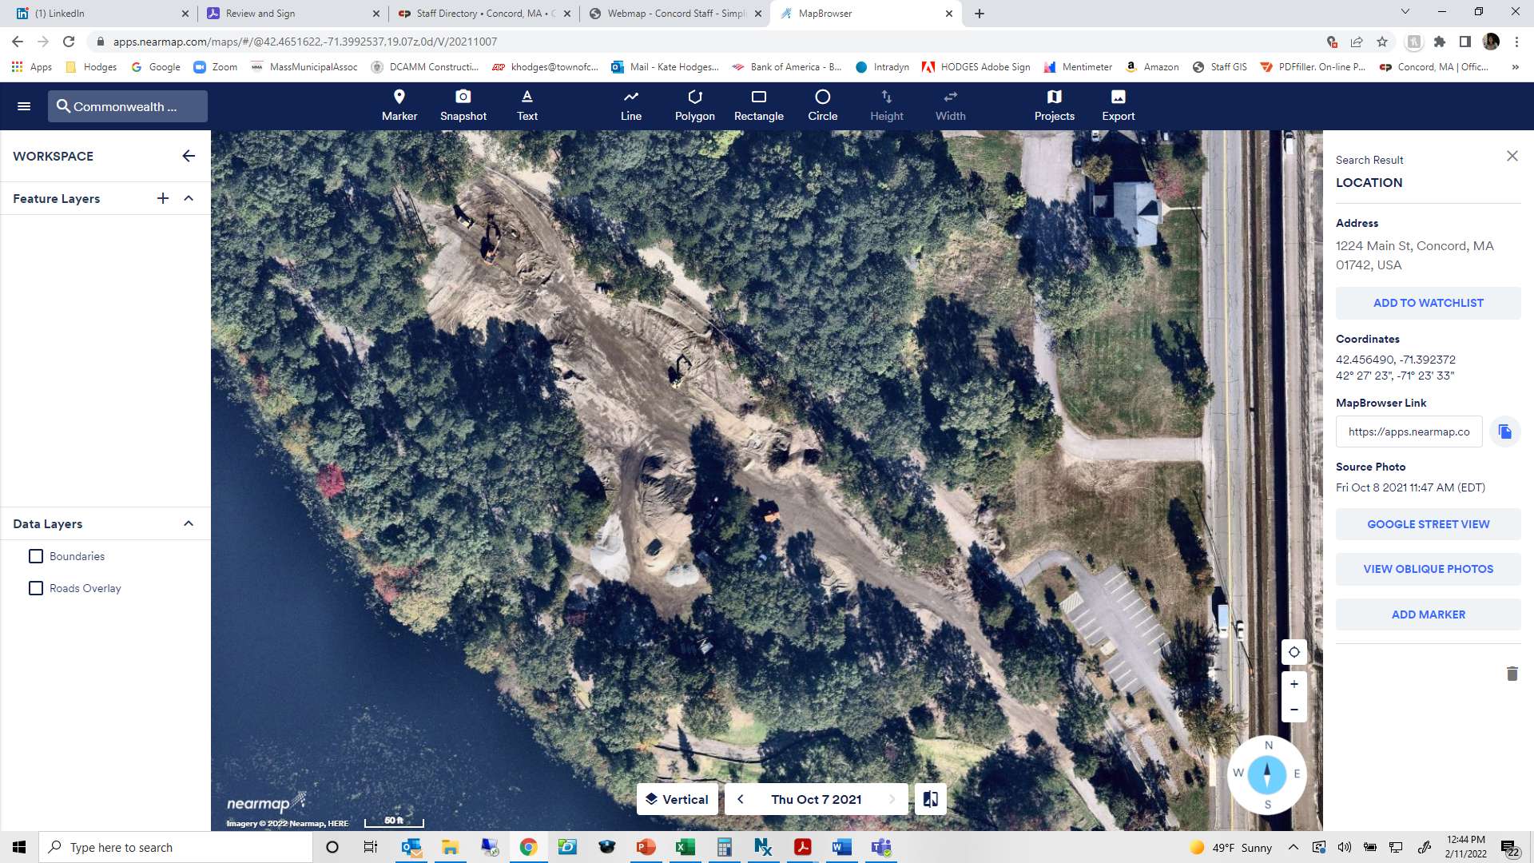
Gerow Park
Notes:
Gerow Park, located off Commonwealth Ave. in West Concord, will be completed by the end of this year. However, as you can see from this photo, while much of the land has been preserved, some of the strategic clearing that was necessary showed many more areas along the shoreline and close to the affordable home unit that are deeply covered with invasive species. These funds allocated here will be to hire the same environmental monitor who handled the initial park area invasive removal to conduct removals in at least three additional areas. The reminder of the funds will be used for replanting efforts along the shoreline and pond slope areas to replace the invasives being removed.

Slide 14
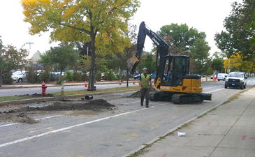
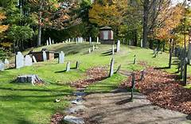
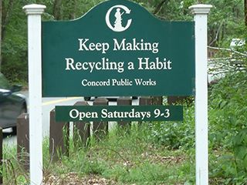
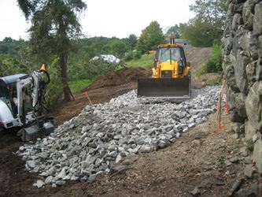
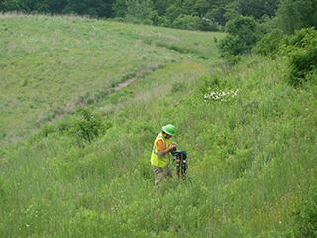
Public Works: Roads, Drainage, Heavy Equip.
Notes:
The remainder of the Town’s borrowing funds will be allocated to the Department of Public Works including:
$772,000 to begin a repair program for the most vulnerable drainage culverts in Town and to provide much needed maintenance to the Town’s 5 vehicular bridges
$2 M for pavement maintenance which seems to apply preservation treatment to extend pavement life and reconstruct streets that are in disrepair. The Department seeks to reverse the trend of declining average pavement conditions that happen Town-wide; efforts in this area work accomplish this goal.
$32,000 for traffic improvements which will improve traffic operations and safety measuring -- including signal timing, better intersection geometry and efficient roadway layout.
In terms of Heavy Equipment, specifics on those include the replacement of:
1 hybrid staff vehicle, 2 Ford F250 pick ups , 2 light-duty dump trucks
1 Volvo L70 Front Loader and
1 2010 Sidewalk Plow.
The total for these is $712,000

Slide 15
ARTICLE 10: Capital Improvement & Debt Plan
Ms. Ackerman moves that the Town take affirmative action on Article 10, as printed in the handout pertaining to the Article.

