Slide 1
Article 9. FY23 Budget
ARTICLE 9. Ms. Ackerman moves that the Town take affirmative action on Article 9, as printed in the handout pertaining to the Article.

Slide 2
Manner of Appropriation
The Town’s budget is appropriated by Town Meeting in 16 distinct line items
The Town Manager must then manage the “bottom line” of each line item appropriation
Adjustments are then only allowed:
  Further Town Meeting action
  MGL Ch. 44, §33B

Slide 3
Summary of Budget Article

Slide 4
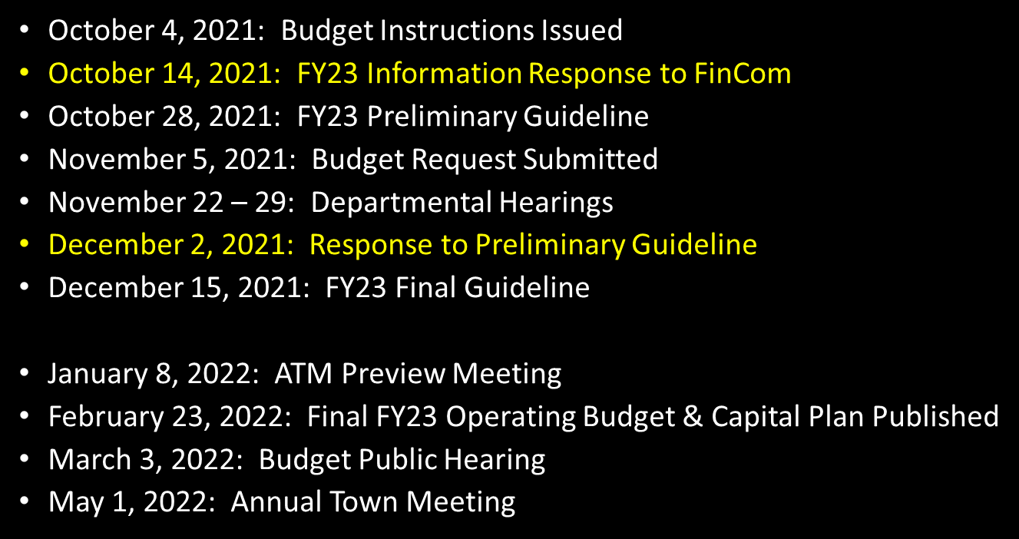
FY23 Budget Timetable

Slide 5
FY2023 Town Budget- Recommendation
To bridge delta:
Carry forward $600k of unspent FY22 Operating appropriation
  MGL Ch. 44, 33 (b) allows transfer of prior year unspent appropriation before
  Close of the FY; Use of carry forward will impact Free Cash, but reduces impact to property tax
Transfer $309,700 from unspent capital article (part of Article 10 motion)

Slide 6
FY2023 Town Budget- Recommendation

Slide 7
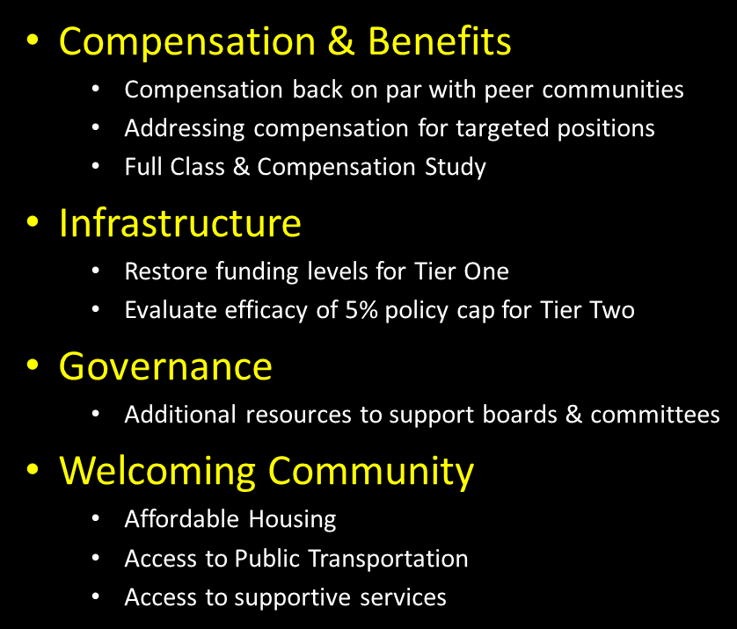
FY2023 Strategic Issues

Slide 8
FY23 Spending Drivers:
Wage Adjustments: $970,792
  +3.41%
  Market
  Attraction & Retention
Increased Utility Costs: $163,965
  Diesel fuel (+17.2%)
  Electricity (+12.1%)
  Solid Waste (+124.1%)
  Cardboard Recycling (new cost)
Addressing Non-Wage Strategic Issues: $227,519
  Infrastructure
  Governance
  Welcoming Community
Build back Tier 1 Funding: $709,700

Slide 9
Fixed Costs

Slide 10
FY23 Budget: Fixed Costs, Group Insurance
funds employer share of insurance benefits provided to eligible employees of Town and CPS
Health Insurance renewal: +12.5% ($829,280); 4 plans offered through MNHG with individual plan renewals ranging from 7.5 – 11.5%.
Approximately 2/3rd of eligible Town employees and 60% of CPS employees are enrolled in insurance plan
Of those enrolled, approximately 33% are enrolled in HSAQ (high-deductible) plans; premiums run about 20% lower than benchmark plans

Slide 11
FY23 Budget: Fixed Cost, Retirement Assessment
Amount assessed to Town by Concord Retirement System for the cost of benefits provided to retirees (system costs + unfunded liability)
Assessment paid from two sources- Annual Budget appropriation + contribution from Pension Reserve (fund established in the 90’s to mitigate spikes in assessment increases)
Pension Reserve contribution schedule has been revised as the Town is nearing the end of its funding schedule (FY29); As of 06/30/21, system is 94.5% funded

Slide 12
FY23 Budget: Fixed Cost, Debt Service

Slide 13
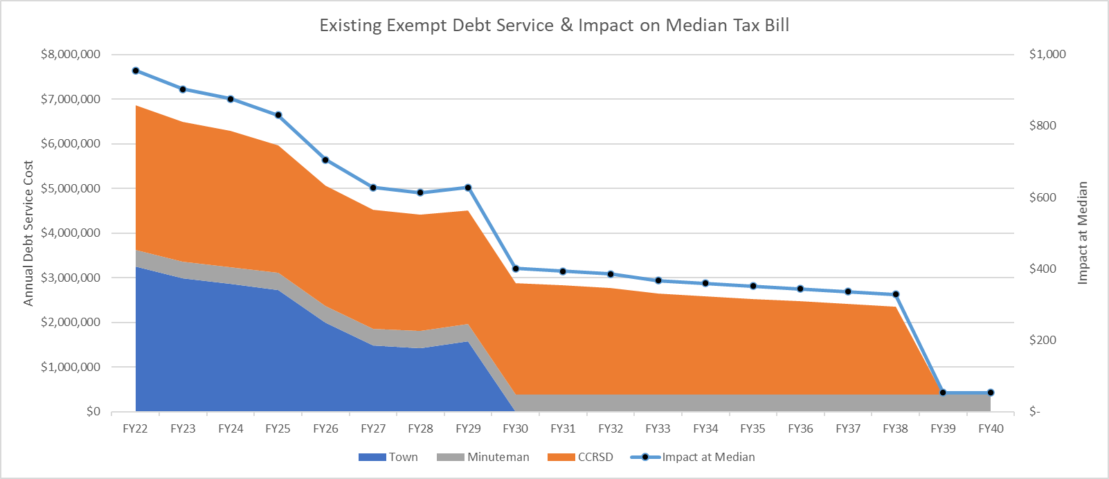
FY23 Budget: Fixed Cost, Exempt Debt Service

Slide 14
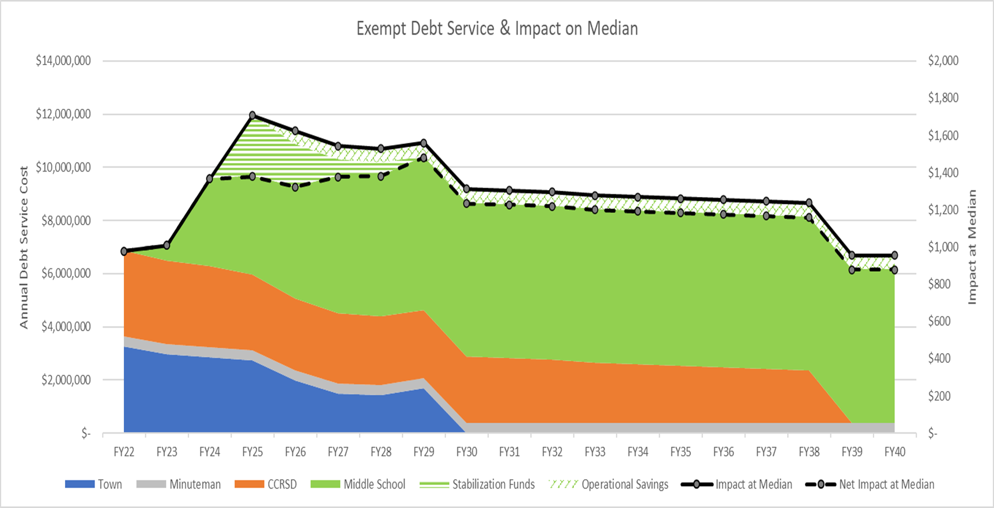
FY23 Budget: Fixed Cost, Exempt Debt Service

Slide 15
Article 9. FY23 Budget
ARTICLE 10. Ms. Ackerman moves that the Town take affirmative action on Article 9, as printed in the handout pertaining to the Article.

