Slide 1
ARTICLE 22: CONCORD-CARLISLE REGIONAL HIGH SCHOOL CAPITAL PROJECTS
Mr. Booth moves that the Town approve $853,665 of debt authorized by the Concord-Carlisle Regional School Committee for repair and repaving of the access road, including sidewalk repairs, drainage, and lighting, as determined by the School Committee; provided, however, that this approval shall be contingent upon passage of a Proposition 2 1⁄2 debt exclusion referendum under Mass. Gen. Laws c. 59, § 21C(k) to exempt the Town’s allocable share of the amounts required for the payment of interest and principal on said borrowing.

Slide 2
ARTICLE 22: CONCORD-CARLISLE REGIONAL HIGH SCHOOL CAPITAL PROJECTS
Article 22 requests approval for funds for the following on the CCHS Campus:
Reconstruct the access road
Install lighting along the access road
Repair sidewalk and curbing

Slide 3
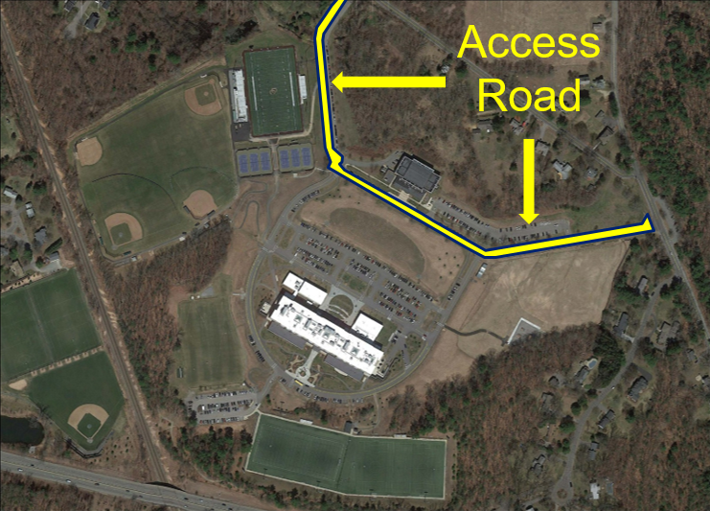
ARTICLE 22: CONCORD-CARLISLE REGIONAL HIGH SCHOOL CAPITAL PROJECTS

Slide 4
ARTICLE 22: CONCORD-CARLISLE REGIONAL HIGH SCHOOL CAPITAL PROJECTS
In FY20, Gale Associates, Inc. evaluated the campus access road as part of the campus feasibility study:
Thoreau Street entrance is in poor condition with cracks and patches through the extent of the apron
Significant ponding with damaged, cracked, and uneven pavement at the Walden Street entrance
The entire length of the access road has alligator cracks, patches, and potholes

Slide 5
ARTICLE 22: CONCORD-CARLISLE REGIONAL HIGH SCHOOL CAPITAL PROJECTS (Cont.)
Tensile strength of the access road is failing and there may be a substandard base material
Sidewalks and curbing are cracked and in need of replacement

Slide 6
ARTICLE 22: CONCORD-CARLISLE REGIONAL HIGH SCHOOL CAPITAL PROJECTS
Concord Town Engineer; “We have performed a field review of the access road and estimated that the Pavement Condition Index (PCI) lies in the range of 40-55 which is considered “poor”.
Estimated Total Costs: $1,053,665 ($200,000) Stabilization Account Offset = $853,665

Slide 7
ARTICLE 22: CONCORD-CARLISLE REGIONAL HIGH SCHOOL CAPITAL PROJECTS
Reconstruction includes new gravel subbase, compaction, paving of the road, catch basins & drainage, manholes (4 need to be replaced), concrete piping, curb and curb removal, granite edging, cement & asphalt
Estimated Assess Road Costs: $830,565

Slide 8
ARTICLE 22: CONCORD-CARLISLE REGIONAL HIGH SCHOOL CAPITAL PROJECTS
Conduit, Light Foundation, Light Post & Lamp Head, & Wire Installation
Estimated Lighting Costs: $223,100

Slide 9
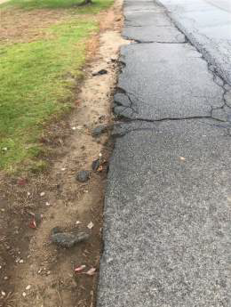
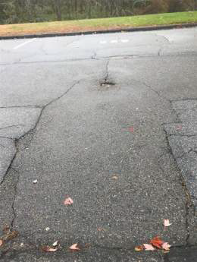
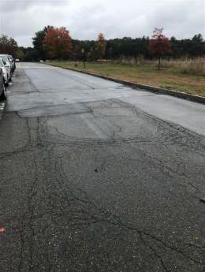
ARTICLE 22: Access Road 2019
Broken and spalled pavement on sidewalks
Sunk utility covers
Multiple patches and significant cracking

Slide 10
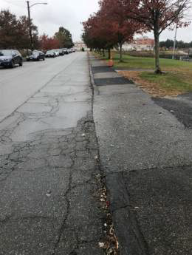
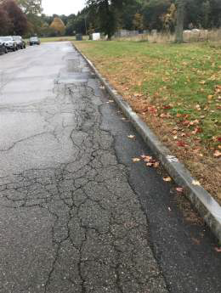
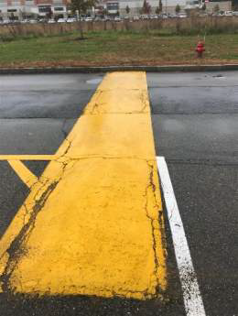
ARTICLE 22: Access Road 2019
Multiple patches and significant cracking

Slide 11
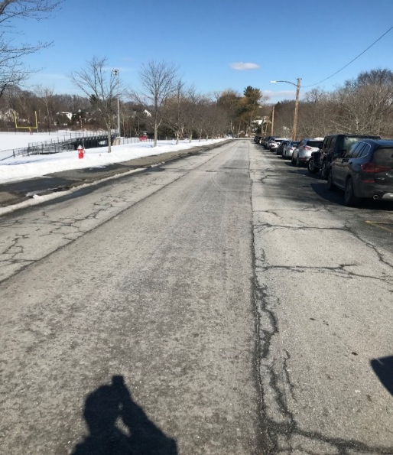
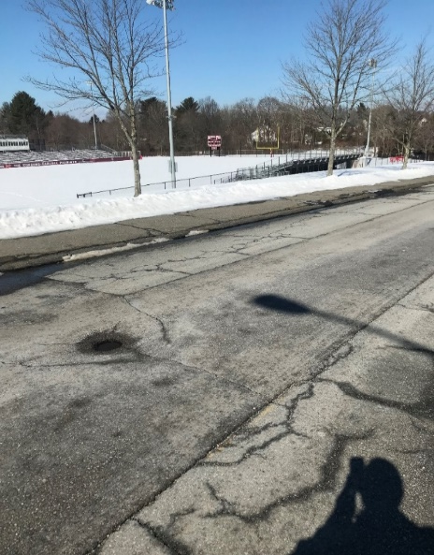
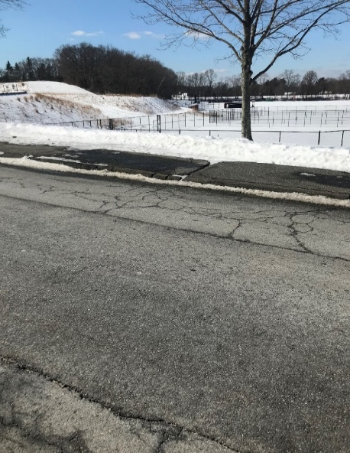
ARTICLE 22: Thoreau St. Entrance 2022

Slide 12
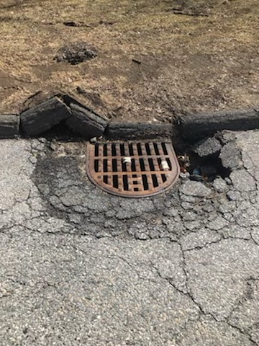
ARTICLE 22: Thoreau St. Entrance 2022

Slide 13
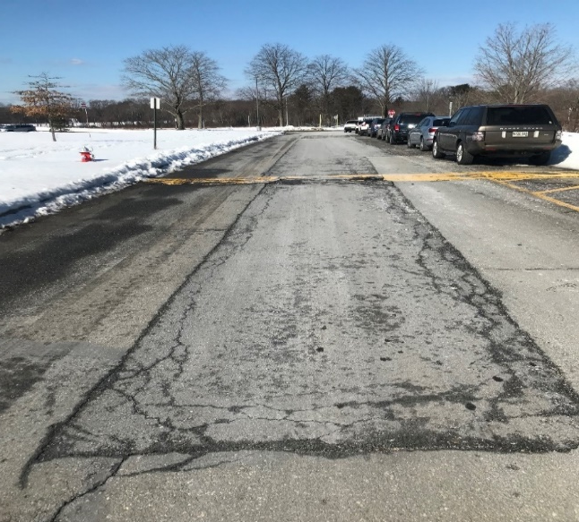
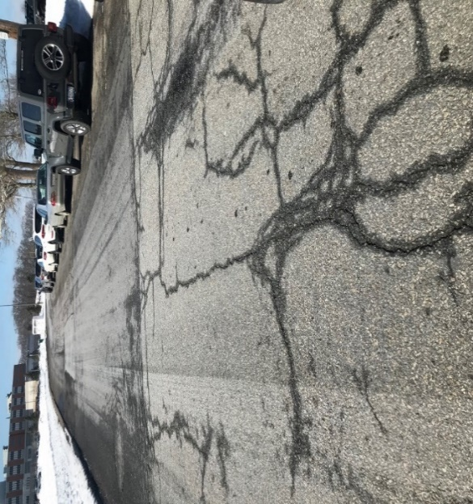
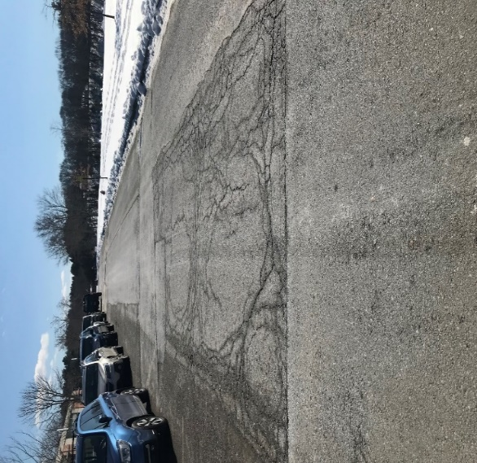
ARTICLE 22: Front of the Beede Center 2022

Slide 14
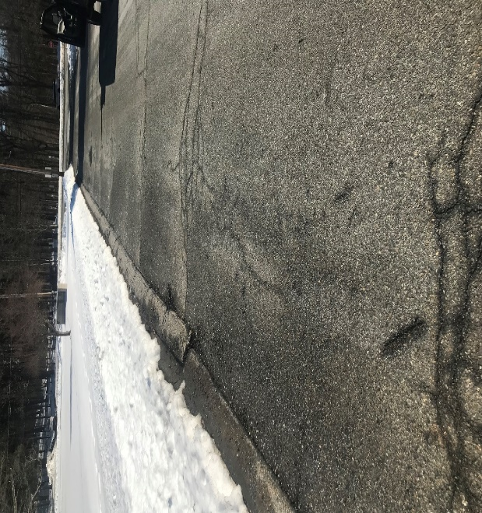
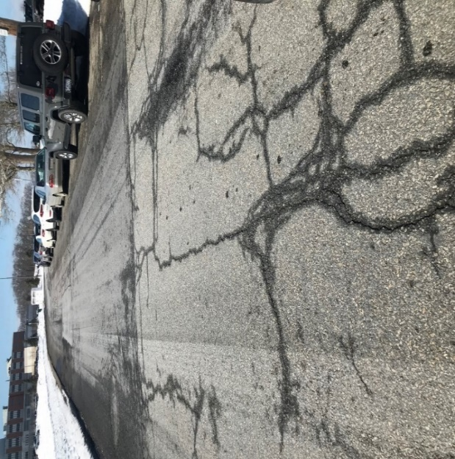
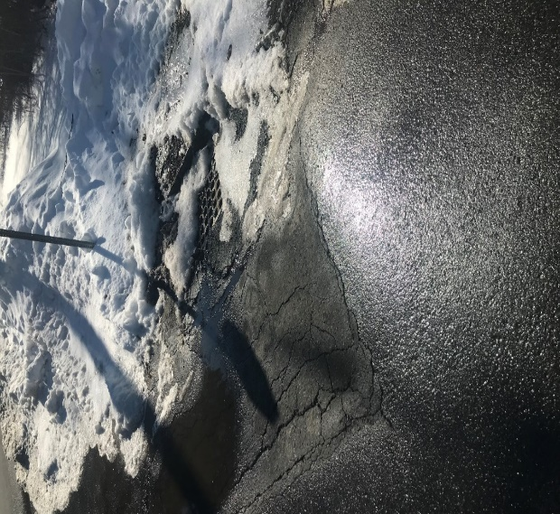
ARTICLE 22: Walden St. Entrance 2022

Slide 15
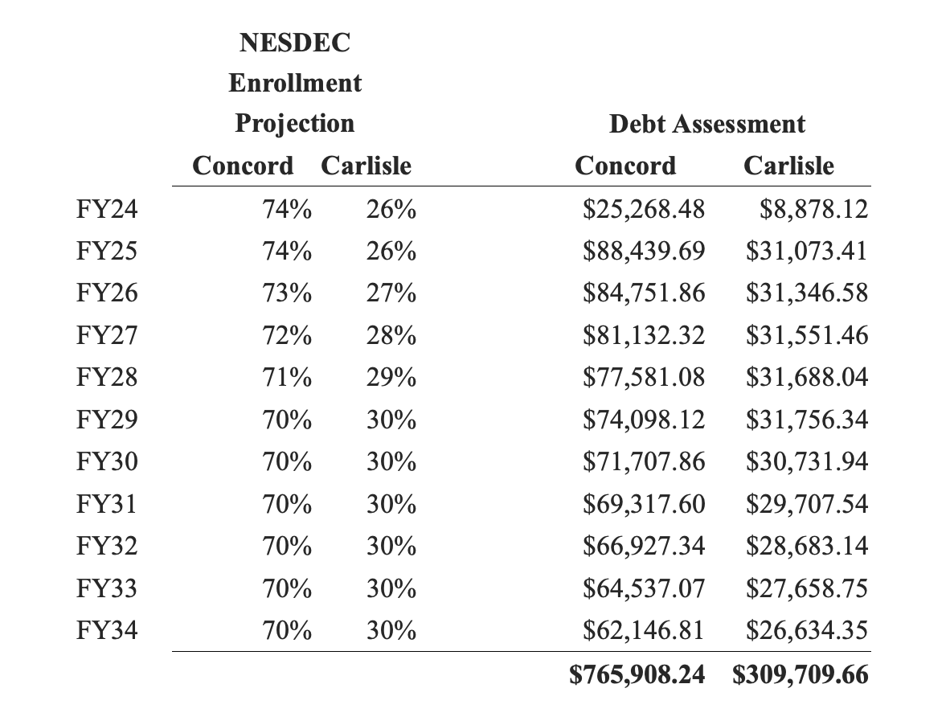
ARTICLE 22: Estimated Costs to Each Community

Slide 16
ARTICLE 22: Contingency
Costs Include:
6% inflation
15% contingency
7.5% Soft costs buffers

Slide 17
ARTICLE 22: Carlisle & Concord Timelines
Carlisle Town Meeting – April 25^{th (approved)}
Concord Town Meeting – May 1st
Carlisle Annual Town Election Ballot – May 10th
Concord September Primary Ballot – September 6th

Slide 18
ARTICLE 22: CONCORD-CARLISLE REGIONAL HIGH SCHOOL CAPITAL PROJECTS
Mr. Booth moves that the Town approve $853,665 of debt authorized by the Concord-Carlisle Regional School Committee for repair and repaving of the access road, including sidewalk repairs, drainage, and lighting, as determined by the School Committee; provided, however, that this approval shall be contingent upon passage of a Proposition 2 1⁄2 debt exclusion referendum under Mass. Gen. Laws c. 59, § 21C(k) to exempt the Town’s allocable share of the amounts required for the payment of interest and principal on said borrowing.

