Slide 1
ARTICLE 25. Assabet River Bluff Acquisition
Ms. Ackerman moves:
That the Town authorize the Treasurer with the approval of the Select Board to borrow the sum of $500,000 under Mass. Gen. Laws c. 44, § 8C or any other enabling authority, for the purpose of purchasing for community housing, conservation, and passive recreation purposes a certain property together with buildings thereon known as the Assabet River Bluff and further described in the Warrant on the conditions and terms set forth in the Warrant.

Slide 2
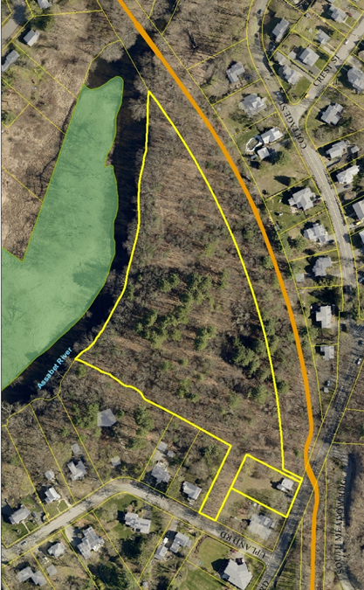
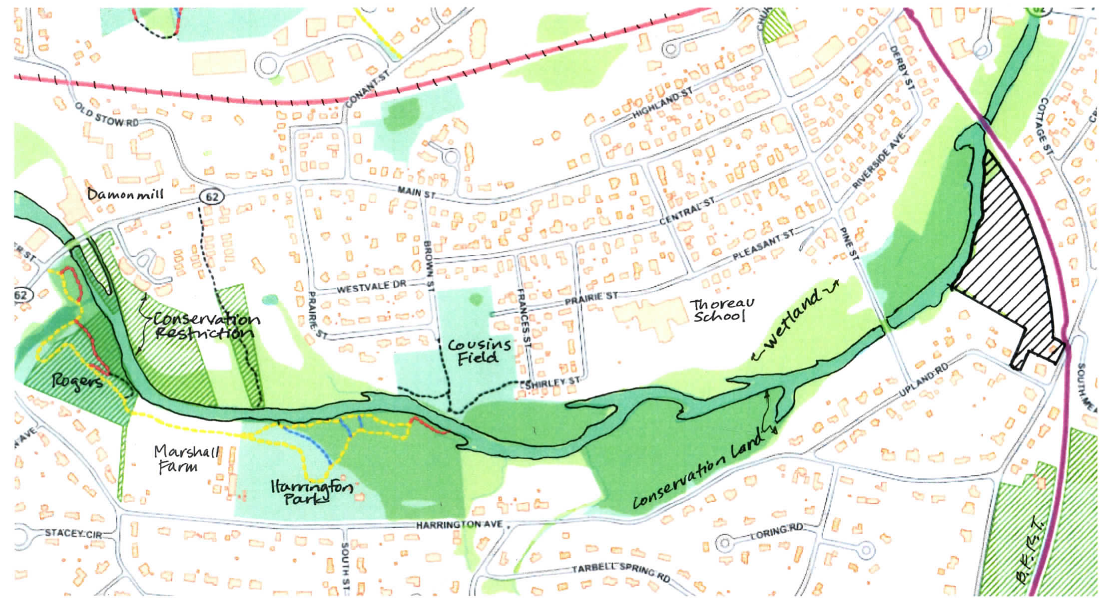
ARTICLE 25: Assabet River Bluff Preservation

Slide 3
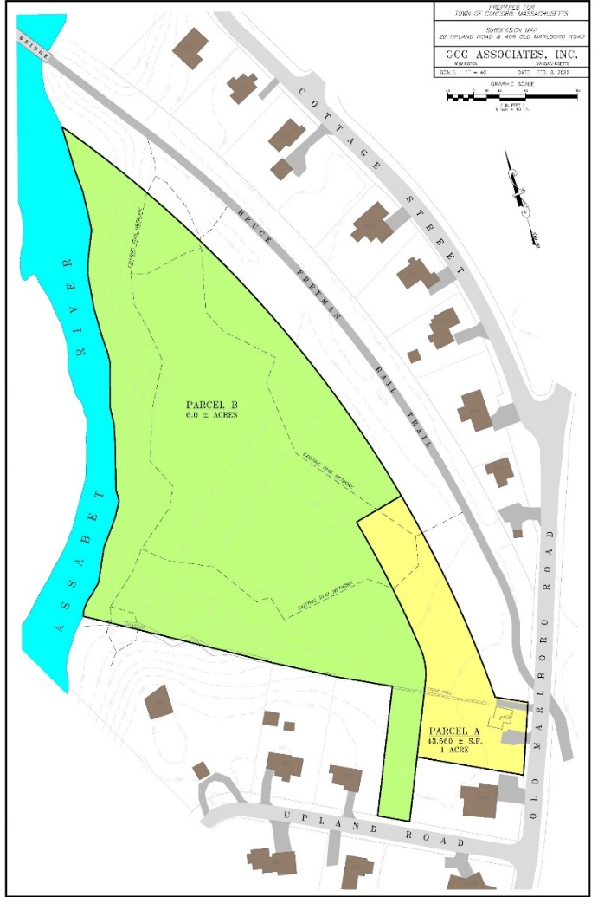
ARTICLE 25: Assabet River Bluff Preservation
Article 25 Funds will be used towards the purchase of the open space (Parcel B)

Slide 4
Funding Source | Land Acquisition for Housing | Land Acquisition for Open Space | Total Land Acquisition Costs | Project Expenses
CPA Funds | $ 300,000 | $ 700,000 | $ 1,000,000
CMAHT Funds | $ 600,000 | $ - | $ 600,000 | $ 50,000
CHF Funds | $ 50,000 | $ - | $ -
CLCT/SVT Fundraising & LWCF Grant | $ - | $ 1,150,000 | $ 1,150,000 | $ 50,000
 | $ 950,000 | $ 1,850,000 | $ 2,800,000 | $ 100,000
ARTICLE 25: Assabet River Bluff Preservation

Slide 5
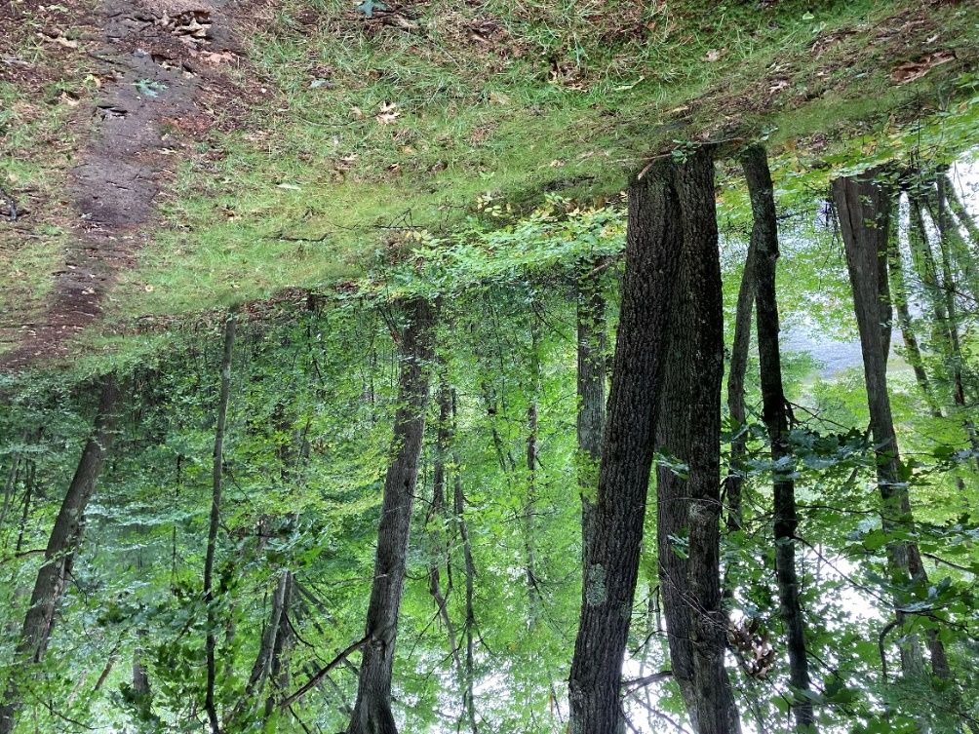
ARTICLE 25: Assabet River Bluff
Preservation
Supported by:
Select Board
Finance Committee
Planning Board
Natural Resources Commission
Concord Housing Development Corporation
Concord Municipal Affordable Housing Trust
Concord Housing Foundation
Concord Land Conservation Trust
Sudbury Valley Trustees
League of Women Voters

Slide 6
ARTICLE 25. Assabet River Bluff Acquisition
Ms. Ackerman moves:
That the Town authorize the Treasurer with the approval of the Select Board to borrow the sum of $500,000 under Mass. Gen. Laws c. 44, § 8C or any other enabling authority, for the purpose of purchasing for community housing, conservation, and passive recreation purposes a certain property together with buildings thereon known as the Assabet River Bluff and further described in the Warrant on the conditions and terms set forth in the Warrant.

