Slide 1
Ms Kavanagh moves
that the Town
take affirmative action on Article 23
Ranked Choice Voting for Concord Elections
(as printed in the handout)

Slide 2
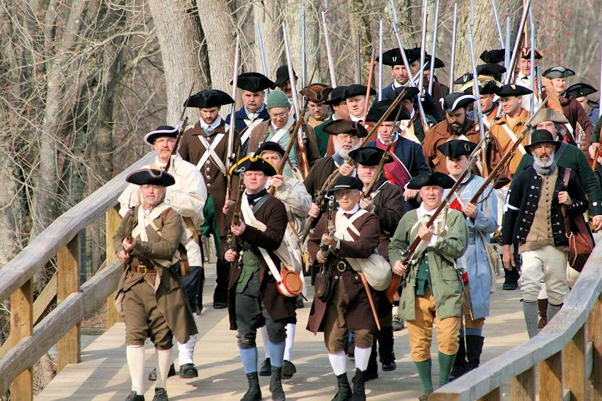
Ranked Choice Voting
Continuing our proud tradition of trailblazing for democracy

Slide 3
Concord for RCV
In 2020 - State Ballot Question 2
61.4% Voted YES!
Endorsements for Article 23
Concord Select Board
Concord-Carlisle League of Women Voters

Slide 4
Who Is Using RCV?
States: MA missed Ballot Question 2 in 2020
Maine (2016 →2018) & Alaska (2020 →2022)
Cities and towns in UT, CA, MD, NM, CO, MN, OR, NY, VT…
MA municipalities:
Cambridge (1941)
Easthampton (2021)
Amherst, Arlington & Northampton (awaiting State House approval)

Slide 5
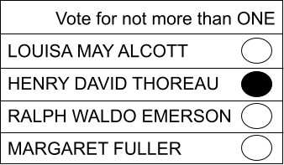
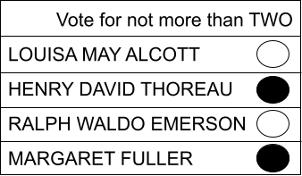
Now: 1-Vote → 1- Chance
Your candidate wins or loses. Period.
Vote splitting or bullet-voting can cause your vote to be wasted.

Slide 6
Well-known Problems with 1-Choice System
Govern without the will of the people
Polarization and negative campaigning work
Vote-splitting discourages newcomers
Homogeneity of candidate pool/elected officials
Voters need to game the system
“The usual suspects” leads to less voting

Slide 7
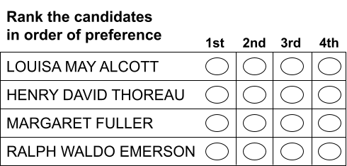
With RCV: 1-Vote → MULTIPLE Chances
…to have elected representatives that reflect YOUR view.
=
You state your preferences: 1, 2, 3…
The software applies all your preferences for an accurate, transparent outcome.
You just rank the candidates in order of preference: 1, 2, 3…
The machines conduct an “Instant Run-Off”

Slide 8
Preparation for Implementation
In collaboration with the Town Clerk & Board of Registrars
Current voting machines are RCV-compatible.
Town clerk will need a dedicated laptop to run software.
First usage will be overseen/audited by consultant.
State House approval likely to take a year or two.
2024 election probably the earliest: 2 seats per Board.

Slide 9
RCV will give us MORE
Diverse, representative elected bodies
Freedom of Choice
First-time candidates
Positive campaigning
Voter engagement
More Democracy - More Better

Slide 10
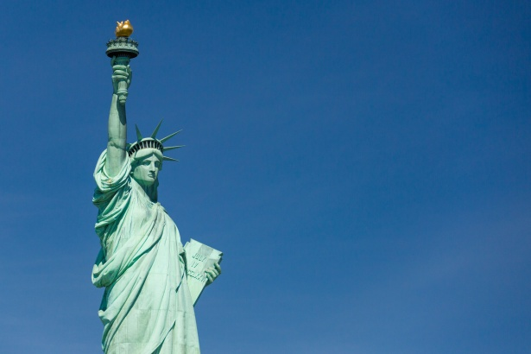
Concord:
It’s time to
trailblaze
for
democracy
again

Slide 11
Ms Kavanagh moves
that the Town
take affirmative action on Article 23
Ranked Choice Voting for Concord Elections
(as printed in the handout)

Slide 12
EXTRA SLIDES MIGHT NEED FOR Q & A

Slide 13
Voting: Your First Choice…
Clears the Majority Threshold (51%)
Game over. Your candidate wins.
Tanks - with no chance of winning (20%)
Your vote goes to your 2nd choice.
Sweeps - (2 seat race - more than 34%)
Software allocates the extra (surplus) to voters’ 2nd choices.
NO VOTE WASTED

Slide 14
Why Do It?
Track record of success where it is being used
More institutions, organizations, states & municipalities using RCV
Enthusiastically endorsed by national and local LWV
Metrowest neighbors (Acton, Wayland, Natick and Newton) are also moving in the RCV direction
Modest expense

Slide 15
Key Counting Concepts
Plurality (current): winner has the MOST votes
Majority (RCV): winner has MORE THAN HALF of votes
Threshold: more than half of votes
percentage of votes needed to win
1 seat = 51%
2 seats = 34%

Slide 16
What Article 23 will do
Improve the process we use to elect town offices:
3 multi-seat committees: Select, School & Housing
1 Town Moderator
____________________________________________________
What Article 23 will not do
Change the current structure of elected offices
Affect state elections or the state ballot

Slide 17

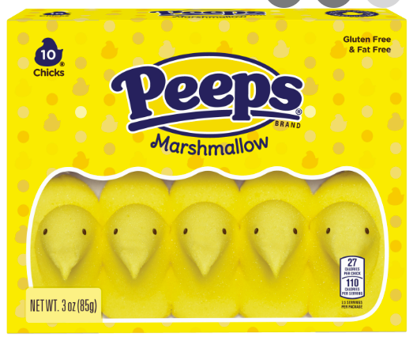

The Problem of Vote-Splitting
60
35
Peeps wins with less than a majority (< 50%) of support
40
40
25
Notes:
But then - there’s a young upstart that wants to enter the race - we’re talking: mini chocolate eggs [click]. Their elders say - no - you’re going to ruin it for Bunnies, but minis goes ahead and throws their hat in the ring.
This is good news for generational/size diversity - but bad news for chocolate fans, now the vote is split [click]
And on election day, Peeps win [click] with less than a majority, less than 50%, of the vote - chocolate loses!

Slide 18
Counting the Votes
Select Board Race with 100 Ballots
Louisa wins with a majority
36
38
58
Louisa
58
42
24
Henry David
32
Margaret
12
Ralph
28
Notes:
Then we continue to drop the last place candidate [click] and transfer their votes until only two candidates remain.
When only two are left, the candidate with more than 50% of the vote, a majority, wins the seat. [click] Congratulations, Louisa

Slide 19
Counting the Votes in a 2-seat race
Select Board Race with 100 Ballots (threshold = 34 votes)
68
Louisa
34
34
31
Henry David
6
Margaret
12
32
23
Ralph
14

Slide 20
Reasons given NOT to
“It’s too complicated”
Cambridge has been using 1941.
Easthampton - same size and # of precincts - used last November.
Concord Voters can handle the voting. Machines handle the counting.
Do you know how your car works or how to program a computer?
But… we happily use our car and computers.

Slide 21
Reasons given NOT to
“It’s too liberal/partisan”
No party connection - takes advantage away from incumbent insiders
“It’s too radical.”
Actually has more of a centrist impact.
Those who’ve been using wouldn’t go back. ME, AK, NY, UT
It is the wave of the future!
“It will cost $”
The amount is modest.

Slide 22
Our democracy is in dire straits.
A winner-takes-all process
and limited engagement access
for the broader democratic electorate
is leading to a serious impoverishment of our democracy with fewer choices on the ballot
and fewer non-traditional candidates
able to enter the pipeline.
Danielle Allen

