Slide 1
Article 38 Development Plan for Municipal Solar Development
Mr. Banfield moves that the Town urge the Concord Municipal Light Plant to develop an action plan and schedule for the achievement of the Town’s 2030 solar capacity targets focused on development of new power generation on Town-owned properties and present the plan and schedule to both the Select Board and FinCom before the end of 2022. The plan should prioritize open sites and include a public process to evaluate any possible tree removal.
Notes:
At the outset I’d just like to focus on the main goal of Article 38. The objective is to get the Light Plant back into the business of creating solar power on Town owned properties. To do this right, we need to step back and engage with the questions and challenges that are inherent in the process, and do that in a thoughtful and transparent manner by establishing a plan that will allow us to reach or exceed our target.

Slide 2
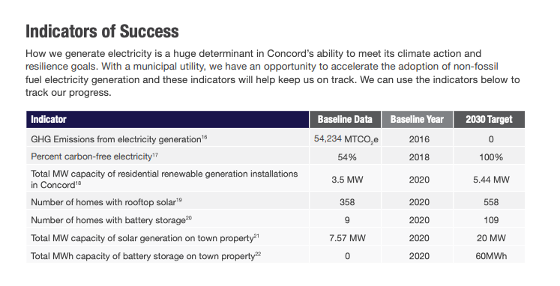

Climate Action Plan
Total capacity on town property by 2020 20MW
Notes:
So, what exactly is our target? The Climate Action Plan says we should be at 20MW of solar generation on town property by 2030. Today, we are about 1/3 of the way there.

Slide 3
Where Are We Now?
In 2010, CMLP targeted 25MW of solar by 2030
2010 48kW array, Willard School
2011 Solar Siting Report identified 22MW of potential
2014 1.7MW former landfill
2017 5.6MW former WR Grace property
In 2017, CMLP adopted an 8 year strategy
Further municipal solar was written out
Local energy storage initiative scheduled for 2022
The 2021 Climate Action Plan targets 20MW by 2030
Notes:
We began 12 years ago with a more aggressive target of 25MW, and we made excellent progress until January of 2017, when the WR Grace solar array went live. But at the end of that year, the Light Plant deprioritized municipal solar development, and none has been created since. The Climate Action Plan trimmed the original target to 20MW, but even with this reduced goal, we will need to create between 1 ½ and 2 MW per year to achieve our objective.

Slide 4
Is Local Solar Important?
CMLP can green our electricity via purchases
Offloads infrastructure to others
GHG reduction: Are we doing our share?
Climate bill requires growth - 3%/yr renewables
MA ‘Clean Peak Standard’
Municipal Light Plants are exempted
Notes:
Right now, about 80% of the electricity we use is from non-emitting sources and the Light Board expects to move that number to 98% by 2023. Given this excellent progress, is renewable power generation on our municipal properties still an important priority? I believe it is. Municipal solar is a direct indication of our values as a community and shows that we are willing to do what we can to reduce our imposition on others for the energy we use.
Looking at the problem with a wider lens, the state saw that the greenhouse gas reduction framework that Concord signed on to in 2017 was not aggressive enough, and recently created fresh roadmaps. Broadly speaking, these actions target investor owned utilities, and municipal light plants are generally exempted from being required to fall into line with the latest standards. I believe that Concord can and should be doing whatever we can.

Slide 5
Challenges with Solar
Are the financials acceptable?
Need to develop financial model
Is solar peak production an issue?
Need to identify and address grid vulnerabilities ’solar saturation’, other issues?
Process for balancing conservation priorities
Notes:
Adding more local solar generation will not come without effort. The highest priorities of a municipal light plant are to provide reliable electric service at a reasonable price. Rate payers should be able to anticipate stable electric rates with only modest increases over time. Creating more local solar will need to be done in the context of rate stability, and any possible upward pressure on rates will need to be balanced against alternatives.
We also need to be thoughtful about the current infrastructure of CMLP. The distribution system in town will need to manage the increased variability of solar power generation, so I don’t want to minimize the need to work through technical barriers that may exist. In addition, I’d like to emphasize that the goal is to focus on sites that don’t require tree removal and to otherwise minimize impacts on the tree canopy. The plan developed should include a public process that incorporates approval of any plans to remove trees.
When I review the work that has been done elsewhere, I am encouraged that these kinds of challenges can be overcome with careful technical planning and appropriate financial analysis. This is why the article specifies a planning period for the remainder of 2022, with a review by the Select Board and Finance Committee.

Slide 6
Benefits from Local Solar
Equity – in our backyard
Local renewable energy to serve demand peak
Transmission and capacity savings
Benefits are enhanced by battery storage
Long term, known costs. No surprises.
Predictable effect on rates
Notes:
Touching briefly on the benefits of doing this – I’ve already mentioned the value of doing what we can to create the energy we consume, but there is an adjacent value at work here. The distributed nature of renewable power generation will help reduce the historical disparities between the places where power is produced and where it is consumed.
As we electrify vehicles and buildings, our thirst for more electricity will keep growing, and that demand will strain the wider New England grid. Local solar helps to alleviate some of that stress, which translates into avoided costs.
And once the financials are worked out, solar should slot in as a stable component of our electricity portfolio, not subject to any kind of price shocks for the 30 years each array is expected to remain in service.

Slide 7
Why Solar Now?
The urgency of now: Limiting temp rise to 1.5°
The Commonwealth needs our participation
Renewables require real infrastructure
Financial opportunities
Top 1% (peak) demand hours = 8% of electricity costs
Top 10% = 40% of electricity costs
Addressing peak is key to avoiding infrastructure costs
Notes:
We are all aware of the growing number of extreme weather events. Ecosystem changes previously understood to take 100’s or 1,000s of years are being reduced to the length of a human lifetime. The earth is not waiting until 2025 for Concord to open a new middle school. So, we simply need to act with more urgency. We can help the state with its 3% annual renewables target, and chip away at the highest cost component of the CMLP power portfolio.

Slide 8
What Will This Mean?
In Town solar = 6% of power portfolio (7.5MWs)
20MWs goal adds another 8% (12.5MWs)
CMS potential = 1.1 MWs (2025)
Plus, Beede, CCHS, Elementary roofs and lots
Public works, Public Safety, Treatment Plant?
Get started now
Notes:
To give a sense of scale, I’ll close with a short list. We will need to look at all our public buildings and parking areas, and also look for another larger scale site. So, lets all commit to getting started today.

Slide 9
Article 38 Development Plan for Municipal Solar Development
Mr. Banfield moves that the Town urge the Concord Municipal Light Plant to develop an action plan and schedule for the achievement of the Town’s 2030 solar capacity targets focused on development of new power generation on Town-owned properties and present the plan and schedule to both the Select Board and FinCom before the end of 2022. The plan should prioritize open sites and include a public process to evaluate any possible tree removal.
Notes:
Thank you for your consideration of Article 38.

