Slide 1
Article 45: Beede Swim & Fitness Center Enterprise Fund Expenditures
Ms. Atkins moves to appropriate $1,793,000 in enterprise fund receipts and transfer $552,340 from Certified Retained Earnings as of June 30, 2021, for a total appropriation of $2,345,340 for the Community Pool Enterprise Fund for the fiscal year ending June 30, 2023 for the operation of the Community Pool, in accordance with Mass. Gen. Laws c. 44, §53F ½ to be expended under the direction of the Town Manager.

Slide 2
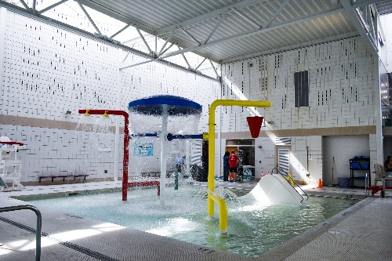
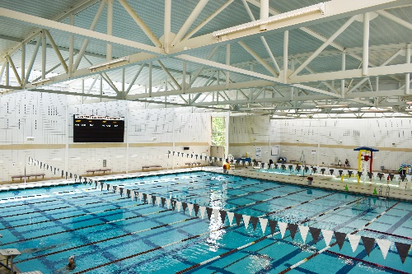
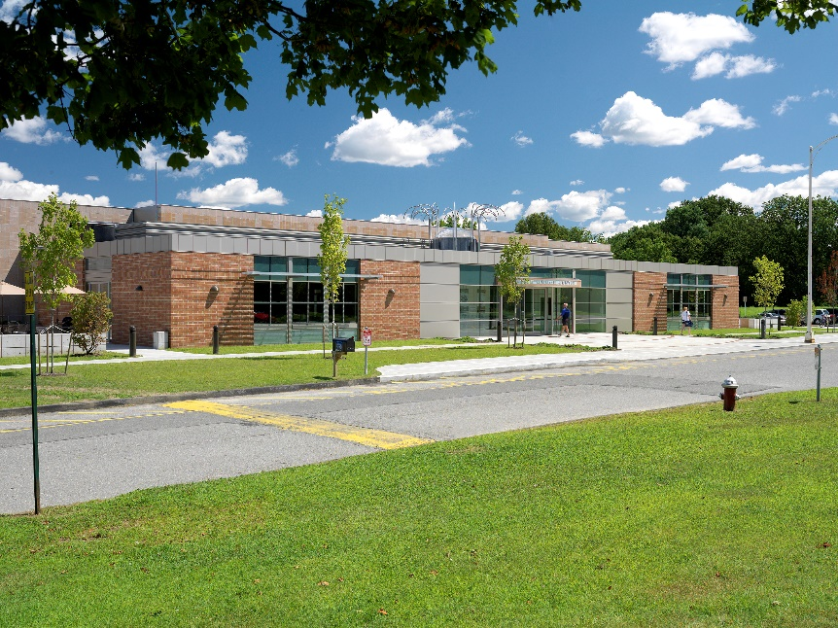
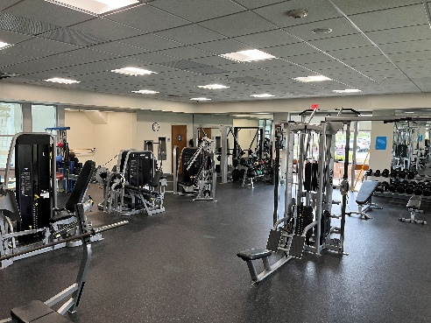
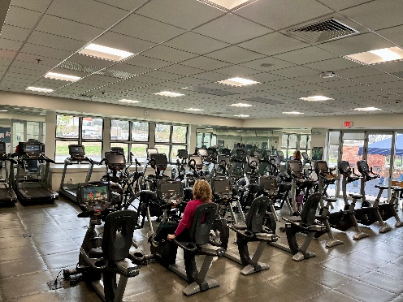

Slide 3
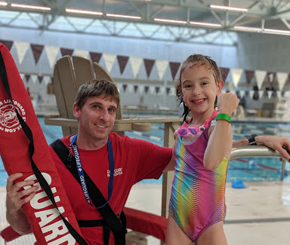

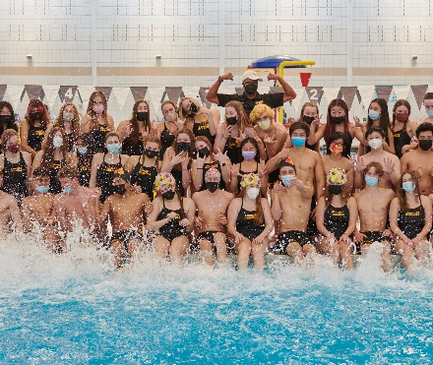
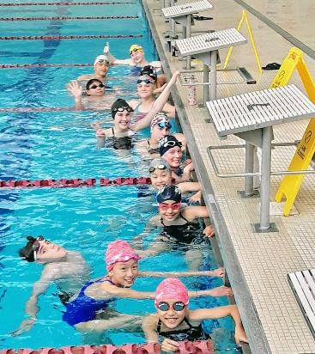
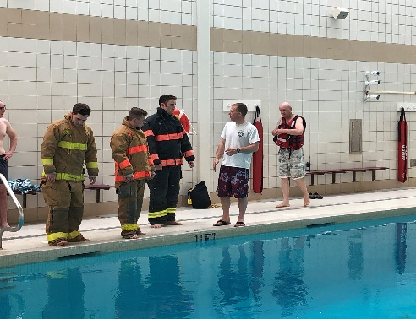
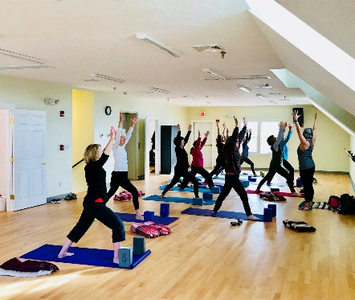
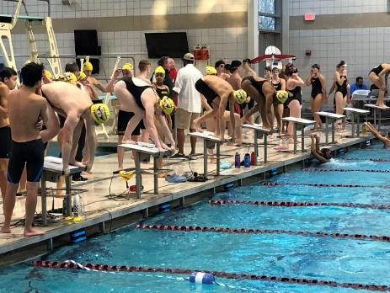
Photo Credit: Jon Straggas Photography

Slide 4
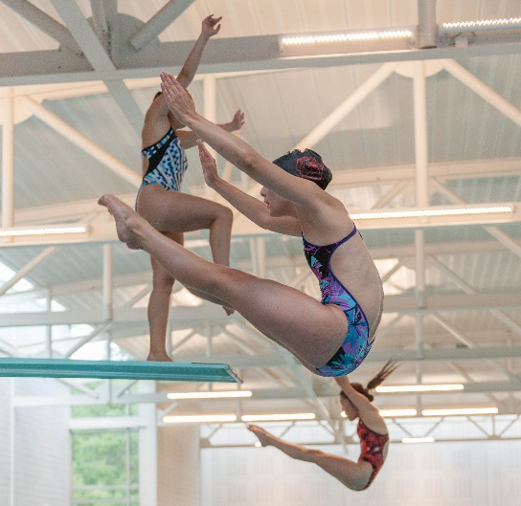
FY22 REVISED BUDGET
Operating Revenue | $1,577,000
Operating Expense | $1,992,425
Operating Income | $(415,425)
Nonoperating Revenue | $5,000
NET INCOME | $(410,425)
Projected Fund Balance | $2,593,600
Photo Credit: Jon Straggas Photography

Slide 5

FY23 PROPOSED BUDGET SUMMARY
Operating Revenue | $1,778,000
Operating Expense | $2,222,340
Total | $(444,340)
Capital Outlay (Expense) | $123,000
Investment Income (Revenue) | $15,000
NET INCOME | $(552,340)
Projected Fund Balance | $2,398,894

Slide 6
FY23 PROPOSED OPERATING REVENUE
TOTAL OPERATING
REVENUE: $1,778,000

Slide 7
Beede Swim & Fitness Center
Memberships and Sales by Category

Slide 8
FY23 PROPOSED OPERATING EXPENSES
TOTAL OPERATING
EXPENSE: $2,222,340

Slide 10
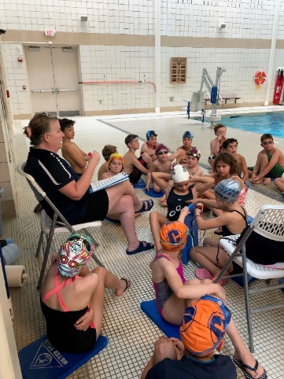
FY23 Action Items
Maximize on financially low risk opportunity areas.
Rentals
Special events
Review maintenance schedules.
Consider capital campaign.
Act on 2018 energy audit.
Collaborate with Finance Committee and Town Mgr Office to explore all options that could aid in fund recovery.
Recreation Facilities Strategic Plan.
General Fund Contributions.
Capital expenses.

Slide 11
Article 45: Beede Swim & Fitness Center Enterprise Fund Expenditures
Ms. Atkins moves to appropriate $1,793,000 in enterprise fund receipts and transfer $552,340 from Certified Retained Earnings as of June 30, 2021, for a total appropriation of $2,345,340 for the Community Pool Enterprise Fund for the fiscal year ending June 30, 2023 for the operation of the Community Pool, in accordance with Mass. Gen. Laws c. 44, §53F ½ to be expended under the direction of the Town Manager.

