Slide 1

Article 33: Zoning Bylaw Amendment Zoning Map & Thoreau Depot Business District Annual Town Meeting May 1, 2022

Slide 2
Art. 33: TDB Zoning
Motion: Mr. Flint moves that the Town take affirmative action on Article 33 as printed in the Warrant.

Slide 3
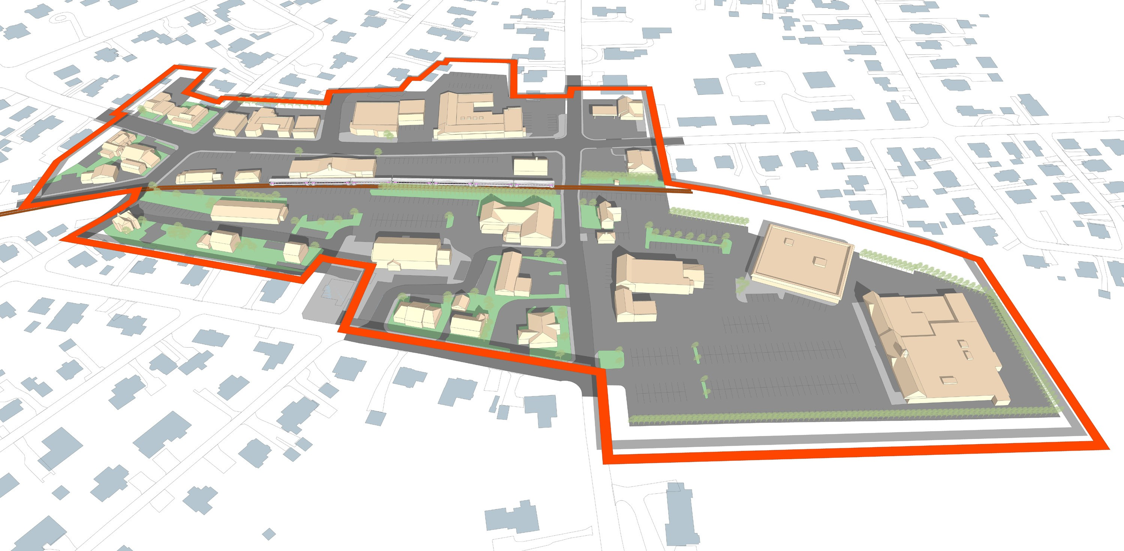
Thoreau Depot Business District
Art. 33: TDB Zoning
Thoreau St.
Crosby’s Market
Sudbury Rd.
Notes:
This is a map of the Thoreau Depot Business District.

Slide 4
What are the objectives of Article 33?
Art. 33: TDB Zoning
Make it more likely that housing is included in future redevelopment of existing commercial properties
Advance the Town’s sustainability goals by facilitating transit-oriented development
Implement dimensional requirements and design standards that reflect the look and feel of Concord

Slide 5
Why these objectives, and why in the Thoreau Depot?
Art. 33: TDB Zoning
Key Priorities of the 2030 Comprehensive Long-Range Plan
Help create housing for a range of needs and income levels
Address the significant shift toward a more senior population
Renew and improve Concord’s village centers
Encourage transit-oriented, sustainable, mixed-use development near train stations
Notes:
As background, Concord has more than a decade of experience in limiting formula businesses in the Business Districts.
At Town Meeting in 2011, Formula Businesses were defined;
were limited to 10 in the West Concord Business and West Concord Village Districts (combined) and
A special permit process for establishing, expanding or relocation of formula businesses was approved.

Slide 6
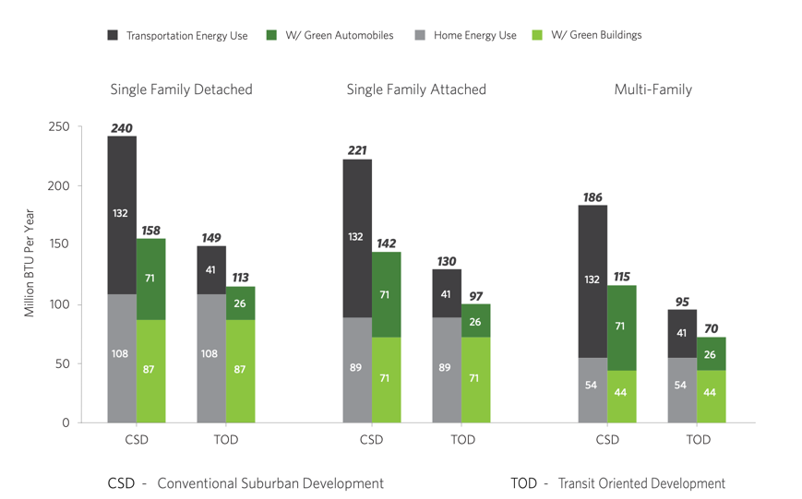
Art. 33: TDB Zoning

Slide 7
Create Opportunity for Mixed-Use
Art. 33: TDB Zoning
Existing | Problem | Proposed Solution
Open space requirement for mixed use = 2x gross floor area of residential portion. | Amount of required open space makes mixed-use infeasible resulting in commercial-only projects. No requirements defining open space quality. | Open space for mixed use residential = 15% of lot area Make open spaces publicly accessible to extent practicable. Allow reduction through improvements to off-site open spaces

Slide 8
Create Opportunity for Mixed-Use
Art. 33: TDB Zoning
Existing Zoning | Problem | Proposed Solution
If projects have >4 housing units, 20% of units must be affordable | The current requirement may hinder development of smaller projects. | 5-10 units: 10% affordable (80% AMI) >10 units: 20% affordable (half of units required at 80% AMI and half between 100-120% AMI) Affordable units must have same mix of bedrooms as market rate

Slide 9
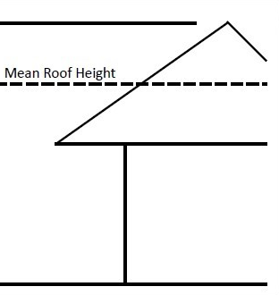
Art. 33: TDB Zoning
Lower Effective Height Limit
New: 38 ft. to Ridge
Current zoning limits height to 35 feet, measured to the top of a flat roof or the mean of a pitched roof.
New zoning would keep the 35 foot limit for flat roofs and limit pitched roofs to 38 feet measured at the ridge.
Old: 35 ft. to

Slide 10
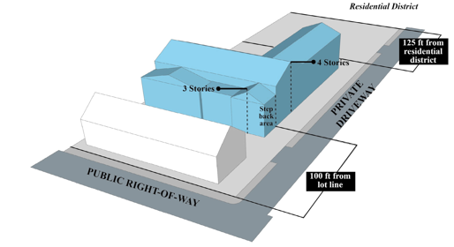
Limit Where Increased Height Allowed by Special Permit
Art. 33: TDB Zoning

Slide 11
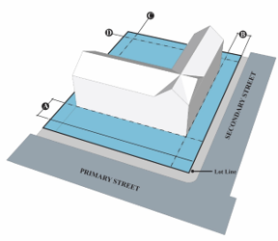
Art. 33: TDB Zoning
New Dimensional Setback Requirements
Current zoning has no front yard set back requirements.
New zoning adds front yard minimum and maximum setbacks:
Sudbury Rd: 12 feet/20 feet
Thoreau St: 0 feet/12 feet
Requires at least 5 feet of rear yard setback abutting residential to be landscaped.

Slide 12
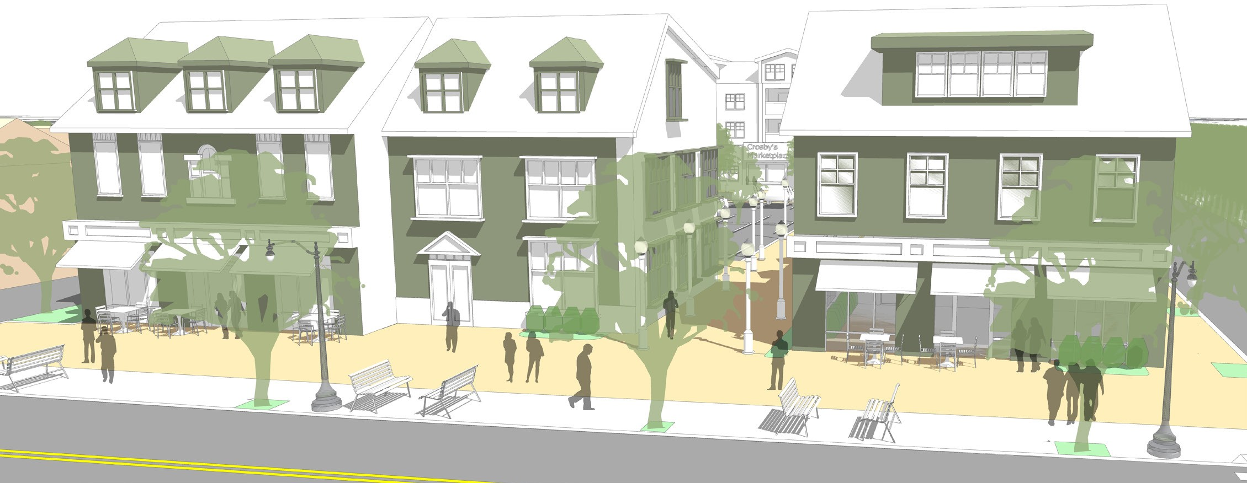
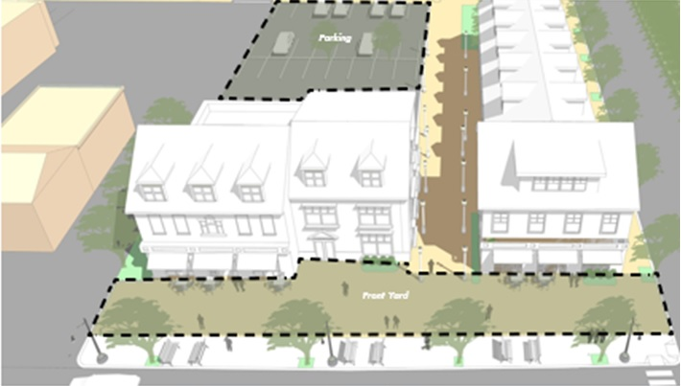
Enhance Walkability and Define Streetscape
Art. 33: TDB Zoning
Parking moved to the rear of buildings, public open space along Sudbury Road
Buildings aligned with the sidewalk edge creating a more defined streetscape like Concord Center

Slide 13
Parking Requirements
Art. 33: TDB Zoning
Prohibit parking in front yard setbacks to minimize visual impact and improve neighborhood walkability
Reduce residential parking requirements for mixed-use
Current requirement: 2 spaces per residential unit
New requirement: 1 space for 1-2 bedroom units, 2 spaces for >2 bedrooms.
No change to commercial parking requirements
Potential parking reduction by Special Permit (e.g., shared parking)

Slide 14
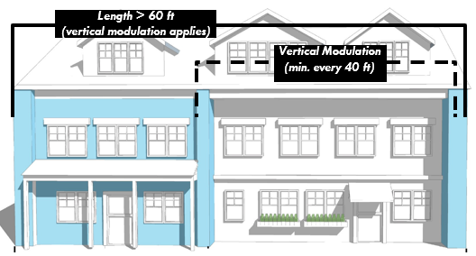
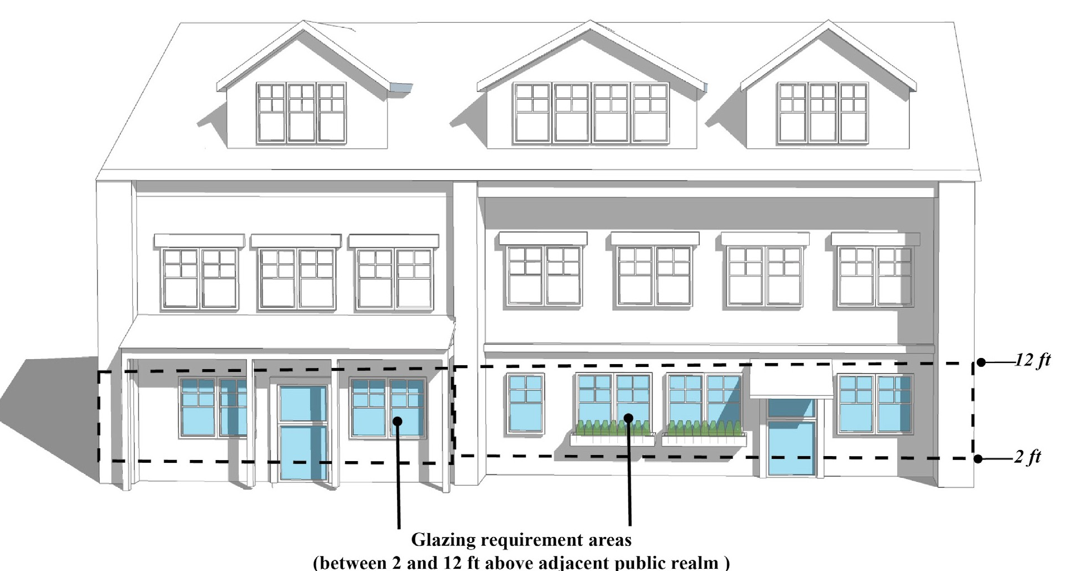
Design Guidelines
Art. 33: TDB Zoning
”context-based building and site development standards that reflect scale, design characteristics, and settlement patterns envisioned for the district”

Slide 15
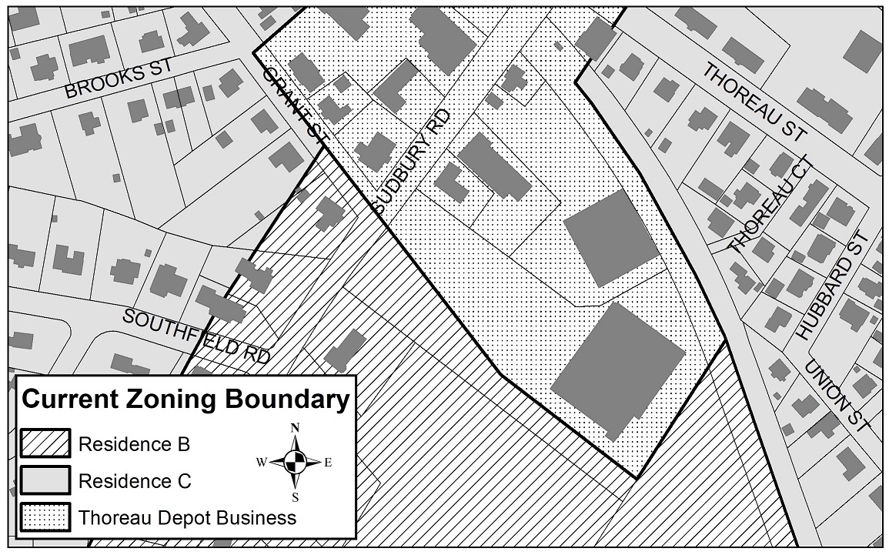
TDB District Boundary Change
Art. 33: TDB Zoning

Slide 16
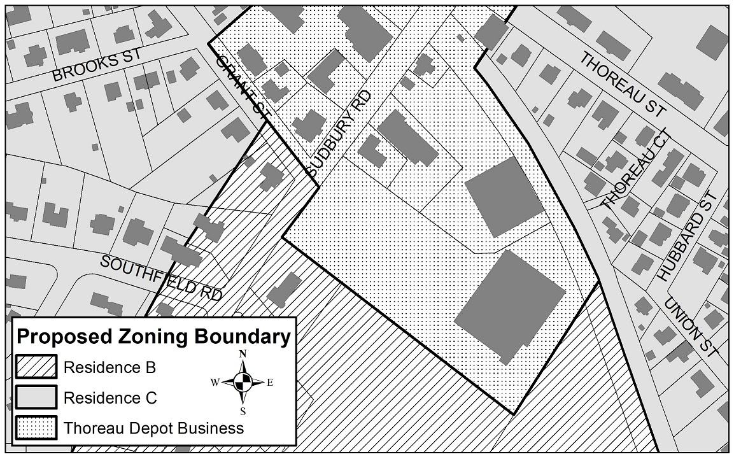
TDB District Boundary Change
Art. 33: TDB Zoning

Slide 17
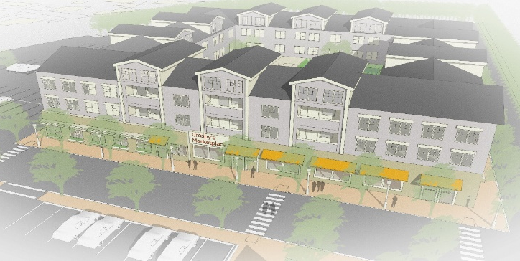
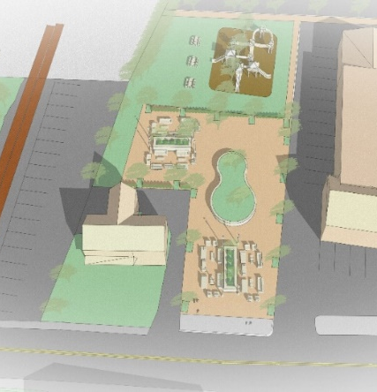
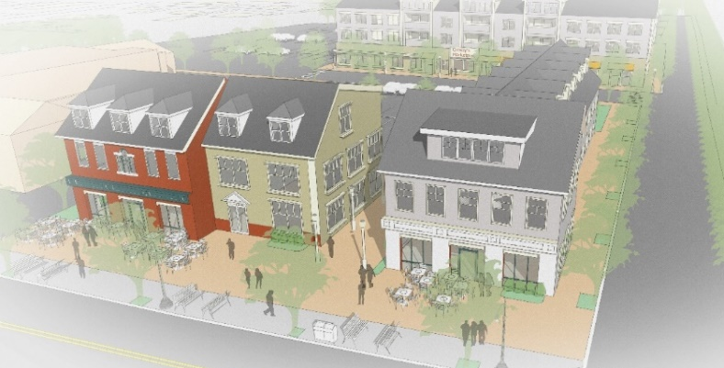
Hypothetical Buildout
Art. 33: TDB Zoning
1
Commercial 1st Floor = 31,600 s.f., Residential Units = 46
Commercial 1st Floor =5,800 s.f., Residential Units = 10
Commercial 1st Floor = 4,440 s.f., Residential Units = 7
Open Space = 15% of total site, includes seating & pathways
1
4
2
3
2
3
4

Slide 18
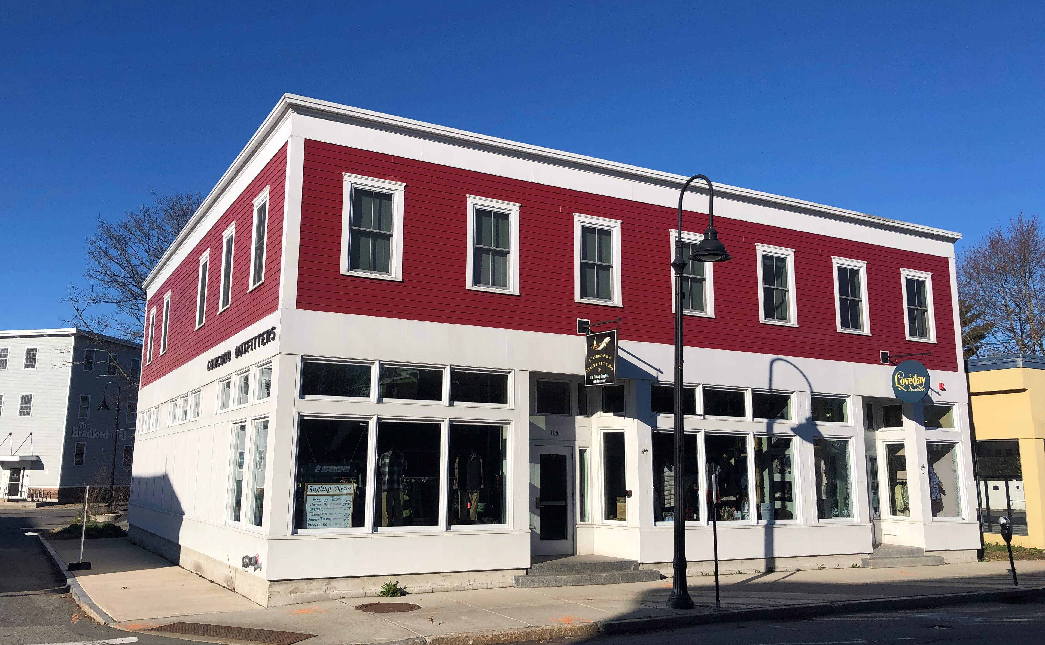
Recent Mixed-Use Examples in West Concord
Art. 33: TDB Zoning
Concord Outfitters
13B Commonwealth Ave. Approved Plan

Slide 19
Art. 33: TDB Zoning
Motion: Mr. Flint moves that the Town take affirmative action on Article 33 as printed in the Warrant.

Slide 20
Additional Information

Slide 21
Hypothetical Build-out Traffic Impact Calculation
Per Institute of Transportation Engineers Manual,
Crosby’s Parcels are estimated to generate 1,500 trips per day. Adding 60 residential units = another 200 trips spread throughout the day, or a 13% increase in trips associated with the Crosby’s parcels.
Assuming 25% of ALL traffic on Sudbury Road is going to or from Crosby’s today, that is a net increase of 3.25%

Slide 22
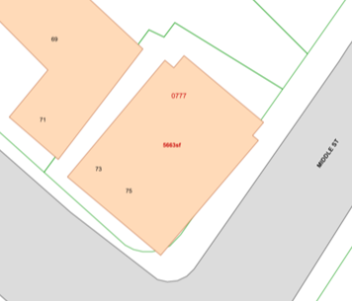
Concord Provisions
5,663 sf parcel, gross floor area of 2,180 sf. For existing use, to be conforming it would require approx. 9 parking spaces.
For comparison, Sorrento’s 10 space parking lot is approx. 4500 sf., or 80% of the size of the entire Provisions parcel.
A re-development of this parcel that added square footage, either commercial or ANY residential, would require a special permit. If residential added, 15% of lot must be open space.

Slide 23
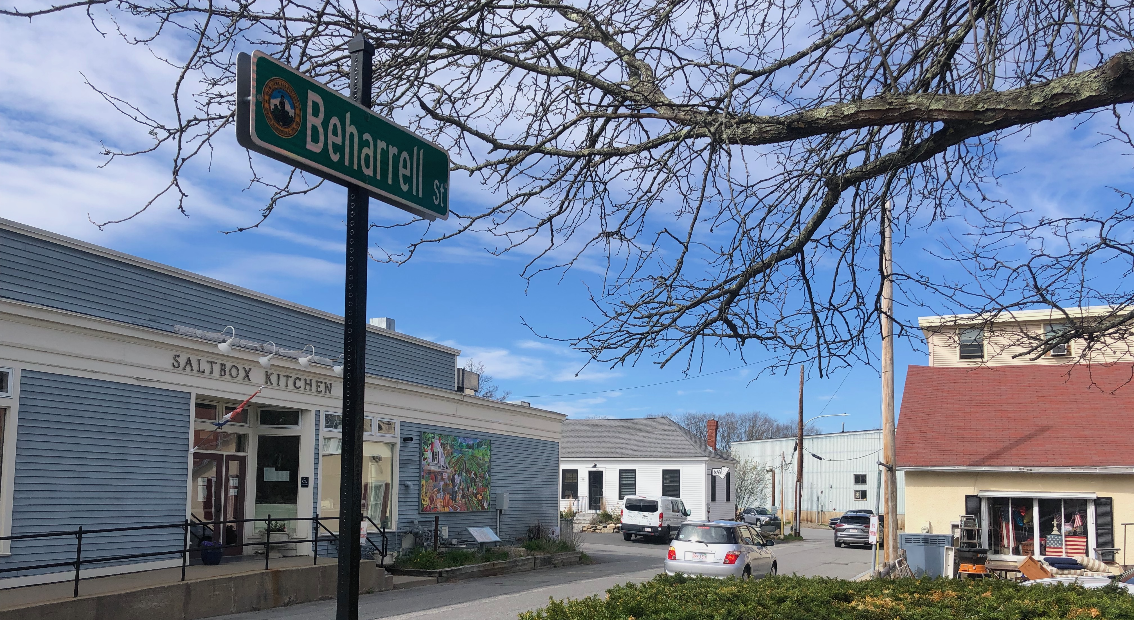
Height and Massing Examples
Brookside Square, 40’ tall
74 units, 8 affordable
View of Brookside Square from Comm. Ave. & Beharrell. 140 meters from front of building.

Slide 24
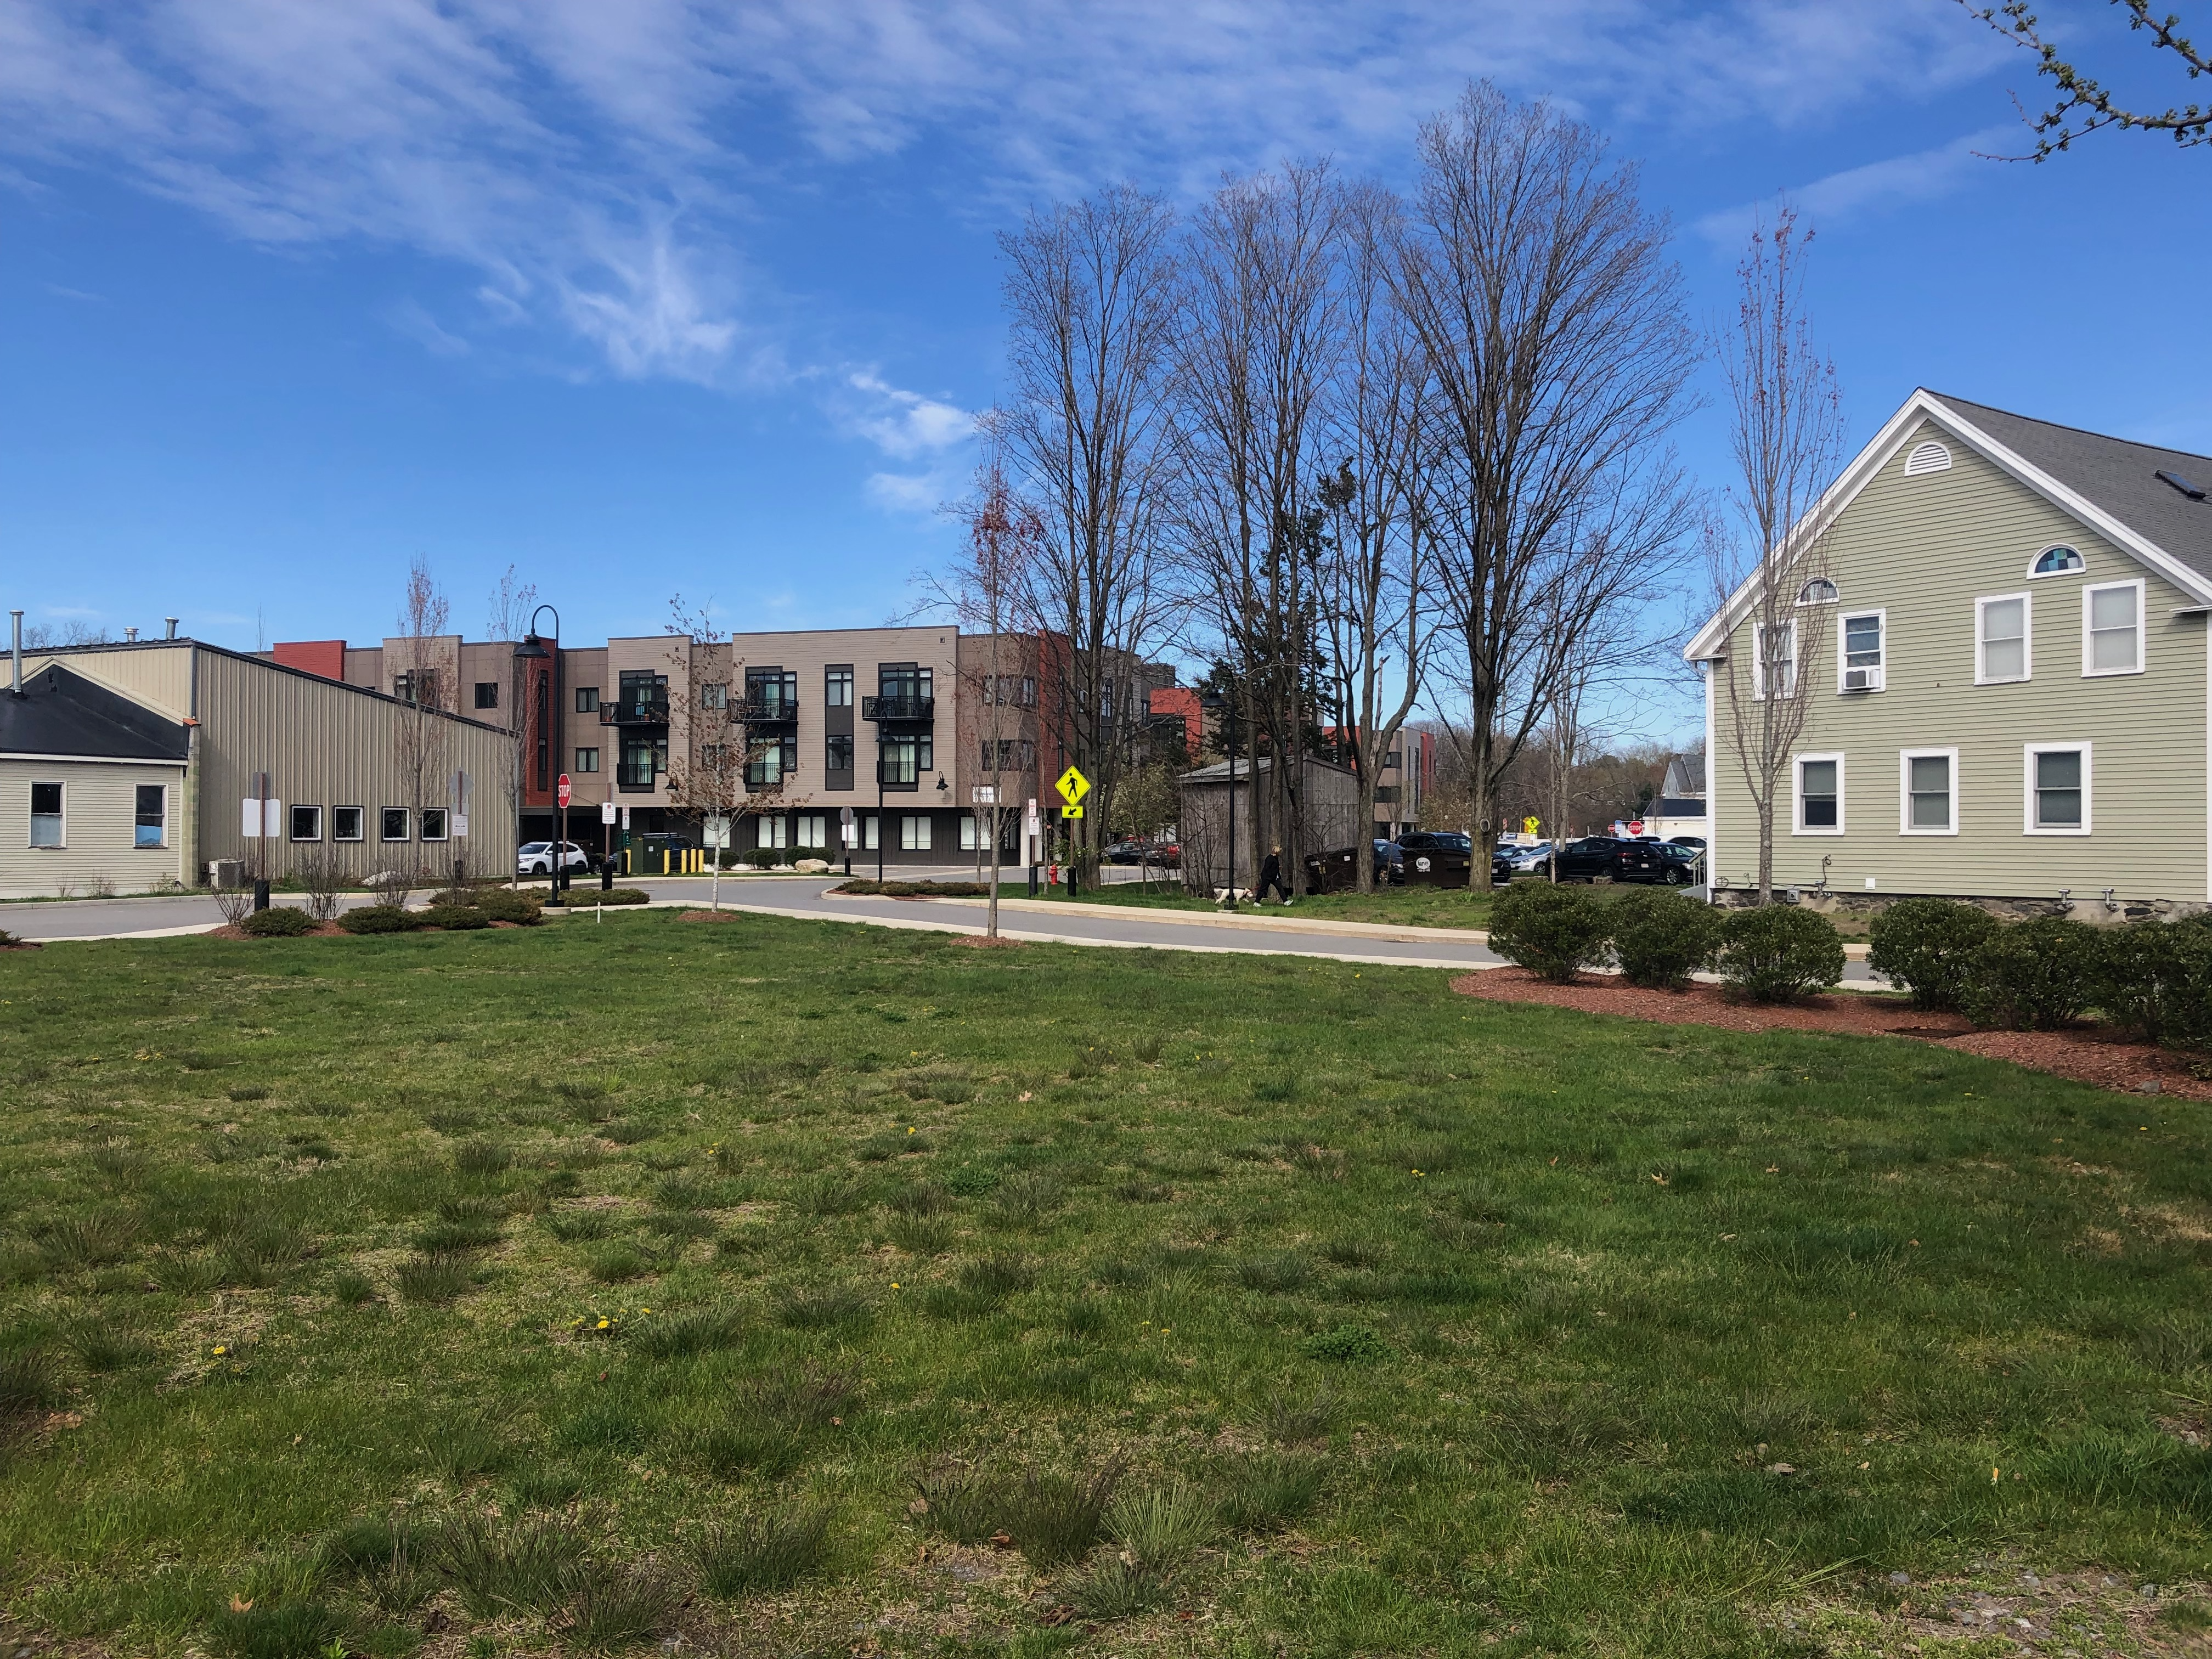
Height and Massing Examples
Brookside Square,
74 apartments, 8 affordable
View of Brookside Square from Comm Ave. 90 meters from of building.

Slide 25
Height and Massing Examples
13B Commonwealth Ave. Eight apartments, two affordable units, will block view of Brookside Square.

Slide 26
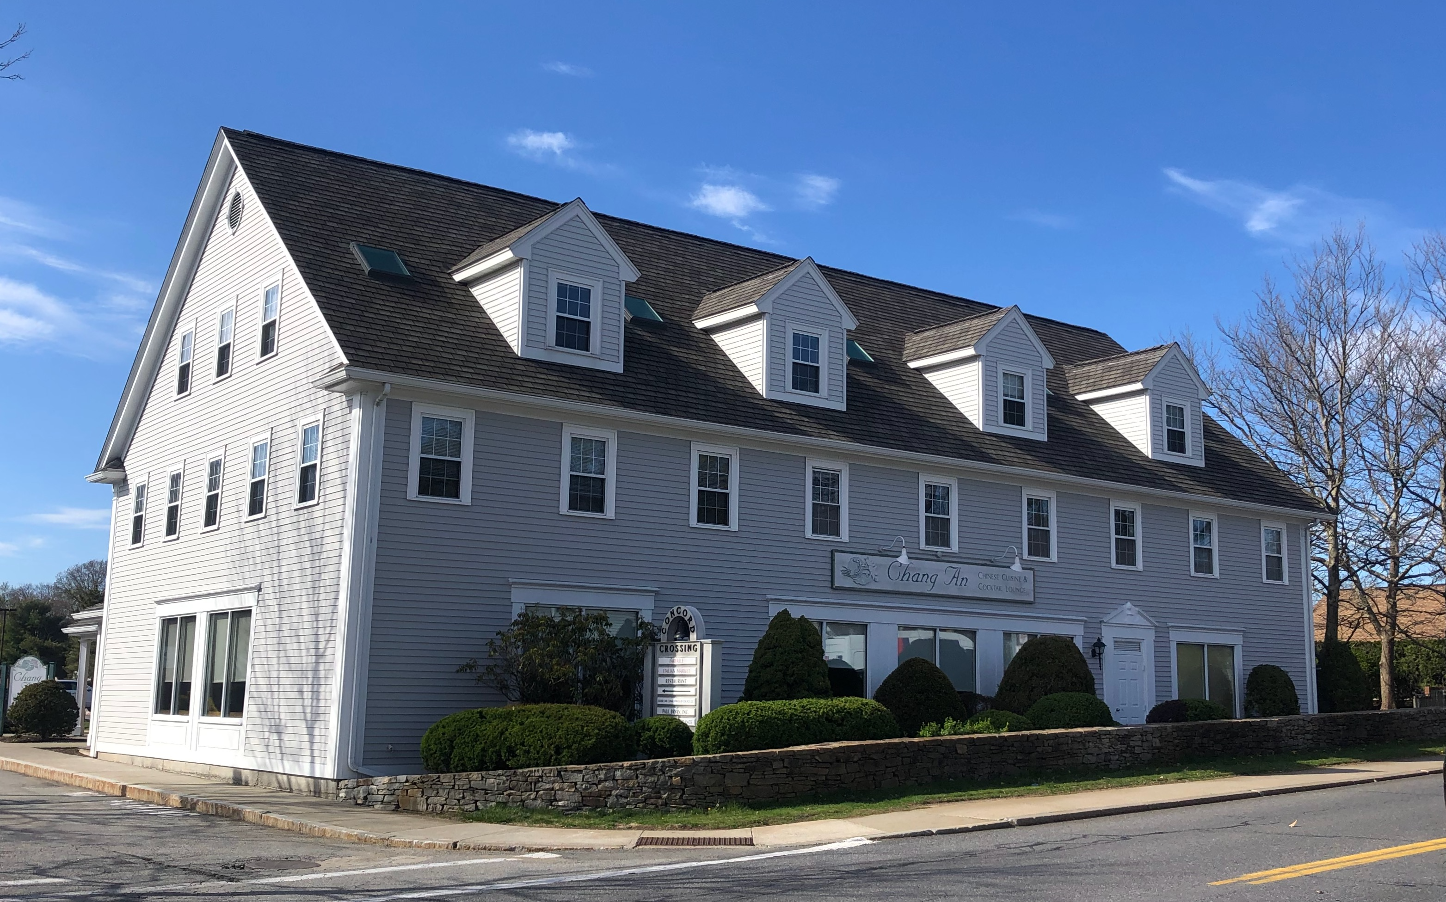
Height and Massing Examples
Chang An. 36 feet to the ridge.

Slide 27
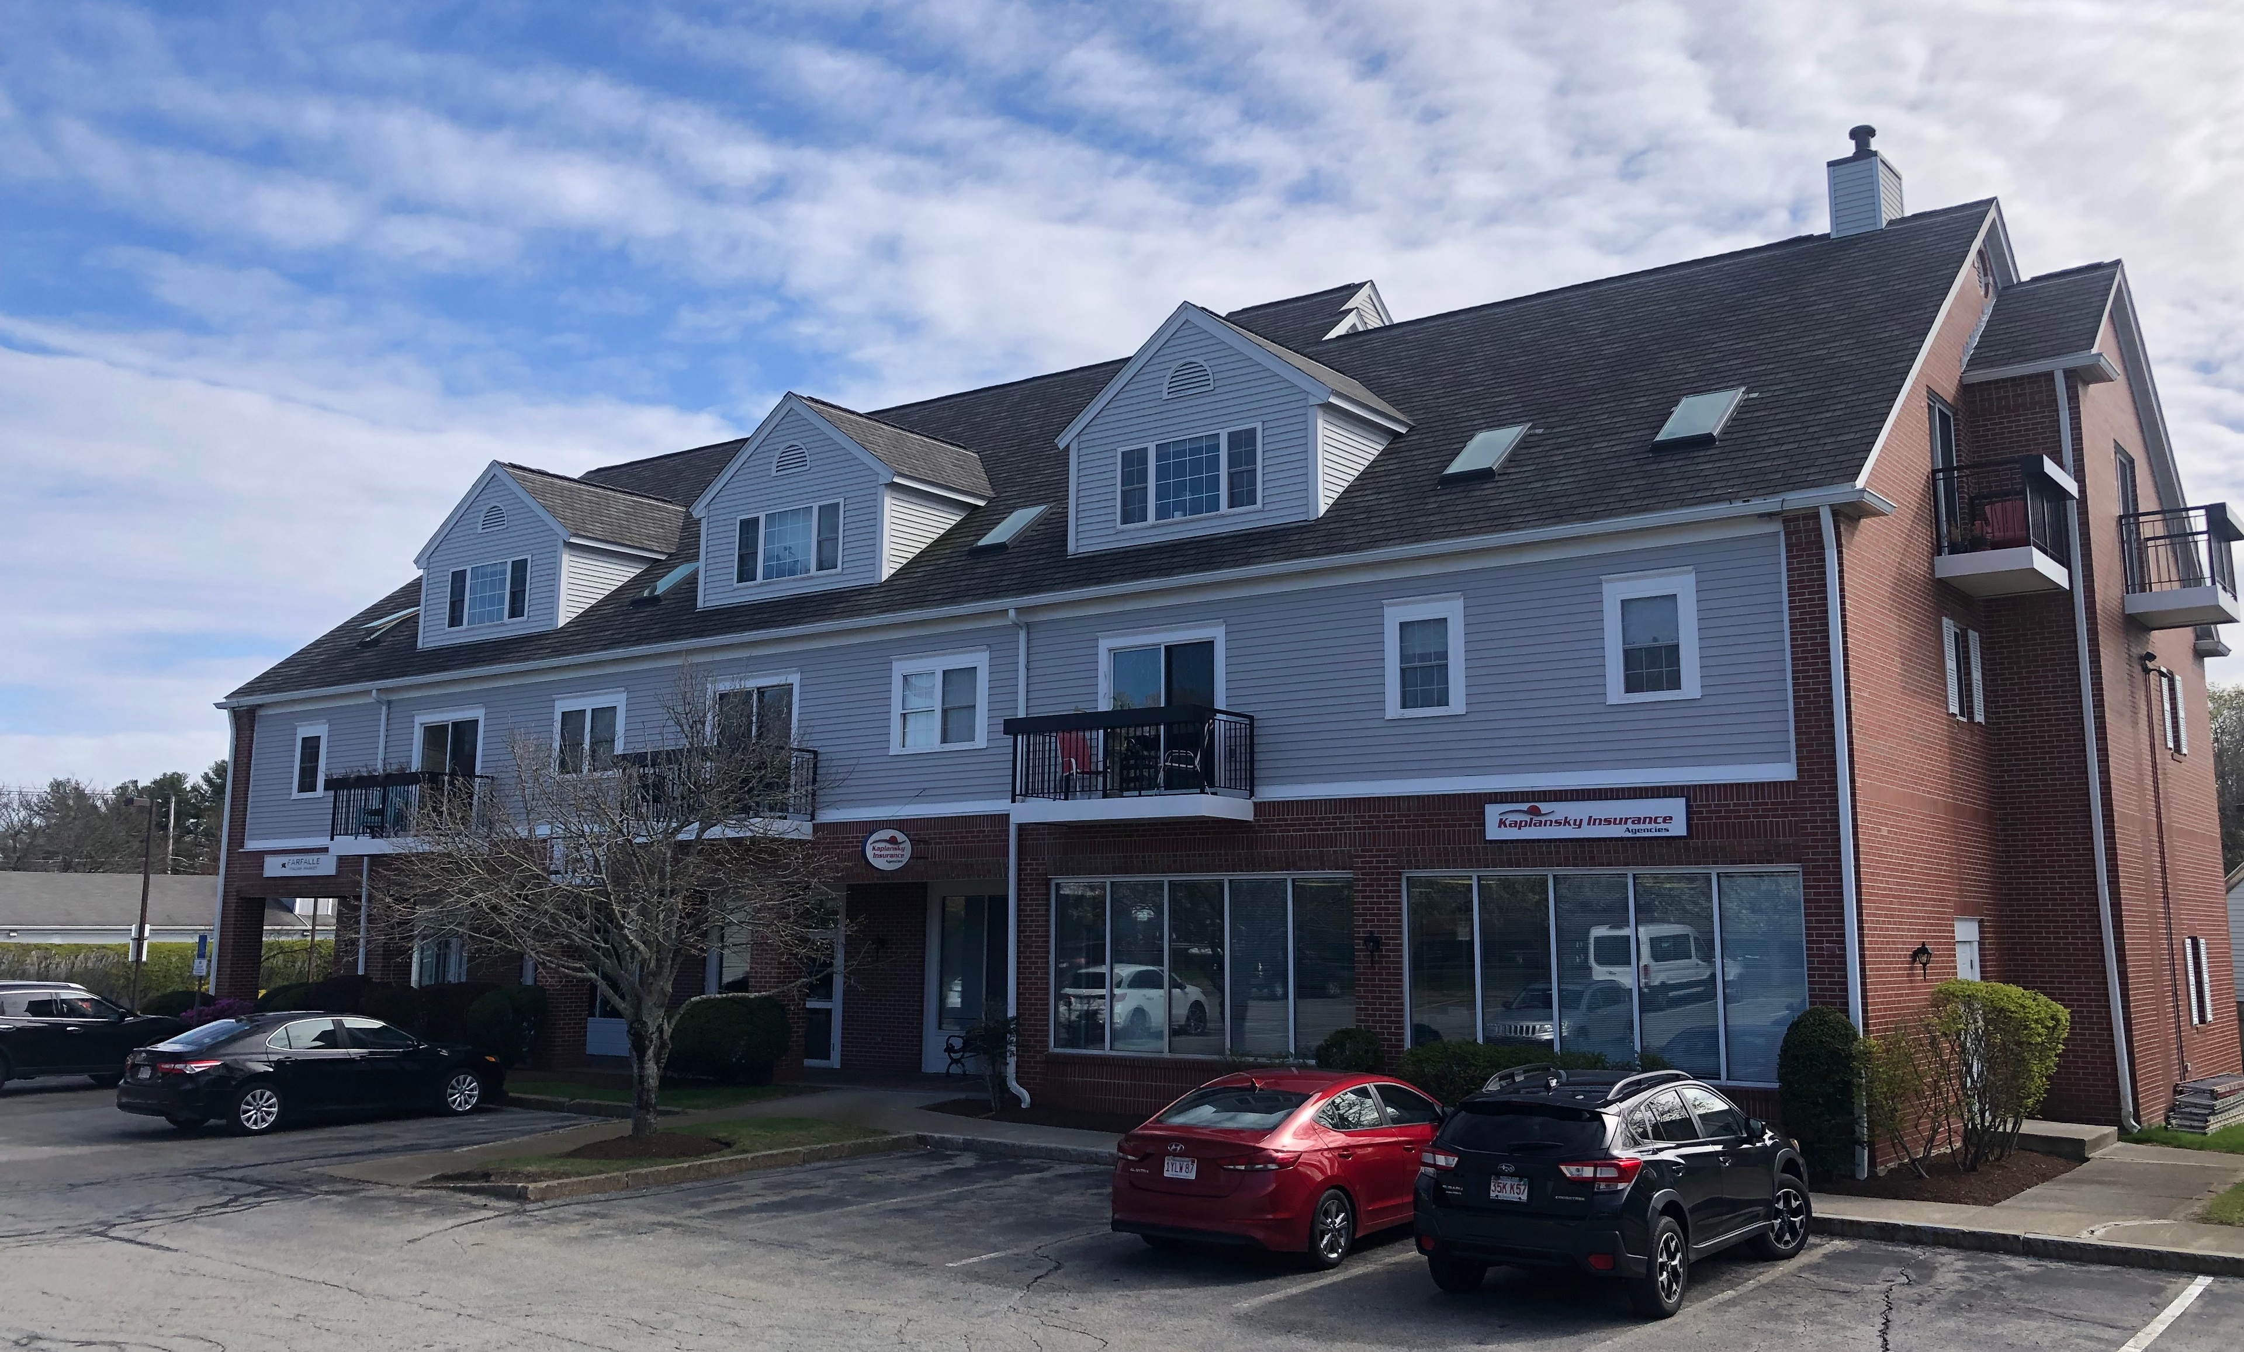
Height and Massing Examples
Concord Crossing, mixed-use, 43’ to main ridge, max height 47’
Taller than what is allowed under Article 33 with a Special Permit

Slide 28
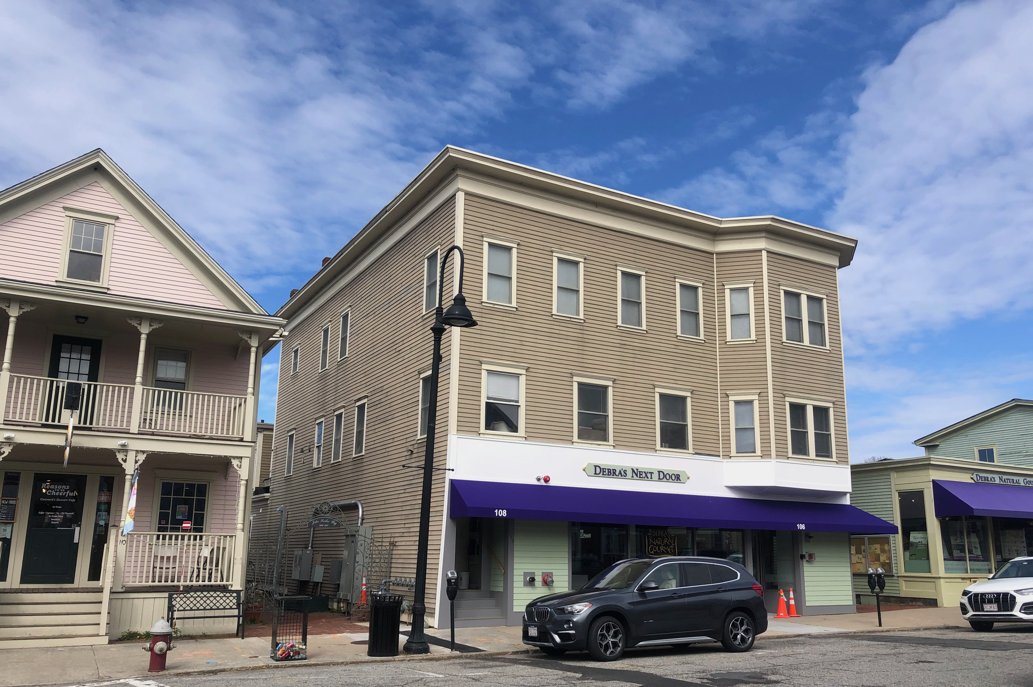
Height and Massing Examples
Debra’s Next Door. Mixed use, approximately 35’ high

Slide 29
Height and Massing Examples
Concord Outfitters. Mixed-use, two stories, two apartments.

