Slide 1
Middle School Impact on Median Household
November 17, 2022
Notes:
Good Evening – I’d like to welcome everyone on behalf of the Finance Committee
I’m Dean Banfield, this year’s Chair, and I’m going to help get the conversation started with a few brief remarks

Slide 2
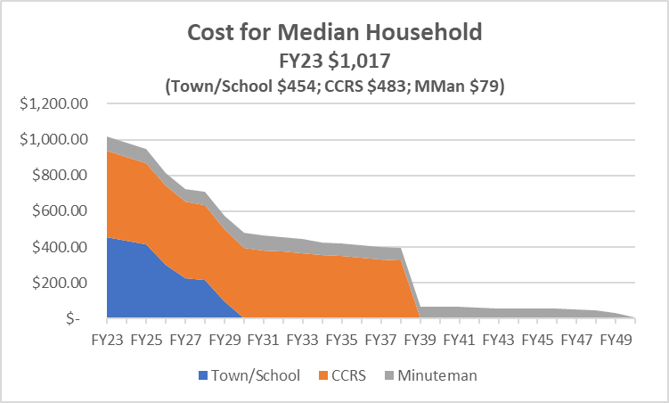
Existing Excluded Debt (without any Middle School debt)

Slide 3
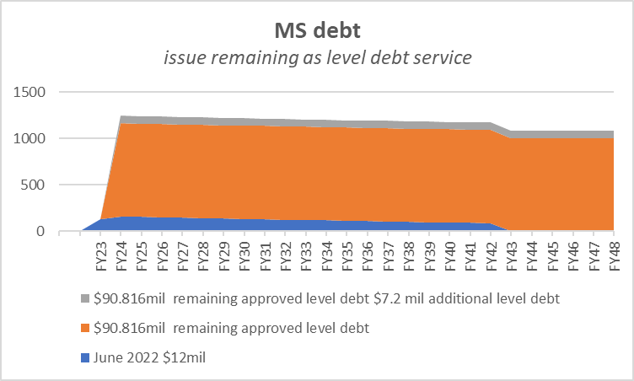
Excluded Debt – Middle School
 | $12 mil issued | $90.816 mil | $7.2 mil | TOTAL
FY23 | $ 131.27 | $ - | $ - | $ 131.27
FY24 | $ 159.36 | $ 1,004.81 | $ 79.52 | $ 1,243.69
Avg FY24-48 | $ 92.65 | $ 1,004.36 | $ 79.65 | $ 1,176.65

Slide 4
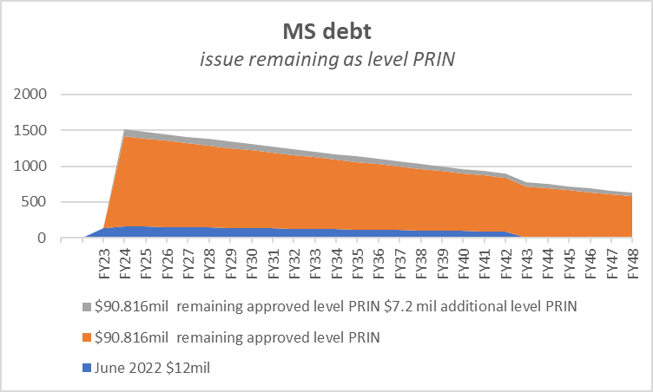
Excluded Debt – Middle School
 | $12 mil issued | $90.816 mil | $7.2 mil | TOTAL
FY23 | $ 131.27 | $ - | $ - | $ 131.27
FY24 | $ 159.36 | $ 1,257.01 | $ 99.92 | $ 1,516.29
Avg FY24-48 | $ 92.65 | $ 918.36 | $ 72.89 | $ 1,083.90

Slide 5
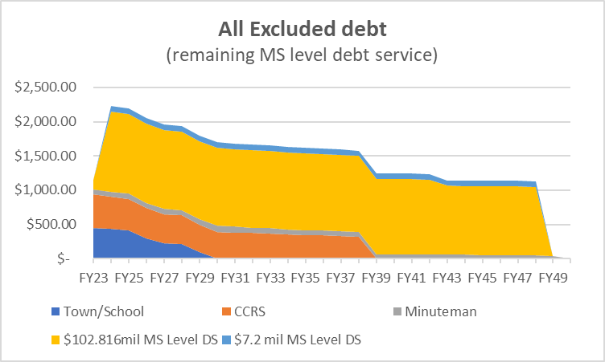
Excluded Debt (all Middle School debt added as level debt service)
 | Non MS | $102.816 MS | $7.2 MS | TOTAL
FY23 | $ 1,016.73 | $ 131.27 | $ - | $ 1,148.00
FY24 | $ 981.55 | $ 1,164.17 | $ 79.52 | $ 2,225.24
Avg FY24-48 | $ 394.27 | $ 1,059.86 | $ 76.59 | $ 1,530.72

Slide 6
Excluded Debt (Smooth previous slide with Stabilization Fund)

Slide 7
What has changed since last winter? Increase $340 in FY24, average $275 over 25yrs 74% is due to Interest Rates; 26% due to additional $7.2 million costs

