Slide 1
Article 9. FY24 Budget
ARTICLE 9. Mr. Johnson moves that the Town take affirmative action on Article 9, as printed in the handout pertaining to the Article.

Slide 2
Manner of Appropriation
The Town’s budget is appropriated by Town Meeting in 16 distinct line items
The Town Manager must then manage the “bottom line” of each line-item appropriation
Adjustments are then only allowed:
  Further Town Meeting action
  MGL Ch. 44, §33B

Slide 3
Summary of Budget Article

Slide 4
FY24 Budget Timetable

Slide 5
FY2024 Town Budget- Recommendation
To bridge delta:
Carry forward $600k of unspent FY22 Operating appropriation
  MGL Ch. 44, 33 (b) allows transfer of prior year unspent appropriation before
  Close of the FY; Use of carry forward will impact Free Cash, but reduces impact to property tax
Remaining gap of $29,850 is required spending as part of the National Opioid Settlement

Slide 6
FY2024 Strategic Issues
    A Great Place to Work
    Governance
    Infrastructure
    Welcoming Community

Slide 7
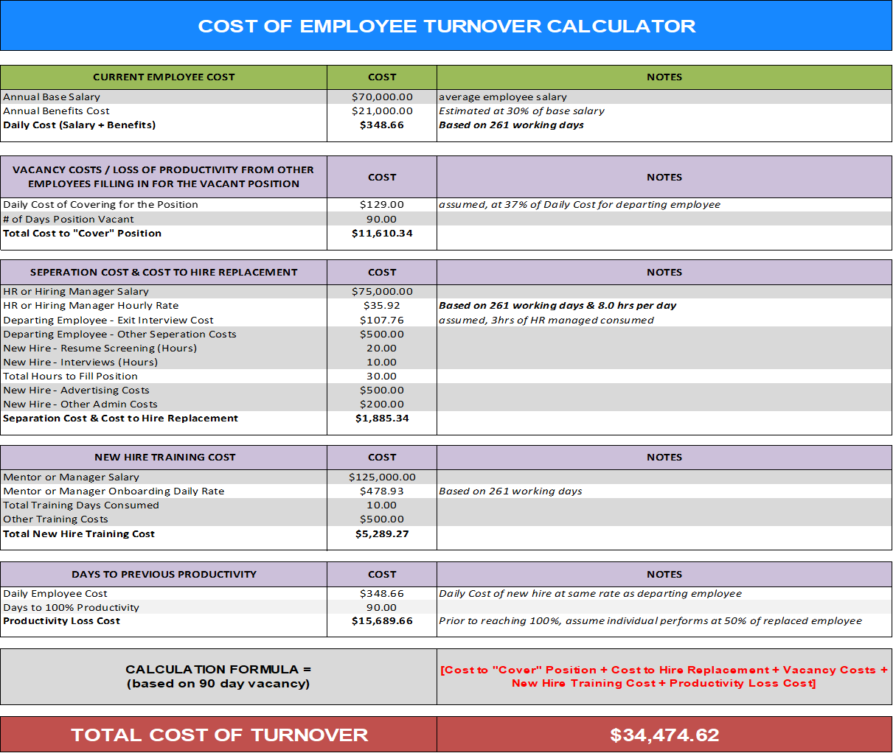
Strategic Issue: A Great Place to Work
Compensation on par with peer communities
Addressing compensation for targeted positions
Work with Personnel Board to redraft key policies

Slide 8


Strategic Issue: Governance
Assess long-term viability of remote & hybrid meetings
Assess permanent staffing needs

Slide 9



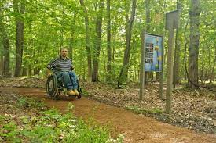
Strategic Issue: Public Works Infrastructure
Goal of PCI = 85
Increasing cost of materials
Pedestrian safety
Opportunities for all

Slide 10

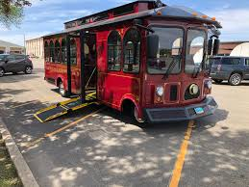

Strategic Issue: Community Support
Public transportation
Additional social and community supports
Affordable housing

Slide 11
FY24 Spending Drivers: Guidelines
Known & anticipated wage adjustments: $950,000
  Up to 4.5%
  Market
  Attraction & Retention
  Flagged by Personnel Study Task Force as top issue to address
Increased Utility & Commodity Costs: $200,000
  Diesel fuel (+25.0%)
  Electricity (+20.0%)
  Natural Gas (+100.0%)
  Cardboard Recycling: single-stream would save money
Build back Tier 1 Funding: $216,000
  Still down $275,000 from pre-pandemic spending levels
  Article 11, Capital
Addressing Non-Wage Strategic Issues, through ARPA: $820,000
  Infrastructure: $680,000
  Governance: $25,000
  Welcoming Community: $105,000

Slide 12
New FTE

Slide 13
FY24 Spending Drivers: Non-Guidelines

Slide 14
FY24 Budget: Fixed Costs, Group Insurance
Funds employer share of insurance benefits provided to eligible employees of Town and CPS
Health Insurance renewal: +9.0% ($675,000); 4 plans offered through MNHG, including HSAQ (high-deductible)
  Approximately 2/3rd of eligible Town employees and 60% of CPS employees are enrolled in insurance plan
  Of those enrolled, approximately 33% are enrolled in HSAQ plans; premiums run about 20% lower than benchmark plans

Slide 15
FY24 Budget: Fixed Cost, Retirement Assessment
Amount assessed to Town by Concord Retirement System for the cost of benefits provided to retirees (system costs + unfunded liability)
Assessment paid from two sources- Annual Budget appropriation + contribution from Pension Reserve (fund established in the 90’s to mitigate spikes in assessment increases)
Pension Reserve contribution schedule has been revised as the Town is nearing the end of its funding schedule (FY28); As of 01/01/22, system is 93.0% funded

Slide 16
FY23 Budget: Fixed Cost, Debt Service

Slide 17
FY24 ARPA Proposal

Slide 18
Article 9. FY24 Budget
ARTICLE 10. Mr. Johnson moves that the Town take affirmative action on Article 9, as printed in the handout pertaining to the Article.

