Slide 1
2023 Annual Town Meeting Finance Committee Public Hearing
March 1, 2023
ARTICLE 26. Community Preservation Act Appropriation Recommendations

Slide 2
Article 26: CPC Appropriations
Recommendations for CPA Funding in Warrant Article 26
TOTAL $1,839,680

Slide 3
ARTICLE 26: CPC Appropriations
Regional Housing Services Program
Summary of Project: To support the Town of Concord’s membership in the Regional Housing Services Program, an inter-municipal program providing professional housing services to develop and monitor Concord’s affordable housing programs.
Recommended Funding: $33,000
Category: Community Housing Applicant: Town of Concord

Slide 4
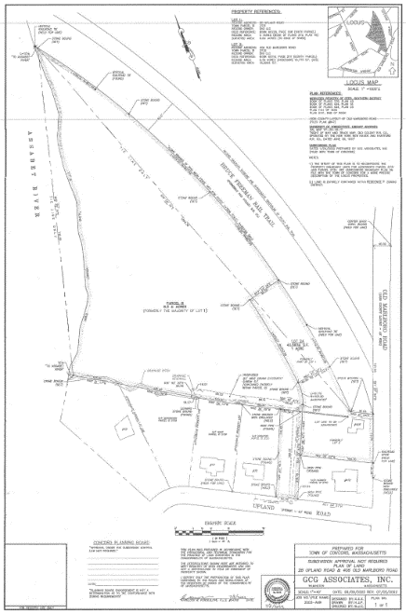
ARTICLE 26: CPC Appropriations
Assabet River Bluff Housing Project
Summary of Project: To support the development of five restricted affordable housing units on the recently acquired property off Old Marlboro Road. The project consists of creating two eligible housing units from the existing apartments and designing the development of three new units on the remaining land area.
Recommended Funding: $500,000
Category: Community Housing
Applicant: Community Housing Development Corp.

Slide 5
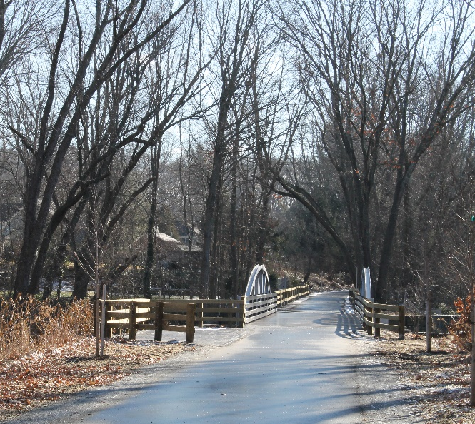
ARTICLE 26: CPC Appropriations
Bruce Freeman Rail Trail Project
Summary of Project: To provide additional amenities to enrich and enhance the user experience on this non-motorized, ADA-accessible, multi-use trail such as: safety improvements at Junction Park, interpretive/contemplative improvements at the Concord Prison Cemetery site adjacent to the BFRT and additional plantings and signage along the trail.
Recommended Funding: $50,000
Category: Open Space and Recreation
Applicant: Town of Concord

Slide 6
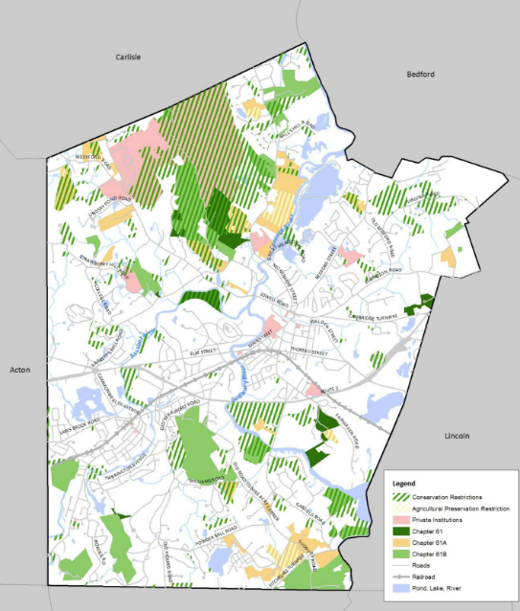
ARTICLE 26: CPC Appropriations
Open Space and Recreation Plan
Summary of Project: For consultation services to assist in the preparation of an update to the Concord Open Space and Recreation Plan (OSRP). A state-approved OSRP, which is valid for 7 years, helps provide a road map for identifying community needs for open space and recreation, and makes the Town eligible for several state and federal grants. Recommended Funding: $100,000
Category: Open Space and Recreation
Applicant: Town of Concord

Slide 7
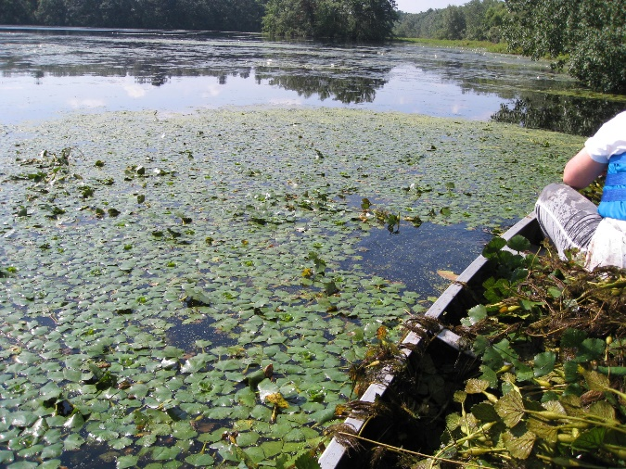
ARTICLE 26: CPC Appropriations
Warner’s Pond Restoration Project
Summary of Project: To improve the ecological health and recreational opportunities at Warner’s Pond through a limited dredging operation and to improve the boat launch access to better serve public access to the pond. Recommended Funding: $550,000
Category: Open Space and Recreation
Applicant: Town of Concord

Slide 8
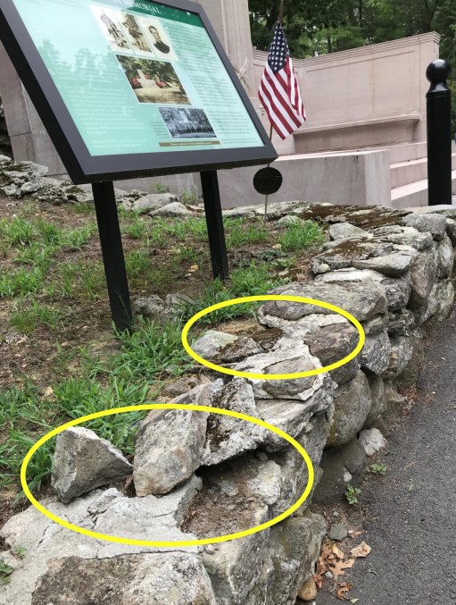
ARTICLE 26: CPC Appropriations
Cemeteries Stone Wall Restoration
Summary of Project: To restore 35 deteriorating stone walls and structures in Concord’s 3 historic cemeteries: Old Hill Burying Ground, South Burying Ground and Sleepy Hollow Cemetery. Recommended Funding: $340,000 Category: Historic Preservation
Applicant: Town of Concord

Slide 9
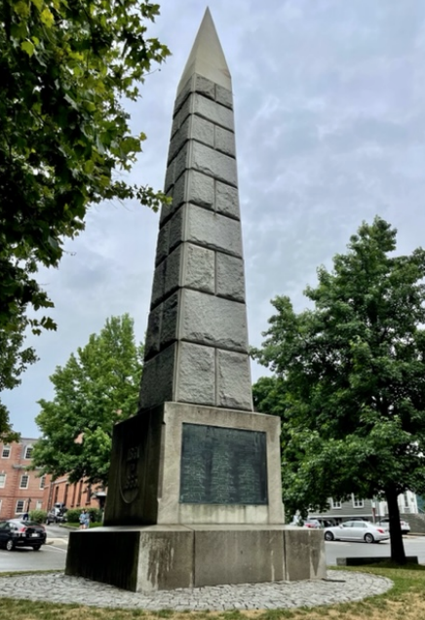
ARTICLE 26: CPC Appropriations
Civil War Soldiers’ Monument Conservation & Preservation Project
Summary of Project: To preserve and conserve the Civil War Soldiers’ Monument and to replace the current tablet, adding the name of Private George W. Dugan, 54th Mass. Vols. Recommended Funding: $165,000 Category: Historic Preservation
Applicant: Town of Concord

Slide 10
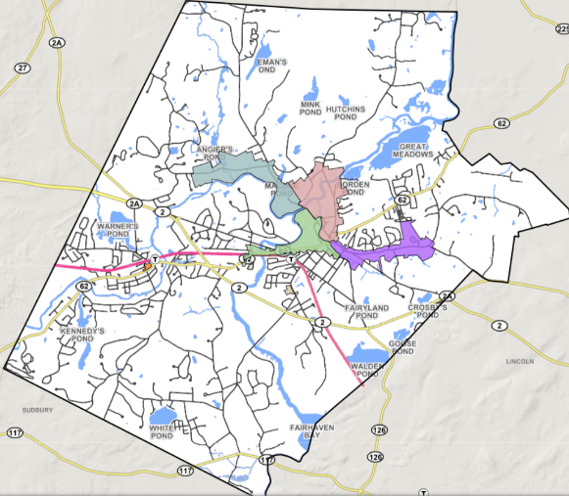
ARTICLE 26: CPC Appropriations
Concord Historic Preservation Plan
Summary of Project: To hire a team of historic preservation consultants to create a Concord Historic Preservation Plan. Recommended Funding: $50,000 Category: Historic Preservation
Applicant/Coapplicant: Town of Concord / Concord Historical Commission

Slide 11
ARTICLE 26: CPC Appropriations
Preservation/Conservation of Historic Town Plans
Summary of Project: To provide for the conservation treatment and digitization of two plans of the Concord Water Works (1874-1875) and seven sheets comprising the Town Plans of Concord (1907-1910). Recommended Funding: $16,230 Category: Historic Preservation
Applicant: Town of Concord

Slide 12
ARTICLE 26: CPC Appropriations
CPC Staff & Technical Support
Summary of Project: Funding for staff support; legal, technical and consulting services; supplies and associated administrative requirements including legal ads, copying, etc.; funding to purchase CPA signage; and other administrative expenses.
Recommended Funding: $40,000 Category: Administration
Applicant: Town of Concord

Slide 13
ARTICLE 26: CPC Appropriation
Questions???

