Slide 1
Article 43: Appropriation of Parking Meter Receipts
ARTICLE 43: Appropriation of Parking Meter Receipts
Mr. Jonson moves to appropriate the sum of $400,000 from Parking Meter Receipts to fund expenses related to parking enforcement or public transportation initiatives for the fiscal year ending June 30, 2024.

Slide 2
ARTICLE 43: Appropriation of Parking Meter Receipts
ARTICLE 43. To determine whether the Town will vote to appropriate the sum of $400,000 from Parking Meter Receipts to fund expenses related to parking enforcement or public transportation initiatives for the fiscal year ending June 30, 2024, or take any other action relative thereto.

Slide 3
Appropriation of Parking Meter Receipts
ARTICLE 43: Appropriation of Parking Meter Receipts
In accordance with Mass. Gen. Laws c.40, §22C, Parking Meter Receipts require annual appropriation
The amount available for appropriation is up to 100% of the estimated balance as of June 30 of the prior fiscal year

Slide 4
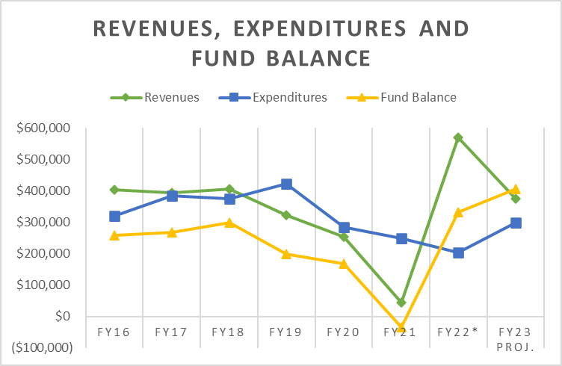
ARTICLE 43: Appropriation of Parking Meter Receipts
* FY22 includes $400,000 transfer of ARPA Funding

Slide 5
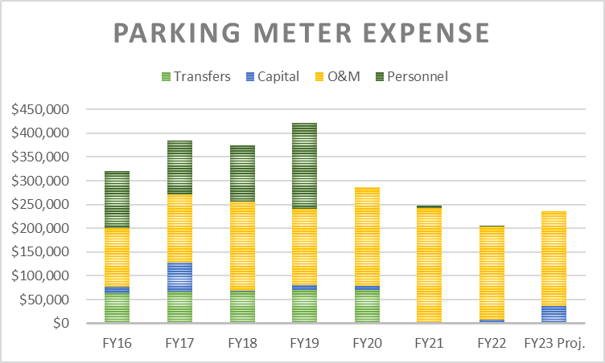
ARTICLE 43: Appropriation of Parking Meter Receipts

Slide 6
Article 43: Appropriation of Parking Meter Receipts
ARTICLE 43: Appropriation of Parking Meter Receipts
Mr. Jonson moves to appropriate the sum of $400,000 from Parking Meter Receipts to fund expenses related to parking enforcement or public transportation initiatives for the fiscal year ending June 30, 2024.

