Slide 1
ARTICLE 17: CONCORD PUBLIC SCHOOLS BUDGET
Ms. Anderson moves to vote to appropriate the sum of $45,047,176 for the necessary and expedient purposes of the public schools of the Town for the fiscal year ending June 30, 2024; and that the same be expended only for such purposes and under the direction of the Concord School Committee, or take any other action relative thereto.
Department | FY2022 Adopted | FY2023 Adopted | FY24 SC Vote 03/08/2023
CPS Budget | $41,708,424 | $43,010,486 | $45,047,176

Slide 2
Article 17: Factors Driving Budget Increase
Students Are Experiencing Mental Health and Social-Emotional Challenges, Impacted by The Covid-19 Pandemic
Costs to Fill Gaps in In-House Special Education Programming, to Provide Continuum of Services / Programs For Grade K – 8
No Longer Realizing Year Over Year Savings on OOD Tuitions
FY14 – FY23 Decreased From 36 To 16 Placements
FY24 Level, However Impacted by 14% Tuition Rate Increase

Slide 3
Article 17: FY24 Budget Summary

Slide 4
Article 17: FY24 Budget Drivers – Salary Accounts
Teachers salaries $1,414,498 (5.7%)
2.75% ($688K) due to contractual cost of living increase
1.5% ($386K) due to Special Education FTE’s (BC/BA, P/T, 1:1 nurse, Special Ed Teacher)
0.3% ($72K) due to longevity adjustments per CTA contract (aligned to CCHS/CCTA)
1.15% ($268K) due to steps/lanes, retirements, replacement cost differentials
Non-Teachers salaries $433,746 (3.8%)
Contractual increases, add’l tutor/assistant positions
Sick/Retirement incentives ($142,267) (-56%)
Total Salary Cost Drivers $1,705,977 (4.6%)

Slide 5
Article 17: FY24 Budget Drivers – Non-Salary Accounts
Out of district tuitions (net) $135,785 (50%)
Energy/utility costs (electricity, heating, bus fuel) $161,484 (12%)
Property/liability insurance $58,354 (76%)
Special Education Transportation $21,423 (3%)
Special education contract services ($105,486) (-19%)
Subtotal – Non-Salary Budget Drivers $271,560

Slide 6
Article 17: FY24 Budget – Unbudgeted Item (Risk)
Homeless Shelter at Best Western
Anticipated now to include some families with school age children
Financial impact not known
Current funding model of $1,000 per student for in-district support/services
Current funding model reimburses homeless transportation costs on a lag basis (fiscal year 2024 costs reimbursed in fiscal year 2025) – TIMING ISSUE
New legislation being proposed with potential adjustments to this funding

Slide 7
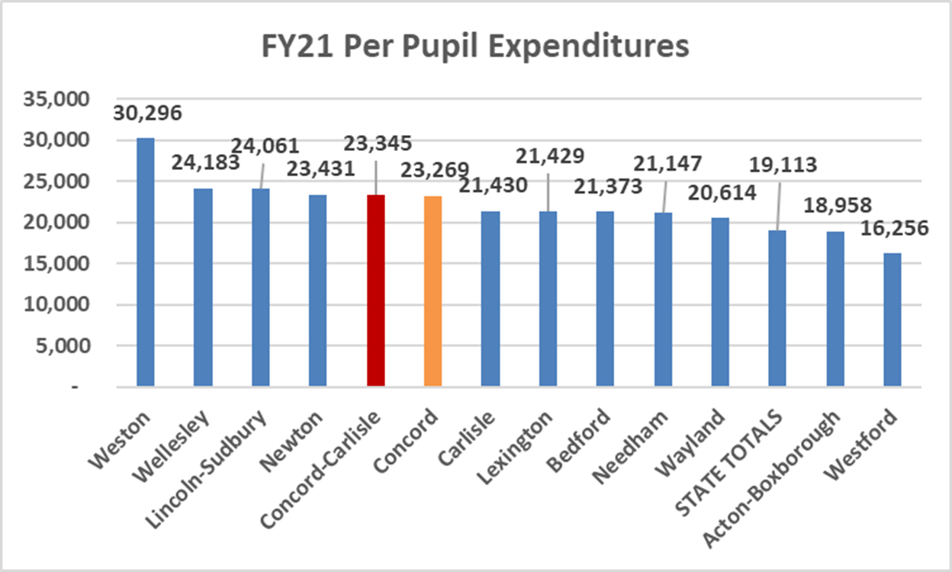
Article 17 – Spending Vs. Peer Districts

Slide 8
ARTICLE 17: ESSER FUNDS UPDATE
GRANT NAME | GRANT BUDGET | PROJ’D EXPENDED (thru FY23) | REMAINING BALANCE (Expend in FY24) | GRANT EXPIRATION
ESSER I (CARES) | 467,775 | 467,775 | - | 12/31/2021
ESSER II | 453,100 | 453,100 | - | 9/30/2023
ARPA – IDEA | 143,904 | 143,904 | - | 9/30/2023
ESSER III | 995,840 | 544,974 | 450,866 | 9/30/2024
Total Grants: | 2,060,619 | 1,609,753 | 450,866

Slide 9
ARTICLE 17: ESSER III
SUMMER SCHOOL | $372,640 | Offset To Current Budgeted Amounts And Expanded Programs
LITERACY PD & MATERIALS | $100,000 | One Time Costs of Multicultural / Diverse Literature Materials
CMS-LANGAUGE BASED SPECIAL EDUCATOR | $261,600 | 1.0 FTE Across FY23-FY24
CMS-ADJUSTMENT COUNSELOR | $261,600 | 1.0 FTE Across FY23-FY24
Esser iii total: | $995,840

Slide 10
ARTICLE 17: CONCORD PUBLIC SCHOOLS BUDGET
FY23 Adopted Budget $43,010,486
FY24 SC Voted $45,047,176
Increase $2,036,690 (4.74%)

Slide 11
ARTICLE 17: CONCORD PUBLIC SCHOOLS BUDGET
Ms. Anderson moves to vote to appropriate the sum of $45,047,176 for the necessary and expedient purposes of the public schools of the Town for the fiscal year ending June 30, 2024; and that the same be expended only for such purposes and under the direction of the Concord School Committee, or take any other action relative thereto.
Department | FY2022 Adopted | FY2023 Adopted | FY24 SC Vote 03/08/2023
CPS Budget | $41,708,424 | $43,010,486 | $45,047,176

