Slide 1
Article 39: Sewer System Expenditures
To determine whether the Town will vote that the income from user fees, special services fees and jobbing services by the Water and Sewer Division of Concord Public Works during the ensuring fiscal year, together with the balance of operating cash in the Sewer Fund be expended without further appropriation under the direction and control of the Town Manager in accordance with the Motion passed under Article 37 of the 1976 Annual Town Meeting, or take and other action relative thereto.

Slide 2
Article 40: Sewer Improvement Fund Expenditures
To determine whether the Town will vote that the income from sewer improvement fees during the ensuing fiscal year, together with the balance of operating cash in the Sewer Improvement Fund, be expended without further appropriation under the direction and control of the Town Manager in accordance with the Motion passed under Article 25 of the 1989 Town Meeting and applicable state enabling statutes, or take any other action relative thereto.

Slide 3
Article 39: Sewer System Expenditures
Article 40: Sewer Improvement Fund Expenditures
Municipal Sewer System
Infrastructure Assets = $18.8 million
1 – Advanced WWTP
2 – Large Scale Pumping Stations
6 – Neighborhood Lift Stations
34 – Miles of Collection Main
903 – Manholes

Slide 4
Article 39: Sewer System Expenditures
Article 40: Sewer Improvement Fund Expenditures

Slide 5
Article 39: Sewer System Expenditures
Article 40: Sewer Improvement Fund Expenditures
FY24 – Capital Improvement Plan
Proposed Expenditures - $1,348,600
$ 86,000 - Station Structures & Equipment
$ 228,000 - Inflow/Infiltration & Sewer Lateral Work
$ 206,000 - Meter Reading System Upgrade
$ 453,000 - Stations Structures & Plant Equipment
$ 313,600 - Wastewater Treatment Plant Improvements
$ 62,000 - Vehicle & Miscellaneous Equipment Replacement

Slide 6
Article 39: Sewer System Expenditures
Article 40: Sewer Improvement Fund Expenditures
FY24 – Sewer Rates
Proposed Adjustment (FY23 vs. FY24)
Residential Rate - $0.1298/cubic foot - 5% increase
Commercial Rate - $0.1298/cubic foot - 5% increase
Sewer Improvement Fee - $40.07 per gallon - no change
Impact on Avg. Residential Customer
$37.07/year

Slide 7
Article 39: Sewer System Expenditures
To determine whether the Town will vote that the income from user fees, special services fees and jobbing services by the Water and Sewer Division of Concord Public Works during the ensuring fiscal year, together with the balance of operating cash in the Sewer Fund be expended without further appropriation under the direction and control of the Town Manager in accordance with the Motion passed under Article 37 of the 1976 Annual Town Meeting, or take and other action relative thereto.

Slide 8
Article 40: Sewer Improvement Fund Expenditures
To determine whether the Town will vote that the income from sewer improvement fees during the ensuing fiscal year, together with the balance of operating cash in the Sewer Improvement Fund, be expended without further appropriation under the direction and control of the Town Manager in accordance with the Motion passed under Article 25 of the 1989 Town Meeting and applicable state enabling statutes, or take any other action relative thereto.

Slide 9
Supplemental Information

Slide 10
Article 39: Sewer System Expenditures
Article 40: Sewer Improvement Fund Expenditures

Slide 11
10 Year Capital Plan
Article 39: Sewer System Expenditures
Article 40: Sewer Improvement Fund Expenditures

Slide 12
10 Year Operating Projections
Article 39: Sewer System Expenditures
Article 40: Sewer Improvement Fund Expenditures

Slide 13
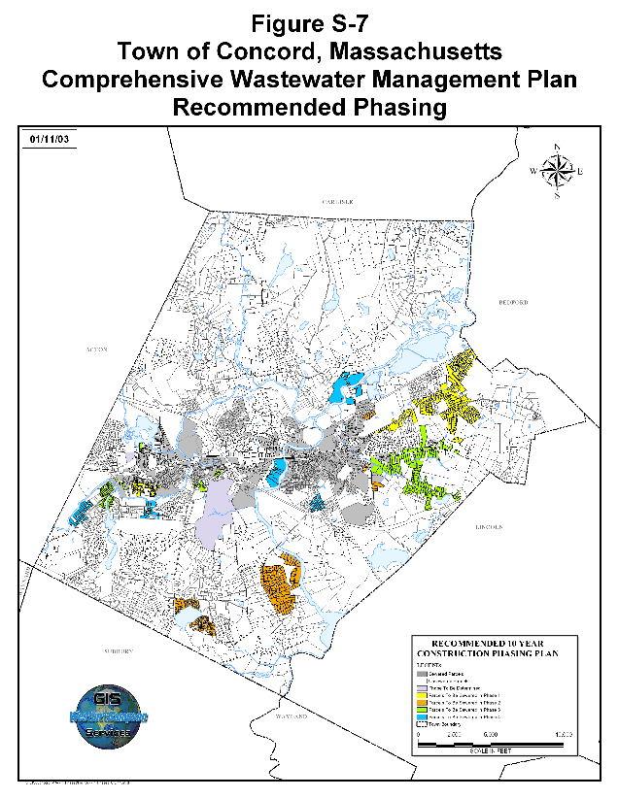
Article 39: Sewer System Expenditures
Article 40: Sewer Improvement Fund Expenditures

Slide 14
Article 39: Sewer System Expenditures
Article 40: Sewer Improvement Fund Expenditures
2003 – ATM Article 36 Comprehensive Wastewater Master Plan (CWMP)
20 Year Plan
Growth Neutral – No allowance for increase in wastewater capacity
Established Eligibility, Allocation and Construction Phasing
2003 – Certification - Executive Office of Environmental Affairs (EEOA)
2004 – ATM Article 48 CWMP – Phase I Design/Construction Funding
2004 – Sewer Rules/Regulations – Codified Right of Connections
Restricted to Parcels/Areas specified within the CWMP.
One connection per parcel, even if later subdivided.

Slide 15
Article 39: Sewer System Expenditures
Article 40: Sewer Improvement Fund Expenditures
Subsequent Planning Efforts
2005 – Comprehensive Long Range Plan (CLRP)
Recommended Focused Redevelopment in Village Centers
Supports Economic Development and Affordable Housing
2005 – Planned Production Housing Plan (PPHP)
Supports State Affordable Housing Goals
2007 – Status of Municipal Wastewater Treatment Report
Stated No Municipal Treatment Capacity Available to Support CLRP and PPHP Recommendations
2009 – Integrated Planning Initiative
Aligned goals – Quantified Wastewater Needs

Slide 16
Article 39: Sewer System Expenditures
Article 40: Sewer Improvement Fund Expenditures
Capacity Management Efforts
2007 – Wastewater Treatment Plant Upgrade (CoMag)
2008 – Brownfield Grant
Assessment of Grace Property for WW discharge
2009 – Post WWTP Upgrade
Desktop Capacity Assessment
2013 – DEP Approval of Hydrogeologic Evaluation @ WWTP (GWD)
2015 – Detailed Wastewater Capacity Assessment of WWTP
2022 – WWTP Facilities Plan

Slide 17
Article 39: Sewer System Expenditures
Article 40: Sewer Improvement Fund Expenditures
Capacity Management Efforts (continued)
Ongoing Inflow/Infiltration Assessment and Mitigation
Public Works Commission Policies
1,000 gallon per day review
Efforts to manage Economic Development, Affordable Housing Objectives & Residential Infill/Expansions (Accessory Dwelling Units - In-Law Apartments)

Slide 18
Article 39: Sewer System Expenditures
Article 40: Sewer Improvement Fund Expenditures
National Pollution Discharge Elimination System (NPDES)
2011 – Permit Renewal
Appeal – EPA’s Environmental Appeals Board (EAB)
2017 – Permit Renewal
Formal Request made for Additional capacity
2022 – Issuance of General Permit
Request for Increase in Capacity – Denied
EPA/DEP Acknowledged Request – Req. for anti-degradation study
Response Letter to EPA Region 1 Administrator
2023 – Notice of Wastewater Needs – Submitted to Governor

Slide 19
Article 39: Sewer System Expenditures
Article 40: Sewer Improvement Fund Expenditures
Potential Wastewater Alternatives
Increase Existing Wastewater Plant Discharge Permit (Requires Challenging Regulatory Process)
Increase Flow to Existing Plant with Groundwater Discharge
Construct New Neighborhood Treatment Systems
Construct New Town Treatment Plant
Partner with Private Entities to Serve Municipal Needs
Demand Management / Conservation
Explore Regional Partnerships

Slide 20
Article 39: Sewer System Expenditures
Article 40: Sewer Improvement Fund Expenditures
Consequences of No Action
Does Not Translate into “No Growth” Alternative
On-Site Treatment / Disposal of Wastewater Flow Potentially Increases where Possible
Permit Exceedance Resulting in EPA Consent Order
Sewer Moratorium
Legal Challenges / Expenses – Hostile Development
Inability for Town to Support Economic Development, Institutional & Regional Facilities, Affordable Housing Objectives & State Requirements, Residential Expansions (Bedroom Additions, In-Law Apartments)

Slide 21
Article 39: Sewer System Expenditures
Article 40: Sewer Improvement Fund Expenditures

Slide 22
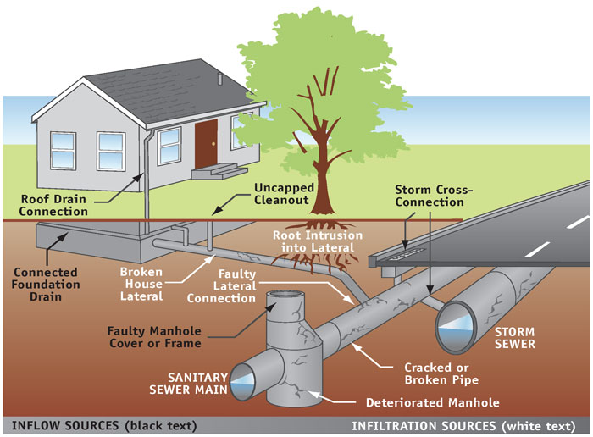
Article 39: Sewer System Expenditures
Article 40: Sewer Improvement Fund Expenditures
King County, Washington, Department of Natural Resources and Parks

Slide 23
Article 39: Sewer System Expenditures
Article 40: Sewer Improvement Fund Expenditures
FY24 – Operations & Maintenance Plan
Proposed Expenditures - $ 3,623,124
$ 1,210,834 - Depreciation
$ 1,211,227 - Treatment Plant
$ 923,408 - Pumping & Collection System
$ 277,656 - General Fund Services

