Slide 1
Article 21
Light Plant Solar Expansion – Middle School
Notes:
Good Evening my name is DW and I will be presenting Article 39.
CHARTS can be copied from … CMLP Operating Forecast <subject year>.xlsx -- Tab: <As noted> and pasted into slides
When inserting Charts, make them all 3.3” tall by 7.5” wide. Charts showing Net income should be 3.6” x 7.0”.
Center them horizontally and try not to move them below the top of the slide number in the footer.
Chart and data sources are noted in the Notes area of each slide.

Slide 2
Light Plant Solar Expansion – Middle School
To determine whether the Town will authorize the Town Treasurer with the approval of the Select Board, to borrow by the issuance of general obligation bonds or notes under the provisions of Mass. Gen. Laws c. 44 or any other authority, a sum not to exceed $13,000,000 for the design and construction of a solar system with battery storage at the Concord Middle School, the funds so borrowed to be expended for engineering design and legal services; hearings; permits and other approvals; material, construction, and installation specifications; bid preparation; materials purchase; construction and installation services; and distribution and expansions, upgrades and improvements, and to be repaid in the first instance from revenues of the Concord Municipal Light Plant, or take any other action relative thereto.

Slide 3
Capital Cost
The $13MM cost estimate in the Warrant article has been revised downward after the battery size was changed from 8MWh to 4MWh.
The revised pricing, based on estimates provided by Solar Design Associates, CMLP’s solar consultant, is between $6 and $7.5MM. This pricing is based on industry comparables and trends and is not based on actual vendor quotes.
There is a wide variation in the capital cost because there may be an opportunity to receive grant funding.
The $6MM cost estimate assumes the grants will apply.
The $7.5MM cost estimate assumes no grant offset.
CMLP expects to revise Article 21 to $7.5MM with a handout.

Slide 4
Quantifiable Costs and Benefits
The project produces benefits
Non-carbon emitting electricity production
Peak cost mitigation
Energy arbitrage from the battery
Progress toward town’s solar goals
Costs include capital and annual maintenance
The Summary Financials below subtract the benefits from the costs to derive a net present value of the annual resulting cash flow

Slide 5
Model Assumptions
Loan term: 15 years
Interest rate: 3.4%
Solar Panel equipment life: 20 years
Inverter life: 10 years
Discount rate used for NPV analysis: 5%

Slide 6
Summary Financials
Without IRA Credit
With IRA + ARPA Credits
X 1,000 | Capital Cost | 20-year NPV
Solar | 4,614 | (2,375)
Battery | 3,339 | 1,802
Total | 7,953 | (573)
X 1,000 | Capital Cost | 20-year NPV
Solar | 3,604 | (864)
Battery | 2,668 | 2,473
Total | 6,272 | 1,609
Notes:
These financial results compare the cost to build this solar plus storage project on the rooftop and canopies of the Midddle School with the cost to contract for solar power (with RECs) from a newly-built utility-scale facility located elsewhere in New England.

Slide 7

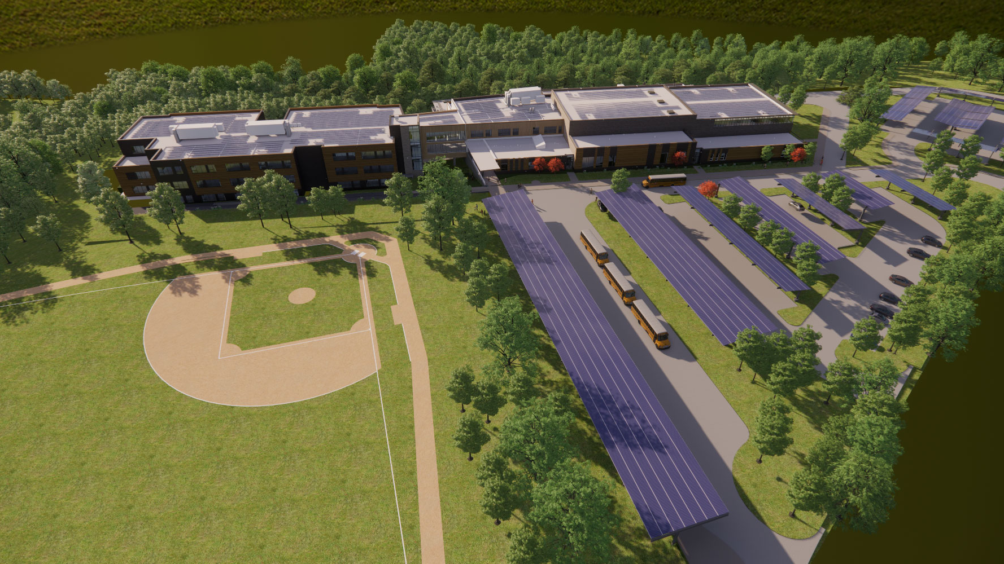
Visual Rendering
Courtesy of SMMA

Slide 8
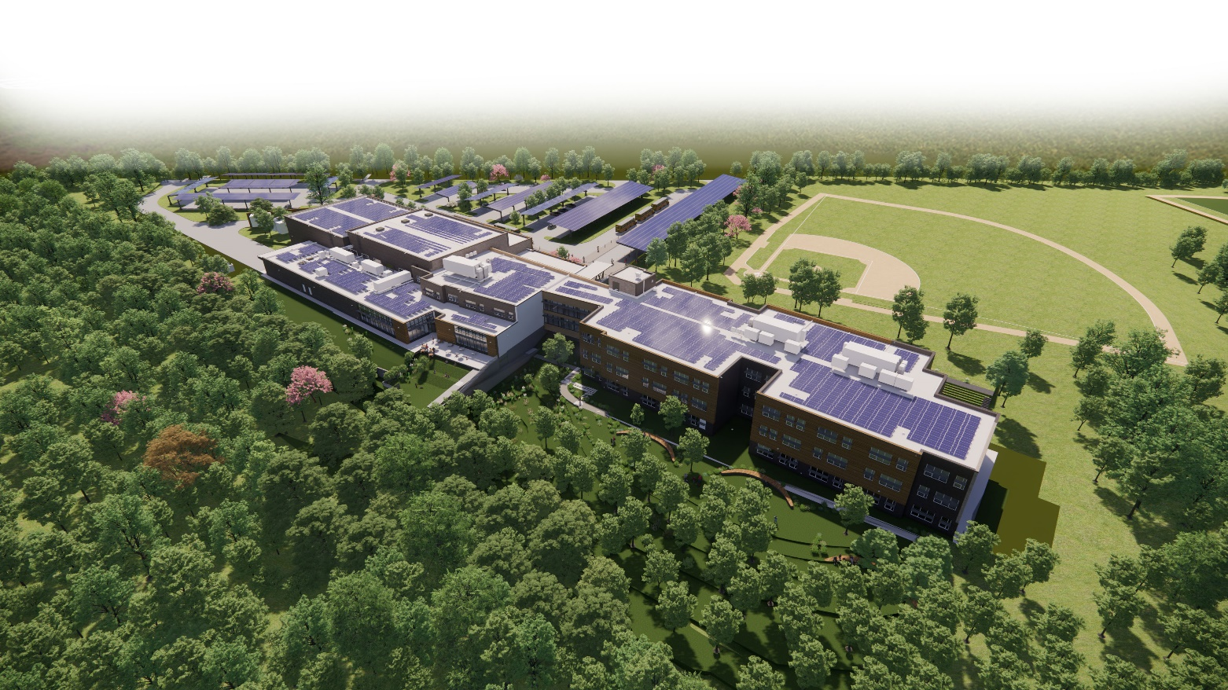
Visual Rendering
Courtesy of SMMA

Slide 9
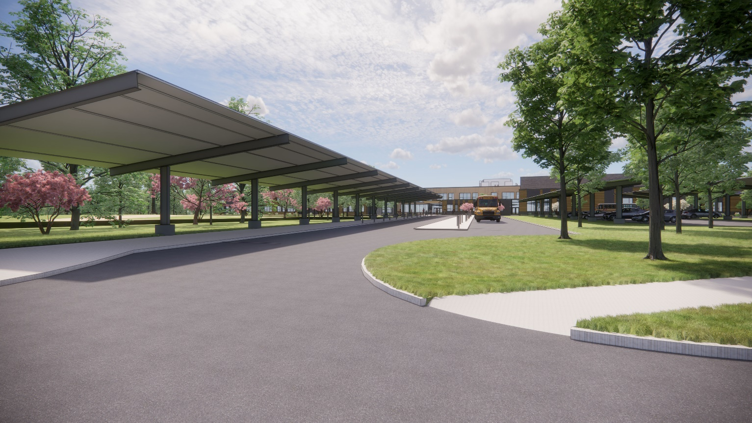
Visual Rendering
Courtesy of SMMA

Slide 10
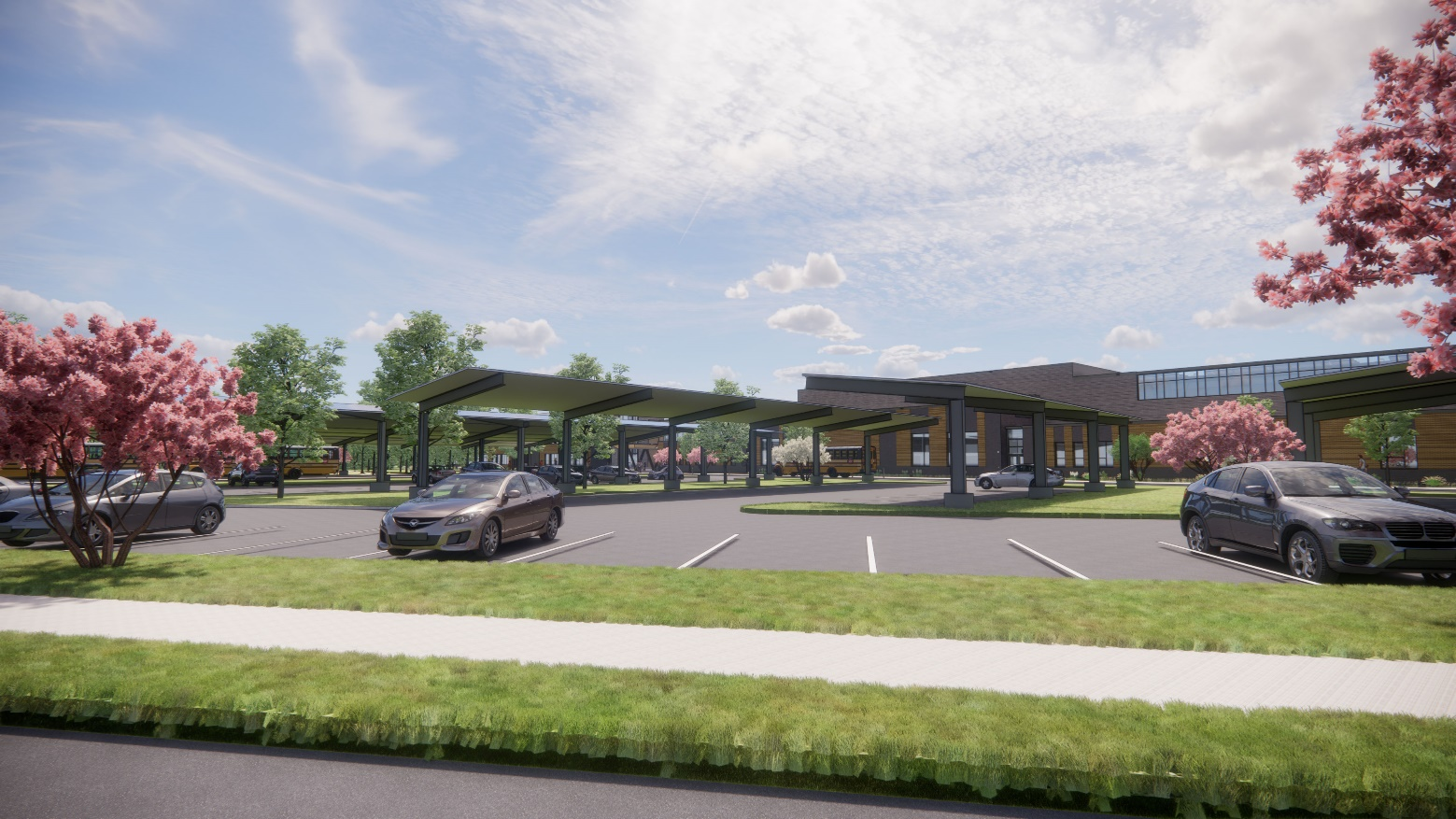
Visual Rendering
Courtesy of SMMA

Slide 11
Article 21
Questions?
Notes:
Source: Copy of Slide #2

