Slide 1

FY24 Beede Swim & Fitness Center Enterprise Fund
Finance Committee Public Hearing
March 15, 2023

Slide 2
To determine whether the Town will vote to appropriate $2,485,700 in Community Pool Enterprise receipts and transfer $188,847 from Community Pool Enterprise Certified Retained Earnings for a total appropriation of $2,674,547 for the Community Pool Enterprise Fund for the fiscal year ending June 30, 2024 for the operation of the Community Pool, in accordance with Mass. Gen. Laws c. 44, §53F ½ to be expended under the direction of the Town Manager.

Slide 3
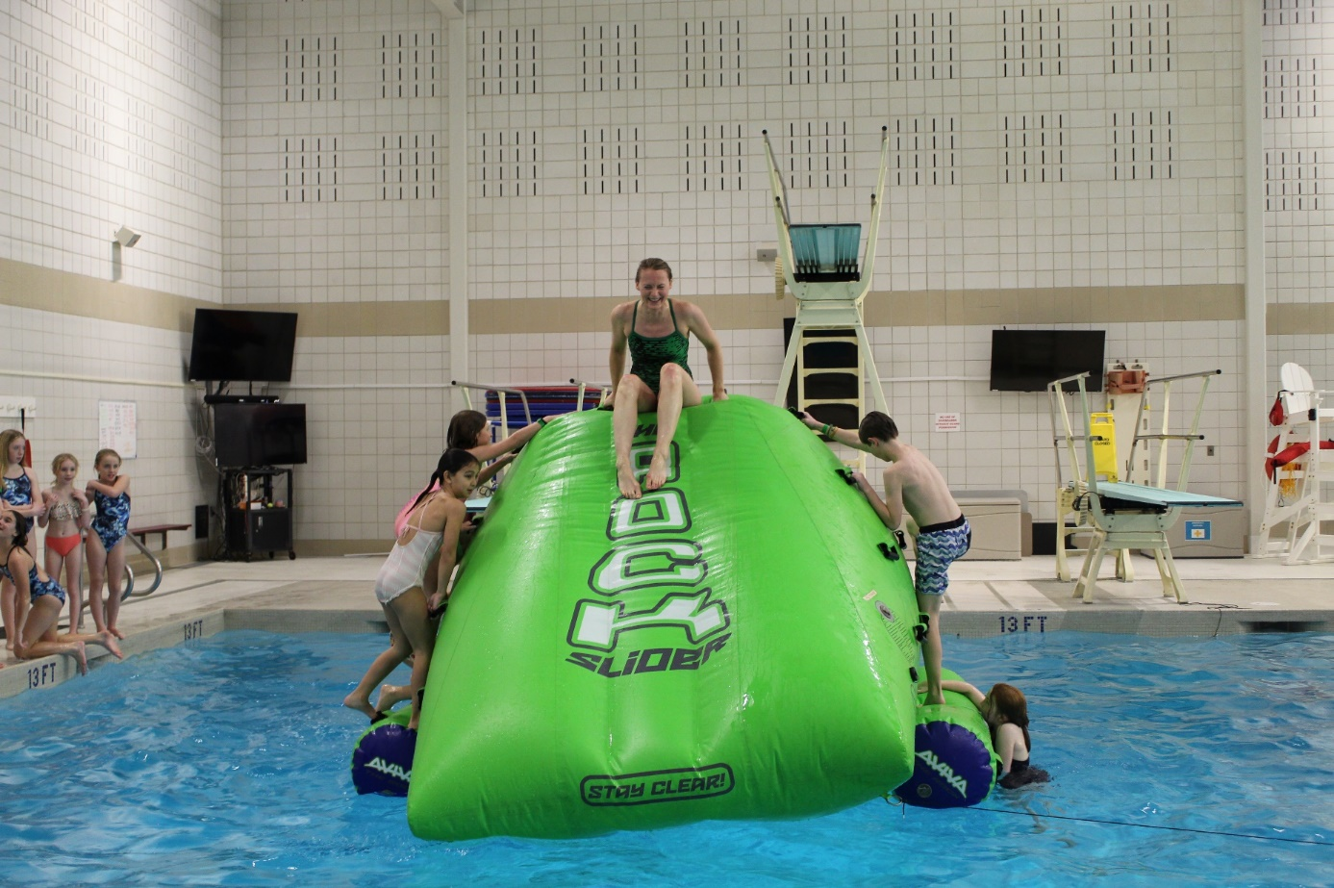
Beede Center Budget Categories
Memberships
  Beede Center and Emerson Pool
Group Fitness
Personal Training
Swim Programs
  Swim Teams
  Swim Lessons
  Adapt Aquatics
  Aquatics Fitness
Facility Rentals
Special Events (new)

Slide 4
FY22 Unaudited Net Income
$297,507
Revenues
Budgeted: $1,576,165
Actual (unaudited): $2,278,673
Change: + $702,508
Expenses
Budgeted: $2,123,621
Actual (unaudited): $1,985,957
Change: - $137,664

Slide 6
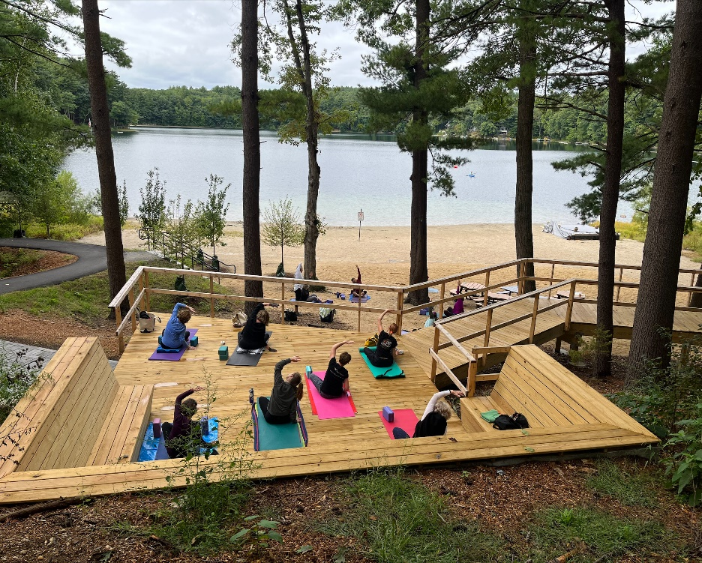
Beede Center Membership Ages (FY22)
59.65%

Slide 7
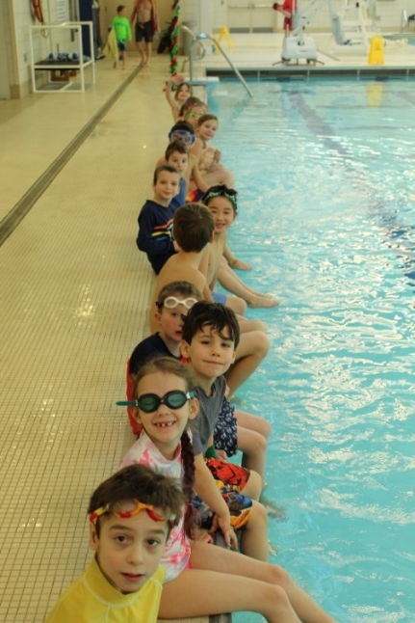
FY24 Swim and Fitness Fund Budget Goals
  Challenge ourselves to be innovative and expansive in programming and special event development.
  Implement cost recovery tools for all program areas.
  Better control capital needs with a capital asset management program and the employment of a Recreation Facilities Coordinator.
  Expend capital dollars as allocated.
7

Slide 8
FY24 Swim and Fitness Fund Budget Summary
Operating Revenues: $2,465,700
Operating Expenses: $2,521,347 (incl. depreciation.)
OPERATING INCOME: $(55,647)
Non-Operating Revenue $20,000
NET INCOME $(35,647)
Capital Outlay Expense: $153,200
8

Slide 9
FY24 Beede Fund Revenue Sources
Category | FY24 Total
Monthly Recurring | $1,320,000
Swim Program Fees | $590,000
Misc. Revenue | $165,000
Personal Training | $130,000
Annual Memberships | $100,000
Rentals | $70,00
Group Exercise | $66,000
Initiation Fees | $17,000
Special Events | $7,770
Total Revenue | $2,465,700

Slide 10
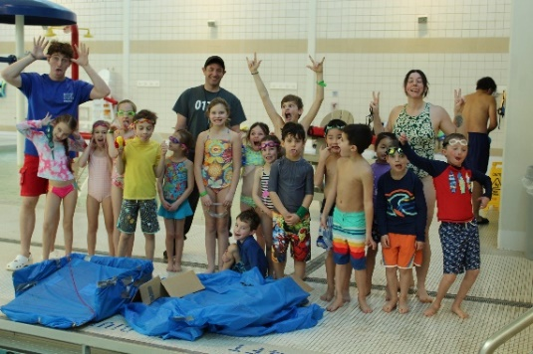
FY24 Beede Fund Non-Operating Revenue Sources
Non-Operating Revenue factored into Budget
  Investment Income ~$20K
Non-Operating Revenue NOT factored into Budget
  Beede Endowment
  Sawyer Trust Sustainability Fund
  Concord Carlisle Community Chest

Slide 11
FY24 Beede Fund Expense Sources
Category | FY24 Total
Personnel Services | $1,269,361
Purchased Services | $730,384
Depreciation | $380,739
Capital Outlay | $153,200
Program Expenses | $79,100
Other Expenses | $21,863
Supplies and Materials | $20,400
Facilities and Maint. | $19,500
General Fund | $0
Total Expense | $2,674,547

Slide 12

Long Term Plan #1 Energy Saving Initiatives
2019 RISE Engineering Energy Audit (Green Community Grant)
  Boiler shell installation
  Improved boiler efficiency/pool hot water recirculation.
  Warm water pool cover
  Updated setpoints for temperature control

Slide 13
Long Term Plan #2 Capital Asset Management
New Recreation Facilities Coordinator Position FY24
  Deferred Maintenance
  Capital Outlay and Depreciation Schedule
  Preventative Maintenance Schedules
  Emergency maintenance contract management
  Custodial contract management
Town asset performance inventory FY24

Slide 14
Long Term Plan #3 Beede Interfund Transfers
Actual expense sourced from budget books

Slide 16
To determine whether the Town will vote to appropriate $2,485,700 in Community Pool Enterprise receipts and transfer $188,847 from Community Pool Enterprise Certified Retained Earnings for a total appropriation of $2,674,547 for the Community Pool Enterprise Fund for the fiscal year ending June 30, 2024 for the operation of the Community Pool, in accordance with Mass. Gen. Laws c. 44, §53F ½ to be expended under the direction of the Town Manager.

