Slide 1


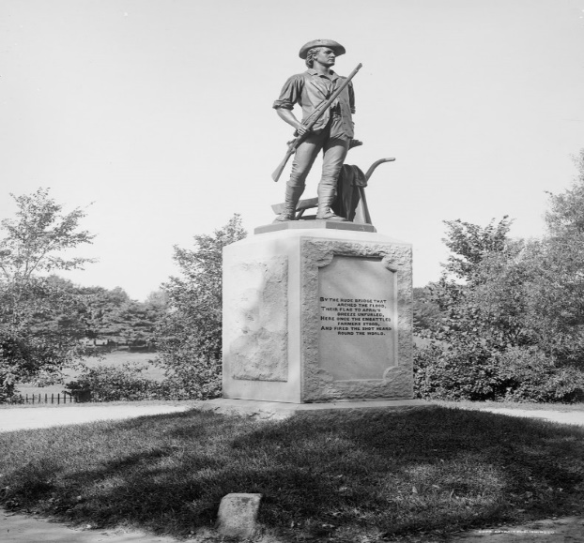
Town of Concord
FY23 RECERTIFICATION/
REVALUATION YEAR
Statutory Senior and Residential Exemptions
April 3, 2023
Presented by:
The concord board of assessors
David Karr Chairman
Meredith stone Town Assessor & Staff

Slide 2
Roadmap
In this presentation, we will examine:
Demographics of the Town of Concord (households, age, income)
Distribution of property value among residential properties
Existing policies affecting the tax burden on households
Alternatives to the existing policies
Implementation, benefits, costs, and risks of the Residential Exemption
Implementation, benefits, costs, and risks of Clause 41C½

Slide 3
Demographics of Concord
16% of households are seniors living alone (2012-2016)
42% of senior households have income below $75,000 (2012-2016)
Sources: https://www.census.gov/quickfacts/concordtownmiddlesexcountymassachusetts https://cleargov.com/massachusetts/middlesex/town/concord/demographics http://www.housing.ma/concord/report https://www.rhsohousing.org/sites/g/files/vyhlif421/f/uploads/concord_infographic_final.pdf
 | All ages | Age 65+
Population (2020) | 18,466 | 3,655
Number of households (2020) | 6,357 | (est.) 3,080
% Home owners (2017-2021) | 74.6%
Median income (2017-2021, 2021 dollars) | $169,335
Median income (2012-2016) | $138,661 | $100,000

Slide 4
Property values and taxes
Distribution of property values of single-family homes:
Approximately 4% are valued under $700,000
Approximately 33% are valued under $1,000,000
50% are valued under $1,169,500
Approximately 66% are valued under $1,400,000
Approximately 94% are valued under $2,500,000
Under the FY2023 tax policy, all properties are taxed at $12.96/1000 in exact proportion to the property value.

Slide 5
Mechanisms for shifting the burden of property taxes
Currently Implemented
Possible to implement
Senior Means-Tested Exemption
Clause 41C (senior)
Clause 17D (senior)
Clauses 22, 22A,B,C,D,E (veteran)
Clause 37A (blind)
Clauses 18 (hardship)
Split rate (residential vs. commercial)
Residential exemption (lower-valued vs. higher-valued properties, non-residents, and rentals)
Clause 41C½ (senior)
The benefits and costs of a split rate have been well-studied and will not be considered in this presentation.

Slide 6
The Residential Exemption
The Residential Exemption is a policy available to all cities and towns in Massachusetts.
Massachusetts law requires the Select Board to decide each year:
Whether to adopt the Residential Exemption.
If the Residential Exemption is adopted, the amount of the exemption.
In order to qualify for an exemption, a residential parcel must be the owner's principal place of residence as of January 1 in the previous fiscal year, as used for state income tax purposes.
The Residential Exemption increases the residential tax rate. It is a tax shift from the exempt portion of qualified properties to the non-exempt portions of all residential properties.

Slide 7
Cities and towns with a Residential Exemption
Barnstable 20%
Boston 35%
Brookline 20%
Cambridge 30%
Chelsea 35%
Everett 25%
Malden 30%
Mashpee 5%
Nantucket 25%
Oak Bluffs 8%
Provincetown 25%
Somerville 35%
Tisbury 22%
Truro 25%
Waltham 35%
Watertown 33%
Wellfleet 25%
Former Residential Exemptions, discontinued
Marlboro
Somerset
Weymouth

Slide 8
Residential exemption example 1
Assumption: 95% of single-family homes and condos are owner-occupied
Rate set by Select Board: 30% (minimum amount to decrease tax on the median single-family home by $1000)
Amount of exemption (estimated from FY23 values): $369,615
Old tax rate: $12.96 New tax rate: $17.68 % increase: 36.4%
Effect on taxpayers
Full assessed value | Old tax | New tax (qualified) | Change | % | New tax (not qualified) | Change | %
700000 | 9072.00 | 5841.21 | -3230.79 | -35.6% | 12376.00 | +3304.00 | +36.4%
1000000 | 12960.00 | 11145.21 | -1814.79 | -14.0% | 17680.00 | +4720.00 | +36.4%
1169500 | 15156.72 | 14141.97 | -1014.75 | -6.7% | 20676.76 | +5520.04 | +36.4%
1400000 | 18144.00 | 18217.21 | +73.21 | +0.4% | 24752.00 | +6608.00 | +36.4%
2500000 | 32400.00 | 37665.21 | +5265.21 | +16.3% | 44200.00 | +11800.00 | +36.4%

Slide 9
Residential exemption example 2
Assumption: 85% of single-family homes and condos are owner-occupied
Rate set by Select Board: 22% (minimum amount to decrease tax on the median single-family home by $1000)
Amount of exemption (estimated from FY23 values): $271,051
Old tax rate: $12.96 New tax rate: $15.72 % increase: 21.3%
Effect on taxpayers
Full assessed value | Old tax | New tax (qualified) | Change | % | New tax (not qualified) | Change | %
700000 | 9072.00 | 6743.08 | -2328.92 | -25.7% | 11004.00 | +1932.00 | +21.3%
1000000 | 12960.00 | 11459.08 | -1500.92 | -11.6% | 15720.00 | +2760.00 | +21.3%
1169500 | 15156.72 | 14123.62 | -1033.10 | -6.8% | 18384.54 | +3227.82 | +21.3%
1400000 | 18144.00 | 17747.08 | -396.92 | -2.2% | 22008.00 | +3864.00 | +21.3%
2500000 | 32400.00 | 35039.08 | +2639.08 | +8.1% | 39300.00 | +6900.00 | +21.3%

Slide 10
Adoption by Oak Bluffs
Total residential parcels: 4628
Original estimate of number of qualifying properties: 1350
FY2022 (first year of residential exemption)
Exemption rate set by select board: 4%
Exempted value: $34,036
Number of prequalified parcels, Nov 2021: 683 (<51% of original estimate)
Residential tax rate with exemption: $6.79
Tax rate on other classes of property: $6.76
FY2023
Exemption rate set by select board: 8%
Exempted value: $90,838
Number of prequalified parcels, Dec 2022: 794 (<59% of original estimate)
Residential tax rate with exemption : $5.28
Tax rate on other classes of property : $5.21

Slide 11
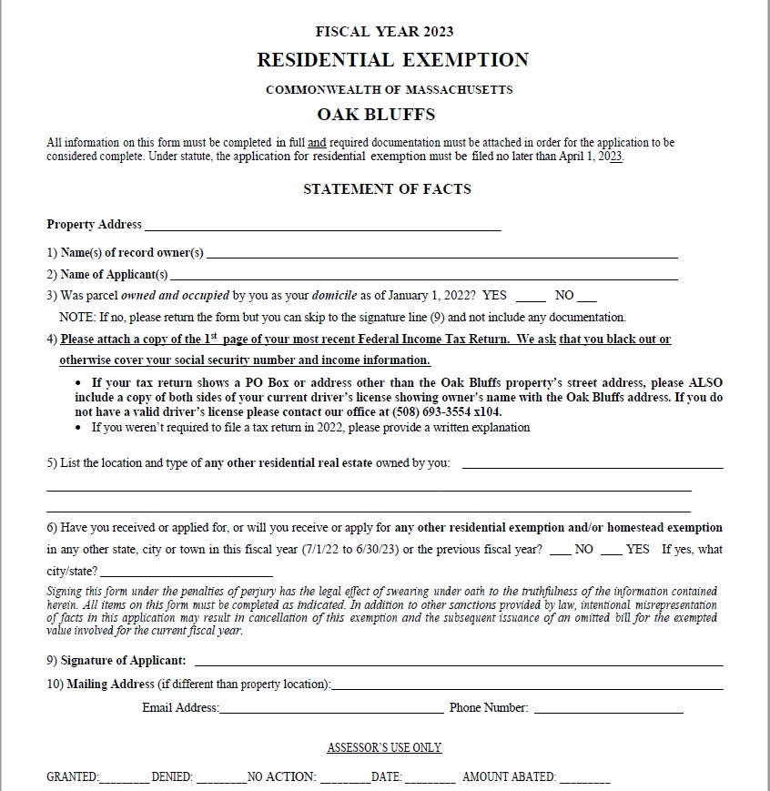
Application
form

Slide 12
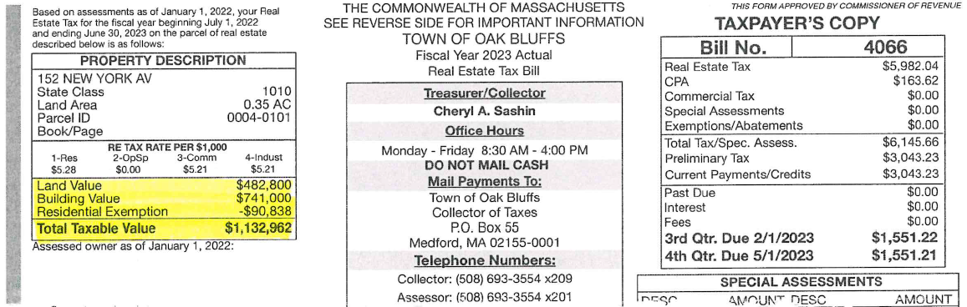
Sample tax bill

Slide 13
Processing an application
Most applications can establish residence by a copy of IRS Form 1040.
The Assessors should establish uniform standards for what documentation (for example, driver’s license) to use when an applicant has not filed Form 1040.
Trust documents need to be examined carefully to establish ownership for the purpose of the exemption.
The Assessors will need to follow up on incomplete applications.
Applications can be submitted up to the beginning of April (3 months after the mailing of the actual tax bill). This means that the total amount of exemptions will not be known until after the tax rate for that year has been set.

Slide 14
Residential exemption example 3
Assumption: 85% of single-family homes and condos are owner-occupied
Rate set by Select Board: 4% (following example of Oak Bluffs)
Amount of exemption (estimated from FY23 values): $49,282
Old tax rate: $12.96 New tax rate: $13.39 % increase: 3.3%
Effect on taxpayers
Full assessed value | Old tax | New tax (qualified) | Change | % | New tax (not qualified) | Change | %
700000 | 9072.00 | 8713.11 | -358.89 | -4.0% | 9373.00 | +301.00 | +3.3%
1000000 | 12960.00 | 12730.11 | -229.89 | -1.8% | 13390.00 | +430.00 | +3.3%
1169500 | 15156.72 | 14999.72 | -157.00 | -1.0% | 15659.61 | +502.89 | +3.3%
1400000 | 18144.00 | 18086.11 | -57.89 | -0.3% | 18746.00 | +602.00 | +3.3%
2500000 | 32400.00 | 32815.11 | +415.11 | +1.3% | 33475.00 | +1075.00 | +3.3%

Slide 15
Residential exemption risks
Exposure to errors in estimated % of qualifying properties, tax collected over/under levy:
Initial overlay account balance FY2023: $2,579,699
Excess levy capacity FY2023: $5,381,932
 | 30% exemption | 22% exemption | 4% exemption
1% error (approx. 60 parcels) | $370,261 error | $241,424 error | $37,389 error
Actual 10% above estimate | N/A | $2,414,236 shortfall | $373,891 shortfall
Actual 4% above estimate | $1,481,044 shortfall | $965,694 shortfall | $149,556 shortfall
Actual 5% below estimate | $1,851,305 excess | $1,207,118 excess | $186,946 excess
Actual 10% below estimate | $3,702,610 excess | $2,414,236 excess | $373,891 excess
Actual 20% below estimate | $7,405,221 excess | $4,828,472 excess | $747,782 excess

Slide 16
Possible effects of residential exemption
Reference: The Lexington Select Board’s Residential Exemption Policy Study Committee (Ad Hoc), An Examination of Residential Property Tax Exemptions for the Town of Lexington, Massachusetts, April 2019.
Indirect effects:
Expect little impact on out-migration, demand for higher-priced homes, activity of developers.
Incentive to convert rental apartments to condos.
Incentive to convert rental houses to owner-occupied.
A shrinking rental market could increase rents.
Shift in property tax could be capitalized into home values as measured by sale prices:
Lower-value homes would increase in price.
Higher-value homes would decrease in price.
Capitalization would reduce the benefit to current residents and even further reduce the benefit to new buyers of lower-value homes (because of increased prices).
Estimated 28% of the residential exemption’s effect would be canceled by changes in property values.
Expert panel recommended means-tested approach and greater promotion of tax deferral.

Slide 17
Exemptions for seniors
 | Concord Means-Tested | Clause 41C | Clause 41C½
Availability | Now | Now | FY2025 or later
Number eligible | 38 | 3 | <1540 (est.)
Benefit | Up to 50% of tax | $1000 | Determined by %
Who qualifies | Minimum age 65(*), 10-year(*) domicile in MA, owner-occupant for 5 years
Income limit, single | $64,000 | $27,147 | $64,000
… head of household | $80,000 | $27,147 | $80,000
… filing jointly | $96,000 | $40,718 | $96,000
Property value limit | $1,169,500 | None | None
Other assets limit, single | $275,000 | $55,297 | None
… married | $275,000 | $74,656 | None
When total of exemptions is known | Before setting tax rate | After setting tax rate | After setting tax rate
(*) Clause 41C½ minimum age is 70 but can be reduced to 65 by Town Meeting; domicile can be reduced to 5 years.

Slide 18
Clause 41C½ exemption
Clause 41C½ is a statutory exemption available to all cities and towns in Massachusetts.
It is similar to the Residential Exemption, but with these differences:
Only resident homeowners 70 years or older are eligible (can be reduced to 65 years by local option)
Applicant must have lived 5 years in the same property
Applicant must have lived 10 years in Massachusetts (can be reduced to 5 years by local option)
There are income limits for eligibility (can be adjusted by local option)
Only 5% or less of the average residential property value can be exempted (can be increased to 20% by local option)

Slide 19
Procedure to adopt Clause 41C½
Clause 41C½ must be accepted by a vote at the polls during a regular town election using language dictated by statute.
Town meeting may then decide
To lower the minimum age to 65
To reduce the in-state residence requirement to 5 years
To raise the exemption to up to 20% of the average value
To adjust income limits
The earliest year for which Concord could adopt Clause 41C½ is FY2025 (the tax year starting on July 1, 2024).
Vote to accept in March 2024 town election
Change limits as allowed by law at April 2024 Annual Town Meeting
Clause 41C½ would then replace Clause 41C, which could no longer be granted.

Slide 20
One town has adopted Clause 41C½
Ashland is the only municipality that has adopted Clause 41C½.
The exemption percentage is set each fall by a Special Town Meeting.
This allows the tax rate to be estimated before setting the percentage.
Figures for FY2023
Percentage 11.25%
Residential value exempted $62,031
Tax exempted $854

Slide 21
Clause 41C½ exemption example
Assumption: 1000 qualifying properties (est. 32% of all senior households, 17% of all residential parcels)
Rate set by Town Meeting: 8% (minimum amount to decrease tax on the median single-family home by $1000)
Amount of exemption (estimated from FY23 values): 98,564
Old tax rate: $12.96 New tax rate: $ 13.14 % increase: 1.4%
Effect on taxpayers
Full assessed value | Old tax | New tax (qualified) | Change | % | New tax (not qualified) | Change | %
700000 | 9072.00 | 7902.87 | -1169.13 | -12.9% | 9198.00 | +126.00 | +1.4%
1000000 | 12960.00 | 11844.87 | -1115.13 | -8.6% | 13140.00 | +180.00 | +1.4%
1169500 | 15156.72 | 14072.10 | -1084.62 | -7.2% | 15367.23 | +210.51 | +1.4%
1400000 | 18144.00 | 17100.87 | -1043.13 | -5.7% | 18396.00 | +252.00 | +1.4%
2500000 | 32400.00 | 31554.87 | -845.13 | -2.6% | 32850.00 | +450.00 | +1.4%

Slide 22
Clause 41C½ exemption risks
Exposure to errors in estimated % of qualifying properties, tax collected over/under levy:
Initial overlay account balance FY2023: $2,579,699
Excess levy capacity FY2023: $5,381,932
Exemption type and amount | 8% exemption, Clause 41C½ | 4% Residential Exemption (for comparison)
1% error (approx. 60 parcels) | $77,345 error | $37,389 error
Actual 10% above estimate | $773,452 shortfall | $373,891 shortfall
Actual 4% above estimate | $309,381 shortfall | $149,556 shortfall
Actual 5% below estimate | $386,726 excess | $186,946 excess
Actual 10% below estimate | $773,452 excess | $373,891 excess
Actual 20% below estimate | N/A | $747,782 excess

Slide 23
Possible effects of Clause 41C½
Direct effects:
Tax shift reducing lower-income owner-occupant senior households’ tax by a large percentage while increasing other taxpayers’ burden by a small percentage.
Clause 41C would no longer be available and would be entirely replaced by Clause 41C½.
The town would receive only a fixed reimbursement from the state based on the previous Clause 41C exemptions. This is estimated at $1000 per year.
Indirect effects:
Purchasers of properties currently receiving the exemption would not qualify for the exemption (due to the 5-year occupancy requirement). Therefore:
Little or no incentive to convert rental apartments to condos or rental houses to owner-occupied.
Little or no upward pressure on prices of lower-valued homes.
Little downward pressure on prices of higher-valued homes since tax increase is small.

Slide 24
Comparison of alternatives
Policy | Residential Exemption implemented rapidly | Residential Exemption implemented gradually | Clause 41C½
Estimated number eligible properties | Approx. 5000 | Approx. 5000 | Approx. 1000
Who pays less tax | Owner-occupants of homes in lower 60% of value |  | Low-income seniors
How much less (first year) | $1000-3200 decrease (below median value) | $160-360 decrease (below median value) | >$1000 for homes in lowest 66% of values
Who pays more tax | Non-resident owners, landlords, owners of homes in upper 30% of value |  | Younger homeowners, higher-income seniors
How much more (first year) | 20-40% increase (non-residents) | 3-4% increase (non-residents) | 1.4% increase
Likely effect on values | Low-valued properties increase in value, high-valued properties decrease, effects on tax burden partially erased |  | Little change
Likely effect on rental availability | Reduced supply due to conversion to owner-occupied units |  | Little change

Slide 25


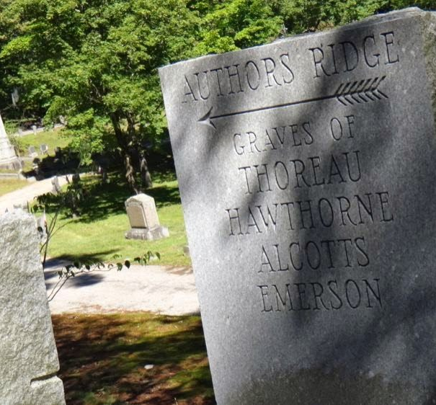
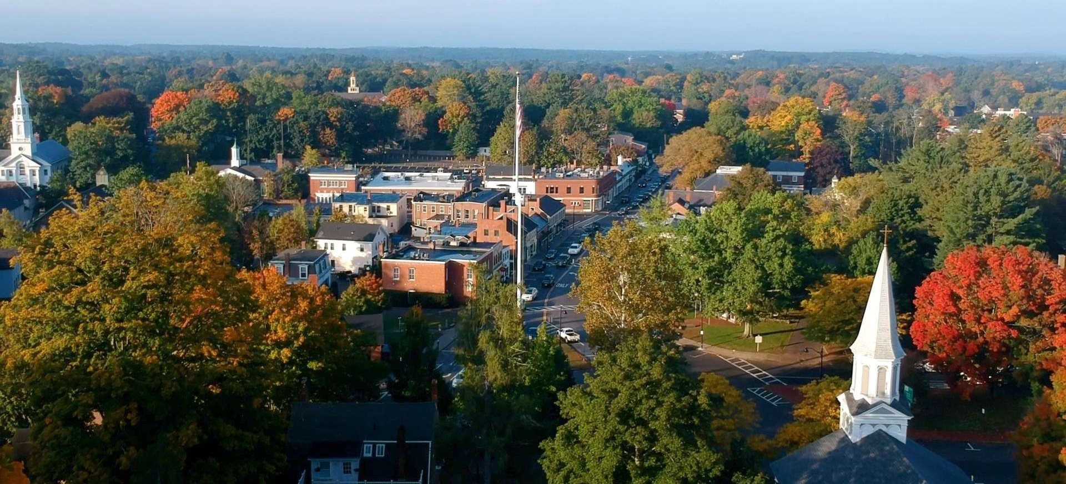
Town of Concord Massachusetts
Statutory Senior and Residential Exemptions
Board of Assessors
David Karr Chairman
Brendan O’Neill Kemeza
Yanni Konstantions Tsitsas
Mera K Tilley
Arry Charles
Office Staff
Meredith Stone Town Assessor
Lee Phalen
Carolyn Dee
Michael Gibbons
4-3-2023
Notes:
Concord Assessors Office 24 Court Lane Concord Massachusetts 01742

