Slide 1

Concord Planning Board Meeting
October 10, 2023
Notes:
The next item on the agenda is the MBTA Communities Act.
We will be discussing this item at every Planning Board meeting through Town Meeting
The MBTA Communities Act has the potential to have a significant impact on the Town’s built environment,
It is complex and,
It is important to receive community input in the design of this zoning.
This presentation is in preparation for our Community-wide kick-off meeting at the Harvey Wheeler Community Center at 6:30 pm on Thursday, June 28th.
That will be s a hybrid meeting and details are available on the Planning Department webpage.
At that session, we will have Town Staff, Planning Consultants and GIS Consultants available to answer questions.
The purpose of this overview is to briefly inform all Board members about the issues in the legislation and to generate questions that we would like staff and the consultants to address next week.

Slide 2
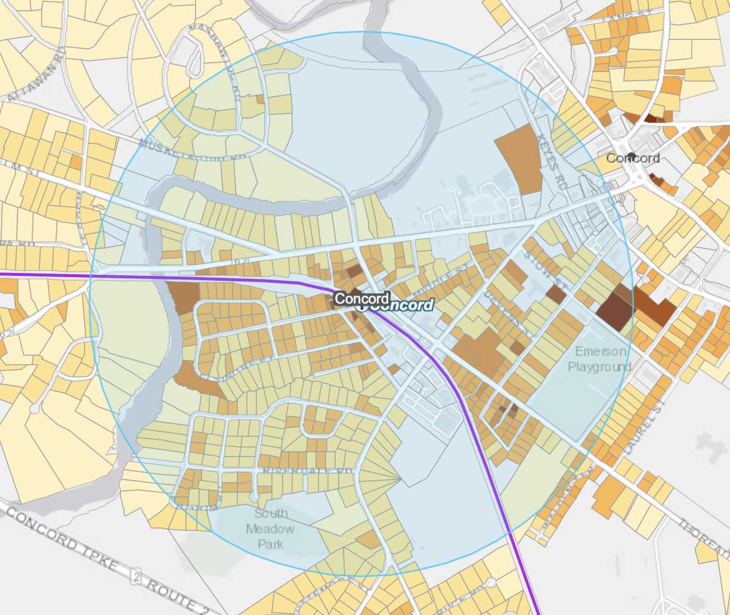
Requirements for Concord
MBTA Communities must have at least one zoning district in which multi-family housing is permitted by right (which can include Site Plan Review)….
Zoning Deadline: December 31st, 2024
Minimum Land Area: 50 acres
Minimum Multifamily Unit Capacity: 1,094 (15% of Concord’s 2020 housing stock)

Slide 3
% of District to be located in Station Areas (1/2 mile radius around the stations): 50%
Minimum gross density of 15 units per acre (average across the district(s))
No age restrictions and suitable for families with children, i.e. no bedroom or occupancy caps
Parity with other uses – multi-family housing cannot be required to meet higher standards than other permitted uses

Slide 4
Calculation of Area (in acres) vs Density (in dwelling units per acre)
Area | Density | Units
50 | 21.88 | 1,094
55 | 19.89 | 1,094
60 | 18.23 | 1,094
65 | 16.83 | 1,094
70 | 15.63 | 1,094
72.9 | 15.00 | 1,094
75 | 14.60 | 1,094

Slide 5
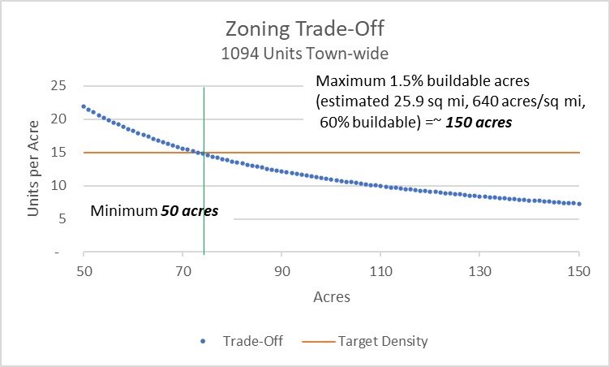
Density vs. Area

Slide 6
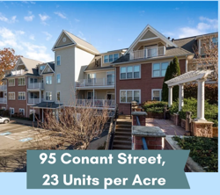
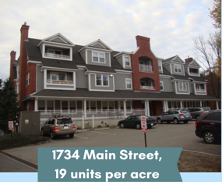
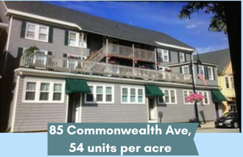
Density examples
Notes:
But Here, are a number of examples of multi-family housing density in Concord that would achieve this overall density goal. Remember, this is a District-wide requirement in zoning, not building.
And, it is a district-wide requirement where subdistricts of variable amounts of density by subdistrict could be defined.

Slide 7
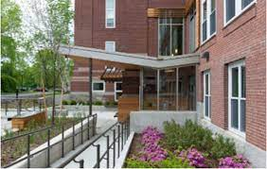
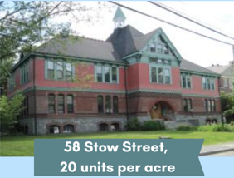
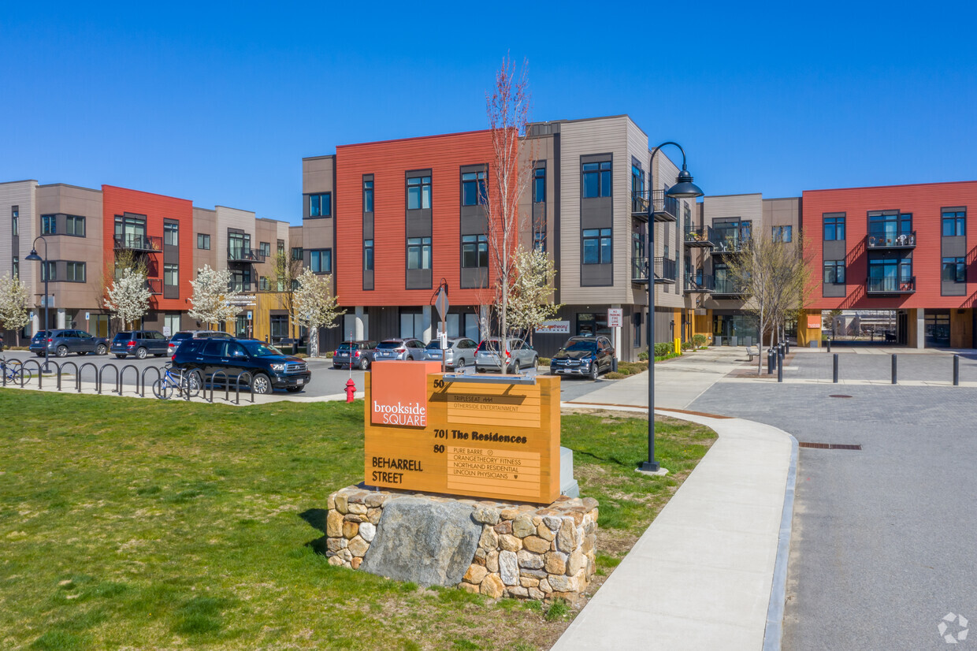
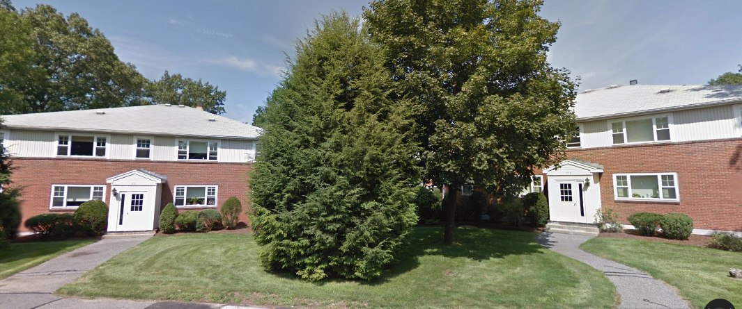
Density examples
115 Stow Street,
34 units per acre
70 Beharrell Street
18 units per acre
235 Elsinore Street
16 units per acre

Slide 8
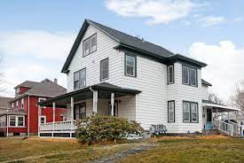
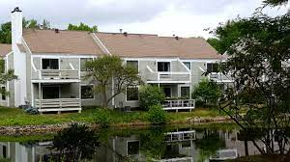
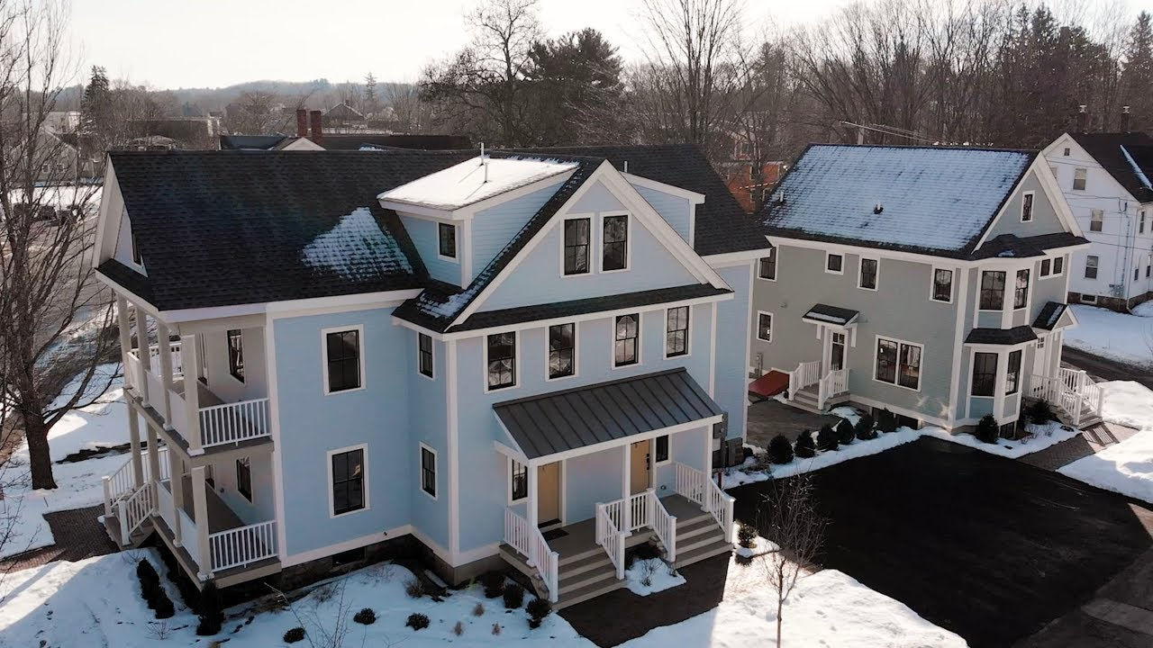
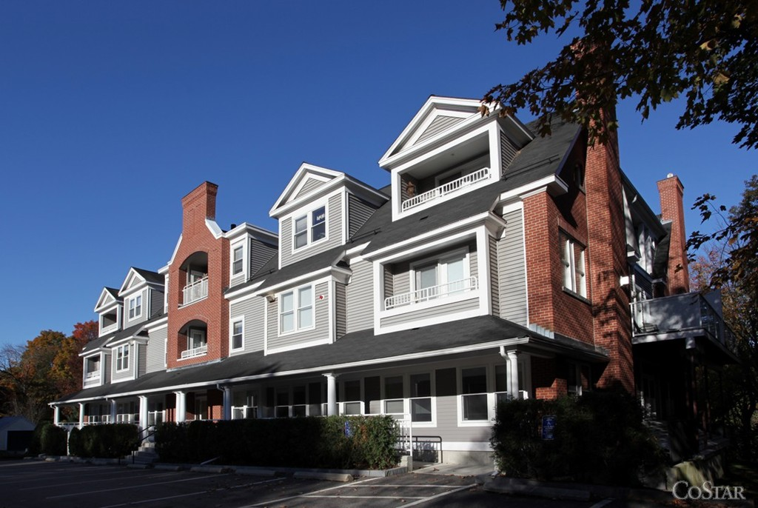
Density examples
238 Commonwealth Avenue
24 units per acre
808 Concord Greene
26 units per acre
1732 Main Street
16 units per acre
17 Laws Brook Road & 15 Maple Streets
40 and 18 units per acre

Slide 9
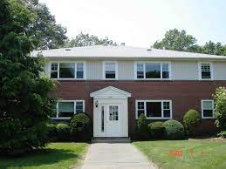
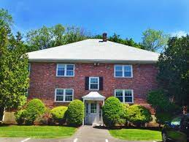
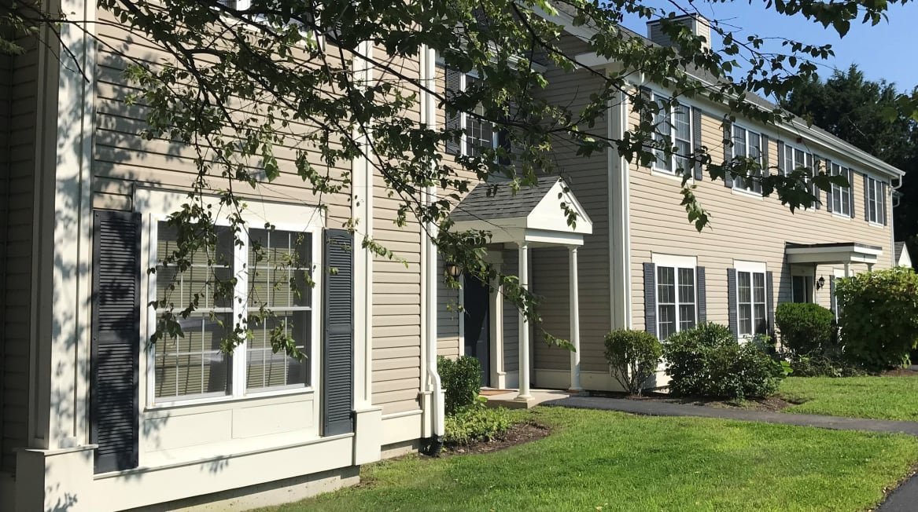
Density examples
231 Elsinor Street
5 units per acre
Thoreau Gardens
153 Thoreau St
6 units per acre
238 Commonwealth Av231
1-6 Abbot Lane

