Slide 1

IDDE Training
May 13, 2025
Town of Concord, MA
141 Keyes Road
Concord, MA
Presented by:
Stefany Campbell
Project Scientist
Comprehensive Environmental, Inc.

Slide 2
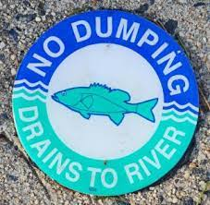
Agenda
Water Pollution Regulations
MS4 Permit
MS4 Permit Requirements
General Good Housekeeping

Slide 3
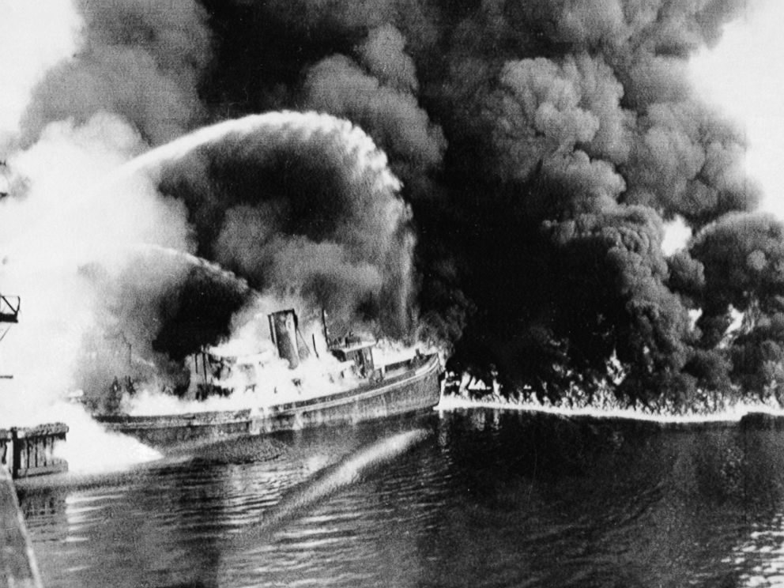
Water Pollution
Oil
NPS Pollutants
Notes:
Cuyahoga River fire in 1969 – caused by oil and pollution of river by nearby factories. Led to the eventual passage of the Clean Water Act in 1972.

Slide 4
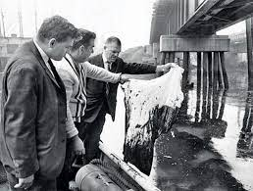
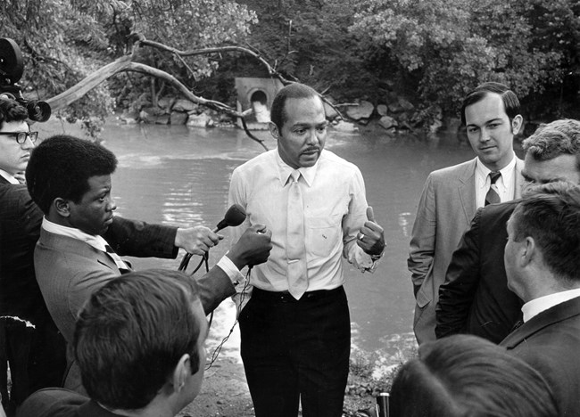
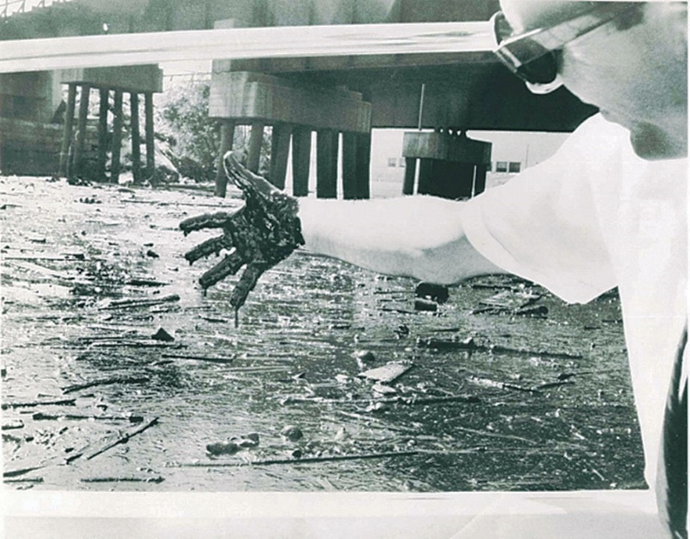
The Cuyahoga River
Notes:
Cuyahoga River fire in 1969 – caused by oil and pollution of river by nearby factories. Led to the eventual passage of the Clean Water Act in 1972. Mayor Carl Stokes

Slide 5
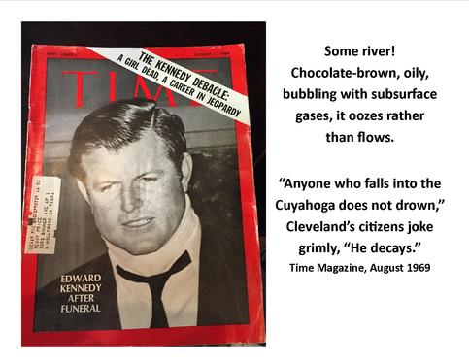
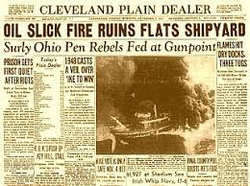
The Cuyahoga River
Creation of the US EPA (1970)
Development of the Clean Water Act (1972)
Development of the Safe Drinking Water Act (1974)

Slide 6
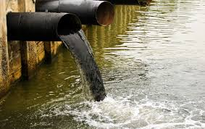
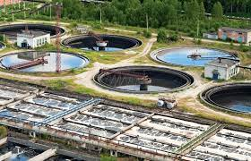
1972 Clean Water Act
Eliminate water pollution discharge by 1985
All US waters fishable and swimmable by 1983
Targeted “Point Sources” of pollution
  Required permits for pipe discharge
  WWTP grants

Slide 7
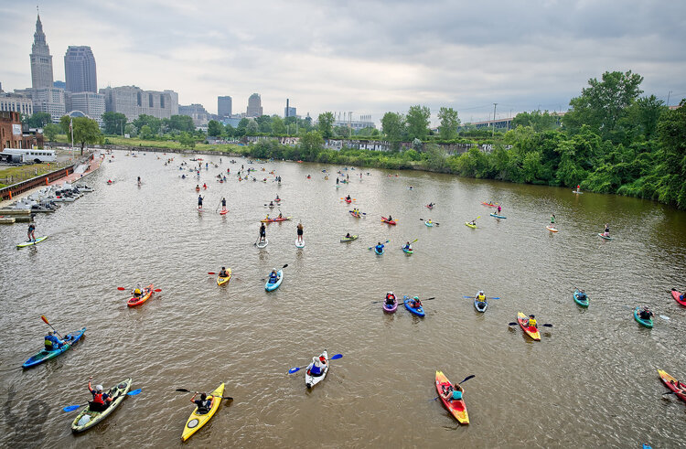
The Cuyahoga River
1969
2023
Notes:
Cuyahoga River fire in 1969 – caused by oil and pollution of river by nearby factories. Led to the eventual passage of the Clean Water Act in 1972. In the 1960s, there were no fish in the river. Today, there are more than 70 species of fish and in 2019, they were declared safe to eat. Named America’s River of the Year in 2019, an Ohio Scenic River, an American Heritage River, and an Ohio Water Trail which encourages recreational activity to return to the formerly hazardous river.

Slide 8

What is Stormwater?
Rain water
Stormwater
Notes:
Massachusetts and New Hampshire receive on average 48 - 50 inches of precipitation/year. Where does that precipitation go?

Slide 9
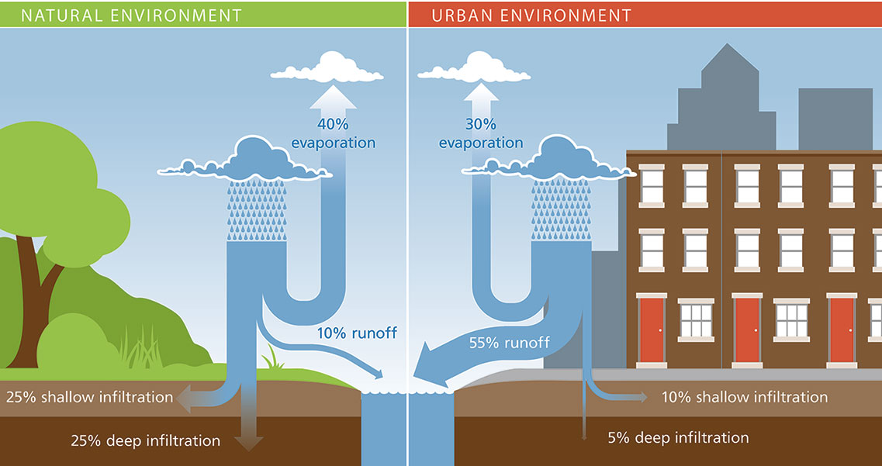
The Problem with Stormwater
Stormwater
Rain water

Slide 10

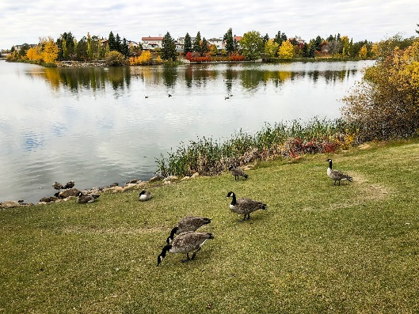
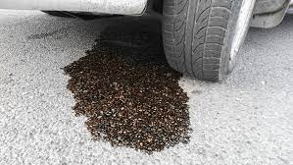
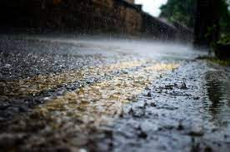
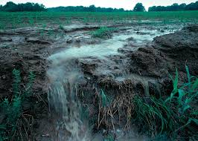
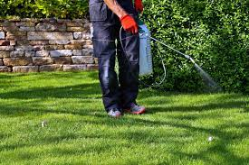
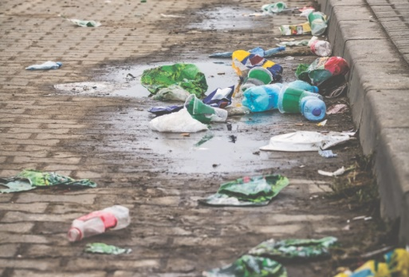
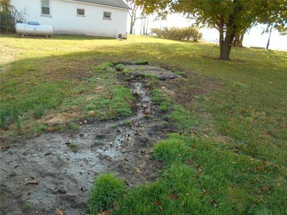
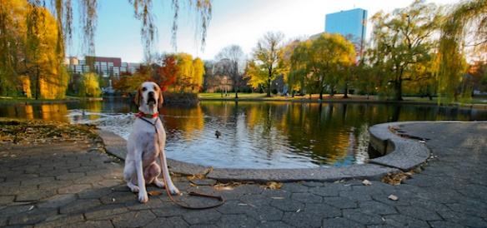
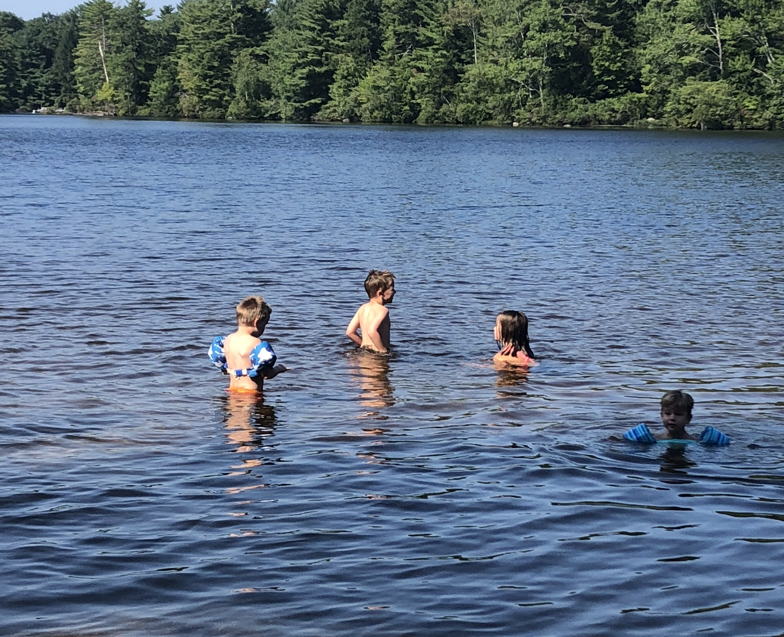
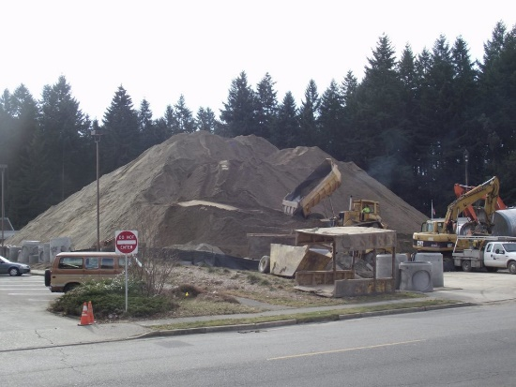
The Problem with Stormwater

Slide 11
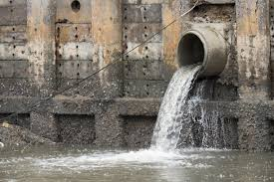
How Do You Regulate Stormwater?

Slide 12
Stormwater Permit
The “MS4 Permit” authorizes the discharge of stormwater from MS4 communities such as Concord.
MS4 = Municipal Separate Storm Sewer System
Regulated by EPA under the Clean Water Act (1972)
Renewal to 2003 MS4 Permit Released in 2016
Effective July 1, 2018
Notes:
EPA at the end of 2024 released an updated draft permit for public comment. There’s a few weeks for public comment then EPA takes another 6-9 months to respond then another lag before it is finalized. So it will probably be at least another 2 years before it comes out. We cant say for certain, but our best guess is that the new permit will be more geared towards building stormwater improvements, disconnecting/reducing impervious area, and rewarding/encouraging additional maintenance like CB cleaning.

Slide 13
MS4 Permit Management of Stormwater
Rain water
Reduce amount of pollutant sources
Reduce amount of stormwater
Treat when you can
Stormwater
Begin to treat developed land like forests...

Slide 14
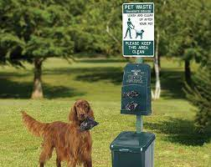
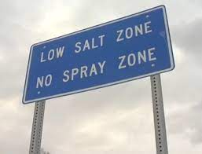
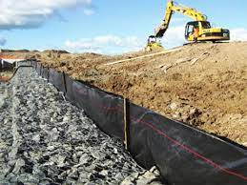

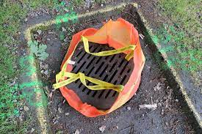
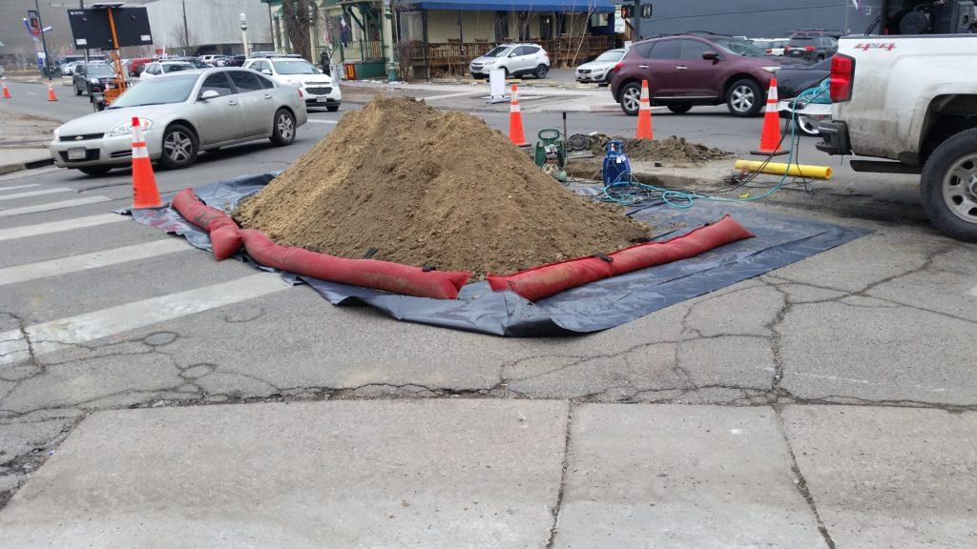
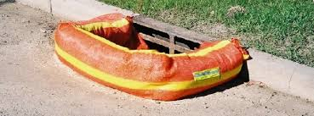
Reduce Amount of Pollutant Sources
Notes:
Picking up pet waste, silt sacks in catch basins, phosphorous free fertilizers, low salt zones, erosions controls at construction site

Slide 15
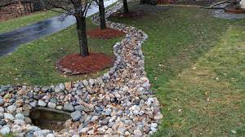
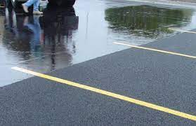
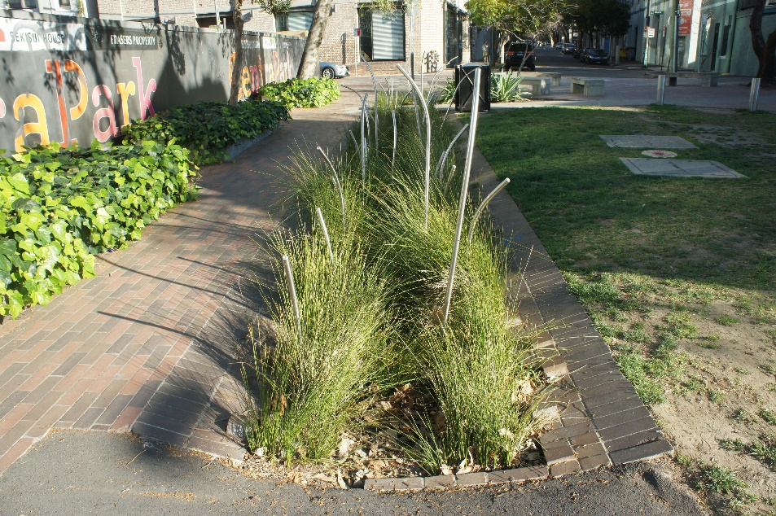
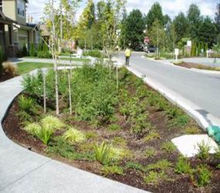
Reduce Amount of Stormwater/Treat
Notes:
Treating stormwater with vegetation rather than pavement. Stormwater will puddle on the pavement and eventually end up in our stormwater system. Compared to vegetation like swales, bioretention areas where the stormwater will soak into the ground

Slide 16
MS4 Permit Requirements
Six Minimum Measures
Public Education & Outreach
Public Involvement & Participation
Illicit Discharge Detection & Elimination (IDDE)
Construction Site Stormwater Controls/Regulations
Post-Construction Site Stormwater Controls/Regulations
Good Housekeeping

Slide 17
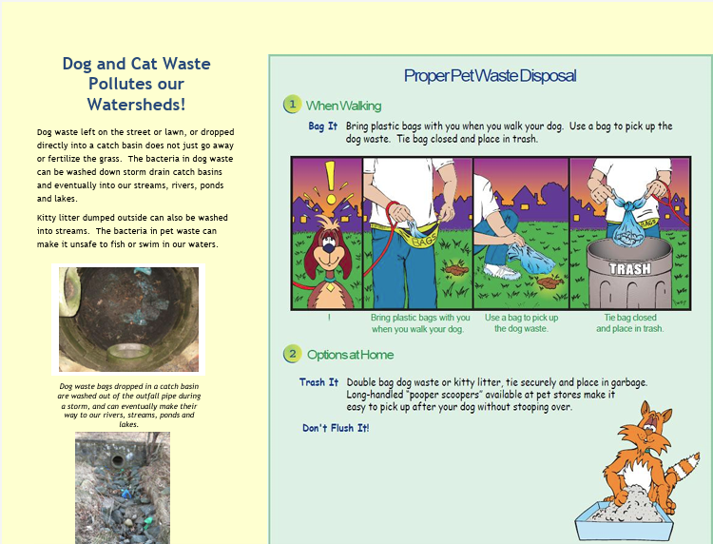
MCM 1: Public Education
2 messages each to 4 audiences over the permit term (8 total)
  Residential
  Businesses, Institutions, Commercial
  Industrial
  Developers
Additional messaging for certain impairments
Notes:
Concord has a stormwater webpage on the Town website with public education outreach flyers for a variety of topics

Slide 18
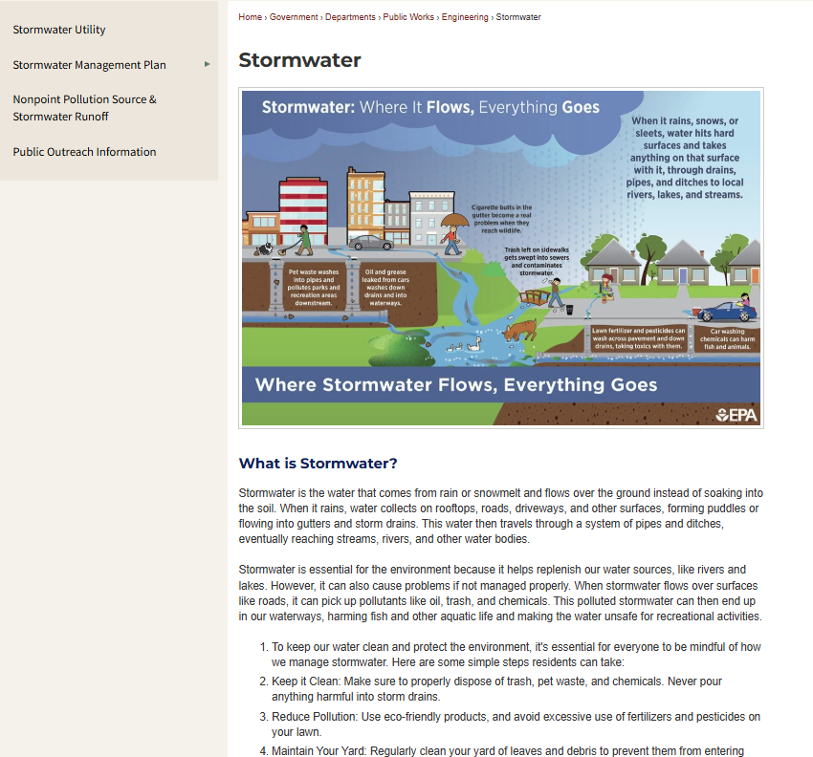
MCM 2: Public Participation
Provide opportunities for public input
Public notice
Town website
Notes:
Concord has a stormwater webpage on the Town website

Slide 19
MS4 Permit Requirements
Six Minimum Measures
Public Education & Outreach
Public Involvement & Participation
Illicit Discharge Detection & Elimination (IDDE)
Construction Site Stormwater Controls/Regulations
Post-Construction Site Stormwater Controls/Regulations
Good Housekeeping

Slide 20
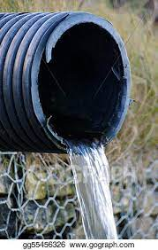
MCM 3: Illicit Discharge Detection and Elimination Program
Develop an IDDE program to find and eliminate illicit discharges.
Goal: Ensure only stormwater is discharging from outfalls.
Reduce amount of pollutant sources

Slide 21
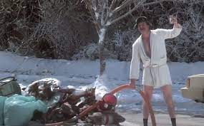
What is an Illicit Discharge?
“Illicit discharge” is any discharge to the MS4 that is not composed entirely of stormwater.
Oil/Gas
Illegal Connections
Illegal Dumping
Sediment/Yard Waste
Garbage
Animals

Slide 22
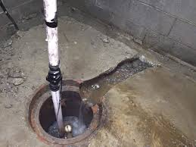
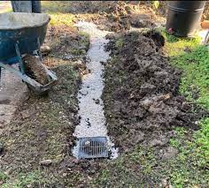
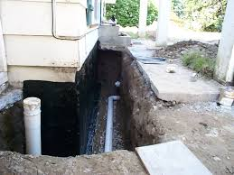
What is NOT an Illicit Discharge?
“Illicit discharge” is any discharge to the MS4 that is not composed entirely of stormwater.
Groundwater
Resident car washing
Street wash waters
Dechlorinated swimming pools
Other permitted discharges

Slide 23
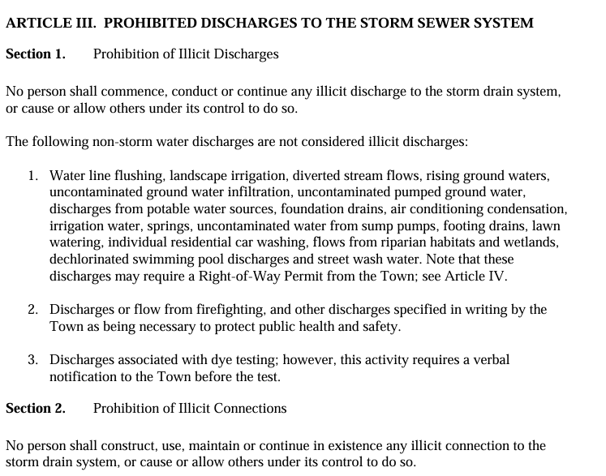
Illicit Discharge Program
Establish Legal Authority
  Prohibit illicit discharges to the MS4.
  Investigate suspected illicit discharges.
  Require removal of illicit connections.
  Eliminate illicit discharges.
  Implement appropriate enforcement.
Storm Water Regulations
Adopted March 15, 2011

Slide 24
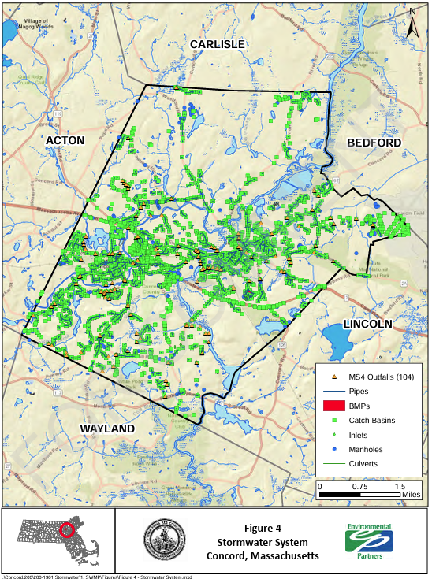
Illicit Discharge Program
Storm System Mapping
Outfalls and infrastructure mapped
  Pipes
  Catch basins
  Manholes
  Open drainage
  Only responsible for municipal system (not state or private)
  Continued Updates
Notes:
Dry weather screening was to be completed by the end of Year 3. If a pipe is flowing during dry weather a sample will be collected and it could tell us a lot about where the water is coming from. If there is low bacteria and its very cold its probably ground water. If the water is warmer and has higher bacteria, we would know that there is something more going on in the system. Other indicators are smell, or visual observations such as seeing toilet paper In a catch basin.
By the end of Year 10 (June 30, 2028) you will need to do wet weather sampling for outfalls but only for ones located in areas with sewer that have certain parameters like shared manholes, shared trenches, and a few other parameters. These are determined by doing a system vulnerability assessment (SVF) analysis which looks at sewer and drainage plans to identify those areas.

Slide 25
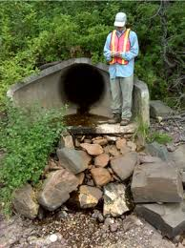
Illicit Discharge Program
Evaluate your system for illicit discharges

Slide 26
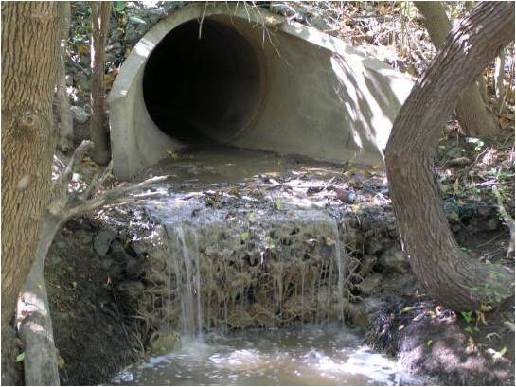
Illicit Discharge Program
Outfall inspection
    Condition of Outfall
    Sample if flowing
    Other signs of illicit discharge?

Slide 27
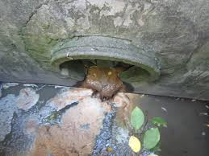
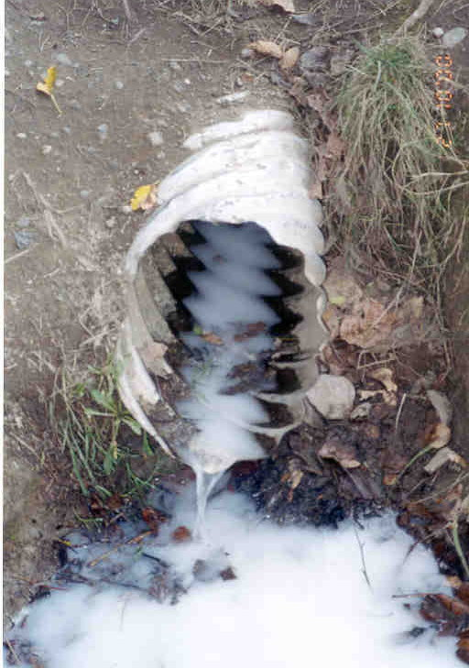
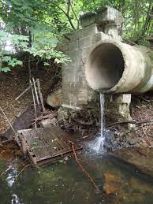
What Should You Look For?
Outfalls
Notes:
Flow, signs of illicit discharges

Slide 28
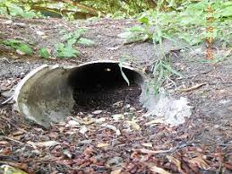
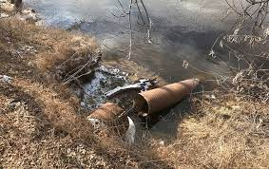
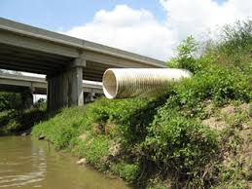
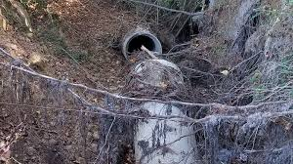
What Should You Look For?
Outfalls
Notes:
Condition of pipe

Slide 29




What Should You Look For?
Catch Basins
Notes:
At CBs – what shouldn’t be there?

Slide 30



What Should You Look For?
Catch Basins
Notes:
Clogged inlet to system

Slide 31



What Should You Look For?
Upgradient
Notes:
Signs of erosion; construction site runoff

Slide 32


Source Investigation
Outfall
Outfall

Slide 33




Source Investigation
Notes:
Sandbagging, dye testing, CCTV, smoke testing
Groveland Ave example-CCTV

Slide 34

Find and Remove Illicit Discharge
Must be removed within 60 days
Voluntary removal
Legal enforcement
Include in Annual Report to EPA
Confirm removal

Slide 35

What do you do if you find an Illicit Discharge?
              Where is it?
              What is it?
              Notify supervisor to investigate further.

Slide 36
MS4 Permit Requirements
Six Minimum Measures
Public Education & Outreach
Public Involvement & Participation
Illicit Discharge Detection & Elimination (IDDE)
Construction Site Stormwater Controls/Regulations
Post-Construction Site Stormwater Controls/Regulations
Good Housekeeping

Slide 37


MCM 4: Construction Site Controls
Construction site runoff control
  Ordinance/regulatory mechanisms
  Control of construction related wastes
  Written site plan review procedure
  Site inspections

Slide 38

MCM 5: Post-Construction Site Controls
Post-Construction Site
  Development sites > 1 acre
    Controls need to retain 1-inch of runoff
    Controls need to remove 90% TSS and 60% TP
  Redevelopment sites > 1 acre
    Controls need to retain 0.8 inch of runoff
    Controls need to remove 80% TSS and 50% TP
  As-built drawings required two years after completion of projects
  Procedures for long-term operation and maintenance of on-site controls
Notes:
TSS: Total suspended solids
TP: Total Phosphorous

Slide 39
MS4 Permit Requirements
Six Minimum Measures
Public Education & Outreach
Public Involvement & Participation
Illicit Discharge Detection & Elimination (IDDE)
Construction Site Stormwater Controls/Regulations
Post-Construction Site Stormwater Controls/Regulations
Good Housekeeping

Slide 40

MCM 6: Good Housekeeping and Pollution Prevention
Requires the municipality to examine and alter their practices to reduce pollution
  Develop Operation and Maintenance Programs
  Street Sweeping
  Catch Basin Cleaning
  Winter Road Maintenance
Reduce amount of pollutant sources

Slide 41

Public Works Street Sweeping Program
  Spring Sweeping (April-June)
  Goal: Remove sand, silt, and other debris accumulated in roadway gutters and on sidewalks over the winter
    All 107 miles of public streets
    4 miles of private roads
    All Town parking lots
    Sidewalks in the sidewalk program
  Weekly Sweeping (Early Spring-Late Fall)
    Goal: Remove debris from roadways to enhance the beauty of the areas
    Downtown and commercial areas are swept early Friday mornings
  Fall Sweeping
    Goal: Minimize the debris entering the MS4 system and prevent drainage issues caused by blocked catch basins
    Limited to arterial roads to remove leaf debris that could restrict water flow into drainage structures
Notes:
Concord Public Works Street Sweeping Program is part of their SWMP which is available on Concord’s stormwater page

Slide 42


Catch Basin Cleaning Program
  Clean catch basins once/year or as needed to prevent sediment from reaching the outlet
  Inspect condition of structures during maintenance
    Height of debris measured before & after cleaning
  Data collected is entered into the tablet and stored within the Town’s GIS database
  Properly Manage Wastes
    Collection area at CPW material yard stores catch basin debris
    Town’s compost site used for debris storage during the season.
    Annually catch basin debris is disposed of in accordance with MassDEP regulations by using a contractor
Notes:
25% of Concord’s CBs cleaned annually based on records from their stormwater webpage

Slide 43

Catch Basin Cleaning (2016 Permit)
Prioritize inspection and maintenance of CBs near construction projects
Establish schedule so that no CB will be >50% full
If continues to be full, investigate catchment area for source of sediment

Slide 44


Winter Roadway Maintenance
Balance public safety & water quality
Follow salt restricted areas
Limit pretreatment
Calibrate salt/sand spreaders
Use zero velocity & adjustable spreaders
Monitor the effectiveness of deicing agents (e.g., Ice-Ban)
Consider methods for salt reduction around environmentally sensitive areas

Slide 45

Stormwater Management & BMPs at Municipal Facilities
Pollution Prevention & Good Housekeeping Techniques for Stormwater Compliance

Slide 46
What is a Stormwater BMP?
“A Best Management Practice (BMP) can be defined as any structure or activity that is employed as the most effective non-polluting practice.”
Structural Examples: leaching catch basins, detention and infiltration basins, gravel wetlands, grassy swales & baffled sediment tanks.
Activity Examples: indoor vehicle maintenance, indoor storage of materials, prohibiting outdoor vehicle washing, public education & today’s training session.

Slide 47

Vehicle & Equipment Maintenance
Maintain leaking vehicles
Store leaking vehicles indoors
Use drip pans if outside
Clean leaks & drips promptly & properly
Use dry cleaning methods
Vehicle leaks that are carried off-site with stormwater.

Slide 48


Vehicle & Equipment Maintenance
No outdoor vehicle & equipment maintenance
No (uncovered) outdoor storage of raw materials & used parts
Prevent stormwater contact with stored materials (e.g., store on pallets)
Pollutants are washed from exposed work areas and parts.

Slide 49


Vehicle Fueling
Use funnels and drop pans as appropriate
Do not “top off” tanks
Inspect daily for spills
Clean promptly
Use dry cleaning methods to maintain fueling areas
Fuel on impervious surfaces only
Covered areas are best

Slide 50


Fueling Equipment Inspections
Inspect hoses & fittings for leaks and equipment for malfunctions
Inspect when refueling & report to management
Band-aids for damaged Stage II Vapor Recovery hoses at a fueling station.

Slide 51


Vehicle Cleaning Practices
Outdoor vehicle washing is prohibited
Indoor washing to tight tank or O/W separator & sewer
Outdoor vehicle rinsing is allowed to a DEP registered drywell (special requirements apply)
Town Garage
Police Station
Fire Station

Slide 52
In conclusion…
  MS4 Permit is required!
  Public Works is responsible for the illicit discharge program
    If you see something, report it

Slide 53

Training Requirements
Attend Annual Training
  Illicit Discharges

