Slide 1
Concord’s
Community Preservation
Committee
Informational Session, May 21, 2025

Slide 2
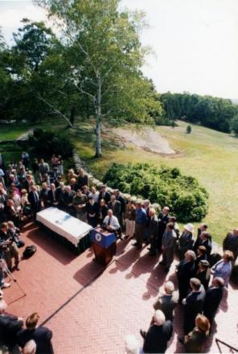
Signed into Massachusetts law in 2000, the Community Preservation Act is a tool that helps communities preserve their most unique natural, community and built features in the face of rapid growth and development.

Slide 3
Each fiscal year, the CPC must allocate at least 10% of its annual revenues to each of the three core community interests of the Act:
10% Affordable Housing
10% Open Space
10% Historic Preservation
The remaining 70% may be spent in any of the three above categories or Recreation.

Slide 4
The CPA in Concord
Concord adopted the Community Preservation Act in 2004.
Voters agreed to fund the CPA account through a 1.5% surcharge on real estate property tax bills.
First $100,000 of taxable value is exempt
Persons with income less than 80% of area median income are exempt
Seniors with income less than 100% of area median income are exempt
Locally raised funds are matched on a percentage basis by funds in the State Community Preservation Fund

Slide 5
CPA State Match Over Time

Slide 6
Concord CPA appropriations by category since 2006
TOTAL $29,999,694

Slide 7
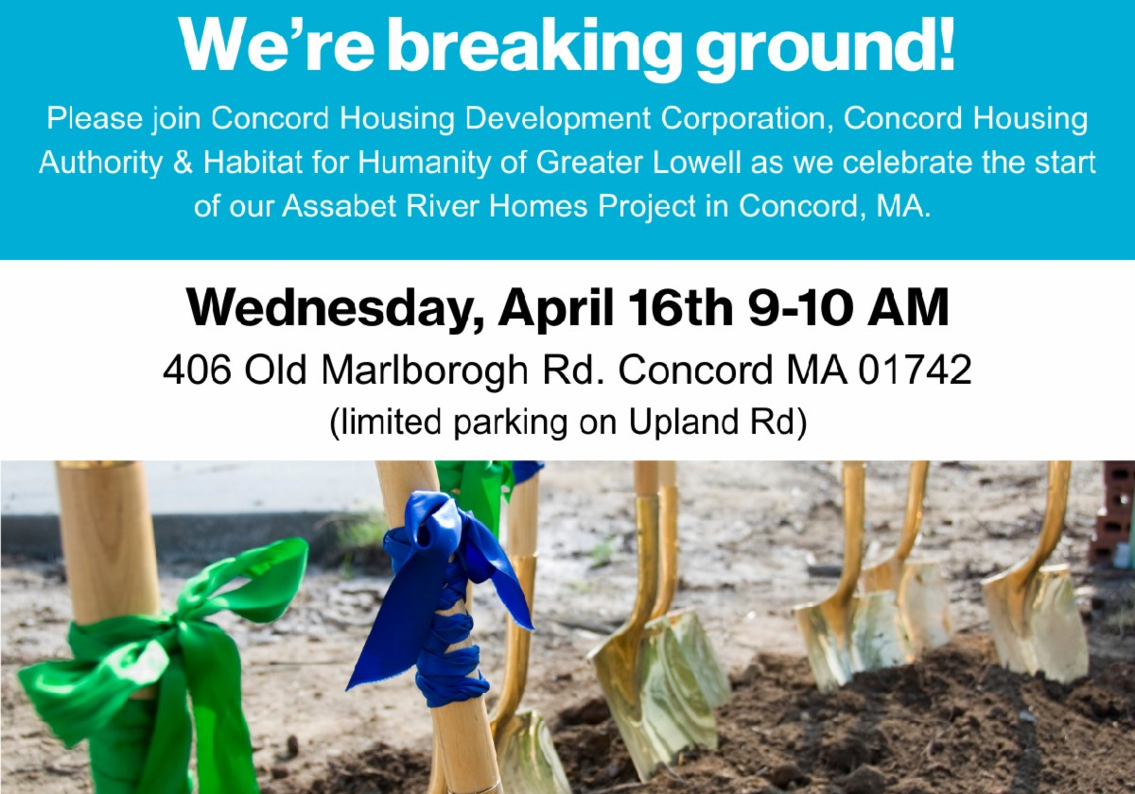
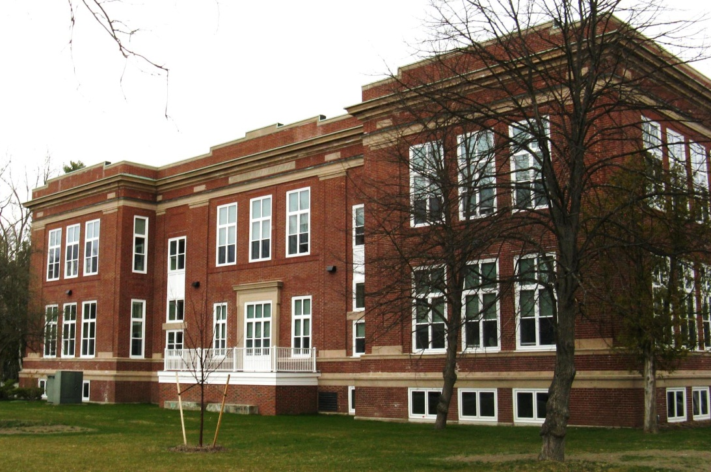
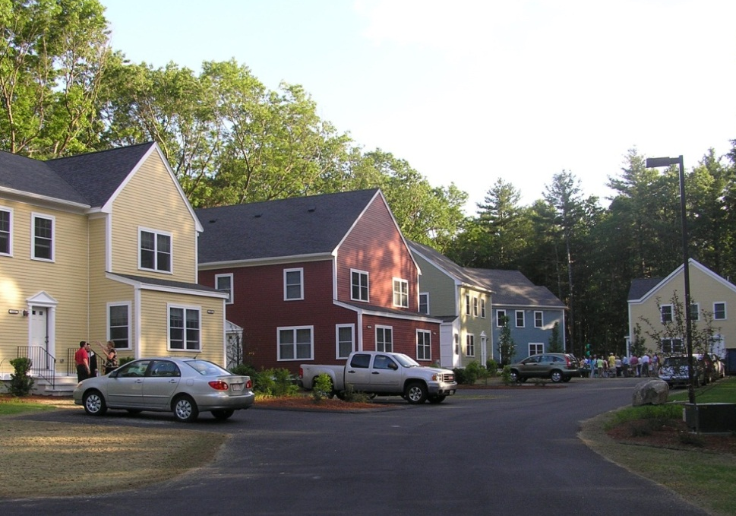
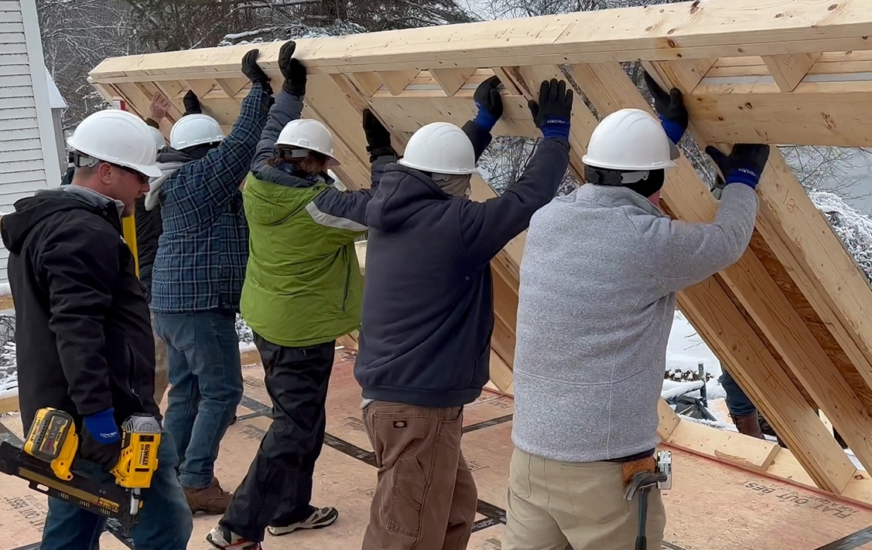
Community Housing Projects – 22%
Peter Bulkeley Terrace, Concord Housing Authority (2009, 2010, 2015)
Commonwealth Ave. Concord Housing Authority (2024)
Lalli Woods, CHDC (2009)

Slide 8
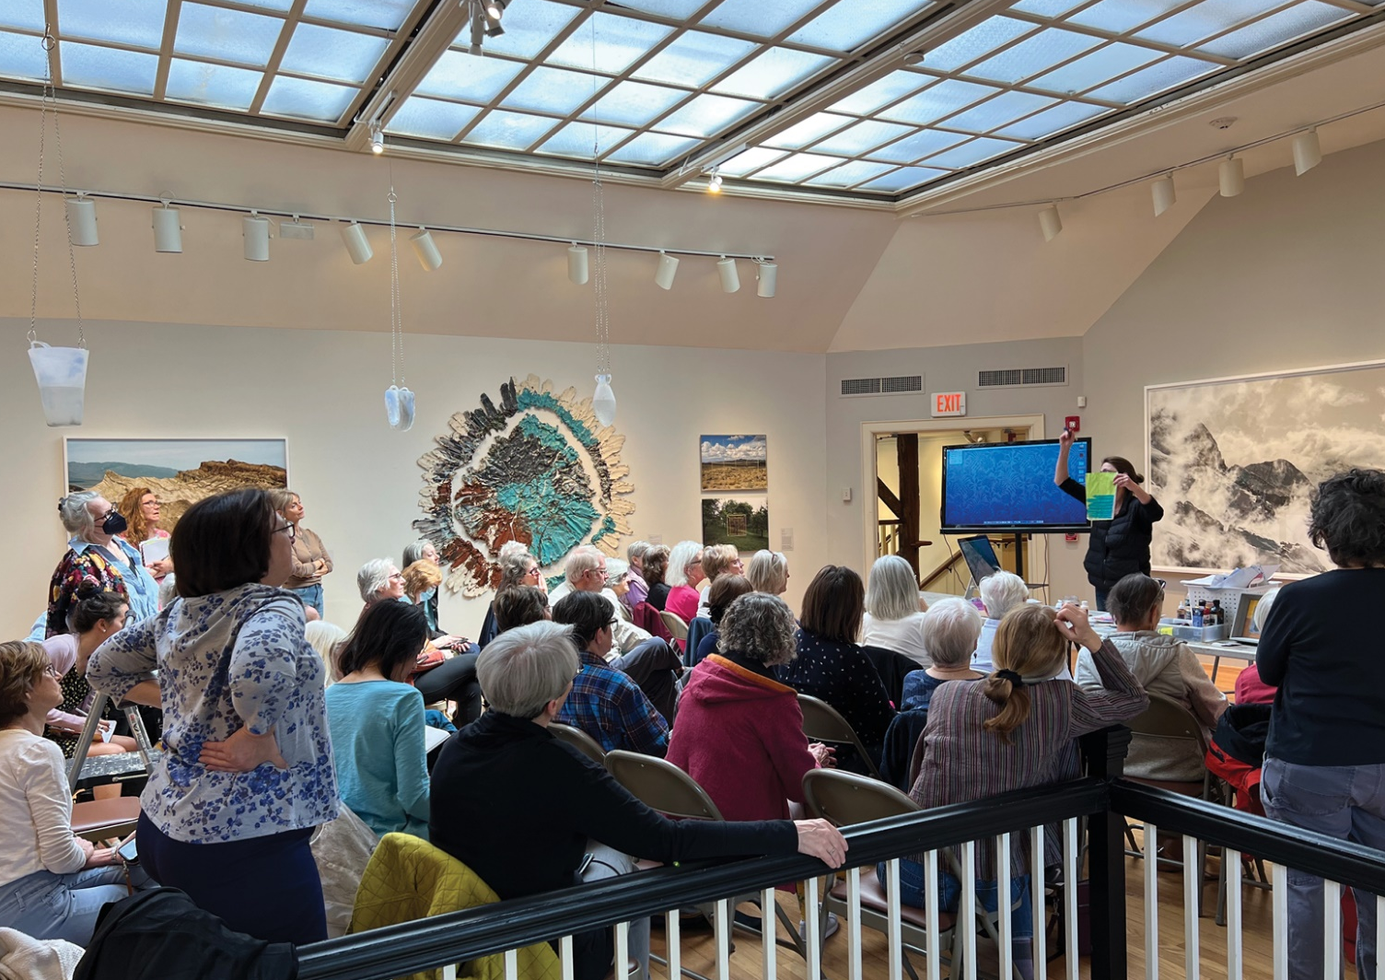
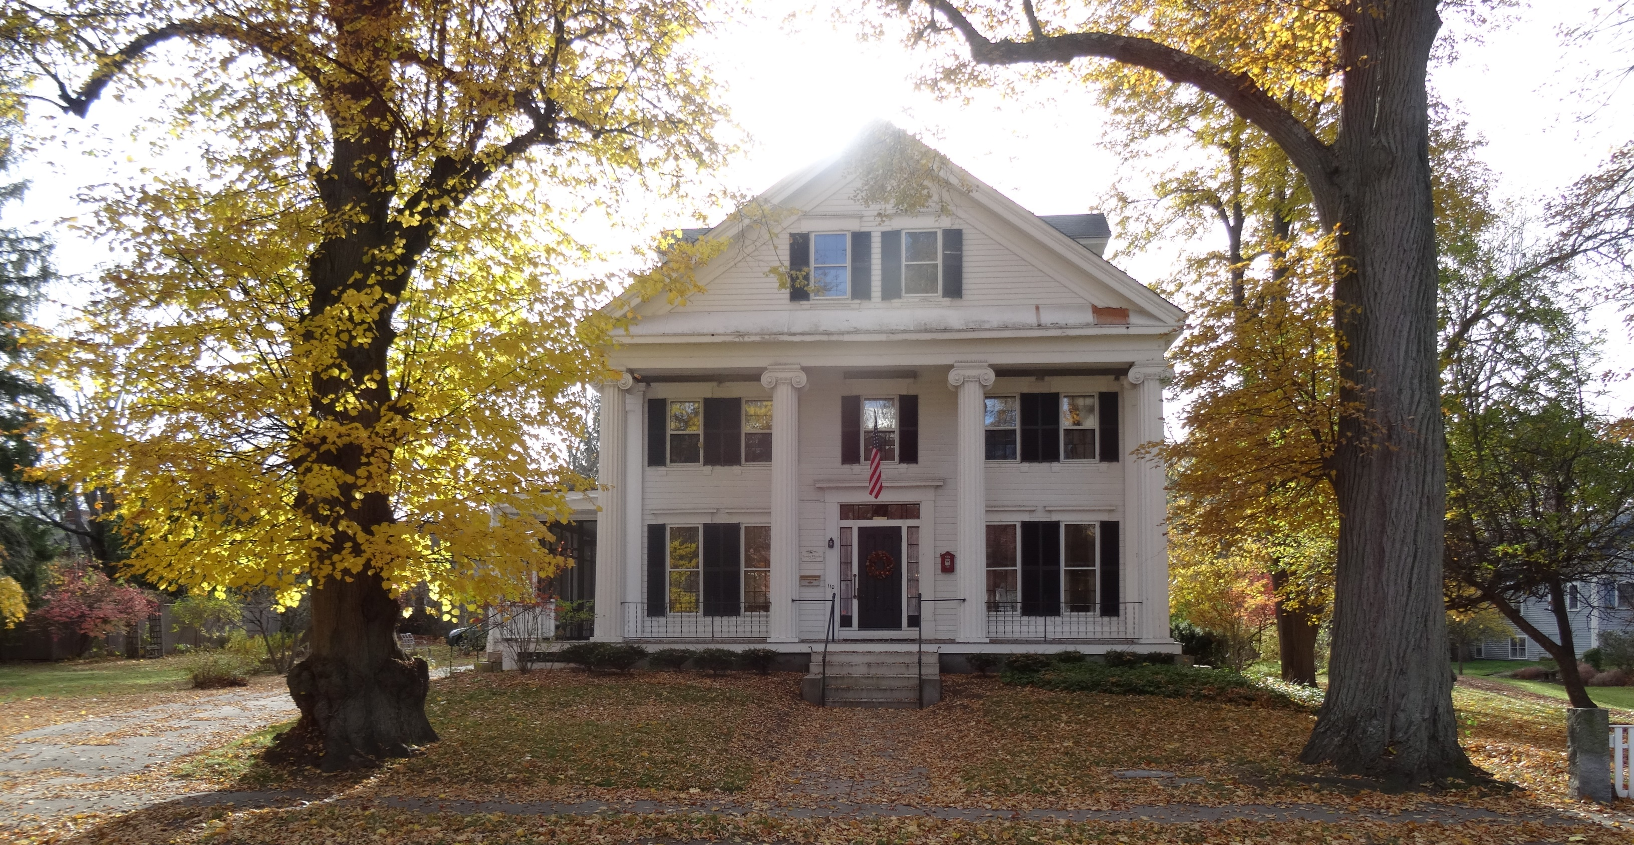
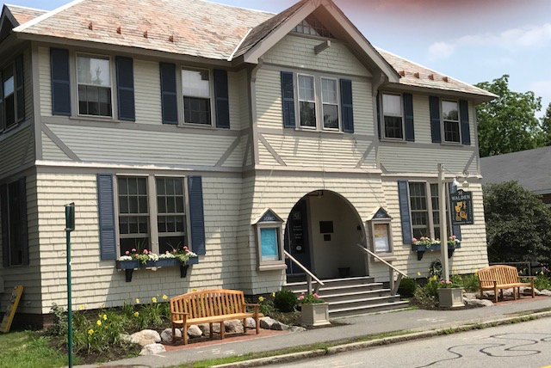
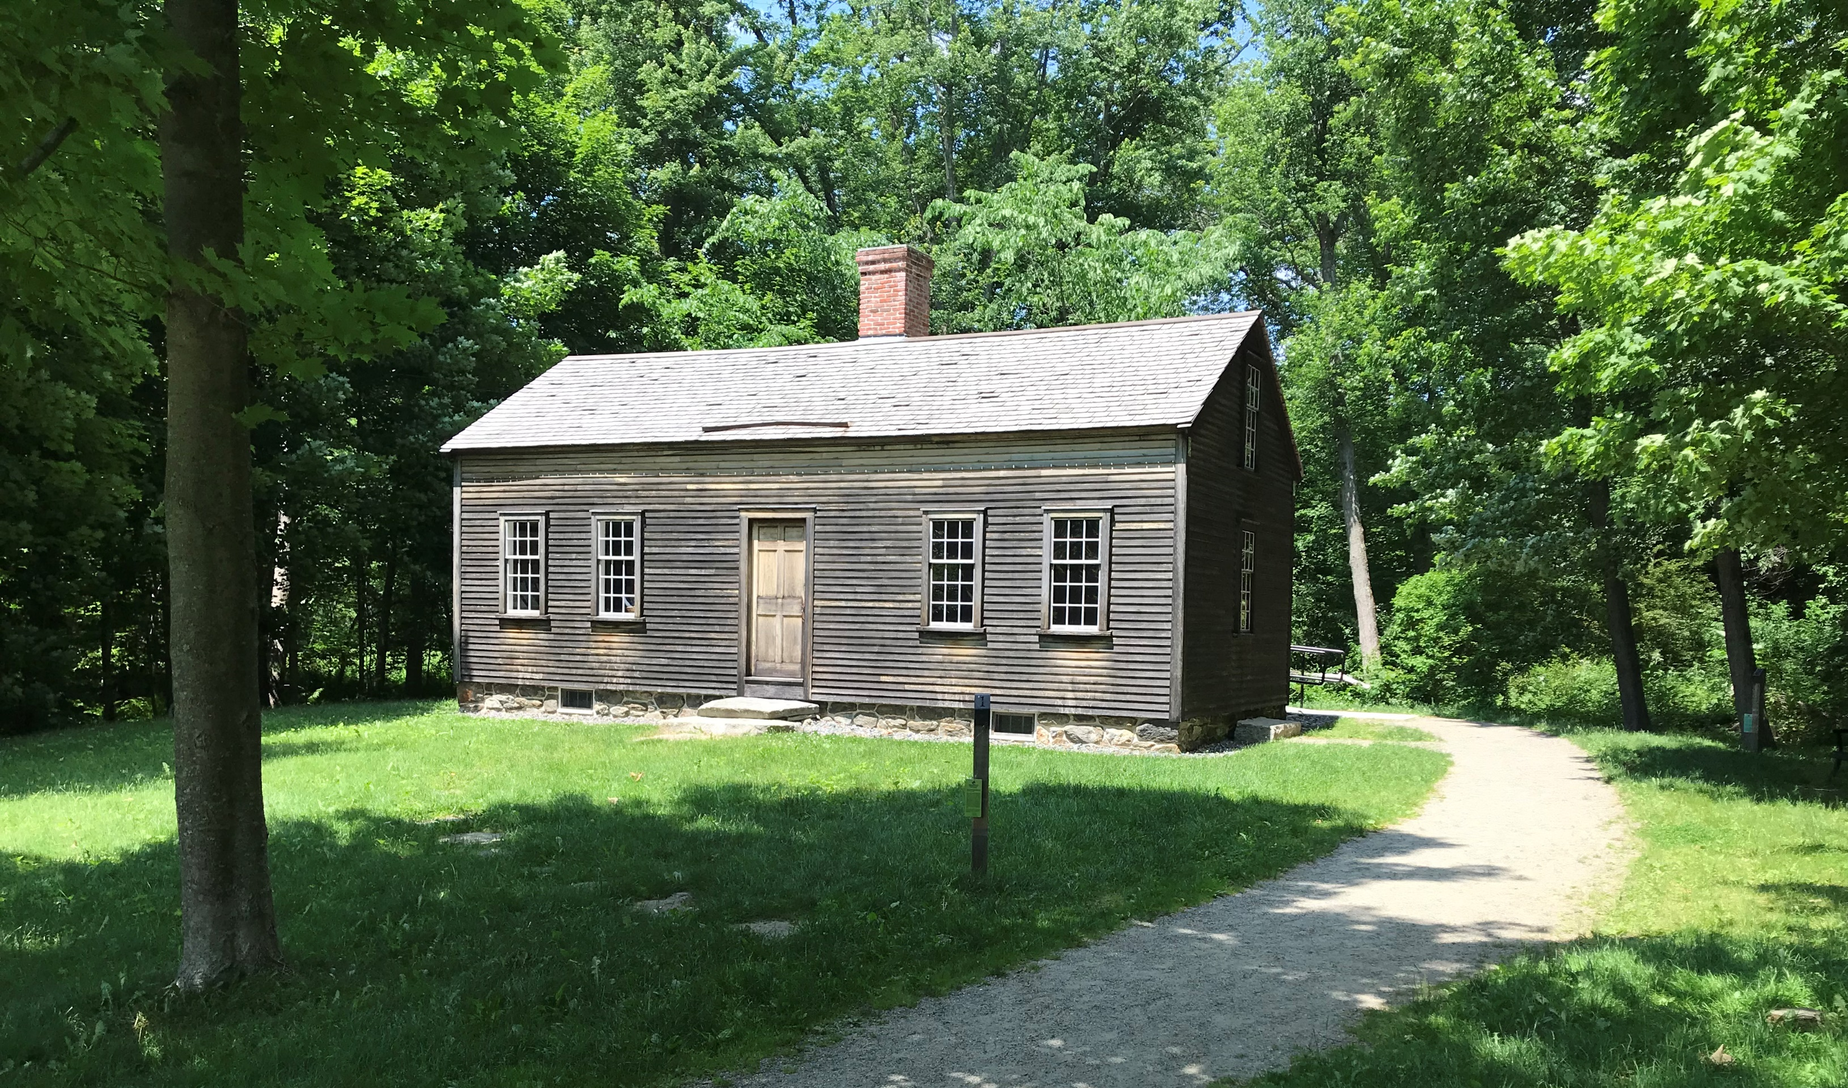
Historic Preservation - 32%
Timothy Wheeler House / Concord Home for the Aged (2017, 2019-2022)
Concord Art Association 2024)
51 Walden Street (2024)
Robbins House (2011, 2012, 2024)

Slide 9
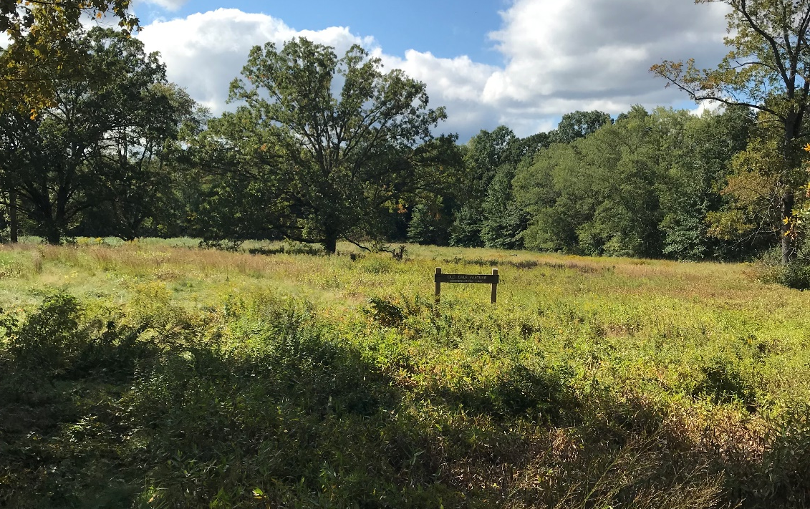
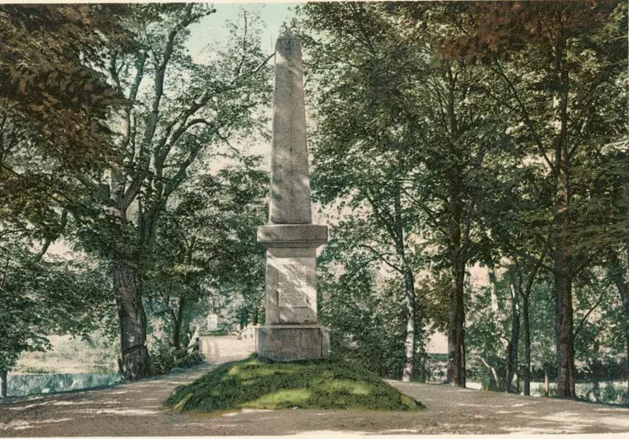
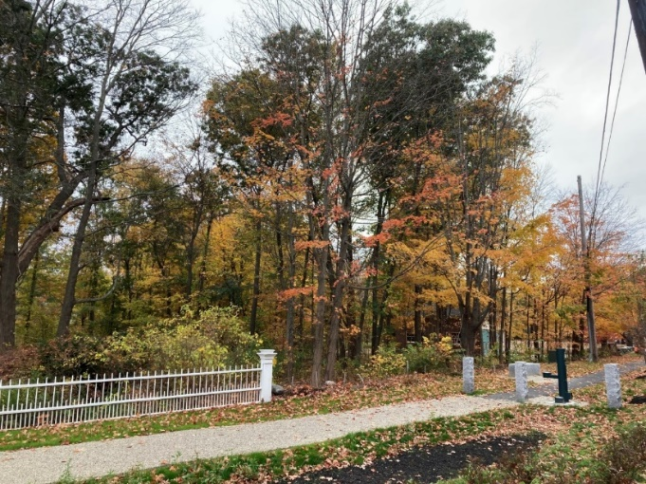
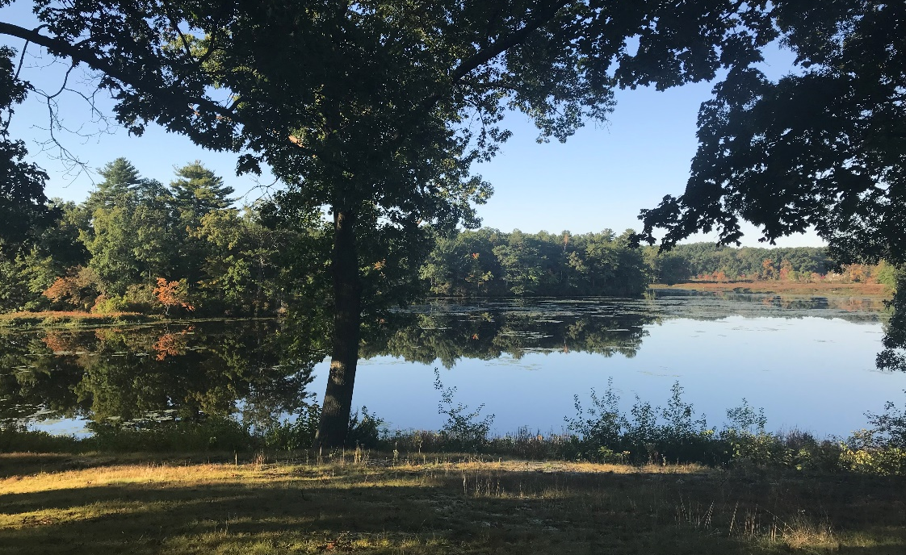
Open Space - 23%
Old Calf Pasture Habitat Restoration Town of Concord (2013 - 2019)
250 Trees for the 250th (2025)
Emerson Land Acquisition & Conservation Restriction (2019, 2021)
Gerow Land Acquisition, Town of Concord (2018)

Slide 10
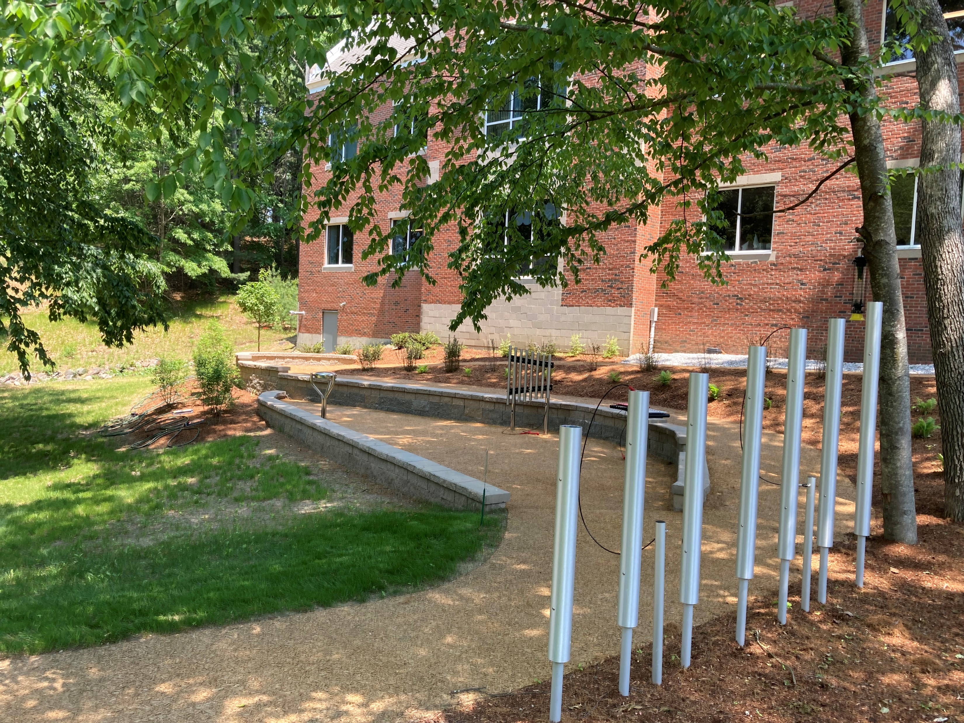
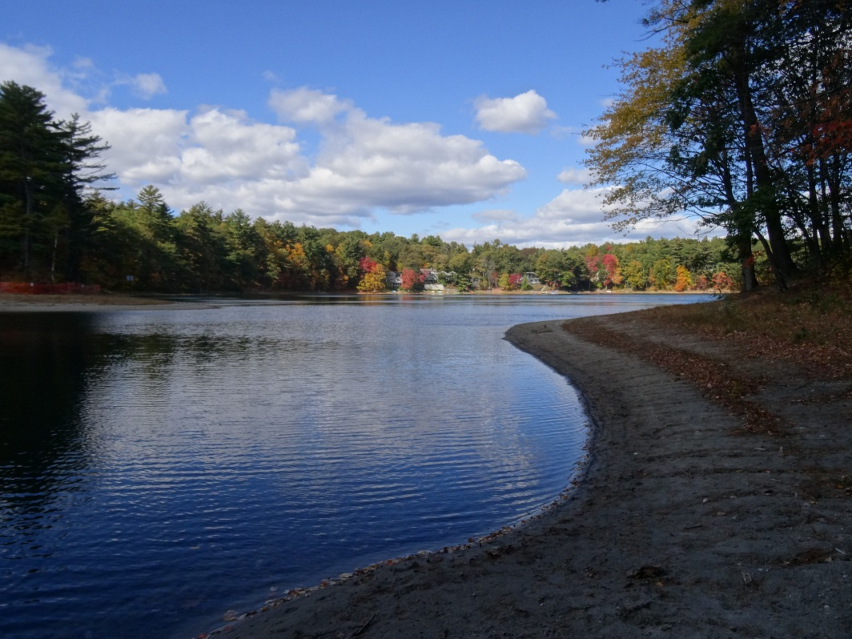
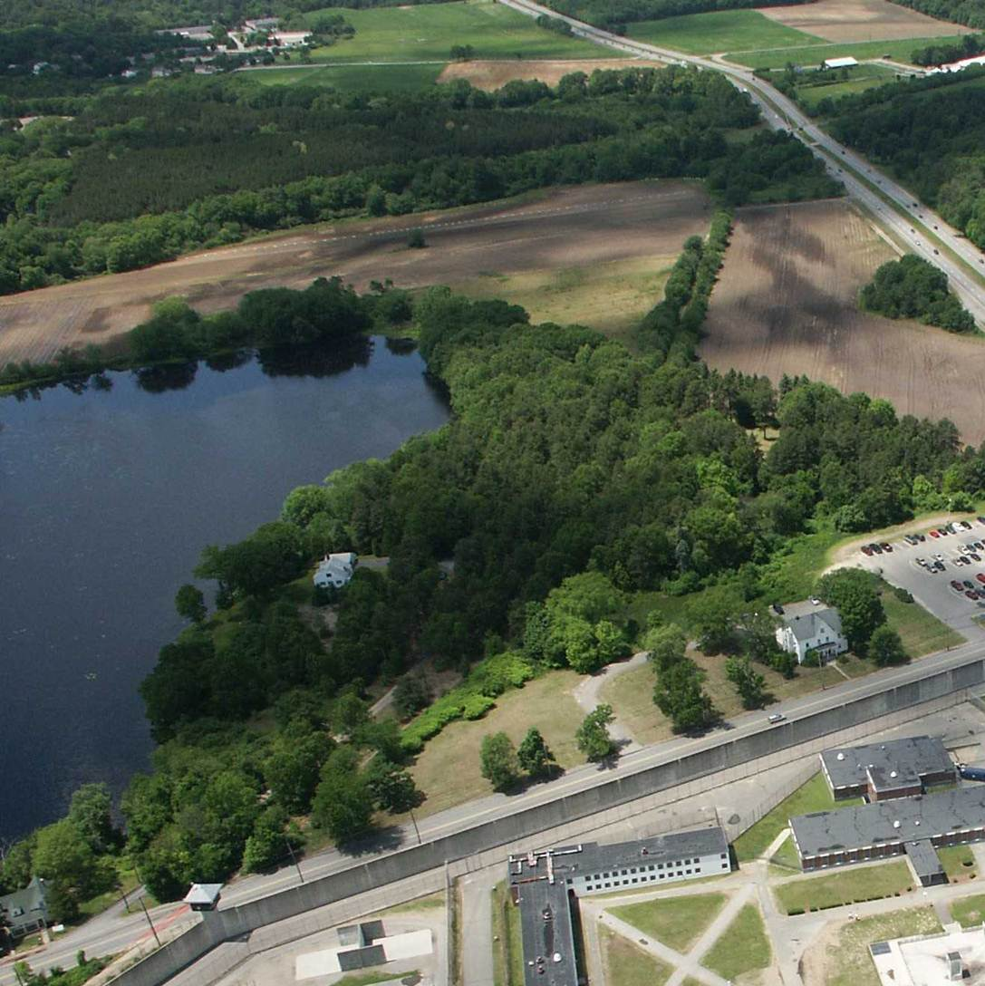
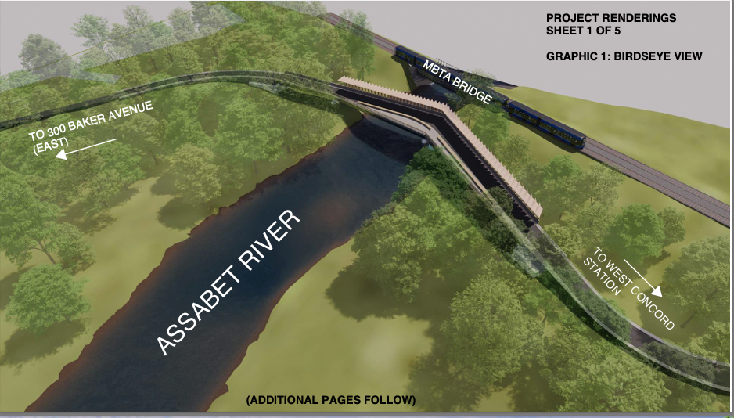
Recreation – 22%
Accessible Outdoor Oasis, Minute Man Arc for Human Services (2020)
White Pond Restoration Project
Town of Concord (2016, 2018, 2024)
Bruce Freeman Rail Trail
Town of Concord (2006, 2009, 2014-2016, 2018, 2021-2024)
Assabet River Bridge Design & Permitting
Town of Concord (2024)

Slide 11
Recommendations for CPA Funding in FY26
TOTAL $1,450,460

Slide 12
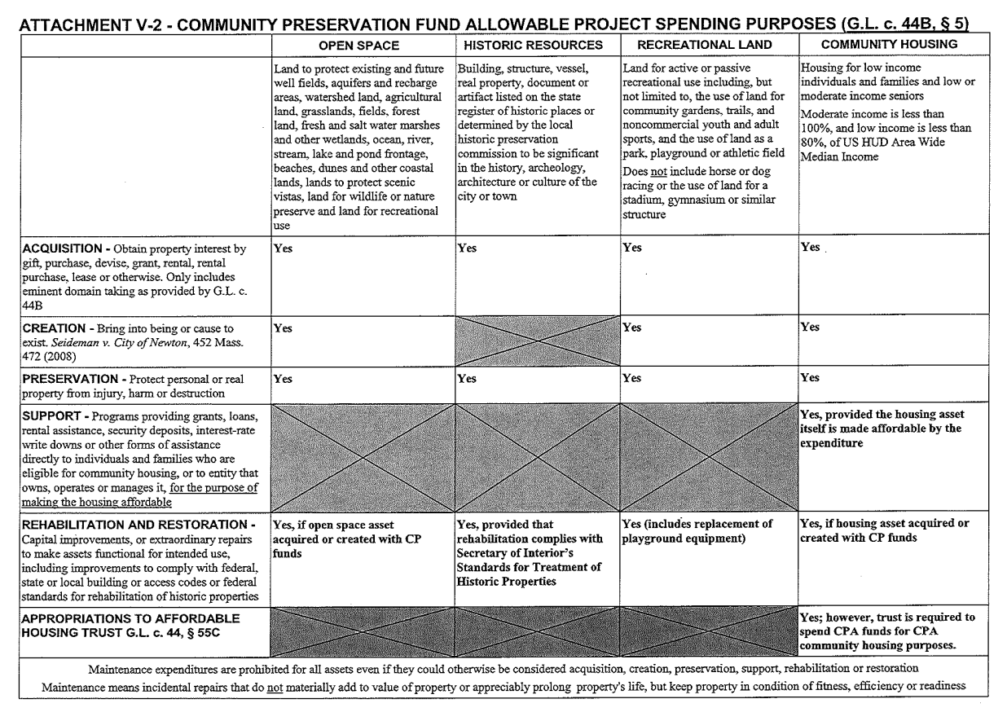
Allowable Uses

Slide 13
Concord CPC Application Review Schedule
Public Informational May 21, 2025 and
Meetings June 10, 2025
Application Deadline September 12, 2025, 12pm
CPC Group Site Visits September 27, 2025
Applicant Interviews October 7, 2025
November 4, 2025
CPC Vote on Recommendations Winter 2025-2026
Annual Town Meeting Vote late April-early May, 2026 Grant funds become available July 1, 2026
*Dates are subject to change*

Slide 14
Questions?

